Slide 1
AWS Site-to-Site VPN

Slide 2
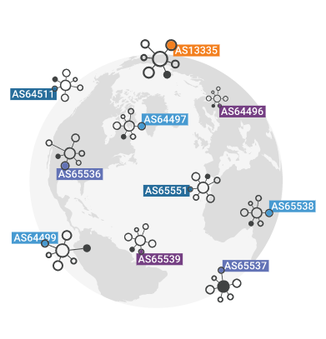
What is an autonomous system?
The Internet is a network of networks, and autonomous systems are the big networks that make up the Internet.
Assigned by IANA(Internet Assigned Numbers Authority ) for Public ASN (1-64495)
Each Public ASN is unique globally, ensuring that each Autonomous System can be distinctly identified on the internet.
Private ASN (64512-65534)
These do not require allocation from a regional internet registry and can be used by any organization internally.
More specifically, an autonomous system (AS) is a large network or group of networks that has a unified routing policy.
Every computer or device that connects to the Internet is connected to an AS.
An AS routing policy is a list of the IP address space that the AS controls, plus a list of the other ASes to which it connects.

Slide 3
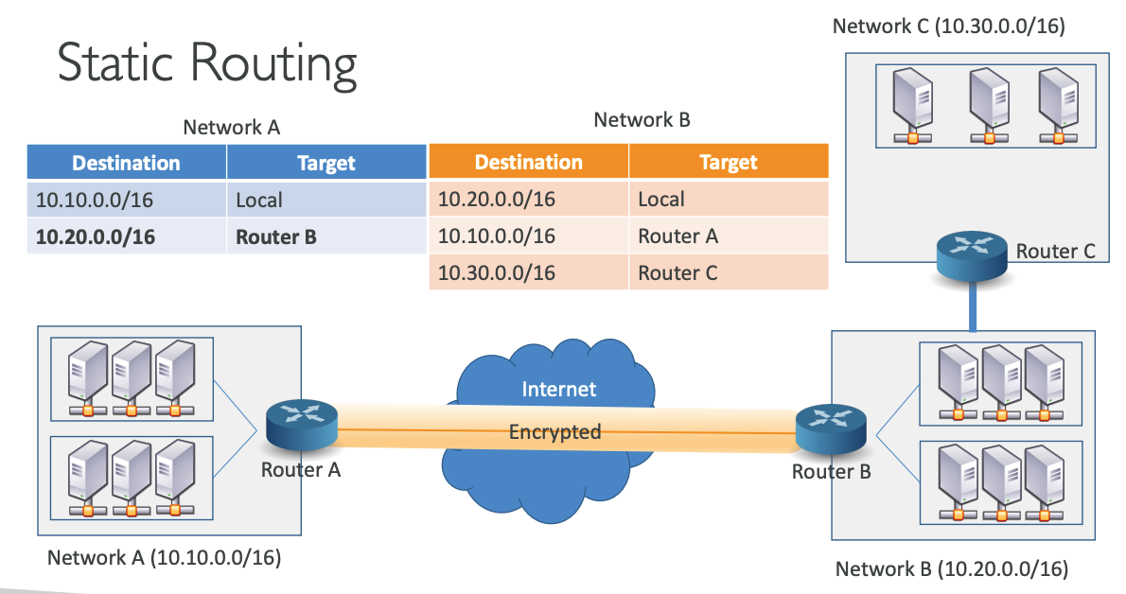
Static& Dynamic Routing
Static Routing = Add Route to route table explicitly
In Dynamic Routing the routes propagated automatically

Slide 4
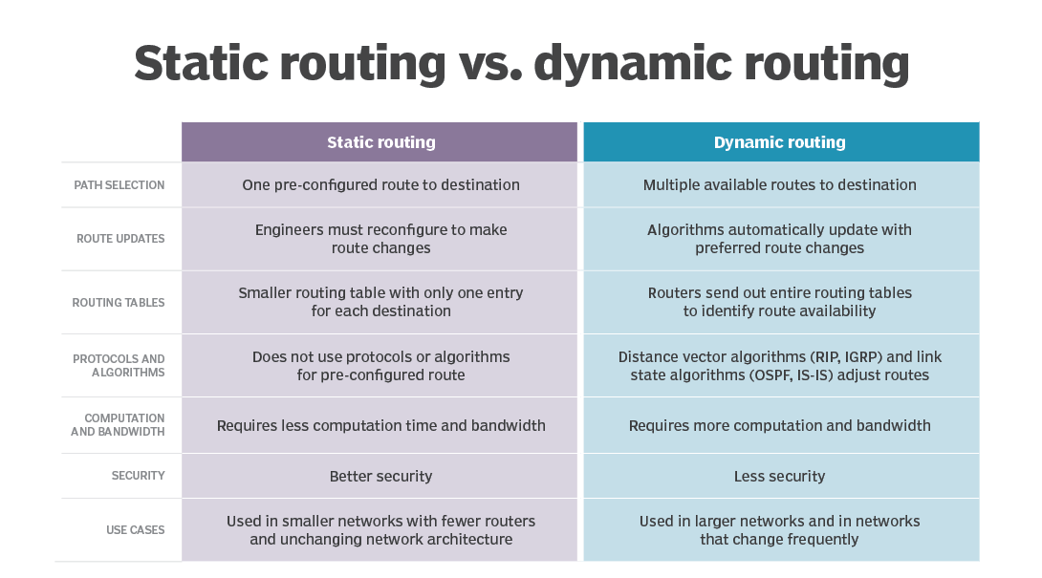
Static vs Dynamic Routing

Slide 5
BGP Border Gateway Protocol (BGP)
Border Gateway Protocol (BGP) is the postal service of the Internet.
BGP is the protocol that makes the Internet work by enabling data routing.
Why is BGP routing necessary?
Isn't IP used for routing?
IP, or the Internet Protocol, is indeed used for routing in that it specifies which destination each packet is going to.
BGP is responsible for directing packets on the fastest route to their destination.
Without BGP, IP packets would bounce around the Internet randomly from AS to AS, like a driver trying to reach their destination by guessing which roads to take.

Slide 6
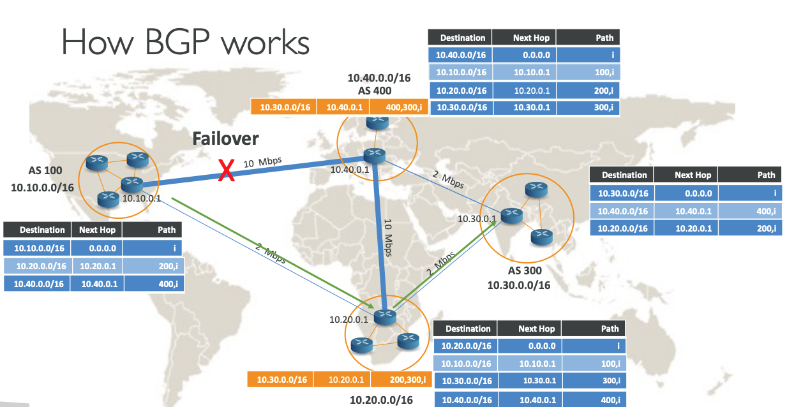

Slide 7
VPN Basics
VPN allows hosts to communicate privately over an untrusted intermediary network like internet, in encrypted form
AWS supports Layer 3 VPN (not Layer 2)
VPN has 2 forms – Site to Site VPN and Client to Site VPN
Site to Site VPN connects 2 different networks.
Client to Site VPN connects the client device like laptop to the private network
VPN types
IPSec (IP Security) VPN which is supported by AWS managed VPN
Other VPNs like GRE and DMVPN are not supported by AWS managed VPN.

Slide 8
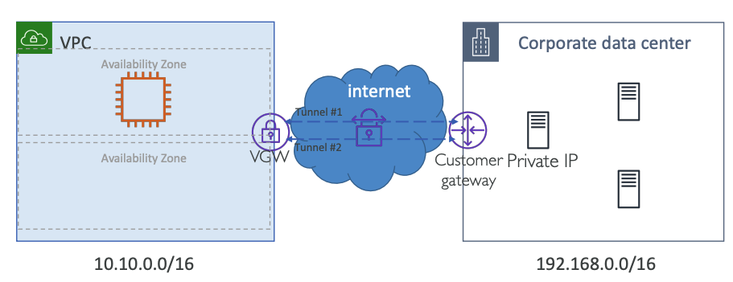
AWS Site-to-Site VPN
VPN connection terminated at Virtual Private Gateway (VGW) on AWS side
VGW creates 2 Tunnel endpoints in different AZs for High Availability

Slide 9
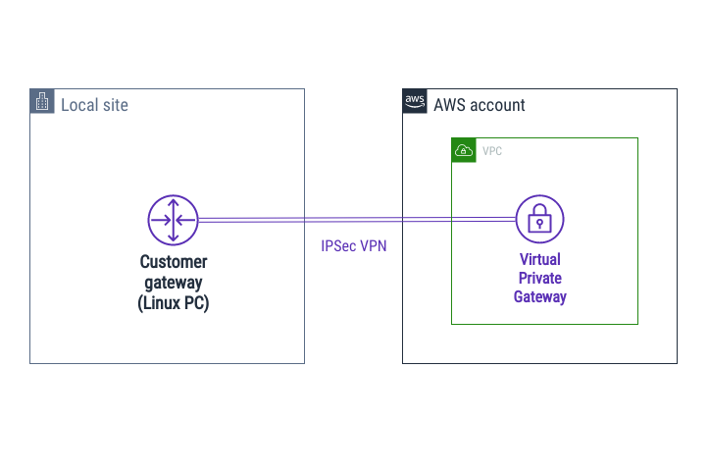
Virtual Private Gateway (VGW)
Managed gateway endpoint for the VPC
Only one VGW can be attached to VPC at a time
VGW supports both Static Routing and Dynamic routing using Border gateway protocol (BGP)
For BGP, you can assign the private ASN (Autonomous System Number) to VGW in the range of 64512 to 65534
If you don’t define ASN, AWS assigns default ASN. ASN cannot be modified once assigned (default 64512)
VGW Supports AES-256 and SHA-2 for encryption and data integrity

Slide 10
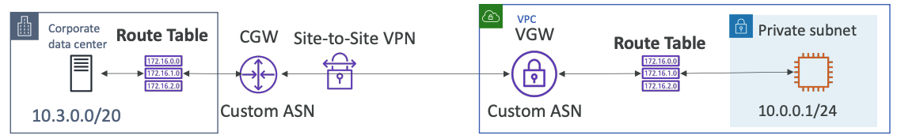
VPN Route Propagations
Static Routing:
Create static route in corporate data center for 10.0.0.1/24 through the CGW
Create static route in AWS for 10.3.0.0/20 through the VGW
Dynamic Routing (BGP):
Uses BGP (Border Gateway Protocol) to share routes automatically (eBGP for internet)
We don’t need to update the routing tables, it will be done for us dynamically
Just need to specify the ASN (Autonomous System Number) of the CGW and VGW
AWS route table cannot have more than 100 propagated routes. Hence you need to make sure you don’t publish more than 100 routes from on-premises network

Slide 11
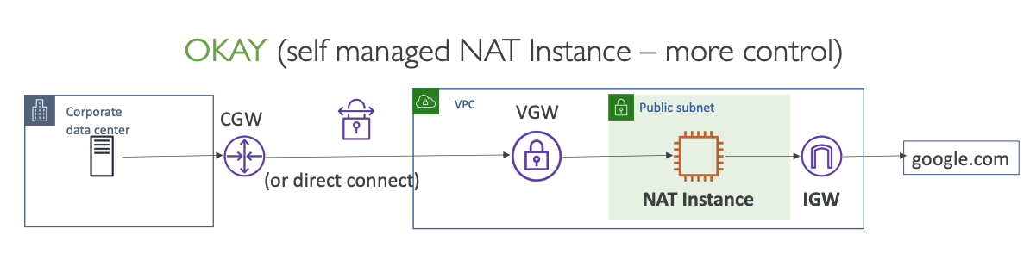
Site to site VPN and Internet Access

Slide 12
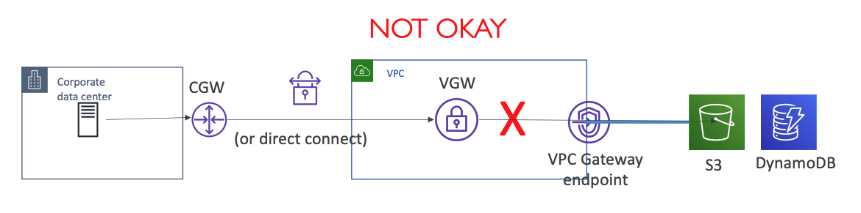
Site to site VPN and VPC Gateway Endpoint

Slide 13
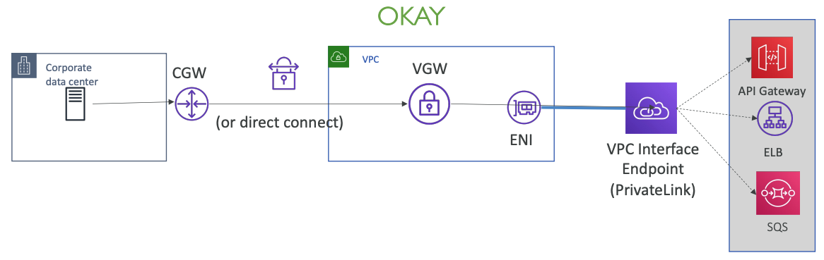
Site to site VPN and VPC Interface Endpoint

Slide 14
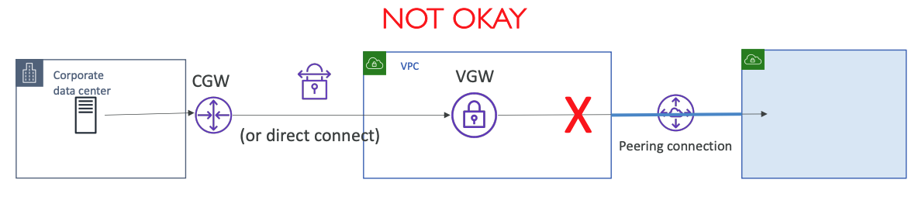
Site to site VPN and VPC Peering

Slide 15
VPN Transitive Routing Summary
From on-premises to AWS via Virtual Private Gateway:
You cannot access Internet through VPC attached Internet Gateway
You cannot access Internet through NAT Gateway in Public subnet
You cannot access peered VPC resources through VPC peering connection via the AWS VGW
You cannot access S3, DynamoDB via the VPC gateway endpoint
You can access AWS services endpoint e.g API gateway, SQS and customer endpoint services (powered by Privatelink) via VPC interface endpoint
You can access Internet through NAT EC2 instance in Public subnet
From AWS to on-premises via customer gateway
You can access Internet and other network endpoints based on routing rules setup on CGW in on-premises network

Slide 16
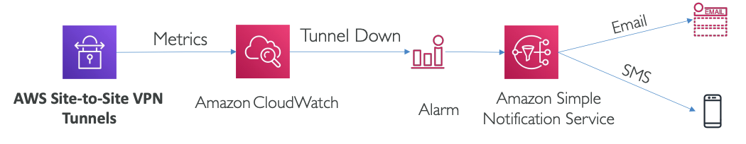
VPN Monitoring with CloudWatch
TunnelState: The state of the tunnel.
0 indicates DOWN and 1 indicates UP.
Value between 0 and 1 indicates that at least 1 tunnel is not UP.
TunnelDataIn: The bytes received through the VPN tunnel
TunnelDataOut: The bytes sent through the VPN tunnel

Slide 17
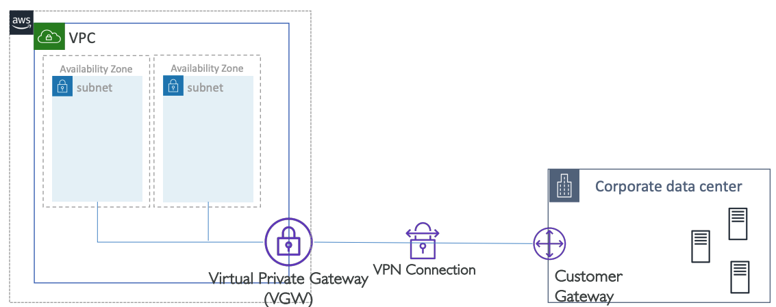
Single Site-to-Site VPN Connection using VGW

Slide 18
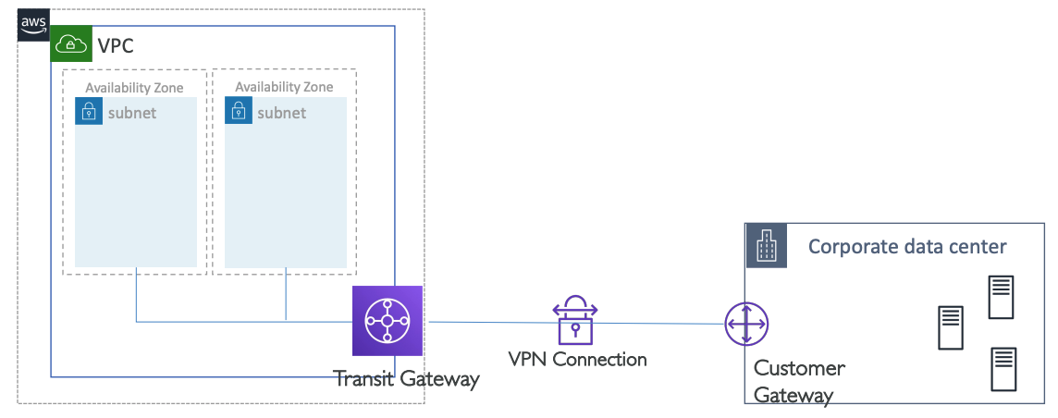
Single Site-to-Site VPN Connection using TGW

Slide 19
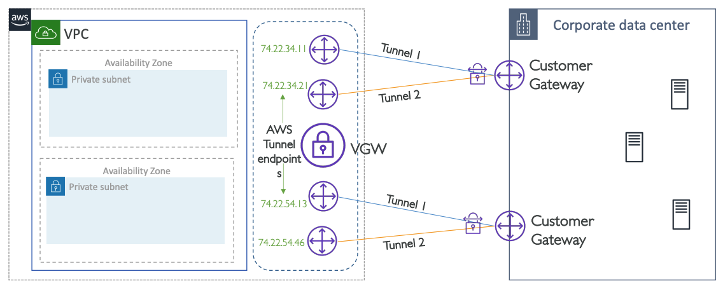
Redundant VPN connections for HA

Slide 20
Site to Site VPN Summary
VPN comes into 2 categories – Site to Site and Client to Site
AWS has fully managed VPN solution for Site-to-Site VPN. On AWS side, VPN terminates at Virtual Private Gateway (VGW) • AWS supports IPSec Site-to-Site (S2S) VPN
AWS S2S VPN creates 2 tunnels for high availability
After successful VPN setup, the traffic should be initiated from the customer end. VGW never initiates the traffic. (was true until Feb 2021)
The VGW has the aggregate bandwidth limit of 1.25 Gbps
AWS S2S VPN supports static and dynamic routing using BGP
You can not publish more than 100 routes towards VGW. You can consolidate CIDRs in case you are hitting the limit
AWS managed VPN supports only IPSec protocol
You can monitor the tunnel status with AWS CloudWatch metrics like TunnelState, TunnelDataIn, TunnelDataOut

Slide 21
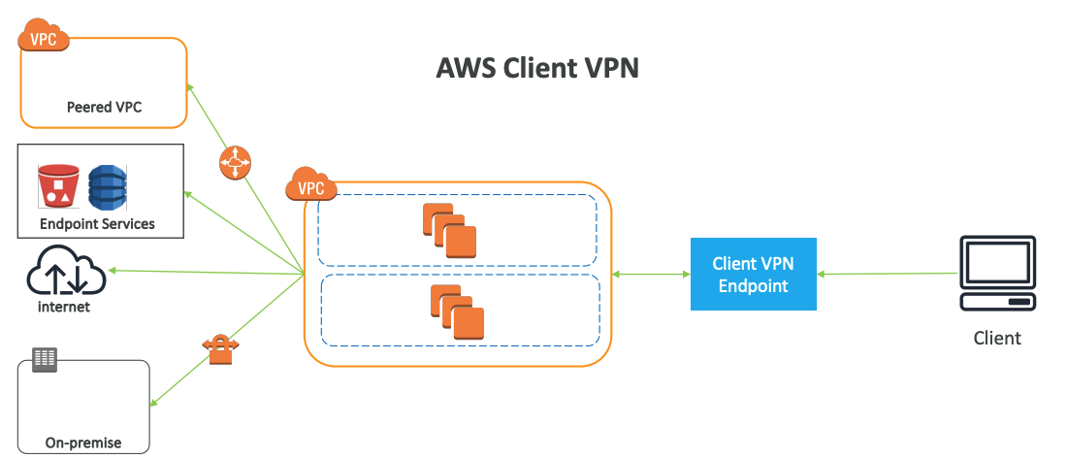
AWS Client VPN

Slide 22
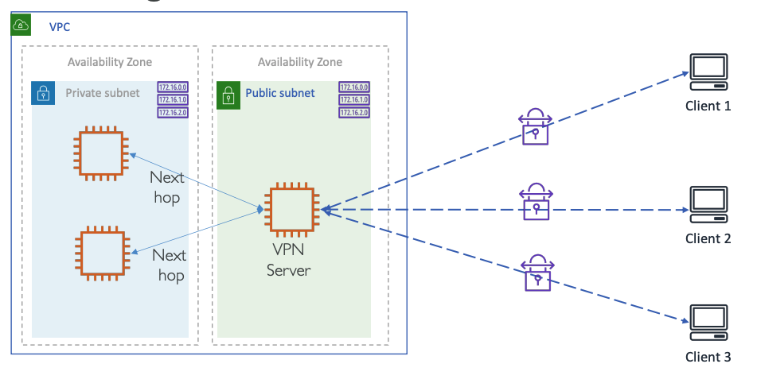
Client to Site VPN using EC2

Slide 23
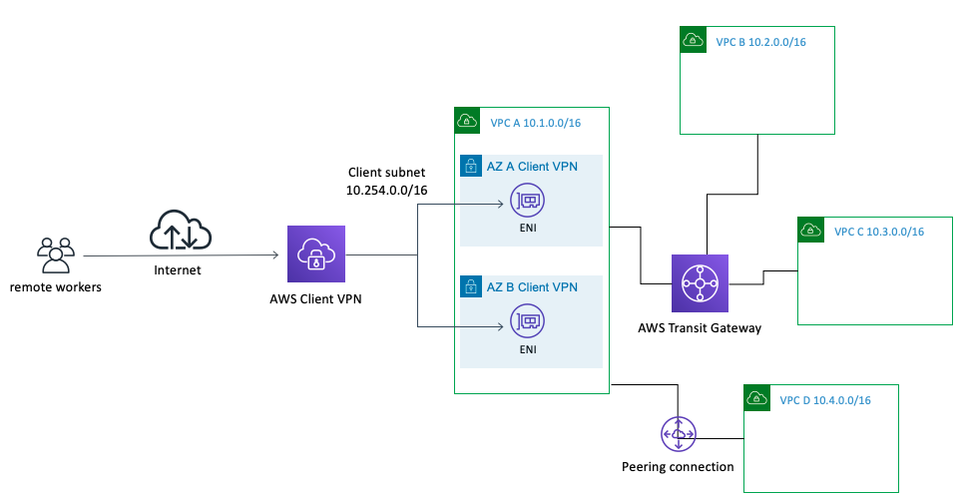
AWS Managed Client VPN
AWS Managed Client VPN is a cloud service provided by AWS that enables you to securely connect your users to AWS or on-premises networks.
It establishes a secure and private tunnel from their devices to the AWS network, which is useful for remote workers, branch offices, or for anyone who needs secure access to your AWS resources and applications.
Secure Access: It uses OpenVPN-based clients, which are widely known for providing secure access over the internet.
Authentication: It supports various types of authentication mechanisms, including Active Directory, certificate-based authentication, and multi-factor authentication.
Managed Service: As a fully managed service, AWS takes care of the deployment, scaling, and management of the VPN infrastructure, reducing the need for manual setup and maintenance.
Encryption: All data transferred over the VPN is encrypted, ensuring the security of the communication.
Split-tunneling: This feature allows users to access the internet directly while connected to the VPN, instead of routing all traffic through the VPN tunnel.
High Availability: AWS Client VPN is designed to be highly available and automatically scales to provide the capacity you need, which is particularly important for handling peak times when many users connect simultaneously.

