Slide 1
AWS Direct Connect

Slide 2
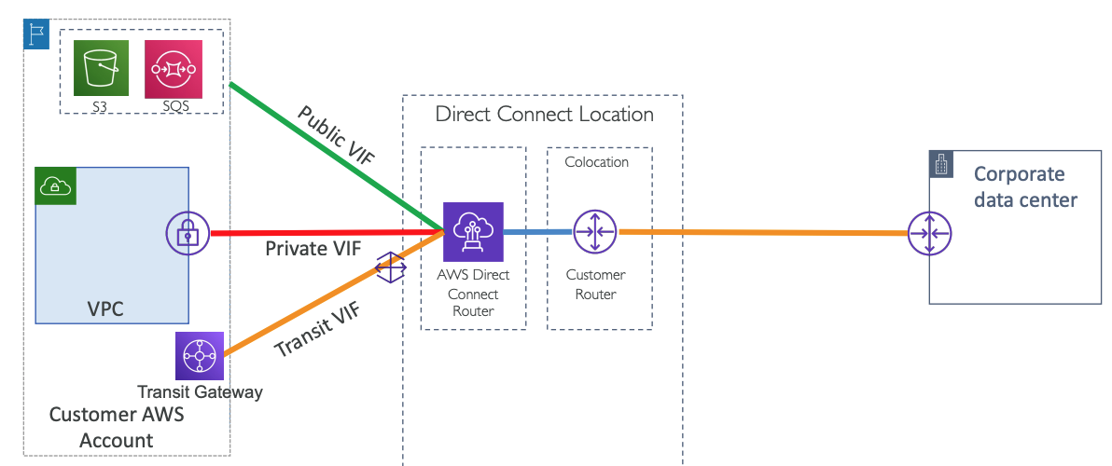
AWS Direct Connect

Slide 3
Direct Connect – Connection Types
Dedicated Connections: 1Gbps, 10 Gbps and 100 Gbps capacity
Physical ethernet port dedicated to a customer
Request made to AWS first, then completed by AWS Direct Connect Partners
Can be either setup by your Network Provider or AWS Direct Connect Partner
Hosted Connections:
50, 100, 200, 300, 400, 500 Mbps and 1 Gbps, 2 Gbps, 5 Gbps, 10 Gbps
Connection requests are made via AWS Direct Connect Partners
1, 2, 5, 10 Gbps available at select AWS Direct Connect Partners
AWS uses traffic policing on hosted connections – excess traffic is dropped

Slide 4
AWS Direct Connect Public and Private VIF
A Virtual Interface (VIF) is a logical partition of an AWS Direct Connect connection that allows access to AWS services.
When you create a Direct Connect connection, you must create a VIF to start using the service.
There are two types of VIFs you can create with AWS Direct Connect:
Private Virtual Interface (Private VIF):
A Private VIF is used to access an VPC using private IP addresses.
Traffic through a Private VIF is routed to the Amazon VPC, bypassing the public internet, which provides enhanced security and potentially better performance.
You can use a Private VIF to connect to resources within a VPC, such as EC2 instances, RDS databases, and other services that can be provisioned within a VPC.
Public Virtual Interface (Public VIF):
A Public VIF is used to access public AWS services that aren't within a VPC, such as Amazon S3 or DynamoDB.
Traffic through a Public VIF is routed to the AWS public endpoints, but still bypasses the internet and goes over the AWS Direct Connect link.
With a Public VIF, you have access to all AWS regions (except those in China) and services that use public IP address space.

Slide 5
AWS Direct Connect Private VIF

Slide 6
AWS Direct Connect Public VIF

Slide 7
AWS Direct Connect Transit VIF

Slide 8
What is AWS Direct Connect SiteLink?

