Slide 1
VPC DHCP

Slide 2
What is VPC DHCP
Dynamic Host Configuration Protocol (DHCP)
Every device on a TCP/IP network requires an IP address to communicate over the network.
In the past, IP addresses had to be assigned to each device in your network manually.
Today, IP addresses are assigned dynamically by DHCP servers using the Dynamic Host Configuration Protocol (DHCP).
Applications running on EC2 instances in subnets can communicate with Amazon DHCP servers as needed to retrieve their IP address lease or other network configuration information (such as the IP address of an Amazon DNS server or the IP address of the router in your VPC).
Amazon VPC enables you to specify the network configurations that are provided by Amazon DHCP servers by using DHCP option sets.

Slide 3
DHCP option set concepts
A DHCP option set is a group of network configurations used by EC2 instances in your VPC to communicate over your virtual network.
Each VPC in a Region uses the same default DHCP option set unless you choose to create a custom DHCP option set, or if you disassociate all option sets from your VPC.
There are two DHCP option set concepts :
Default DHCP option set.
Custom DHCP option set.

Slide 4
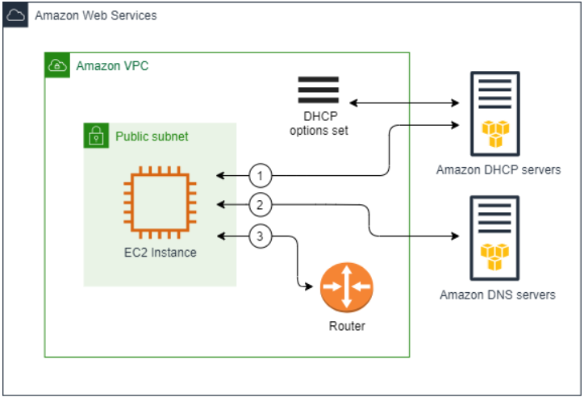
Default DHCP option set
Each VPC in a Region uses the same default DHCP option set, which contains the following network configurations:
Domain name: The domain name that a client should use when resolving hostnames via the Domain Name System.
Domain name servers: The DNS servers that your network interfaces will use for domain name resolution.
If you use the default option set, the Amazon DHCP server uses the network configurations stored in the default option set.
When you launch an instance into your VPC, the instance interacts with the DHCP server(1), interact with the Amazon DNS server (2), and connect to other devices in the network through your VPC's router (3).
The instances can interact with the Amazon DHCP server at any time to get their IP address lease and additional network configurations.

Slide 5
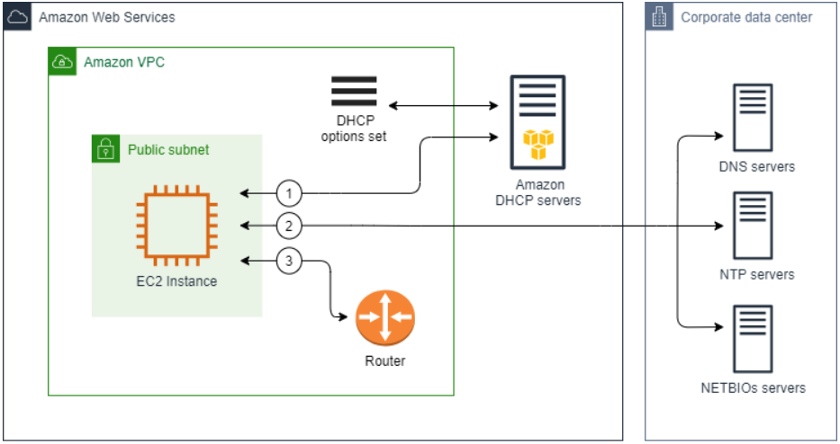
Custom DHCP option set
You can create your own DHCP option set in Amazon VPC. This enables you to configure the following network configurations:
Domain name: The domain name that a client should use when resolving hostnames via the Domain Name System.
Domain name servers: The DNS servers that your network interfaces will use for domain name resolution.
NTP servers: The NTP servers that will provide the time to the instances in your network.
NetBIOS name servers: For EC2 instances running a Windows OS, the NetBIOS computer name is a friendly name assigned to the instance to identify it on the network. A NetBIOS name server maintains a list of mappings between NetBIOS computer names and network addresses for networks that use NetBIOS as their naming service.
NetBIOS node type: For EC2 instances running a Windows OS, the method that the instances use to resolve NetBIOS names to IP addresses.
If you use a custom option set, instances launched into your VPC use the network configurations in the custom DHCP option set (1), interact with non Amazon DNS, NTP, and NetBIOS servers (2), and then connect to other devices in the network through your VPC's router (3).

Slide 6
DNS Resolutions & DNS Hostnames
DNS Resolution is a service that points the domain name to the website space IP so that people can easily access the website through the registered domain name.
An IP address is a numeric address that identifies a site on the network.
In order to facilitate the memory, the domain name is used instead of the IP address to identify the site address.
Domain resolution is the process of converting domain names to IP addresses.
One domain name corresponds to one IP address, and one IP address can correspond to multiple domain names;
therefore, multiple domain names can be resolved to one IP address at the same time.
Domain name resolution needs to be completed by a dedicated domain name resolution server (DNS).
Domain Name System (DNS) is a standard by which names used on the internet are resolved to their corresponding IP addresses.
A DNS hostname is a name that uniquely and absolutely names a computer;
it's composed of a host name and a domain name.
DNS servers resolve DNS hostnames to their corresponding IP addresses.

Slide 7
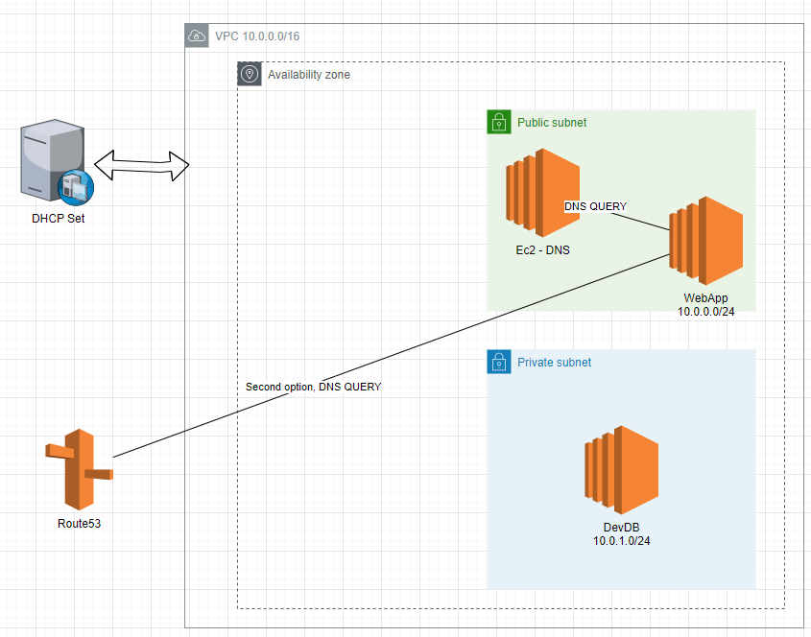
DHCP HANDS ON

Slide 8
DHCP Importants
Once created, you can not modify DHCP Options set however you can create new DHCP Options set and associate it with VPC
You can only associate a single DHCP Options set with a VPC
VPC can also be setup with No DHCP Options set
After DHCP Option set is associated with VPC, the instances automatically use new option set, but this may take few hours
You can also refresh the DHCP option parameters using an operating system command:
Example Linux command: $sudo dhclient -r eth0

