Slide 1
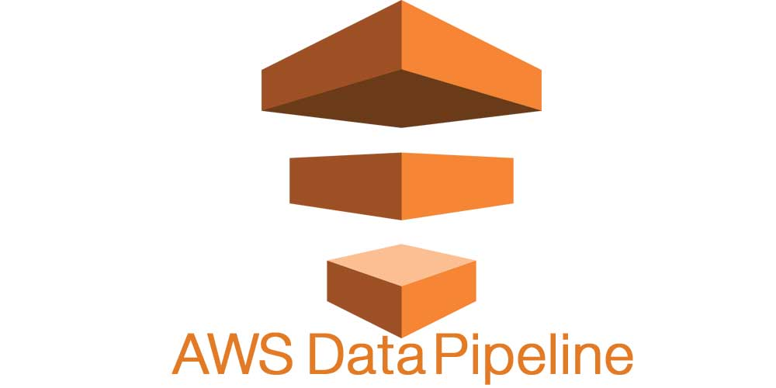
AWS Data Pipeline
AWS Data Pipeline is a web service that you can use to automate the movement and transformation of data.
With AWS Data Pipeline, you can define data-driven workflows, so that tasks can be dependent on the successful completion of previous tasks.
You define the parameters of your data transformations and AWS Data Pipeline enforces the logic that you've set up.

Slide 2
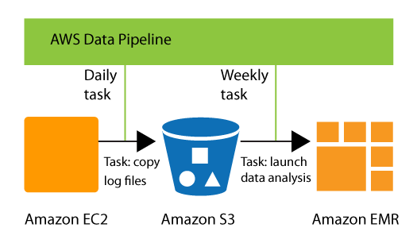
AWS Data Pipeline: Components
A pipeline definition specifies the business logic of your data management.
A pipeline schedules and runs tasks by creating Amazon EC2 instances to perform the defined work activities.
You upload your pipeline definition to the pipeline, and then activate the pipeline. You can edit the pipeline definition for a running pipeline and activate the pipeline again for it to take effect. You can deactivate the pipeline, modify a data source, and then activate the pipeline again. When you are finished with your pipeline, you can delete it.
Task Runner polls for tasks and then performs those tasks.
For example, Task Runner could copy log files to Amazon S3 and launch Amazon EMR clusters. Task Runner is installed and runs automatically on resources created by your pipeline definitions. You can write a custom task runner application, or you can use the Task Runner application that is provided by AWS Data Pipeline. For more information, see Task Runners.

