Slide 1

AWS Glue
Discover, prepare, and integrate all your data at any scale

Slide 2
Apache Spark

Slide 3
AWS Glue
AWS Glue is a serverless data integration service that makes it easy for analytics users to discover, prepare, move, and integrate data from multiple sources
Managed ETL service (extract transform load)

Slide 4
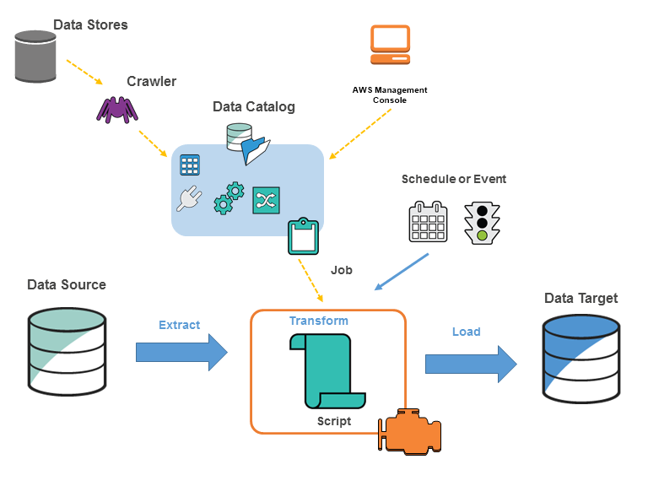
AWS Glue concepts
For data store sources, you define a crawler to populate your AWS Glue Data Catalog with metadata table definitions.
You point your crawler at a data store, and the crawler creates table definitions in the Data Catalog.
For streaming sources, you manually define Data Catalog tables and specify data stream properties.
In addition to table definitions, the AWS Glue Data Catalog contains other metadata that is required to define ETL jobs. You use this metadata when you define a job to transform your data.
AWS Glue can generate a script to transform your data. Or, you can provide the script in the AWS Glue console or API.
You can run your job on demand, or you can set it up to start when a specified trigger occurs. The trigger can be a time-based schedule or an event.
When your job runs, a script extracts data from your data source, transforms the data, and loads it to your data target. The script runs in an Apache Spark environment in AWS Glue.

Slide 5
AWS Glue terminology
AWS Glue Data Catalog
Classifier
Connection
Crawler
Database
Data store, data source, data target
Development endpoint
Dynamic Frame
Job
Notebook server
Script
Table
Transform
Trigger
Worker

Slide 7
AWS Glue Data Catalog
The AWS Glue Data Catalog is your persistent technical metadata store in the AWS Cloud.

Slide 8
AWS Glue Job Bookmarks

Slide 9
AWS Glue Elastic Views

Slide 10
AWS Glue DataBrew

Slide 11
AWS Glue Streaming ETL

Slide 12
AWS Glue Studio

Slide 13
AWS Glue Use Cases
Data Lake Creation and Management: Organizations can employ AWS Glue for data lake creation and management, where it helps in discovering, cataloging, and preparing large volumes of data from various sources, enabling a centralized repository for analytics and big data processing.
ETL Processes for Business Intelligence: Companies can use AWS Glue to facilitate ETL (Extract, Transform, Load) processes, transforming disparate data into a format suitable for analytical tools, thereby enhancing business intelligence and helping decision-makers gain better insights from their data.
Real-time Analytics for E-commerce: E-commerce platforms can utilize AWS Glue for real-time analytics, streamlining the process of data preparation and loading data into data warehouses swiftly, which aids in deriving actionable insights to enhance customer experiences and optimize business strategies.
Data Migration to the Cloud: Businesses undergoing digital transformation can leverage AWS Glue to migrate on-premises data warehouses to cloud-native data services smoothly, aiding in the transition process by simplifying data discovery, transformation, and data schema version management.
Healthcare Data Harmonization: Healthcare organizations can use AWS Glue to harmonize disparate healthcare data, facilitating the creation of a unified patient view and enhancing data interoperability, which enables more informed decision-making in medical care and research.

