Slide 1
EC2

Slide 2
Features of Amazon EC2
Amazon EC2 provides the following features:
Virtual computing environments, known as instances
Preconfigured templates for your instances, known as Amazon Machine Images (AMIs), that package the bits you need for your server (including the operating system and additional software)
Various configurations of CPU, memory, storage, and networking capacity for your instances, known as instance types
Secure login information for your instances using key pairs (AWS stores the public key, and you store the private key in a secure place)
Storage volumes for temporary data that's deleted when you stop, hibernate, or terminate your instance, known as instance store volumes
Persistent storage volumes for your data using Amazon Elastic Block Store (Amazon EBS), known as Amazon EBS volumes
Multiple physical locations for your resources, such as instances and Amazon EBS volumes, known as Regions and Availability Zones
A firewall that enables you to specify the protocols, ports, and source IP ranges that can reach your instances using security groups
Static IPv4 addresses for dynamic cloud computing, known as Elastic IP addresses
Metadata, known as tags, that you can create and assign to your Amazon EC2 resources
Virtual networks you can create that are logically isolated from the rest of the AWS Cloud, and that you can optionally connect to your own network, known as virtual private clouds (VPCs)

Slide 3
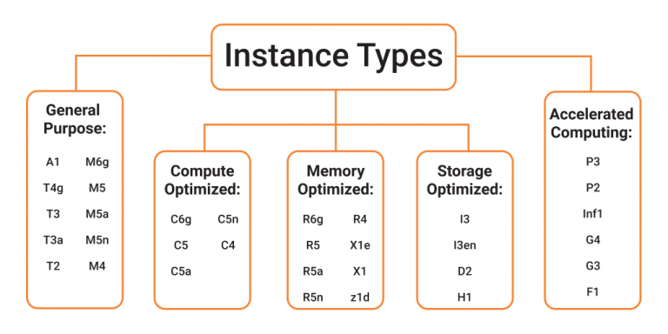
EC2: Instance type
When you launch an instance, the instance type that you specify determines the hardware of the host computer used for your instance. Each instance type offers different compute, memory, and storage capabilities, and is grouped in an instance family based on these capabilities.
instance types comparison
Instance prices
Instance generation
Instance
Family
c5.xlarge
Instance size

Slide 4
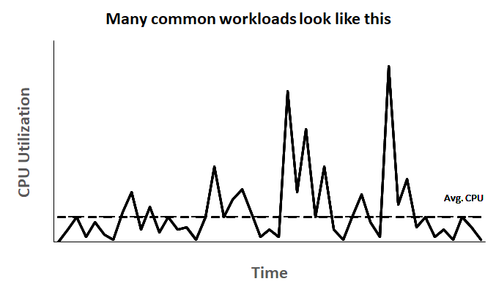
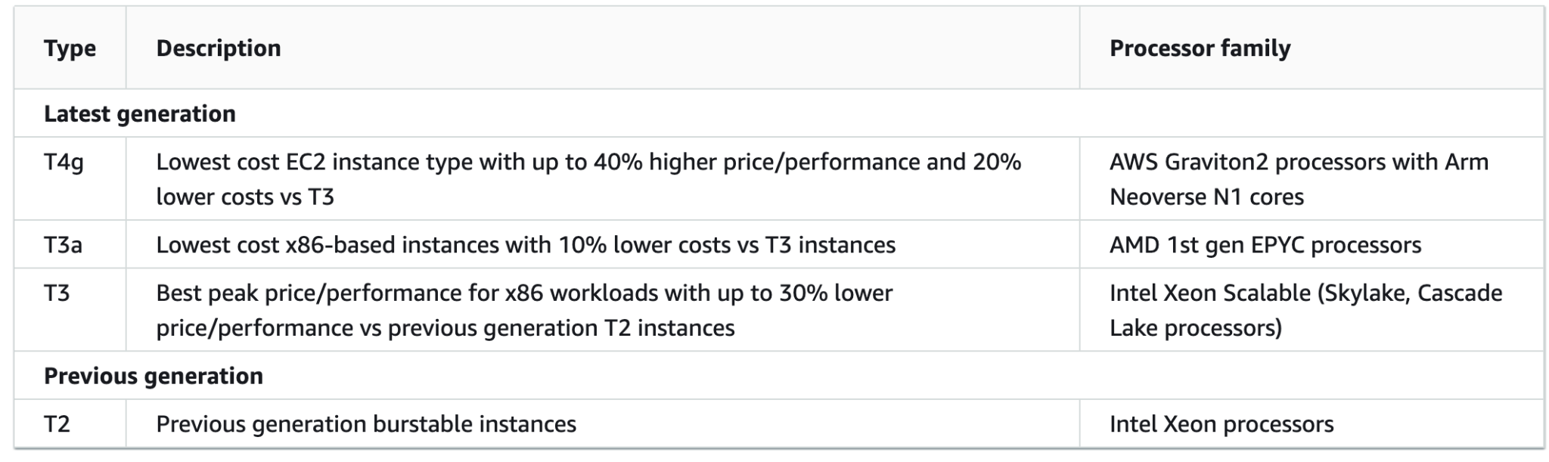
What is Burstable performance instances
Many general purpose workloads are on average not busy, and do not require a high level of sustained CPU performance.
These low-to-moderate CPU utilization workloads lead to wastage of CPU cycles and, as a result, you pay for more than you use.
The T instance family provides a baseline CPU performance with the ability to burst above the baseline at any time for as long as required

Slide 5
EC2 CloudWatch metrics
AWS Provided metrics
Basic monitoring (default) - 5 min
Detailed monitoring (paid) - 1 min
Custom metrics
Basic resolution - 1 minute resolution
High resolution - way to 1 second resolution
EC2 metrics
CPU + credit usage
Network
Status check
RAM not included!

Slide 6
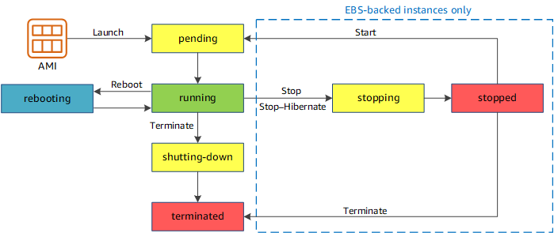
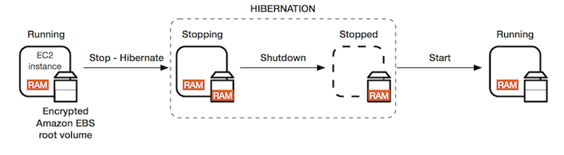
EC2 instance life cycle

Slide 7
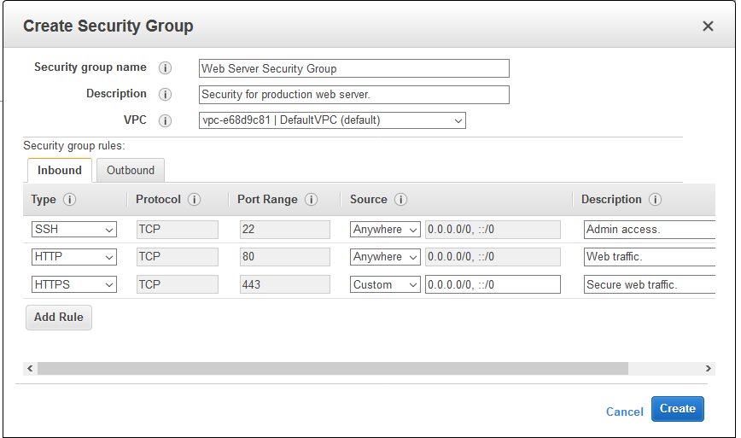
Amazon EC2 security groups
A security group acts as a virtual firewall for your EC2 instances to control incoming and outgoing traffic. Inbound rules control the incoming traffic to your instance, and outbound rules control the outgoing traffic from your instance.
You can modify the rules for a security group at any time. New and modified rules are automatically applied to all instances that are associated with the security group. When Amazon EC2 decides whether to allow traffic to reach an instance, it evaluates all of the rules from all of the security groups that are associated with the instance.
Locked down to a region / VPC combination
if your application is not accessible (time out), then it’s a security group issue
All inbound traffic is blocked by default
All outbound traffic is authorised by default

Slide 8
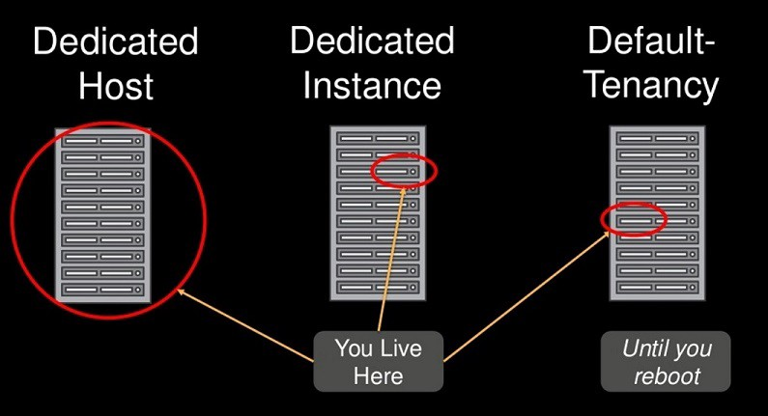
EC2 Dedicated host vs Dedicated instances
“An important difference between a Dedicated Host and a Dedicated Instance is that a Dedicated Host gives you additional visibility and control over how instances are placed on a physical server, and you can consistently deploy your instances to the same physical server over time.”
While Dedicated Instances are extremely valuable from a compliance perspective, Dedicated Hosts also give you the visibility into the physical host that is required for a Bring Your Own License (BYOL) model — if you want to use your own Windows Server, SQL Server, SUSE, or RHEL licenses that are provided on a CPU core basis.

Slide 9
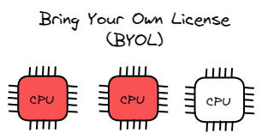
BYOL
Software licenses are often pegged on the number of CPUs, cores, and sockets.
A dedicated host provides visibility into the number of cores utilized by each deployed instance. It is, therefore, possible to directly determine if licenses are being correctly used. This makes it one of the main reasons for obtaining a dedicated host.
License management can be further simplified by using AWS License Manager, automatically tracking licenses when AMIs belonging to a license group are launched.

Slide 10
Dedicated hosts Restrictions
AMIs
Certain OSes and SQL Server require you to provide your own AMI, and AWS's AMIs are incompatible with dedicated hosts.
Host Limit
There is a soft limit of 2 dedicated hosts per family per region, but it can be increased.
RDS
AWS Relational DB Service cannot be launched on Dedicated Hosts
ASG.
Auto Scaling Group Instances targeting a Dedicated Host need to be launched via a Launch Template.

Slide 11
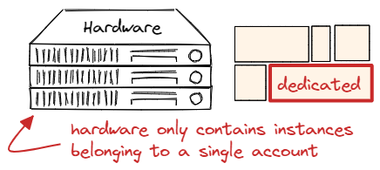
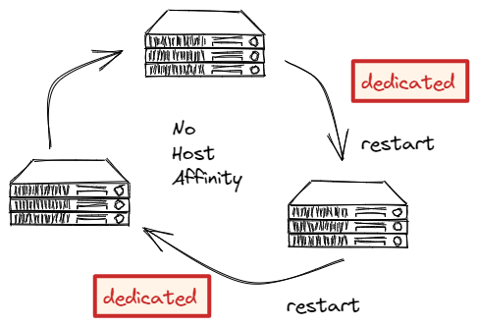
Dedicated instances
You are guaranteed that the Dedicated Instance will be launched in physical hardware dedicated to your account, and it will not contain instances belonging to other accounts. However, a dedicated instance does not show how many underlying cores are utilized.
A Dedicated Instance may or may not be instantiated on the same physical hardware upon restart. However, the underlying physical hardware is guaranteed to only contain instances belonging to the same account.

Slide 12
Dedicated instances PRICE
Dedicated Instances
You pay a flat fee of $2/hour for each region in which at least 1 Dedicated instance is running (this fee is the same regardless if you have 1 Dedicated Instance or 1,000)
You then pay hourly for each individual Dedicated Instance at a premium of around 10% from the cost of a shared, on-demand instance
You can purchase reserved Dedicated Instances to reduce cost further
You also have option to buy Spot and Reserved dedicated instance

Slide 13
Dedicated host PRICE
Dedicated Hosts
You pay hourly for a single physical host based on instance type, which can then hold a certain number of instances. Pricing is based on the instance size, as seen on the Amazon EC2 Dedicated Hosts Pricing Page
Each Dedicated Host must run the same instance type and instance size (no mixing and matching within a single Dedicated Host - not even different instance sizes of the same family)
For example, if you are using the C3 instance family, you must pay hourly for an entire physical C3 host that can launch up to 16 c3.large instances, 8 c3.xlarge instances, etc. If you need to launch 17 c3.large instances, you need to pay for 2 entire Dedicated Hosts, and you will have 15 open slots on the 2nd host
If you fill an entire on-demand Dedicated Host with instances, you will be paying around a 10% premium vs. on-demand instances
You can purchase reserved Dedicated Hosts to reduce cost

Slide 14
EC2 Monitoring

Slide 15
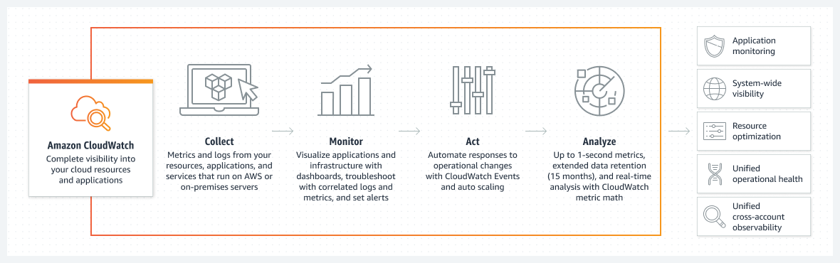
CloudWatch

Slide 16
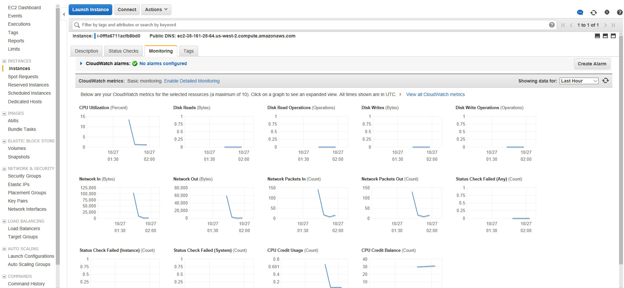
CloudWatch

Slide 17
Monitoring plan
What are your goals for monitoring?
What resources will you monitor?
How often will you monitor these resources?
What monitoring tools will you use?
Who will perform the monitoring tasks?
Who should be notified when something goes wrong?
SLA - A service-level agreement (SLA) sets the expectations between the service provider and the customer and describes the products or services to be delivered, the single point of contact for end-user problems, and the metrics by which the effectiveness of the process is monitored and approved.

Slide 18
EC2 monitoring Metrics
CPU utilization | CPUUtilization
Network utilization | NetworkIn NetworkOut
Disk performance | DiskReadOps DiskWriteOps
Disk Reads/Writes | DiskReadBytes DiskWriteBytes

Slide 19
EC2 best practice
Security
Implement the least permissive rules for your security group
Storage
Use separate Amazon EBS volumes for the operating system versus your data. Ensure that the volume with your data persists after instance termination
Use the instance store available for your instance to store temporary data. Remember that the data stored in instance store is deleted when you stop, hibernate, or terminate your instance.
Encrypt EBS volumes and snapshots
Backup and recovery
Deploy critical components of your application across multiple Availability Zones,
Ensure that you are prepared to handle failover. For a basic solution, you can manually attach a network interface or Elastic IP address to a replacement instance

Slide 21
Instance purchasing options
On-Demand Instances – Pay, by the second, for the instances that you launch.
Savings Plans – Reduce your Amazon EC2 costs by making a commitment to a consistent amount of usage, in USD per hour, for a term of 1 or 3 years.
Reserved Instances – Reduce your Amazon EC2 costs by making a commitment to a consistent instance configuration, including instance type and Region, for a term of 1 or 3 years.
Spot Instances – Request unused EC2 instances, which can reduce your Amazon EC2 costs significantly.
Dedicated Hosts – Pay for a physical host that is fully dedicated to running your instances, and bring your existing per-socket, per-core, or per-VM software licenses to reduce costs.
Dedicated Instances – Pay, by the hour, for instances that run on single-tenant hardware.
Capacity Reservations – Reserve capacity for your EC2 instances in a specific Availability Zone for any duration.

Slide 22
Instance purchasing options: Reserved Instances
The following payment options are available for Reserved Instances:
All Upfront: Full payment is made at the start of the term, with no other costs or additional hourly charges incurred for the remainder of the term, regardless of hours used.
Partial Upfront: A portion of the cost must be paid upfront and the remaining hours in the term are billed at a discounted hourly rate, regardless of whether the Reserved Instance is being used.
No Upfront: You are billed a discounted hourly rate for every hour within the term, regardless of whether the Reserved Instance is being used. No upfront payment is required.
Offering class
If your computing needs change, you might be able to modify or exchange your Reserved Instance, depending on the offering class.
Standard: These provide the most significant discount, but can only be modified. Standard Reserved Instances can't be exchanged.
Convertible: These provide a lower discount than Standard Reserved Instances, but can be exchanged for another Convertible Reserved Instance with different instance attributes. Convertible Reserved Instances can also be modified.

Slide 23
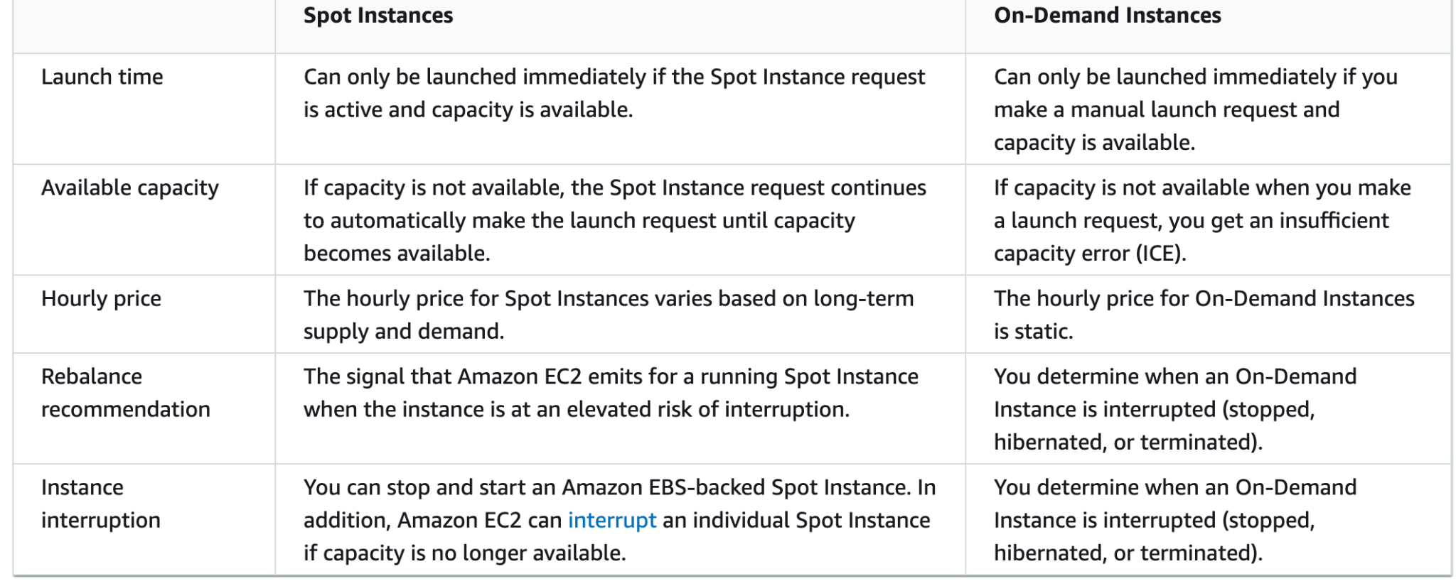
Instance purchasing options: On demand vs Spot instances
When you use Spot Instances, you must be prepared for interruptions. Amazon EC2 can interrupt your Spot Instance when the demand for Spot Instances rises or when the supply of Spot Instances decreases. When Amazon EC2 interrupts a Spot Instance, it provides a Spot Instance interruption notice, which gives the instance a two-minute warning before Amazon EC2 interrupts it. You can't enable termination protection for Spot Instances.
You can stop, start, reboot, or terminate an Amazon EBS-backed Spot Instance. The Spot service can stop, terminate, or hibernate a Spot Instance when it interrupts it.

Slide 24
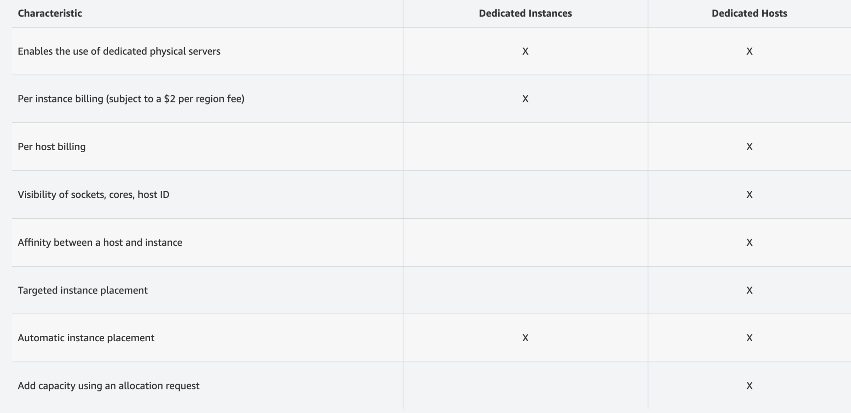
Instance purchasing options: Dedicated host vs dedicated instances
An important difference between a Dedicated Host and a Dedicated instance is that a Dedicated Host gives you additional visibility and control over how instances are placed on a physical server, and you can consistently deploy your instances to the same physical server over time.

Slide 25
Launch configurations

Slide 26
Launch Configuration
AWS Launch configuration is an instance configuration template that an Auto Scaling group uses to launch EC2 instances since 2010.
AWS strongly recommends that you do not use launch configurations. They do not provide full functionality for Amazon EC2 Auto Scaling or Amazon EC2. Amazon requests customers to migrate Launch configuration templates to Launch templates.
Only for autoscaling
Immutable
Limited configuration options

Slide 27
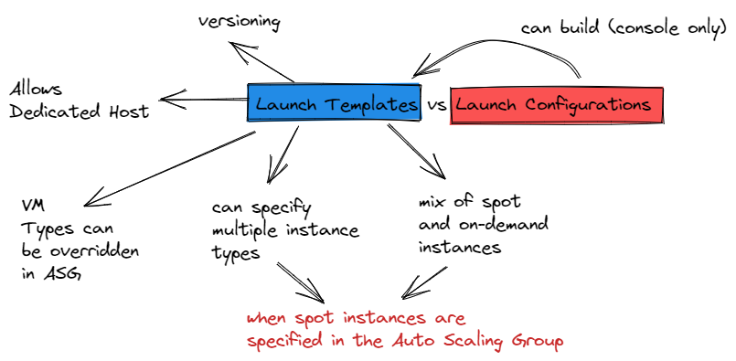
Launch Template
Launch Templates available since 2017. Launch Templates enables a new way to templatize your launch requests. Launch Templates reduce the number of steps required to create an instance by capturing all launch parameters within one resource.
Also, through support for Auto Scaling, Spot Fleet, Spot and On-Demand instances, Launch Templates make it easier to implement standards and best practices, helping you to better manage costs, improve your security posture, and minimize the risk of deployment errors. This capability is available at no additional cost.

Slide 28
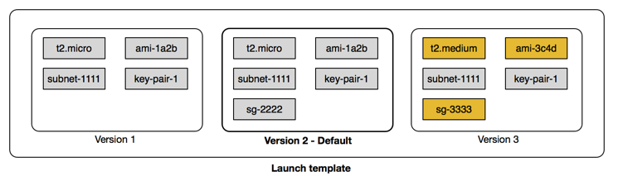
Launch template Versioning
With versioning of launch templates, you can create a subset of the full set of parameters.
Then, you can reuse it to create other versions of the same launch template.
After you create your launch template, you can create a new version and add the AMI and user data that has the latest version of your application for testing.
This results in two versions of the launch template.

Slide 29
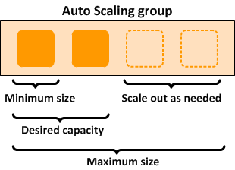
Auto scaling group
An Auto Scaling group contains a collection of EC2 instances that are treated as a logical grouping for the purposes of automatic scaling and management. An Auto Scaling group also lets you use Amazon EC2 Auto Scaling features such as health check replacements and scaling policies. Both maintaining the number of instances in an Auto Scaling group and automatic scaling are the core functionality of the Amazon EC2 Auto Scaling service.

Slide 30
Auto scaling group Components
Groups - Your EC2 instances are organized into groups so that they can be treated as a logical unit for the purposes of scaling and management. When you create a group, you can specify its minimum, maximum, and, desired number of EC2 instances
Configuration templates - Your group uses a launch template, or a launch configuration (not recommended, offers fewer features), as a configuration template for its EC2 instances
Scaling options - Amazon EC2 Auto Scaling provides several ways for you to scale your Auto Scaling groups. For example, you can configure a group to scale based on the occurrence of specified conditions (dynamic scaling) or on a schedule.

Slide 31
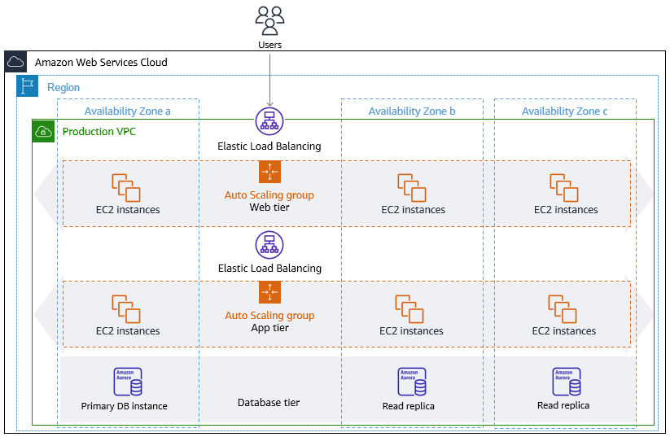
Auto scaling group

Slide 32
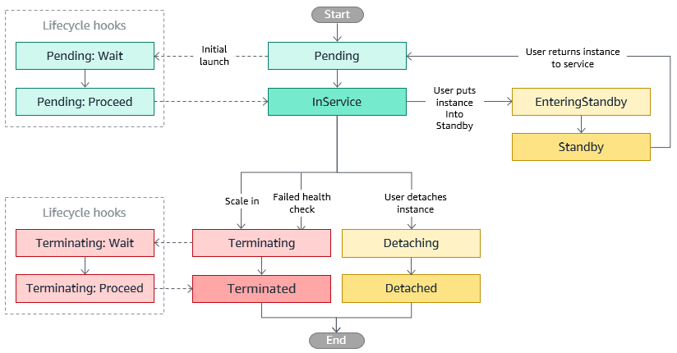
Autoscaling group instance lifecycle

Slide 33
Autoscaling group instance lifecycle
You can put an instance that is in the InService state into the Standby state, update or troubleshoot the instance, and then return the instance to service.
Instances that are on standby are still part of the Auto Scaling group, but they do not actively handle load balancer traffic.
Amazon EC2 Auto Scaling does not perform health checks on instances that are in a standby state. While the instance is in a standby state, its health status reflects the status that it had before you put it on standby. Amazon EC2 Auto Scaling does not perform a health check on the instance until you put it back in service.
Amazon EC2 Auto Scaling offers the ability to add lifecycle hooks to your Auto Scaling groups.
These hooks let you create solutions that are aware of events in the Auto Scaling instance lifecycle, and then perform a custom action on instances when the corresponding lifecycle event occurs.
A lifecycle hook provides a specified amount of time (one hour by default) to wait for the action to complete before the instance transitions to the next state

Slide 34
Auto scaling will be a big separate lecture:
Auto scaling group
Lifecycle hooks
Warm pool
Control instance termination
Scaling policies
Step scaling
Schedule scaling
Target scaling
Simple scaling
Scaling based on SQS
Scalability architectures

Slide 35
Placement Group

Slide 36
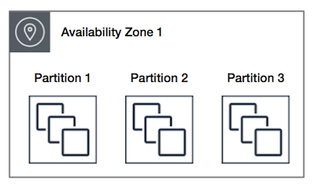
Partition placement group
Partition — divides each group into logical segments called partitions:
Amazon EC2 ensures that each partition within a placement group has its own set of racks.
Each rack has its own network and power source. No two partitions within a placement group share the same racks, allowing you to isolate the impact of hardware failure within your application.
Partition placement groups can be used to deploy large distributed and replicated workloads, such as HDFS, HBase, and Cassandra, across distinct racks.
When: Reduce the risk of simultaneous instance failure if underlying hardware fails
Benefit: Can span multiple AZs
Maximum of 7 instances running per group, per AZ

Slide 37
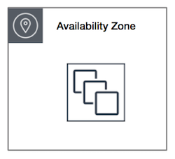
CLuster placement group
Cluster – clusters instances into a low-latency group in a single AZ:
A cluster placement group is a logical grouping of instances within a single Availability Zone.
Cluster placement groups are recommended for applications that benefit from low network latency, high network throughput, or both, and if most of the network traffic is between the instances in the group.
When: Need low network latency and/or high network throughput
Goal: Get the most out of enhanced networking Instances
Finite capacity: recommend launching all you might need up front

Slide 38
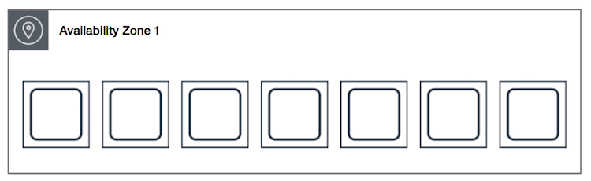
Spread placement group
Spread – spreads instances across underlying hardware (can span AZs):
A spread placement group is a group of instances that are each placed on distinct underlying hardware.
Spread placement groups are recommended for applications that have a small number of critical instances that should be kept separate from each other.
When: Need control and visibility into instance placement
Partition placement groups are not supported for Dedicated Hosts
Reduces likelihood of correlated failures for large workloads

Slide 39
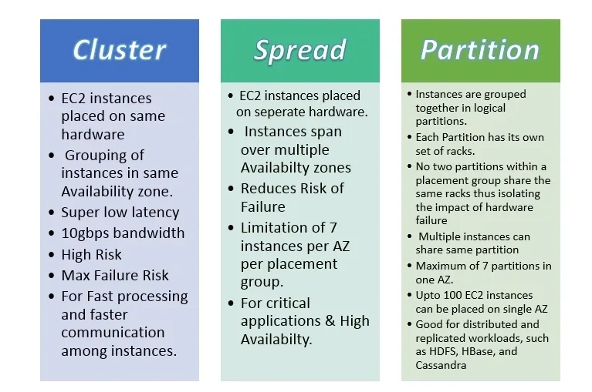
Placement group comparing

Slide 40
Placement Group. Good to know
Recommended for applications that benefit from low latency and high bandwidth.
Recommended to use an instance type that supports enhanced networking.
Best performance is achieved when using private IP addresses.
Using public IP addresses the performance is limited to 5Gbps or less.
Low-latency 10 Gbps or 25 Gbps network.
The name you specify for a placement group must be unique within your AWS account for the Region.
An instance can be launched in one placement group at a time; it cannot span multiple placement groups.
Instances with a tenancy of host cannot be launched in placement groups.

Slide 41
AMI

Slide 42
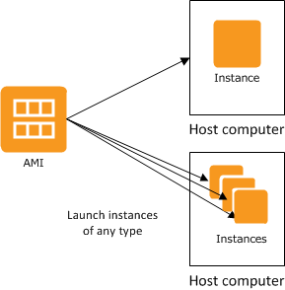
AMIs
An Amazon Machine Image (AMI) is a template that contains a software configuration (for example, an operating system, an application server, and applications). From an AMI, you launch an instance, which is a copy of the AMI running as a virtual server in the cloud. You can launch multiple instances of an AMI, as shown in the following figure.

Slide 43
EC2 CLI commands
https://www.thegeekstuff.com/2016/04/aws-ec2-cli-examples/

