Slide 1

AWS Glue
Discover, prepare, and integrate all your data at any scale

Slide 2
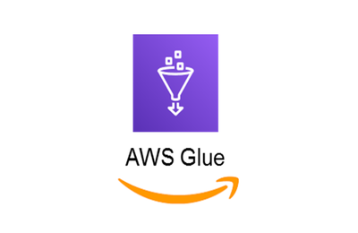
AWS Glue
AWS Glue is a serverless data integration service that makes it easy for analytics users to discover, prepare, move, and integrate data from multiple sources
Managed ETL service (extract transform load)

Slide 3
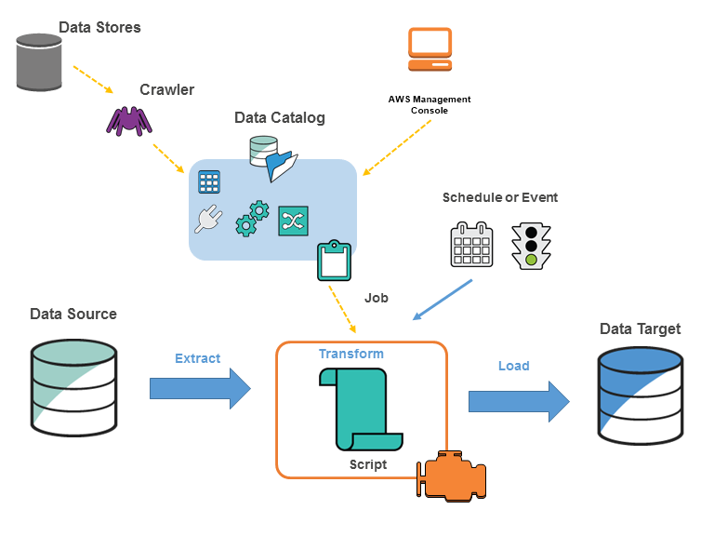
AWS Glue concepts
For data store sources, you define a crawler to populate your AWS Glue Data Catalog with metadata table definitions.
You point your crawler at a data store, and the crawler creates table definitions in the Data Catalog.
For streaming sources, you manually define Data Catalog tables and specify data stream properties.
In addition to table definitions, the AWS Glue Data Catalog contains other metadata that is required to define ETL jobs. You use this metadata when you define a job to transform your data.
AWS Glue can generate a script to transform your data. Or, you can provide the script in the AWS Glue console or API.
You can run your job on demand, or you can set it up to start when a specified trigger occurs. The trigger can be a time-based schedule or an event.
When your job runs, a script extracts data from your data source, transforms the data, and loads it to your data target. The script runs in an Apache Spark environment in AWS Glue.

Slide 4
AWS Glue terminology
AWS Glue Data Catalog
Classifier
Connection
Crawler
Database
Data store, data source, data target
Development endpoint
Dynamic Frame
Job
Notebook server
Script
Table
Transform
Trigger
Worker

Slide 5
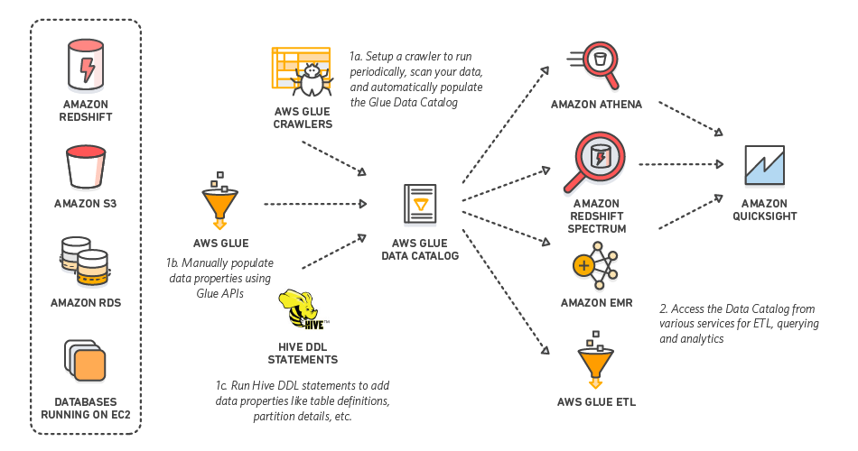
AWS Glue Data Catalog
The AWS Glue Data Catalog is your persistent technical metadata store in the AWS Cloud.
Amazon AWS Glue Data Catalog is one such Data Catalog that stores all the metadata related to the AWS ETL software
AWS Glue Data Catalog tracks runtime metrics, and stores the indexes, locations of data, schemas, etc.
It basically keeps track of all the ETL jobs being performed on AWS Glue.
All this metadata is stored in the form of tables where each table represents a different data store.

Slide 6
AWS Glue Data Catalog: Components
Databases and Tables
Makes up Data Catalog. A Table can only exist in one Database. Your Database can contain Tables from any of the AWS Glue-supported sources.
Crawlers and Classifiers
A Crawler assists in the creation and updating of Data Catalog Tables. It has the ability to crawl both file-based and table-based data stores.
Crawlers can crawl the following data stores via their native interfaces:
Amazon S3
DynamoDB
Crawlers can crawl the following data stores via a JDBC connection:
Redshift, RDS, Aurora
A Classifier in the AWS Glue crawler recognizes the data format and generates the schema. AWS Glue comes with a set of built-in classifiers, but you can also create your own Custom Classifiers.
Connections
Connections allow you to centralize connection information such as login credentials and virtual private cloud (VPC) IDs.
This saves time because you don’t have to input connection information each time you create a crawler or job.
The following Connection types are available:
JDBC Amazon RDS Redshift Amazon DocumentDB, Network (designates a connection to a data source within a VPC environment on AWS)
AWS Glue Schema Registry
The AWS Glue Schema Registry allows disparate systems to share a serialization and deserialization schema. Assume you have a data producer and a data consumer, for example. Whenever the serialized data is published, the producer is aware of the schema. The consumer makes use of the Schema Registry deserializer library, which extracts the schema version ID from the record payload. The schema is then used by the consumer to deserialize the data.
you can manage and enforce schemas on your data streaming applications using convenient integrations with the following data input sources:
Apache Kafka, Amazon Managed Streaming for Apache Kafka, Amazon Kinesis Data Streams, Amazon Kinesis Data Analytics for Apache Flink, AWS Lambda
Schema Registry consists of the following components:
Schemas: A Schema is a representation of the structure and format of a data record.
Registry: A Registry is a logical container for schemas. You can use registries to organize your schemas and manage access control for your applications.

Slide 7
AWS Glue Job Bookmarks
AWS Glue tracks data that has already been processed during a previous run of an ETL job by persisting state information from the job run.
This persisted state information is called a job bookmark. Job bookmarks help AWS Glue maintain state information and prevent the reprocessing of old data.
With job bookmarks, you can process new data when rerunning on a scheduled interval.
A job bookmark is composed of the states for various elements of jobs, such as sources, transformations, and targets.
AWS Glue version | Amazon S3 source formats
Version 0.9 | JSON, CSV, Apache Avro, XML
Version 1.0 and later | JSON, CSV, Apache Avro, XML, Parquet, ORC

Slide 8
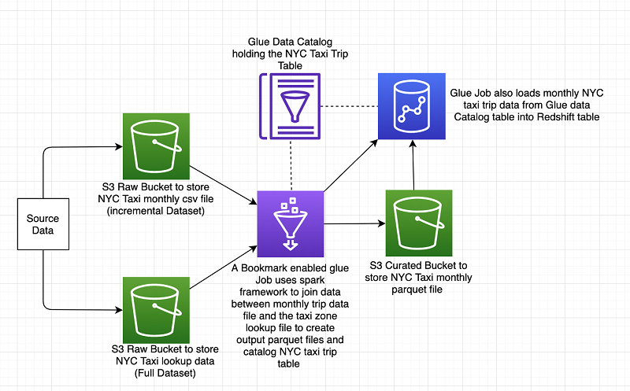
AWS Glue Job Bookmarks Architecture

Slide 9
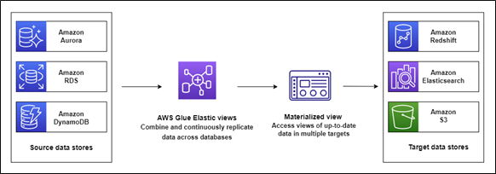
AWS Glue Elastic Views
AWS Glue Elastic Views is a capability of AWS Glue that makes it easy to build materialized views that combine and replicate data across multiple data stores without you having to write custom code.
With AWS Glue Elastic Views, you can use familiar Structured Query Language (SQL) to quickly create a virtual table—a materialized view—from multiple different source data stores.
AWS Glue Elastic Views copies data from each source data store and creates a replica in a target data store.
AWS Glue Elastic Views continuously monitors for changes to data in your source data stores, and provides updates to the materialized views in your target data stores automatically, ensuring data accessed through the materialized view is always up-to-date.

Slide 10
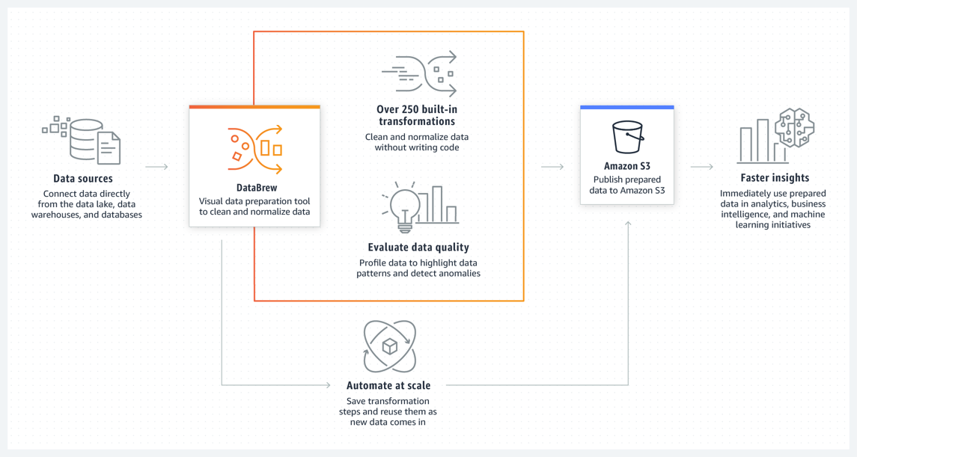
AWS Glue DataBrew
AWS Glue DataBrew is a visual data preparation tool that enables users to clean and normalize data without writing any code.
Using DataBrew helps reduce the time it takes to prepare data for analytics and machine learning (ML) by up to 80 percent, compared to custom developed data preparation.
You can choose from over 250 ready-made transformations to automate data preparation tasks, such as filtering anomalies, converting data to standard formats, and correcting invalid values.

Slide 11
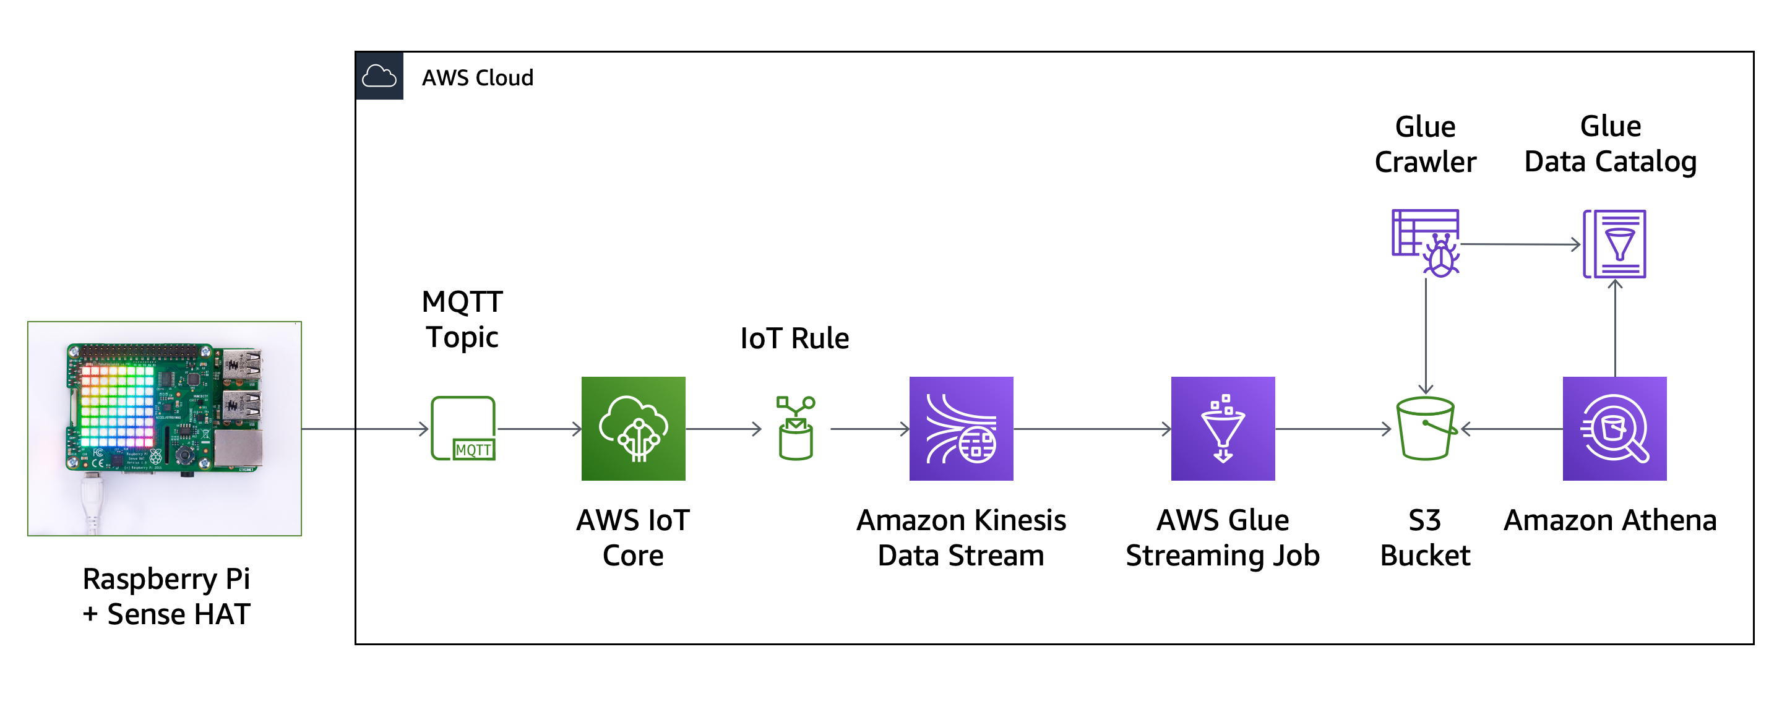
AWS Glue Streaming ETL
You can create streaming extract, transform, and load (ETL) jobs that run continuously, consume data from streaming sources like Amazon Kinesis Data Streams, Apache Kafka, and Amazon Managed Streaming for Apache Kafka (Amazon MSK).
The jobs cleanse and transform the data, and then load the results into Amazon S3 data lakes or JDBC data stores.

Slide 12
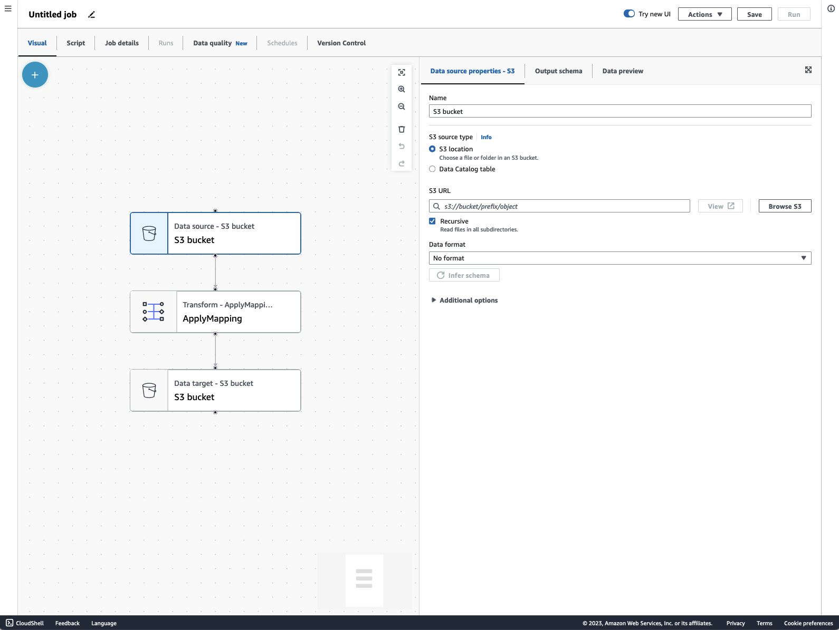
AWS Glue Studio
AWS Glue Studio is a graphical interface that makes it easy to create, run, and monitor extract, transform, and load (ETL) jobs in AWS Glue.
You can visually compose data transformation workflows, seamlessly run them on AWS Glue’s Apache Spark-based serverless ETL engine and inspect the schema and data results in each step of the job.
AWS Glue Studio provides a visual interface that makes it easy to:
Pull data from an Amazon S3, Amazon Kinesis, or JDBC source.
Configure a transformation that joins, samples, or transforms the data.
Specify a target location for the transformed data.
View the schema or a sample of the dataset at each point in the job.
Run, monitor, and manage the jobs created in AWS Glue Studio.

Slide 13
AWS Glue Use Cases
Data Lake Creation and Management: Organizations can employ AWS Glue for data lake creation and management, where it helps in discovering, cataloging, and preparing large volumes of data from various sources, enabling a centralized repository for analytics and big data processing.
ETL Processes for Business Intelligence: Companies can use AWS Glue to facilitate ETL (Extract, Transform, Load) processes, transforming disparate data into a format suitable for analytical tools, thereby enhancing business intelligence and helping decision-makers gain better insights from their data.
Real-time Analytics for E-commerce: E-commerce platforms can utilize AWS Glue for real-time analytics, streamlining the process of data preparation and loading data into data warehouses swiftly, which aids in deriving actionable insights to enhance customer experiences and optimize business strategies.
Data Migration to the Cloud: Businesses undergoing digital transformation can leverage AWS Glue to migrate on-premises data warehouses to cloud-native data services smoothly, aiding in the transition process by simplifying data discovery, transformation, and data schema version management.
Healthcare Data Harmonization: Healthcare organizations can use AWS Glue to harmonize disparate healthcare data, facilitating the creation of a unified patient view and enhancing data interoperability, which enables more informed decision-making in medical care and research.

