Slide 1

Amazon Elastic Transcoder
Amazon Elastic Transcoder is a highly scalable, easy to use and cost-effective way for developers and businesses to convert (or “transcode”) video and audio files from their source format into versions that will playback on devices like smartphones, tablets and PCs.
Supports a wide range of input and output formats, resolutions, bitrates, and frame rates.
Also offers features for automatic video bit rate optimization, generation of thumbnails, overlay of visual watermarks, caption support, DRM packaging, progressive downloads, encryption and more.

Slide 2
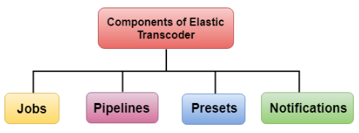
Components of Elastic Transcoder
Jobs - The main task of the job is to complete the work of transcoding. Each job can convert a file up to 30 formats.
For example, if you want to convert a media file into eight different formats, then a single job creates files in eight formats. When you create a job, you need to specify the name of the file that you want to transcode.
Pipelines - are the queues that consist of your transcoding jobs. When you create a job, then you need to specify which pipeline you want to add your job.
If you want a job to create more than one format, Elastic Transcoder creates the files for each format in the order you specify the formats in a job.
You can create either of the two pipelines, i.e., standard-priority jobs and high-priority jobs. Mainly jobs go into the standard-priority jobs.
Sometimes you want to transcode the file immediately; the high-priority pipeline is used.
Presets - are the templates that contain the settings for transcoding the media file from one format to another format.
Elastic transcoder consists of some default presets for common formats.
You can also create your own presets that are not included in the default presets. You need to specify a preset that you want to use when you create a job.
Notifications - are an optional field which you can configure with the Elastic Transcoder.
Notification Service is a service that keeps you updated with the status of your job: when Elastic Transcoder starts processing your job, when Elastic Transcoder finishes its job, whether the Elastic Transcoder encounters an error condition or not.
You can configure Notifications when you create a pipeline.

Slide 3
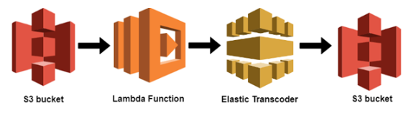
How A Cloud Uses Elastic Transcoder
Suppose I uploaded the mp4 file in S3 bucket. As soon as uploading is completed, it triggers a Lambda function.
Lambda function will then invoke Elastic Transcoder.
Elastic Transcoder converts the mp4 file into different formats so that the file can be opened in iphone, Laptop, etc.
Once it has completed the transcoding, it stores the transcoded files in S3 bucket.

