Slide 1

AWS Security Hub

Slide 2
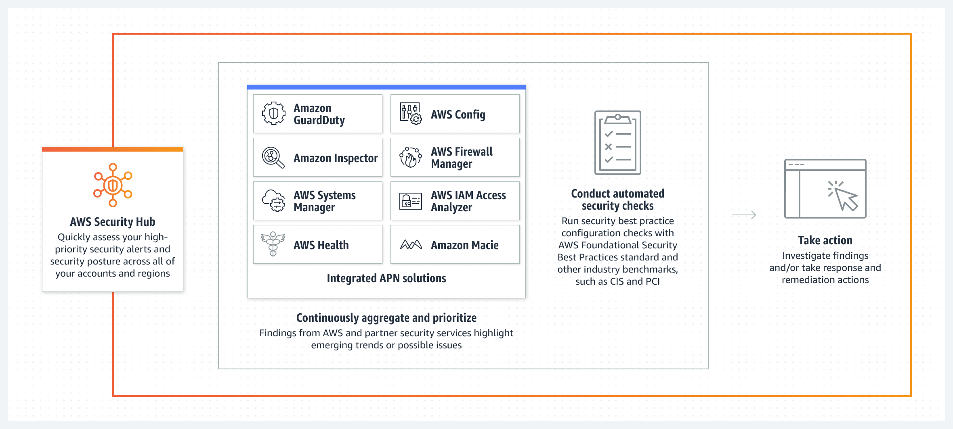
AWS Security Hub

Slide 3

What is AWS Security Hub?
AWS Security Hub is a cloud security posture management (CSPM) service that performs security best practice checks, aggregates alerts, and enables automated remediation.
Security Hub also receives findings from other AWS services:
Amazon GuardDuty
Amazon Inspector
Amazon Macie
AWS Systems Manager Patch Manager
Amazon Detective
AWS Firewall Manager
AWS Config
supported third-party products.
Security Hub supports multiple security standards:
AWS Foundational Security Best Practices (FSBP) standard developed by AWS
Center for Internet Security (CIS)
Payment Card Industry Data Security Standard (PCI DSS)
National Institute of Standards and Technology (NIST).

Slide 4
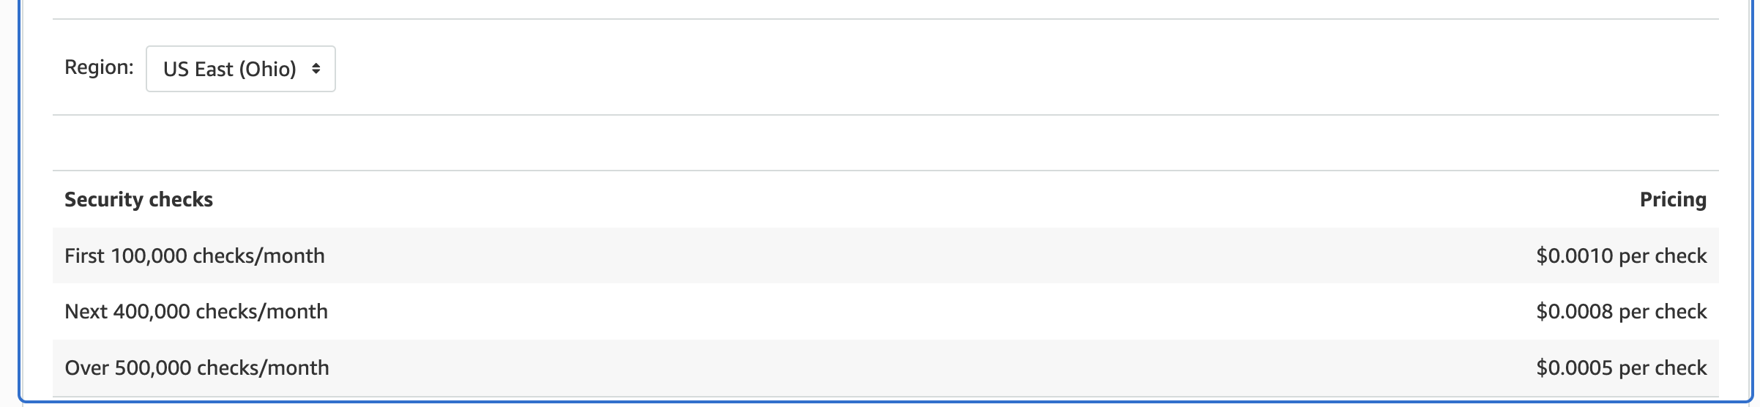
Security Hub Pricing
for the first time a 30-day Security Hub free trial.
https://aws.amazon.com/security-hub/pricing/

Slide 5
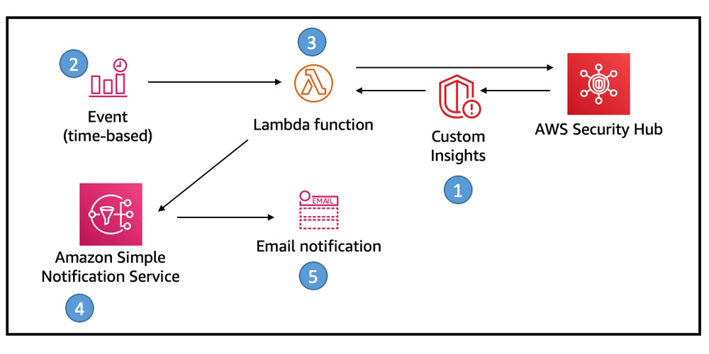
Sucurity Hub SNS Notification

Slide 6
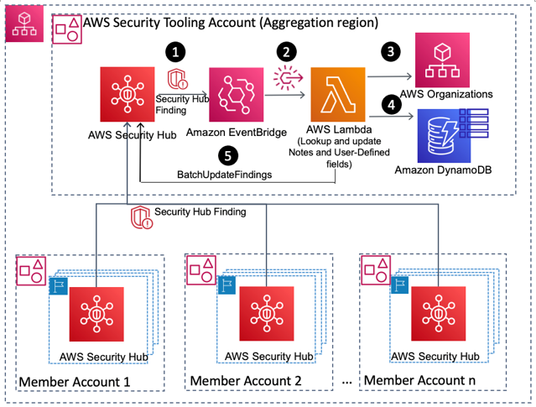
Solution Architecture

