Slide 1

Amazon Detective
Analyze and visualize security data to investigate potential security issues

Slide 2

Amazon Detective How it works
Amazon Detective simplifies the investigative process and helps security teams conduct faster and more effective investigations.
With the Amazon Detective prebuilt data aggregations, summaries, and context, you can quickly analyze and determine the nature and extent of possible security issues.

Slide 3
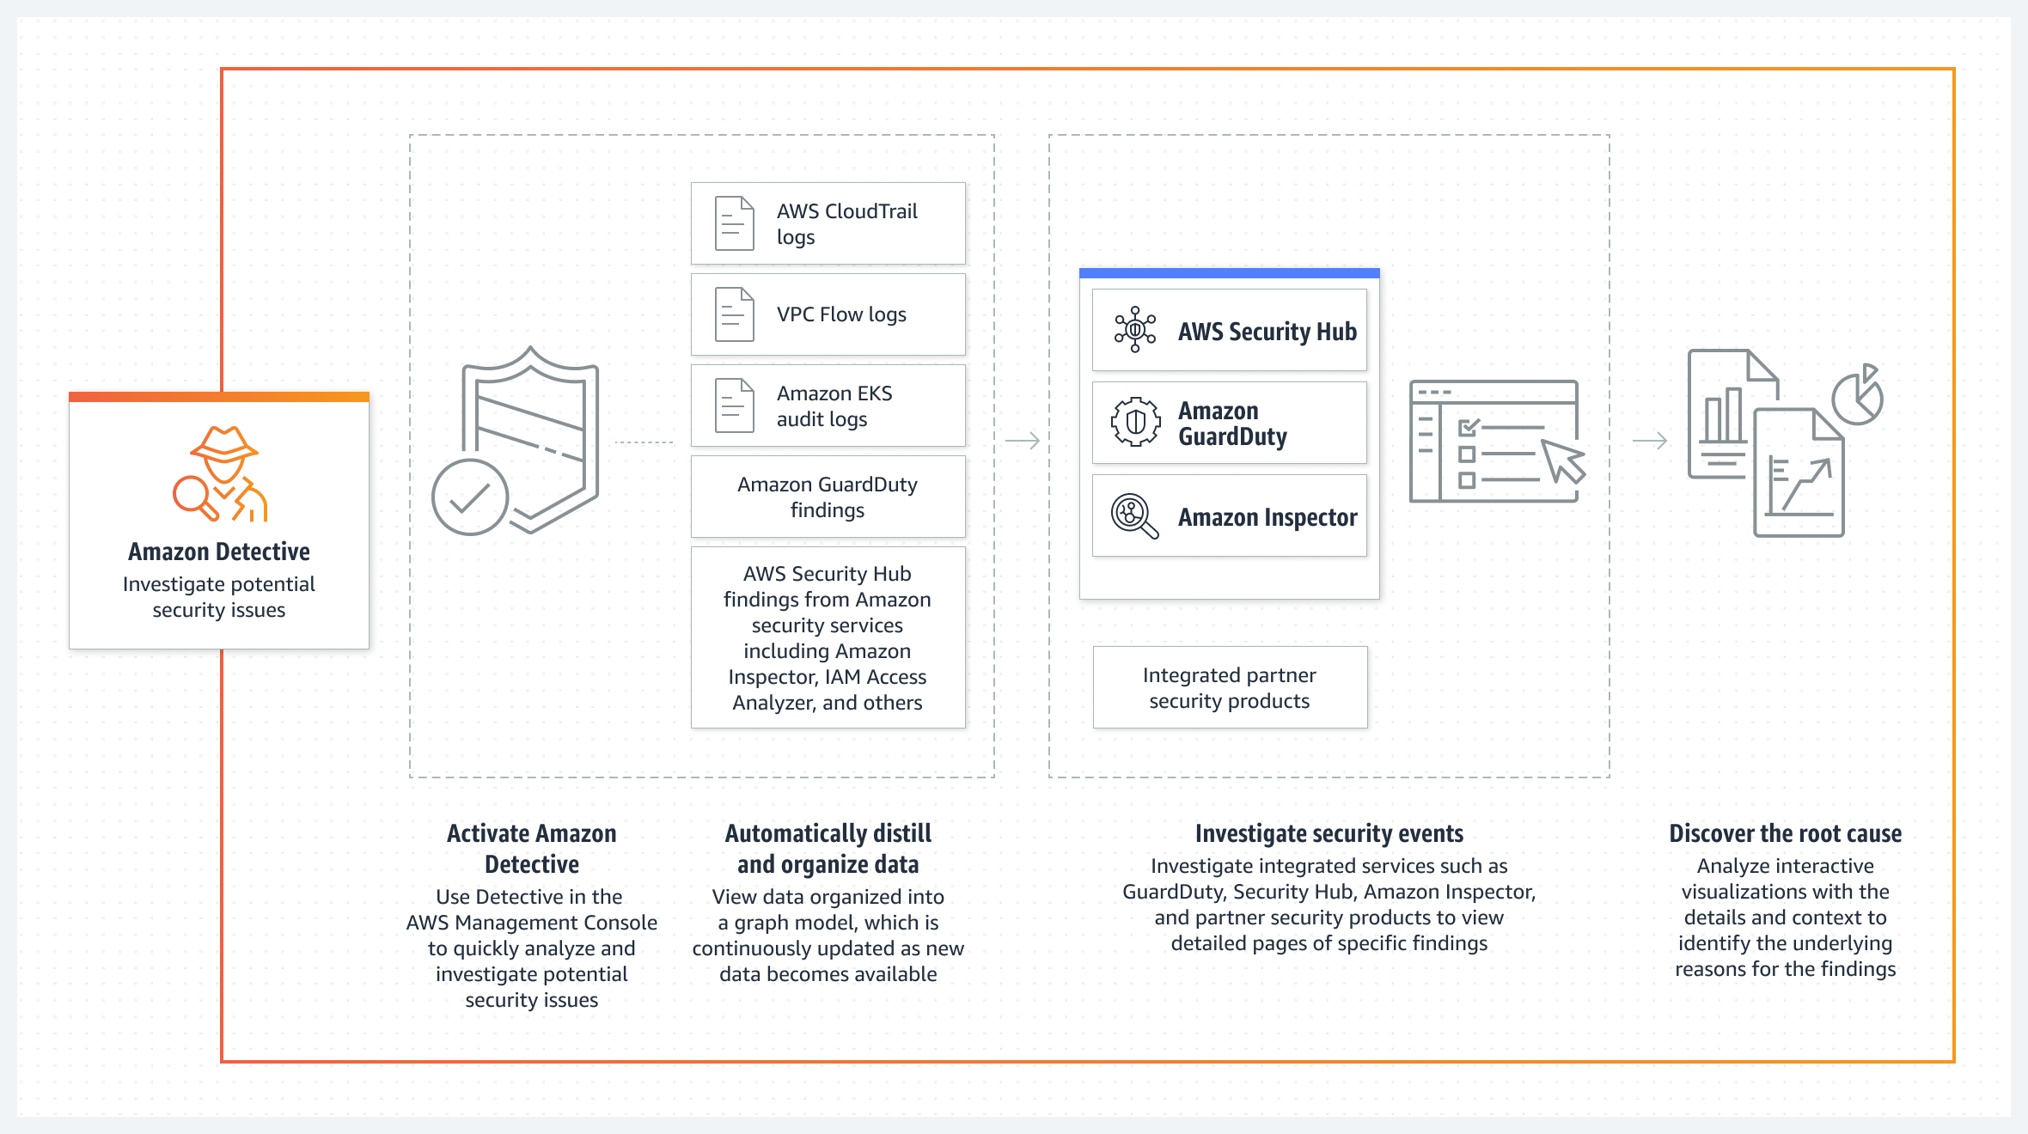
Amazon Detective

Slide 4
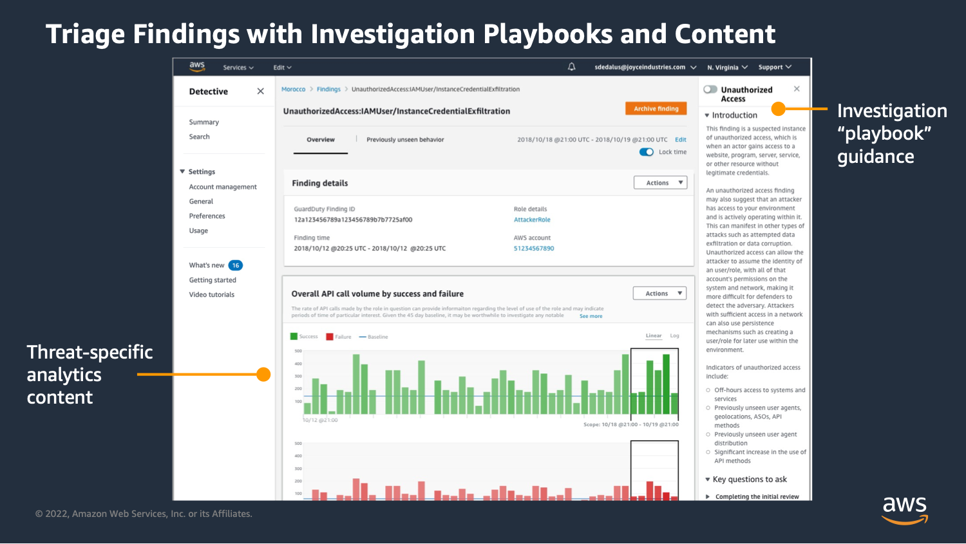
Amazon Detective

