Slide 1
AWS Gateway Load Balancer

Slide 2
Gateway ELB
Gateway Load Balancers enable you to:
deploy, scale, and manage virtual appliances,
such as:
Firewalls
intrusion detection
prevention systems
deep packet inspection systems.
It combines a transparent network gateway and distributes traffic while scaling your virtual appliances with the demand.
A typical use case features customer AWS deployments, with one or more VPCs, with a requirement to protect and inspect network traffic with Check Point's CloudGuard Network Security Gateways.

Slide 3
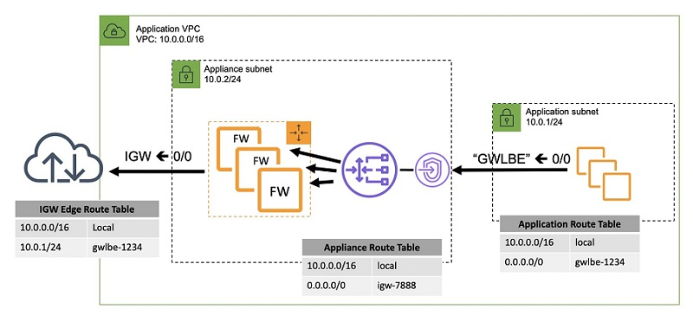

Slide 4
