Slide 1
Transit Gateway

Slide 2
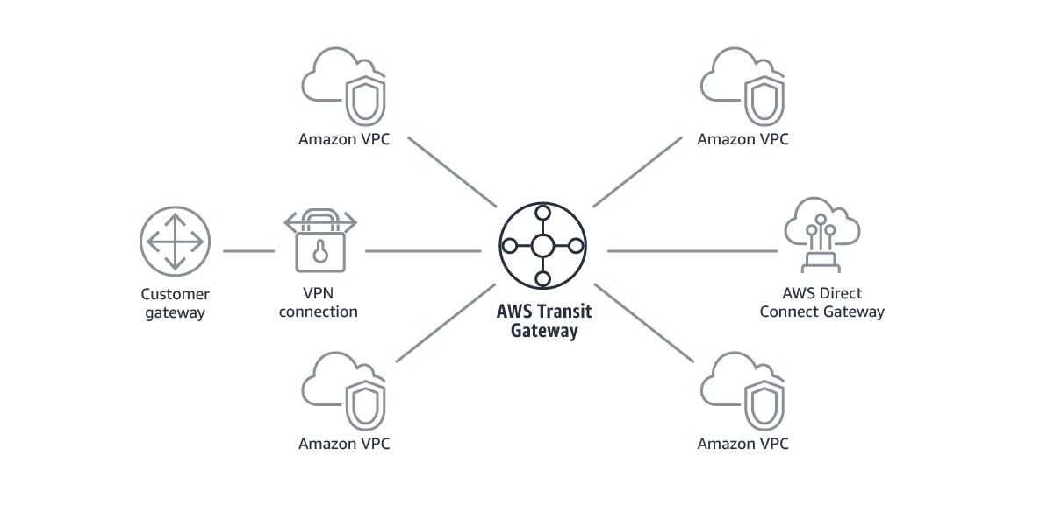
What is a transit gateway?
A transit gateway is a network transit hub that you can use to interconnect your virtual private clouds (VPCs) and on-premises networks.
As your cloud infrastructure expands globally, inter-Region peering connects transit gateways together using the AWS Global Infrastructure.
Your data is automatically encrypted and never travels over the public internet.

Slide 3
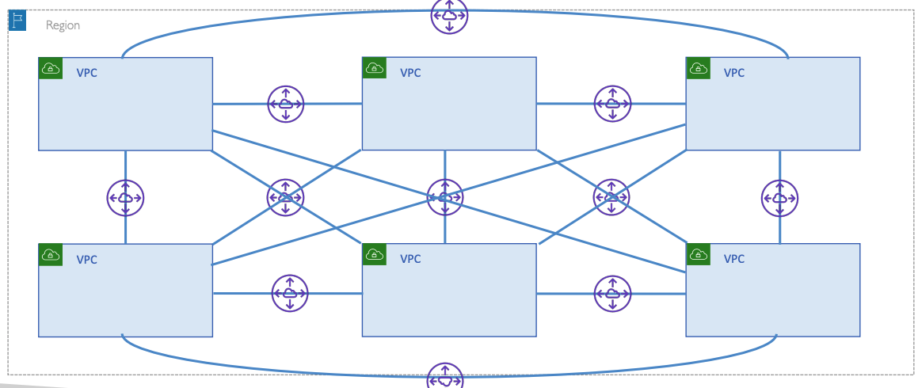
Without Transit Gateway

Slide 4
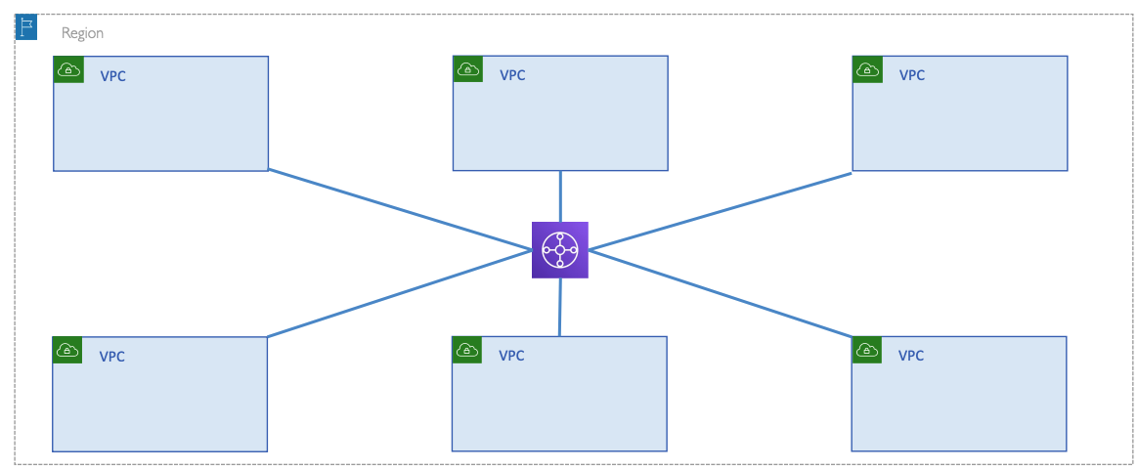
With Transit Gateway

Slide 5
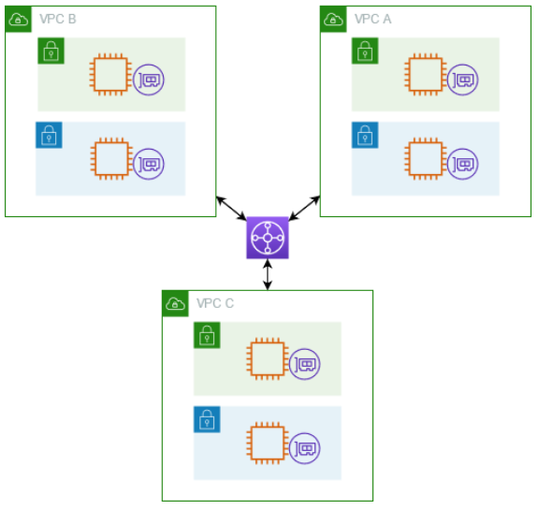
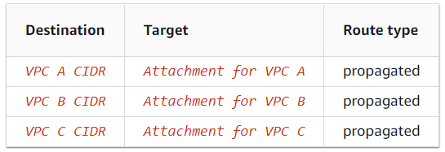
Transit gateway
The following diagram shows a transit gateway with three VPC attachments.
The route table for each of these VPCs includes the local route and routes that send traffic destined for the other two VPCs to the transit gateway.
The following is an example of a default transit gateway route table for the attachments shown in the previous diagram.
The CIDR blocks for each VPC propagate to the route table. Therefore, each attachment can route packets to the other two attachments.

Slide 6
Transit Gateway Attachments
Transit Gateway Attachments are essentially the connections or links between your Transit Gateway and your VPCs, VPN connections, AWS Direct Connect gateways, or other AWS Transit Gateways. These attachments are the means through which different network environments can communicate with each other via the Transit Gateway.
VPC Attachments: These allow you to connect your VPCs to a Transit Gateway. Once attached, resources in your VPC (like EC2 instances) can communicate with resources in other connected VPCs, Transit Gateways, or on-premises networks.
VPN Attachments: These are used to connect on-premises networks to the Transit Gateway via a VPN connection. This setup is common for companies that want to extend their on-premises infrastructure to AWS securely.
Direct Connect Gateway Attachments: If you're using AWS Direct Connect to create a dedicated network connection between your on-premises environment and AWS, you can attach your Direct Connect gateway to the Transit Gateway. This facilitates private connectivity to multiple VPCs across your AWS accounts.
Peering Attachments: Transit Gateways in different AWS Regions can be connected via peering attachments. This allows you to route traffic across different AWS Regions, keeping it within the AWS network.
Transit Gateway Connect: A feature that allows you to connect SD-WAN (Software-Defined Wide Area Network) devices, further simplifying branch connectivity and network management.

Slide 7
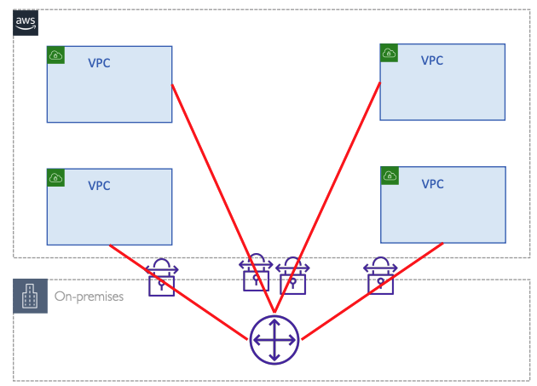
Multiple VPCs and VPN

Slide 8
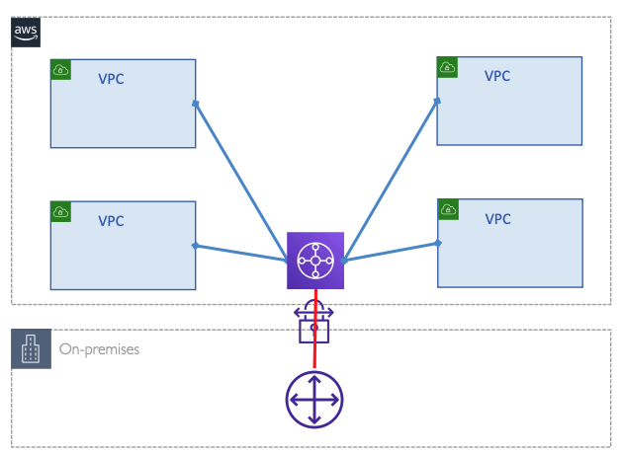
Multiple VPCs and VPN with Transit Gateway

Slide 9
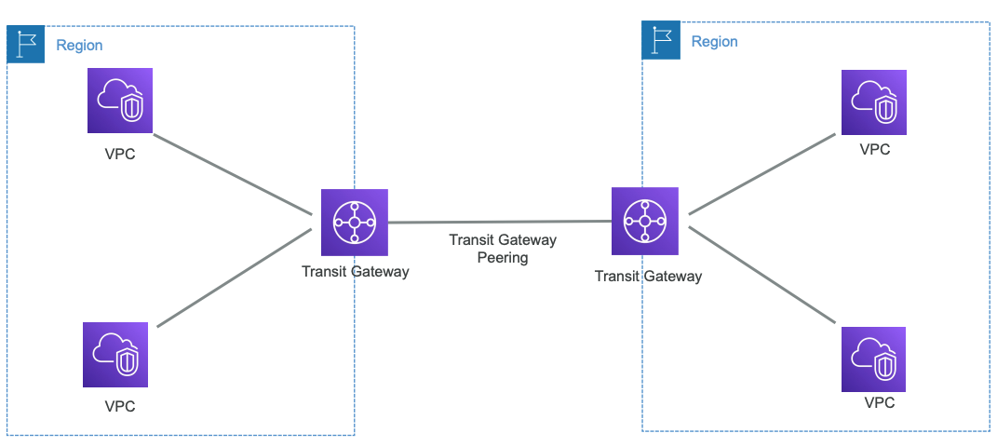
Transit Gateway Peering

Slide 10

Transit Gateway Peering
Transit gateways are regional router which means you can connect VPCs from the same region
For inter region network connectivity you can peer the transit gateways across the regions
Static routes needs to be added for peering connection (No BGP)
The inter-Region traffic is encrypted, traverses the AWS global network, and is not exposed to the public internet. Supports bandwidth up to 50 Gbps.
Use unique ASNs for the peered transit gateways

Slide 11
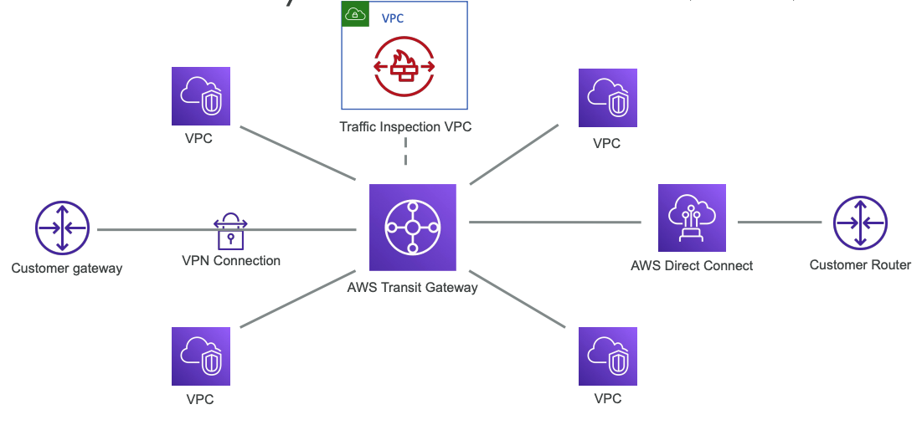
Transit Gateway: VPC, VPN, DX, Traffic Inspection VPC

Slide 12
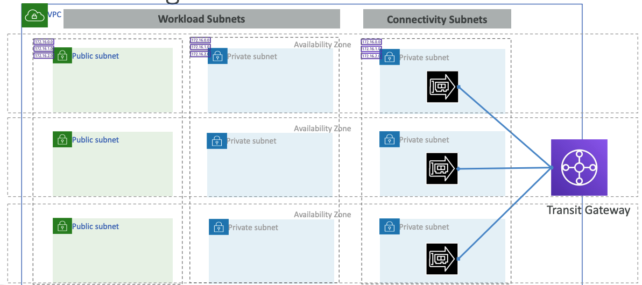
VPC design for TGW

Slide 13
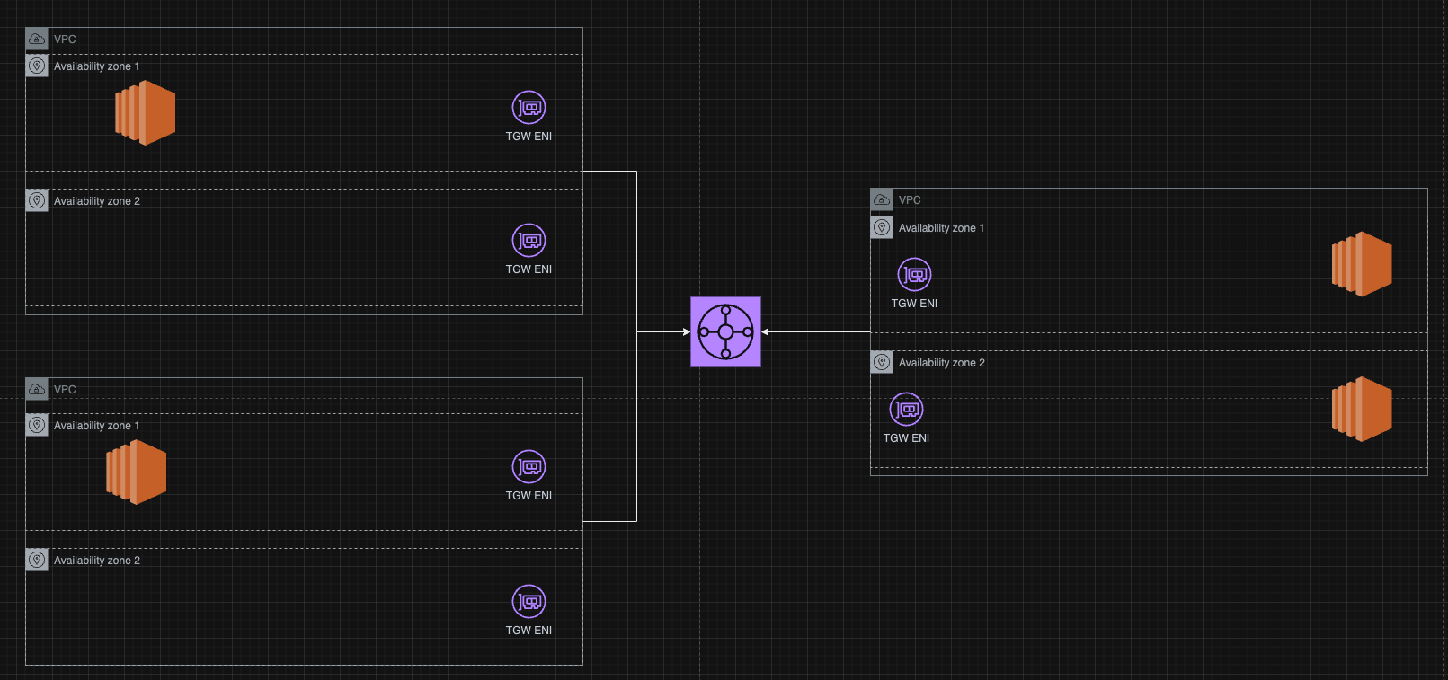
TGW: AZ Affinity Source and destination in same AZ
Transit Gateway attempts to keep the traffic in the in the originating Availability Zone until it reaches its destination.

Slide 14
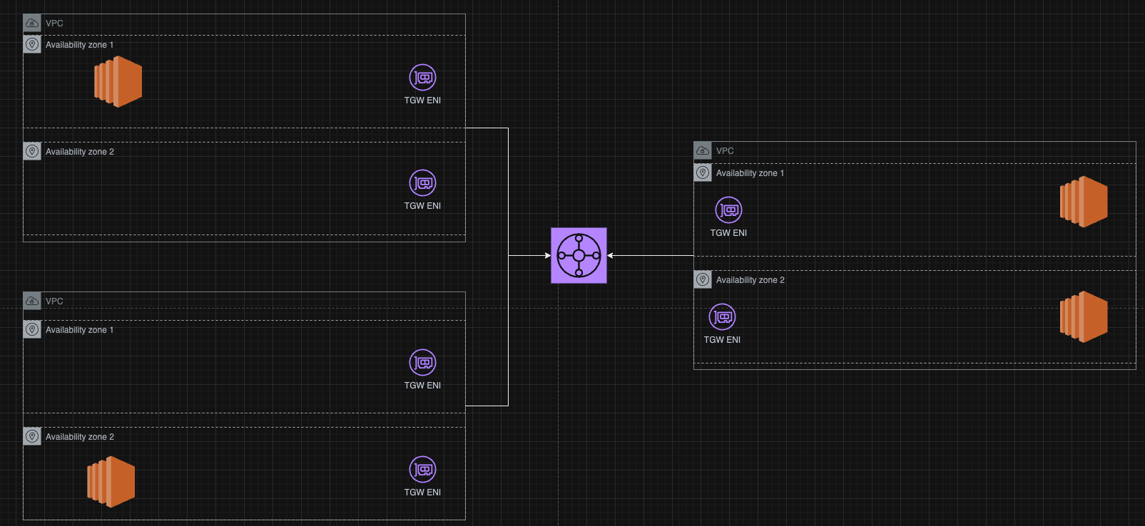







TGW: AZ Affinity Source and destination in different AZ
This called Asymmetric Routing
Works if Appliance is Stateless

Slide 15
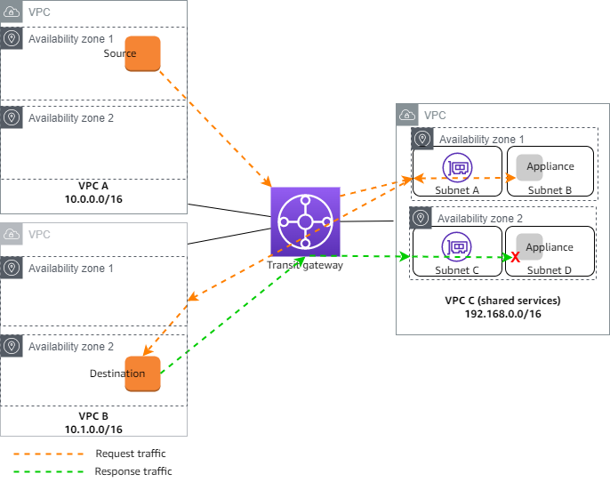
TGW: Appliance mode Disabled
When appliance mode is not enabled, a transit gateway attempts to keep traffic routed between VPC attachments in the originating Availability Zone until it reaches its destination.
Traffic crosses Availability Zones between attachments only if there is an Availability Zone failure or if there are no subnets associated with a VPC attachment in that Availability Zone.
The response traffic that originates from Availability Zone 2 in VPC B is routed by the transit gateway to the same Availability Zone in VPC C.
The traffic is therefore dropped, because the appliance in Availability Zone 2 is not aware of the original request from the source in VPC A.

Slide 16
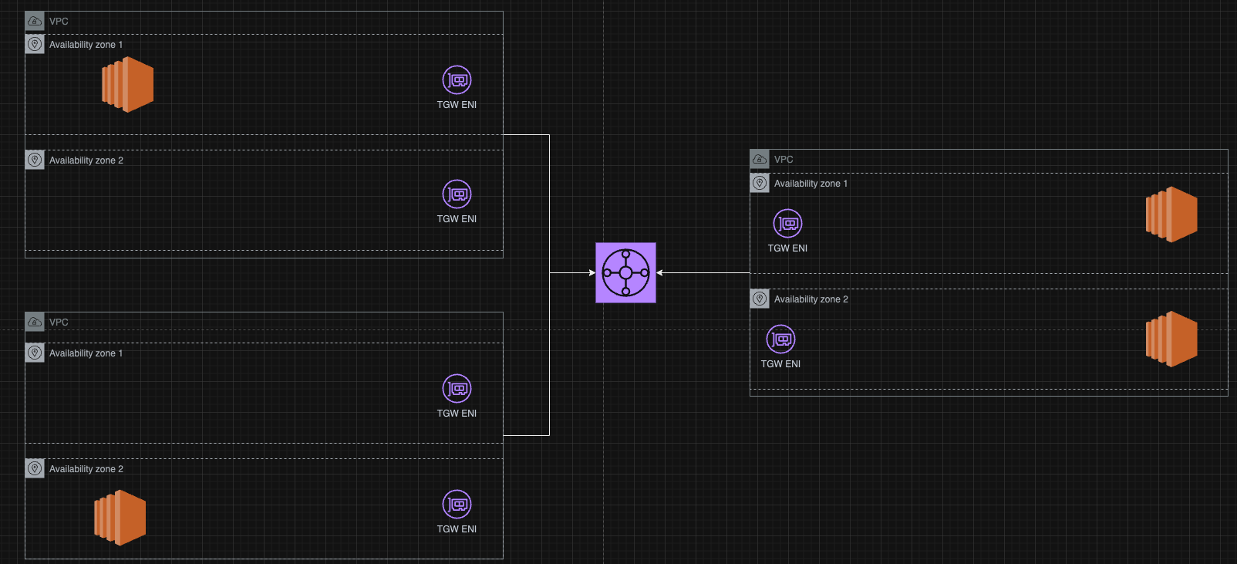












TGW: Appliance mode Enabled
When appliance mode is enabled, a transit gateway selects a single network interface in the appliance VPC, using a flow hash algorithm, to send traffic to for the life of the flow.
The transit gateway uses the same network interface for the return traffic.
This ensures that bidirectional traffic is routed symmetrically—it's routed through the same Availability Zone in the VPC attachment for the life of the flow.
If you have multiple transit gateways in your architecture, each transit gateway maintains its own session affinity, and each transit gateway can select a different network interface.
If your VPC attachments span multiple Availability Zones and you require traffic between source and destination hosts to be routed through the same appliance for stateful inspection, enable appliance mode support for the VPC attachment in which the appliance is located.

Slide 17
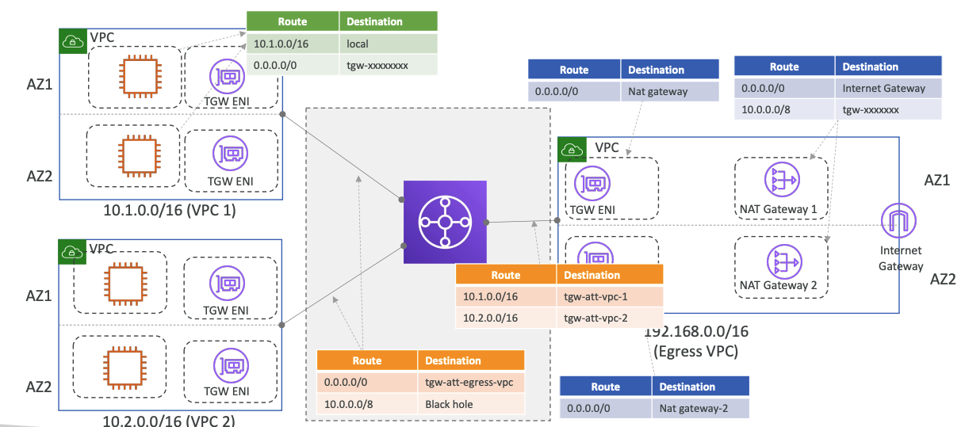
TGW – Egress NAT Gateway Pattern

Slide 18
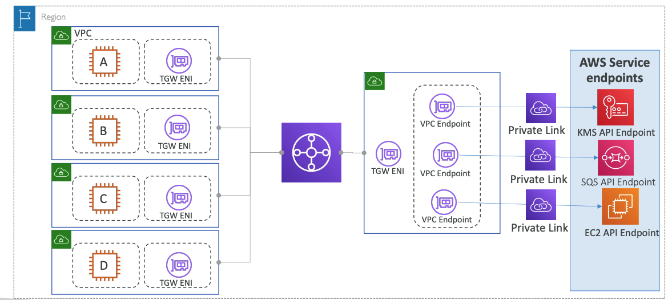
TGW – Centralized VPC Interface Endpoint Pattern

Slide 19
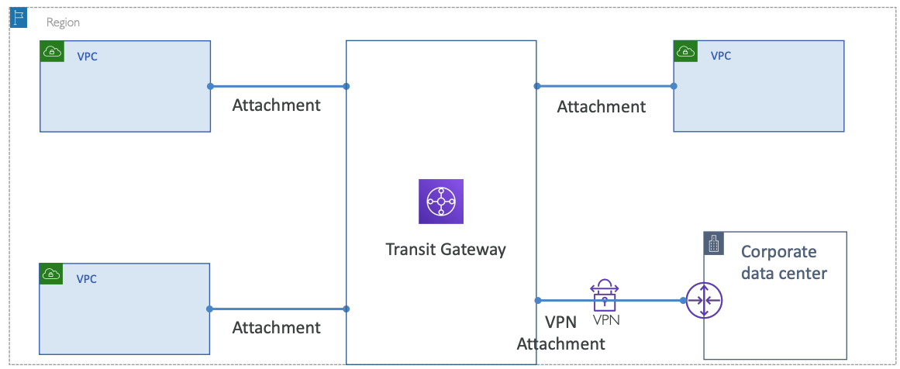
TGW – Hybrid Connection with VPN Attachment

Slide 20
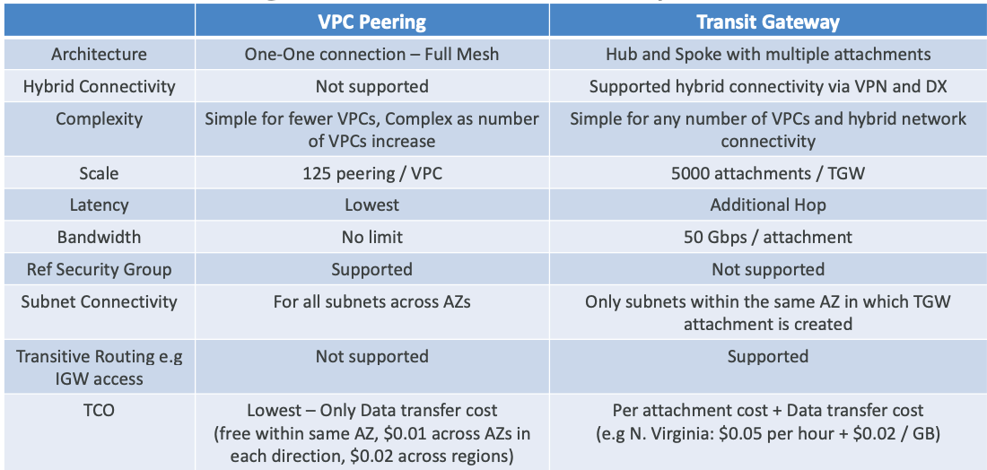
VPC Peering vs Transit Gateway

