Slide 1
Elastic Network Interface
Essentially, ENIs are virtual network cards you can attach to your EC2 instances.
They are used to enable network connectivity for your instances, and having more than one of them connected to your instance allows it to communicate on two different subnets.

Slide 2
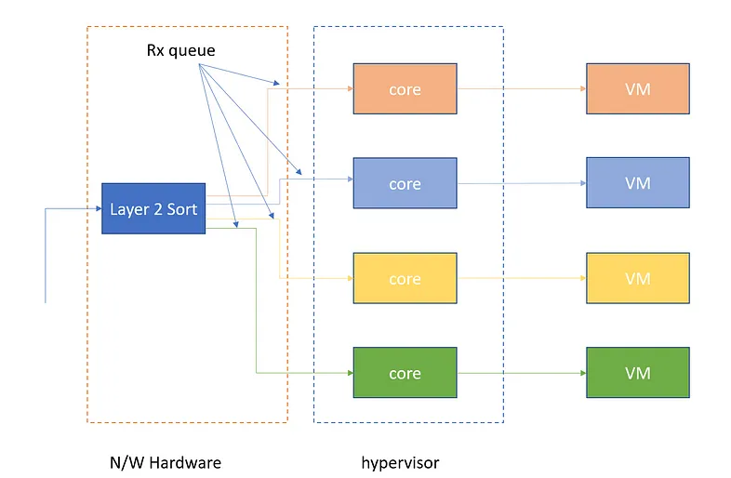
ENI based on Virtual Machine Device Queues

Slide 3
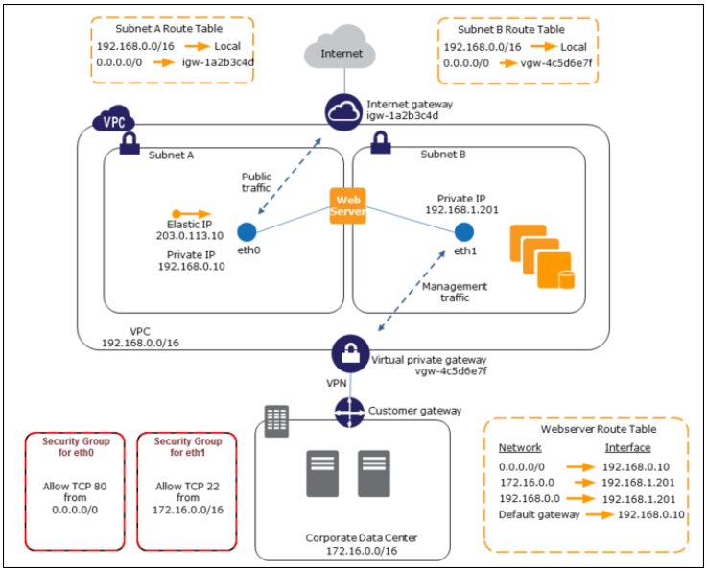
ENI Use Cases
A common use case for ENIs is the creation of management networks.
This allows you to have public-facing applications like web servers in a public subnet but lock down SSH access down to a private subnet on a secondary network interface.

Slide 4
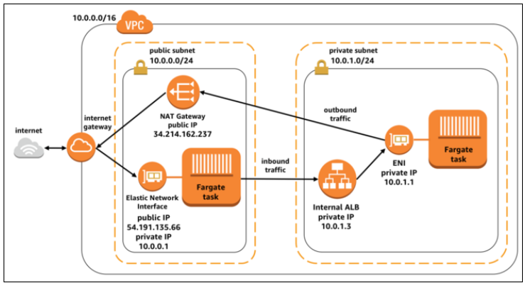
ENI Use Cases
ENIs are also often used as the primary network interfaces for Docker containers launched on ECS using Fargate.
This allows Fargate tasks to handle complex networking, set firewalls in place using security groups, and be launched into private subnets.

Slide 5
Enhanced Networking
Enhanced networking uses Single Root I/O virtualization (SR-IOV) to provide high network capabilities.
Usually, ec2 sends traffic via Xen hypervisor.
With enhanced networking it “owns” it own network interface, which means it can send traffik without using Hen hypervisor
Benefits:
Higher bandwidth
Higher PSS performance (packet per second)
Lower inter-instance latency
Around 8% gain in throughput
Requirements:
Instance with Intel 82599 VF Interface

Slide 6
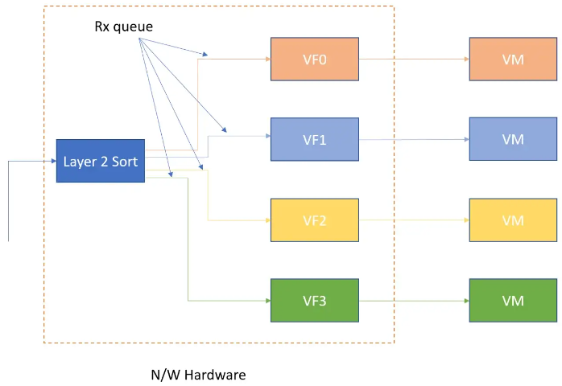
ENA
The Elastic Network Adapter (ENA) is designed to provide Enhanced Networking to your EC2 instances.
With ENA, you can expect high throughput and packet per second (PPS) performance, as well as consistently low latencies on Amazon EC2 instances.
Using ENA, you can utilize up to 20 Gbps of network bandwidth on certain EC2 instance types – massively improving your networking throughput compared to other EC2 instances, or on premises machines.
In the above diagram we see that sorting and queue assignment happens at networking device and VM directly get the message.
There is no hypervisor switch involved in this. Also all VMs process packets from their own dedicated queue in parallel.

Slide 7
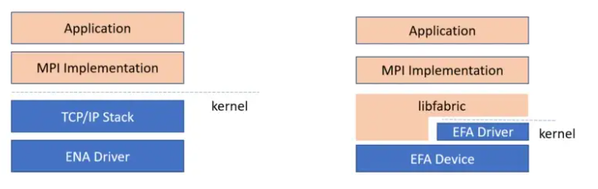
EFA
EFAs are Elastic Network Adapters (ENAs) with additional OS-bypass capabilities.
AWS Elastic Fabric Adapter (EFA) is a specialized network interface for Amazon EC2 instances that allows customers to run high levels of inter-instance communication, such as HPC applications on AWS at scale on.
AWS EFA is often used in conjunction with Cluster placement groups – which allow physical hosts to be placed much closer together within an AZ to decrease latency even more.
Due to EFA’s support for libfabric APIs, applications using a supported MPI library can be easily migrated to AWS without having to make any changes to their existing code.

Slide 8
EFA Limitations
Elastic Fabric Adapter Limitations
You can attach only one EFA per instance.
EFA OS-bypass traffic is limited to a single subnet. EFA traffic cannot be sent from one subnet to another. Normal IP traffic from the EFA can be sent from one subnet to another.
EFA OS-bypass traffic is not routable. Normal IP traffic from the EFA remains routable.
The EFA must be a member of a security group that allows all inbound and outbound traffic to and from the security group itself.

Slide 9
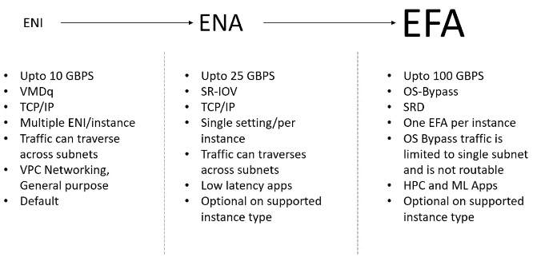
ENI vs ENA vs EFA

Slide 10
