Slide 1
VPC Endpoints

Slide 2
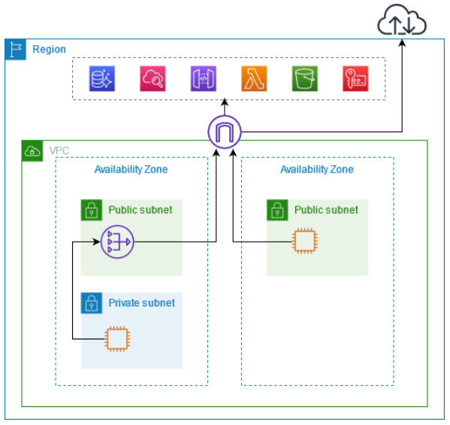
VPC endpoints
Access through public service endpoints
The following diagram shows how instances access AWS services through the public service endpoints.
Traffic to an AWS service from an instance in a public subnet is routed to the internet gateway for the VPC and then to the AWS service.
Traffic to an AWS service from an instance in a private subnet is routed to a NAT gateway, then to the internet gateway for the VPC, and then to the AWS service.
While this traffic traverses the internet gateway, it does not leave the AWS network.
They remove the need of IGW, NAT GW to access AWS Services

Slide 3
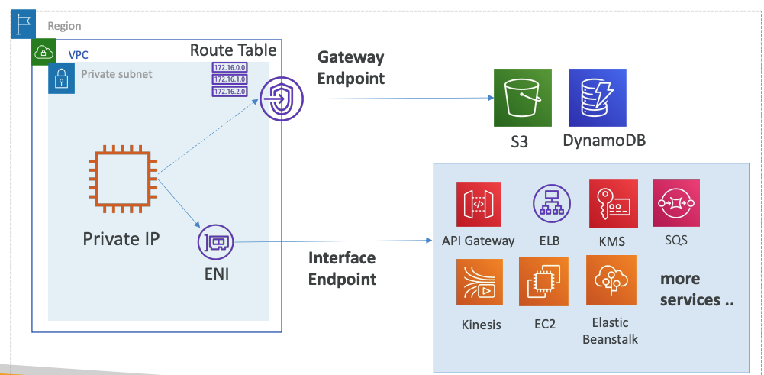
VPC Endpoint Types
There are three types of VPC endpoints –
Interface endpoints
Gateway endpoints
Gateway Load Balancer endpoints
Gateway Endpoint: provisions a target and must be used in a route table – S3 and DynamoDB
Interface Endpoint: provisions an ENI (private IP) as an entry point – most other AWS services

Slide 4
VPC Gateway Endpoint

Slide 5
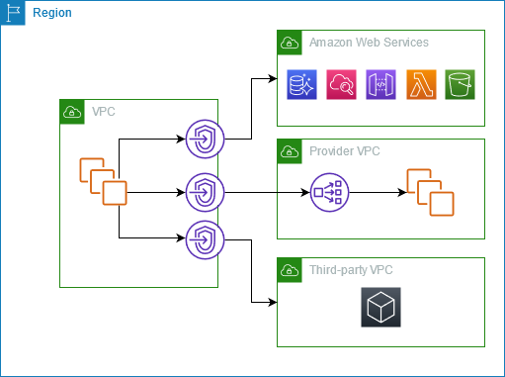
AWS PrivateLink
Connect through AWS PrivateLink
The following diagram shows how instances access AWS services through AWS PrivateLink.
First, you create an interface VPC endpoint, which establishes connections between the subnets in your VPC and an AWS service using network interfaces.
Traffic destined for the AWS service is resolved to the private IP addresses of the endpoint network interfaces using DNS, and then sent to the AWS service using the connection between the VPC endpoint and the AWS service.

Slide 6
VPC endpoints
You can create an interface VPC endpoint to connect to services powered by AWS PrivateLink, including many AWS services.
For each subnet that you specify from your VPC, we create an endpoint network interface in the subnet and assign it a private IP address from the subnet address range.
An endpoint network interface is a requester-managed network interface; you can view it in your AWS account, but you can't manage it yourself.
Gateway endpoints provide reliable connectivity to Amazon S3 and DynamoDB without requiring an internet gateway or a NAT device for your VPC.
Gateway endpoints do not enable AWS PrivateLink.
There is no additional charge for using gateway endpoints.

Slide 7
VPC endpoint services
You can create your own service powered by AWS PrivateLink, known as an endpoint service.
You are the service provider, and the AWS principals that create connections to your service are the service consumers.
Endpoint services require either a Network Load Balancer or a Gateway Load Balancer.
The load balancer receives requests from service consumers and routes them to your service.
You can use a Gateway Load Balancer to distribute traffic to a fleet of network virtual appliances.
The appliances can be used for security inspection, compliance, policy controls, and other networking services.
You specify the Gateway Load Balancer when you create a VPC endpoint service.
Other AWS principals access the endpoint service by creating a Gateway Load Balancer endpoint.

Slide 8
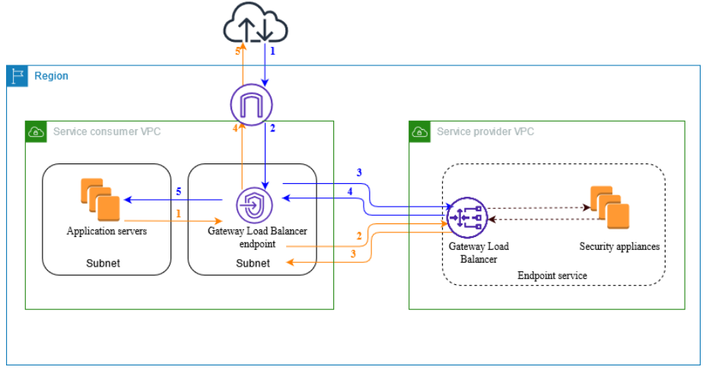
VPC endpoint services
The following diagram shows how application servers access security appliances through AWS PrivateLink.
The application servers run in a subnet of the service consumer VPC.
You create a Gateway Load Balancer endpoint in another subnet of the same VPC.
All traffic entering the service consumer VPC through the internet gateway is first routed to the Gateway Load Balancer endpoint for inspection and then routed to the destination subnet.
Similarly, all traffic leaving the application servers is routed to the Gateway Load Balancer endpoint for inspection before it is routed back through the internet gateway.

Slide 9
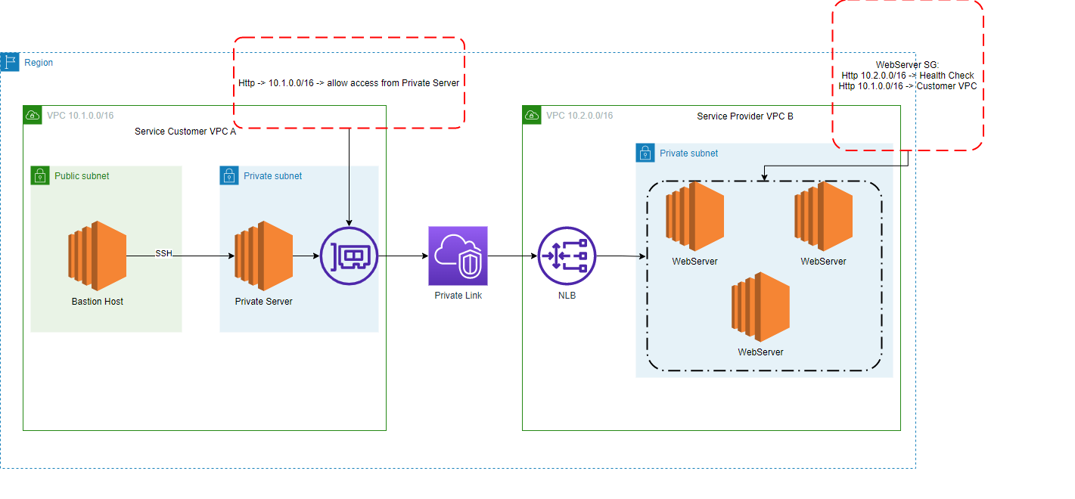
Vpc Endpoints Service Hands On

Slide 10
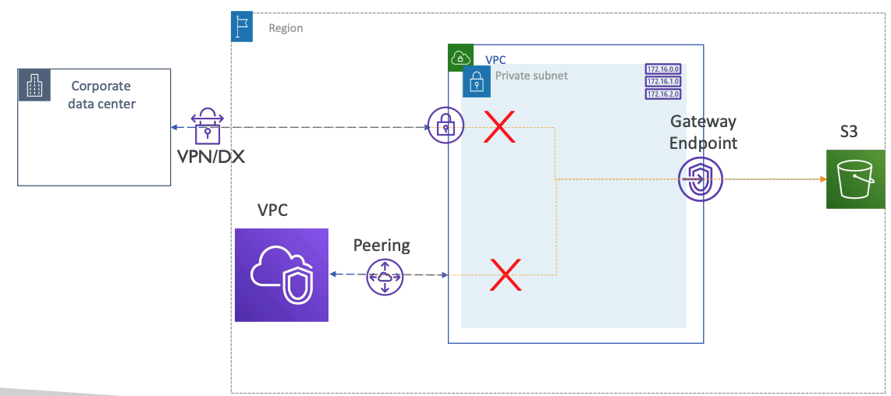
Gateway endpoint access from Remote Networks

