Slide 1
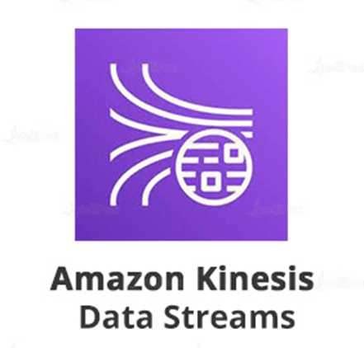
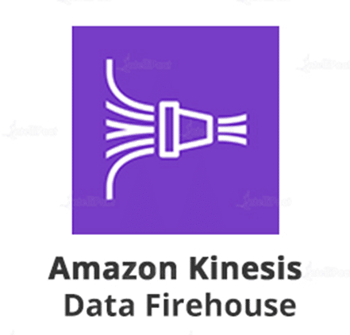
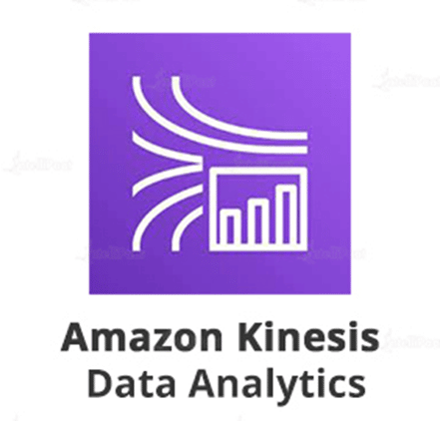
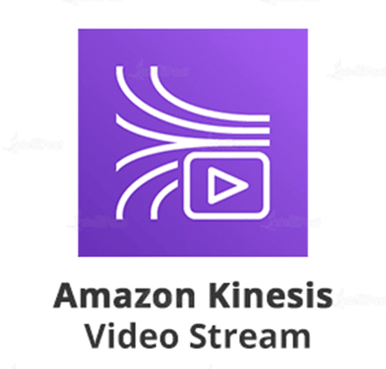
Kinesis overview
Amazon Kinesis is an Amazon Web Service designed to makes it easy to collect, process, and analyze video and data streams in real time.

Slide 2
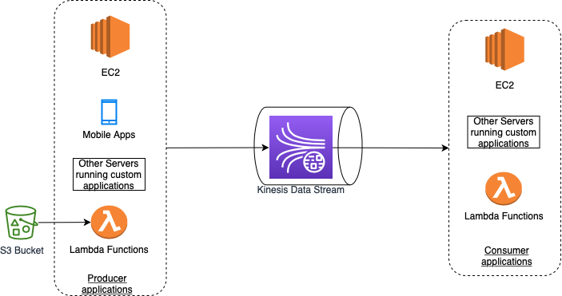
Kinesis Data Stream
You can use Amazon Kinesis Data Streams to collect and process large streams of data records in real time.
A typical Kinesis Data Streams application reads data from a data stream as data records.
These applications can use the Kinesis Client Library, and they can run on Amazon EC2 instances. You can send the processed records to dashboards, use them to generate alerts, dynamically change pricing and advertising strategies, or send data to a variety of other AWS services.
The following are typical scenarios for using Kinesis Data Streams:
Accelerated log and data feed intake and processing
Real-time metrics and reporting
Real-time data analytics
Complex stream processing

Slide 3
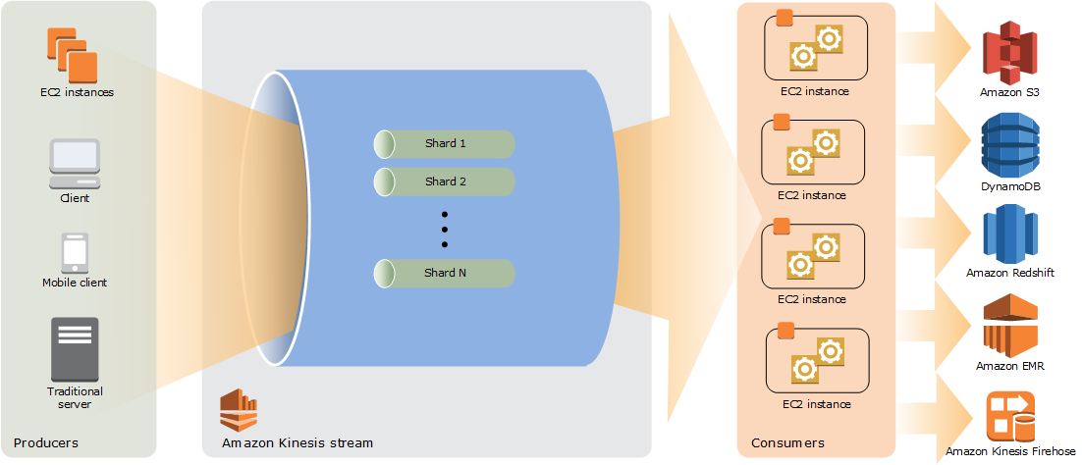
Kinesis Data Stream How shards work
A Kinesis data stream is a set of shards. Each shard has a sequence of data records. Each data record has a sequence number that is assigned by Kinesis Data Streams.
A shard is a uniquely identified sequence of data records in a stream. A stream is composed of one or more shards, each of which provides a fixed unit of capacity. Each shard can support up to 5 transactions per second for reads, up to a maximum total data read rate of 2 MB per second and up to 1,000 records per second for writes, up to a maximum total data write rate of 1 MB per second (including partition keys). The data capacity of your stream is a function of the number of shards that you specify for the stream. The total capacity of the stream is the sum of the capacities of its shards.

Slide 4
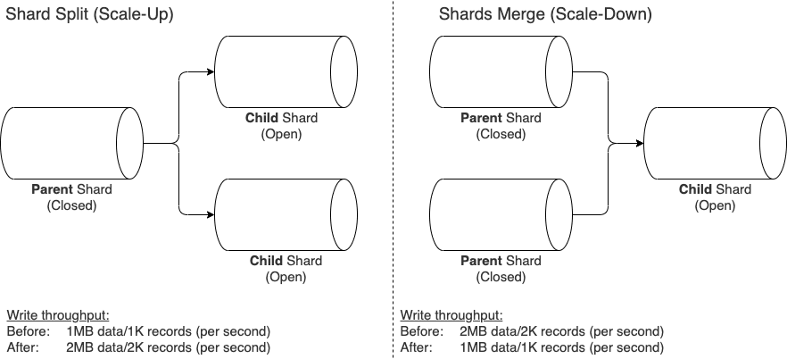
Kinesis Data Stream Resharding a Stream
Amazon Kinesis Data Streams supports resharding, which lets you adjust the number of shards in your stream to adapt to changes in the rate of data flow through the stream.
There are two types of resharding operations: shard split and shard merge.
Resharding is always pairwise in the sense that you cannot split into more than two shards in a single operation, and you cannot merge more than two shards in a single operation.
Splitting increases the number of shards in your stream and therefore increases the data capacity of the stream and the cost of your stream. Similarly, merging reduces the number of shards in your stream and therefore decreases the data capacity—and cost—of the stream.
The maximum number of instances you can launch is n, to match the number of open shards in a ratio of 1:1.

Slide 5
Destinations

Slide 6
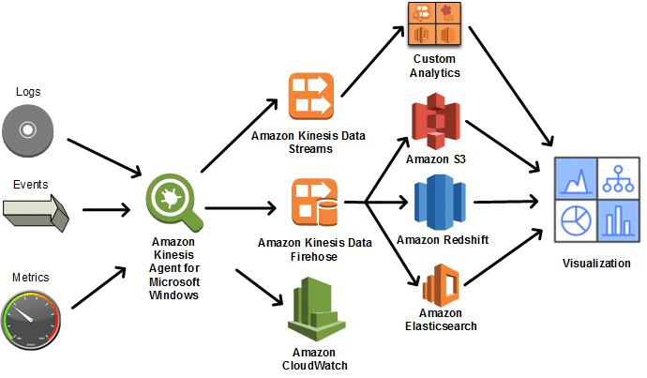
Kinesis Agent
Kinesis Agent is a stand-alone Java software application that offers an easy way to collect and send data to Kinesis Data Streams or Kinesis Data Firehose.
The agent continuously monitors a set of files and sends new data to your stream.
The agent handles file rotation, checkpointing, and retry upon failures.
It delivers all of your data in a reliable, timely, and simple manner.
It also emits Amazon CloudWatch metrics to help you better monitor and troubleshoot the streaming process.

Slide 7
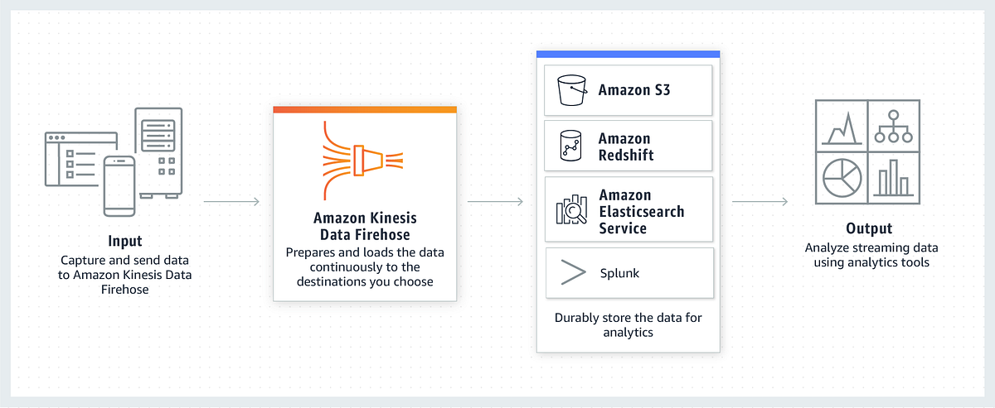
Kinesis Firehose
Amazon Kinesis Data Firehose is a fully managed service for delivering real-time streaming data to destinations such as Amazon Simple Storage Service (Amazon S3), Amazon Redshift, Amazon OpenSearch Service, Amazon OpenSearch Serverless, Splunk, and any custom HTTP endpoint or HTTP endpoints owned by supported third-party service providers.
With Kinesis Data Firehose, you don't need to write applications or manage resources. You configure your data producers to send data to Kinesis Data Firehose, and it automatically delivers the data to the destination that you specified. You can also configure Kinesis Data Firehose to transform your data before delivering it.

Slide 8
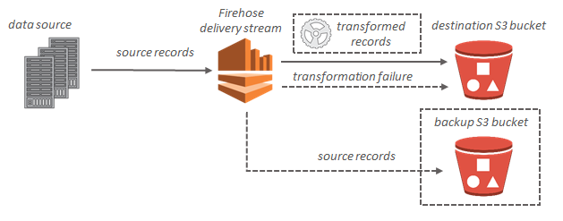
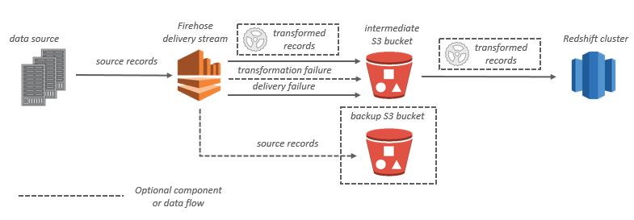
Kinesis Firehose Data flow

Slide 9
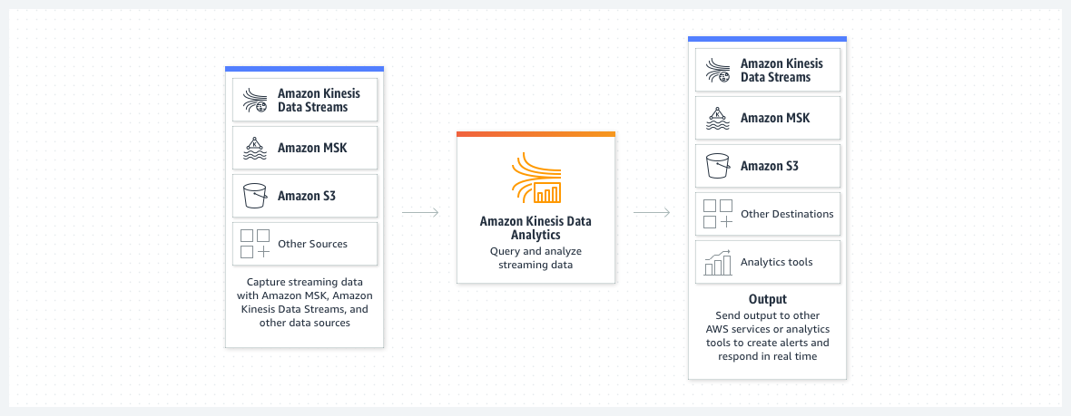
Kinesis Data Analytics
Amazon Kinesis Data Analytics is the easiest way to manipulate and analyze streaming data in real time with Apache Flink.
You can also use an interactive SQL editor to easily query streaming data and build streaming applications.

Slide 10
Apache Flink

Slide 11
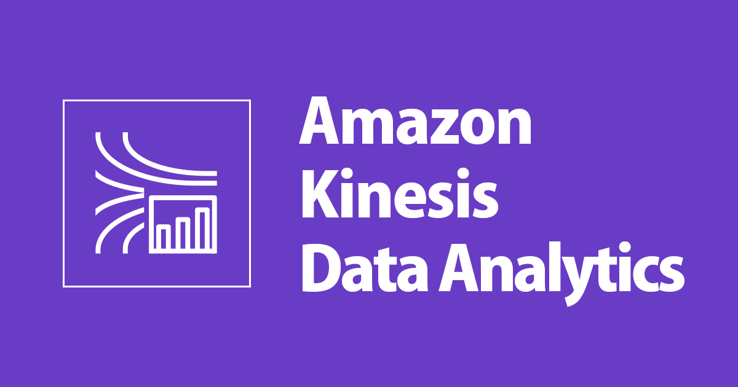
Kinesis Data Analytics
Amazon Kinesis Data Analytics is ideal for solving a wide range of streaming data use cases, including:
Streaming ETL for Internet-of-Things (IoT) with Apache Flink Applications
You can develop applications with Apache Flink libraries and use Amazon Kinesis Data Analytics to transform, aggregate, and filter streaming data from IoT devices such as consumer appliances, embedded sensors, and TV set-top boxes. You can then use the data to send real-time alerts when a sensor exceeds certain operating thresholds.
Real-time log analytics with SQL
You can stream billions of small messages to Amazon Kinesis Data Analytics and calculate key metrics, which you can then use to refresh content performance dashboards in real time and improve content performance.

Slide 12
Kinesis Analytics Benefits
Powerful real-time processing
Amazon Kinesis Data Analytics provides built-in functions to filter, aggregate, and transform streaming data for advanced analytics. It processes streaming data with sub-second latencies, enabling you to analyze and respond to incoming data and streaming events in real time.
No servers to manage
Amazon Kinesis Data Analytics is serverless; there are no servers to manage. It runs your streaming applications without requiring you to provision or manage any infrastructure. Amazon Kinesis Data Analytics automatically scales the infrastructure up and down as required to run your applications with low latency.
Pay only for what you use
With Amazon Kinesis Data Analytics, you pay only for the processing resources that your streaming applications use. There are no minimum fees or upfront commitments.

Slide 13
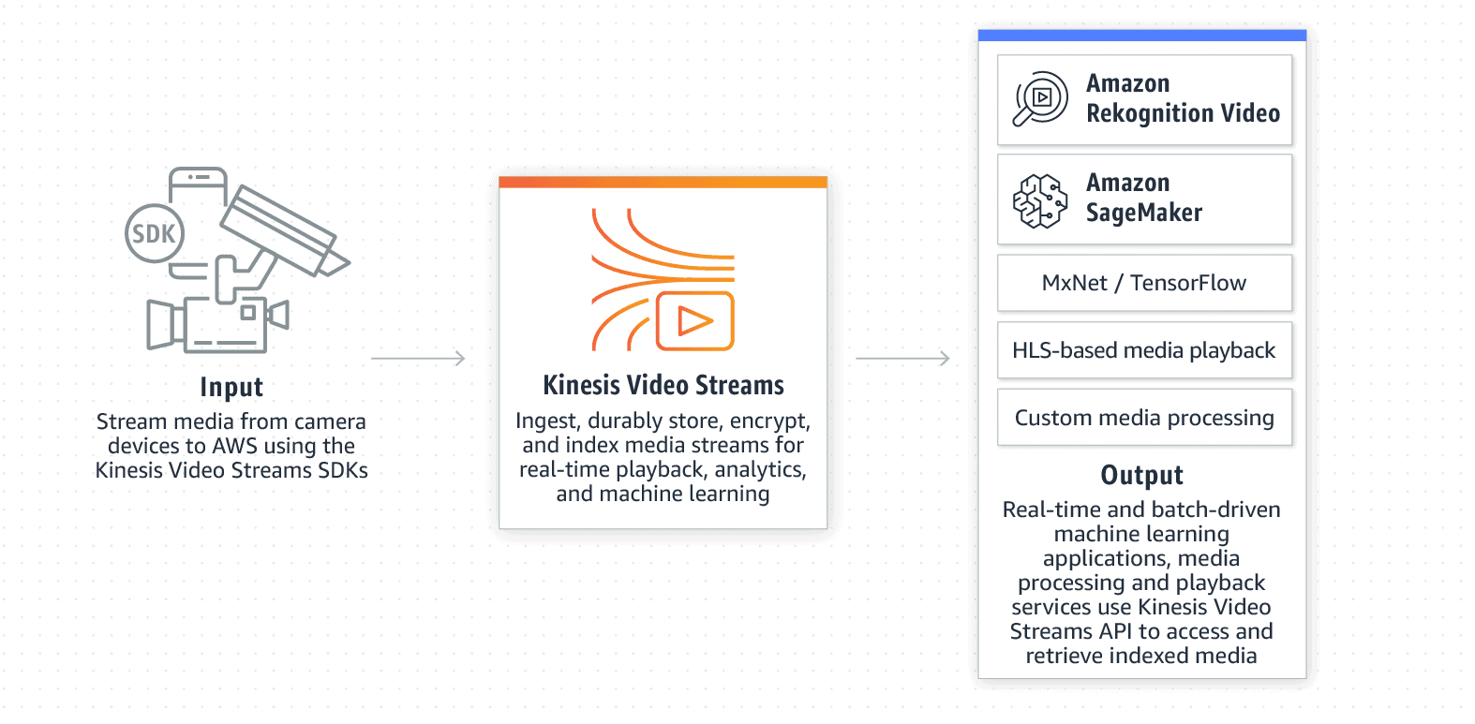
Kinesis video streams
You can use Amazon Kinesis Video Streams, a fully managed AWS service, to stream live video from devices to the AWS Cloud, or build applications for real-time video processing or batch-oriented video analytics.
Kinesis Video Streams isn't only storage for video data. You can use it to watch your video streams in real time as they are received in the cloud.
You can use Kinesis Video Streams to capture massive amounts of live video data from millions of sources. You can also send non-video, time-serialized data such as audio data, thermal imagery, depth data, and RADAR data.
You can also configure your Kinesis video stream to durably store media data for the specified retention period. Kinesis Video Streams automatically stores this data and encrypts it at rest.

Slide 14
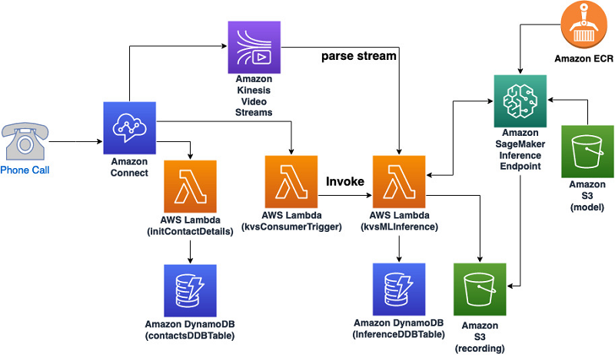
Kinesis video streams
Benefits of using Kinesis Video Streams include the following:
Connect and stream from millions of devices.
Durably store, encrypt, and index.
Focus on managing applications instead of infrastructure.
Build real-time and batch applications on data streams.
Stream data more securely.
Pay as you go.

Slide 15
Exam takeaway

