Slide 1
RDS
Amazon Relational Database Service (Amazon RDS) is a managed service that you can use to launch and manage relational databases on AWS.
Amazon RDS is an Online Transaction Processing (OLTP) type of database.
It is best suited to structured, relational data store requirements.
Amazon RDS supports the following database engines:
Amazon Aurora.
MySQL.
MariaDB.
Oracle.
SQL Server.
PostgreSQL.

Slide 2
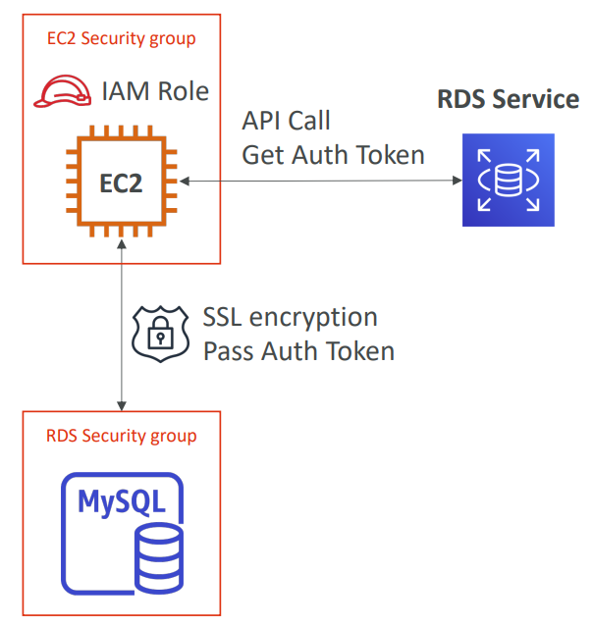
RDS IAM Authentication
IAM database authentication works with MySQL and PostgreSQL
You don’t need a password, just an authentication token obtained through IAM & RDS API calls
Auth token has a lifetime of 15 minutes
Benefits:
Network in/out must be encrypted using SSL
IAM to centrally manage users instead of DB
Can leverage IAM Roles and EC2 Instance profiles for easy integration

Slide 3
Performance
Amazon RDS uses EBS volumes (never uses instance store) for DB and log storage.
There are three storage types available: General Purpose (SSD), Provisioned IOPS (SSD), and Magnetic.
General Purpose (SSD):
Use for Database workloads with moderate I/O requirement.
Cost effective.
Also called gp2.
3 IOPS/GB.
Burst up to 3000 IOPS.
Provisioned IOPS (SSD):
Use for I/O intensive workloads.
Low latency and consistent I/O.
User specified IOPS (see table below).
Magnetic:
Not recommended anymore, available for backwards compatibility.
Doesn’t allow you to scale storage when using the SQL Server database engine.
Doesn’t support elastic volumes.
Limited to a maximum size of 4 TiB.
Limited to a maximum of 1,000 IOPS.

Slide 4
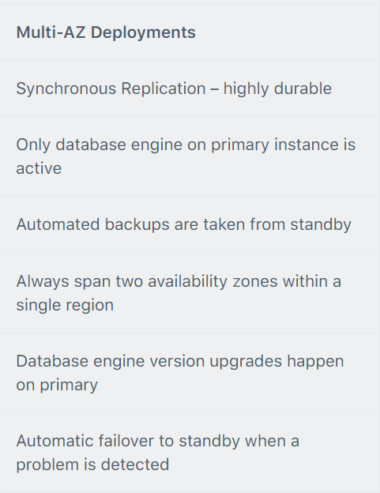
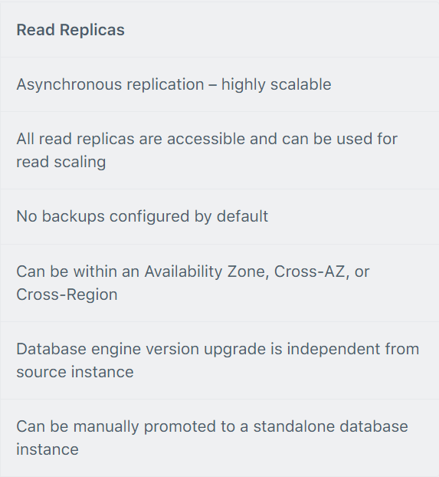
Multi-AZ and Read Replicas
Multi-AZ and Read Replicas are used for high availability, fault tolerance and performance scaling.
The table below compares multi-AZ deployments to Read Replicas:

Slide 5
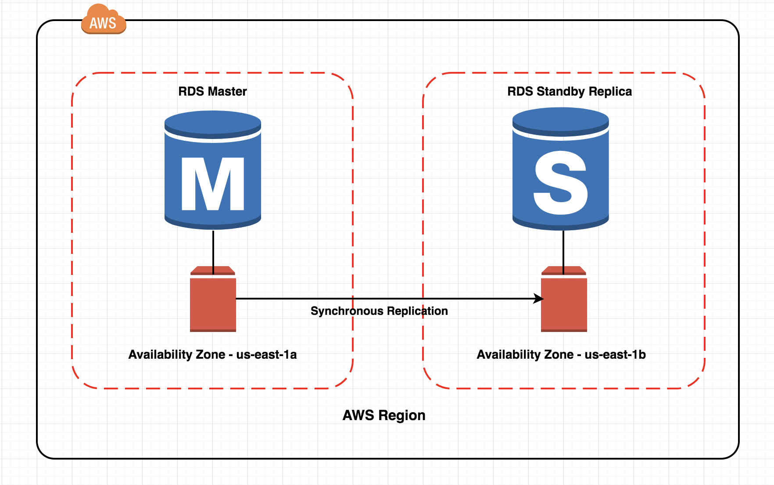
RDS Multi AZ
Multi-AZ RDS creates a replica in another AZ and synchronously replicates to it.
There is an option to choose multi-AZ during the launch wizard.
AWS recommends the use of provisioned IOPS storage for multi-AZ RDS DB instances.
Each AZ runs on its own physically distinct, independent infrastructure, and is engineered to be highly reliable.
You cannot choose which AZ in the region will be chosen to create the standby DB instance.

Slide 6
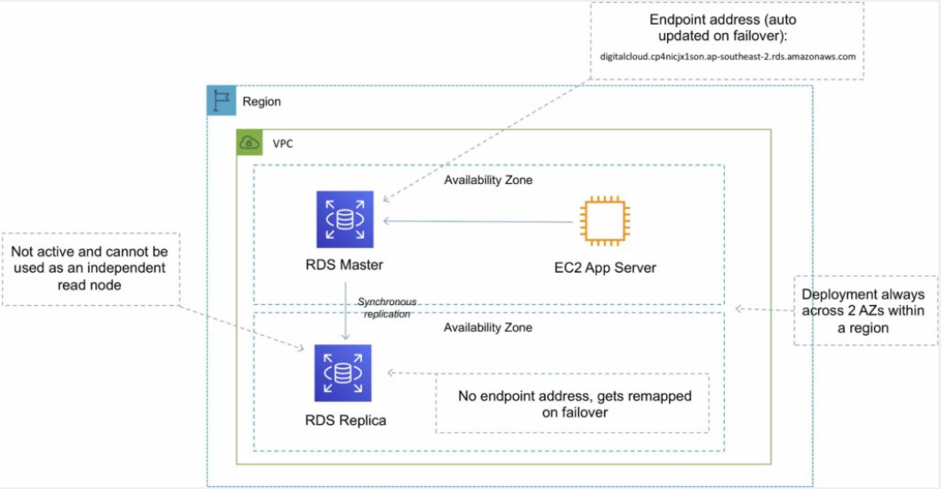
RDS Multi AZ

Slide 7
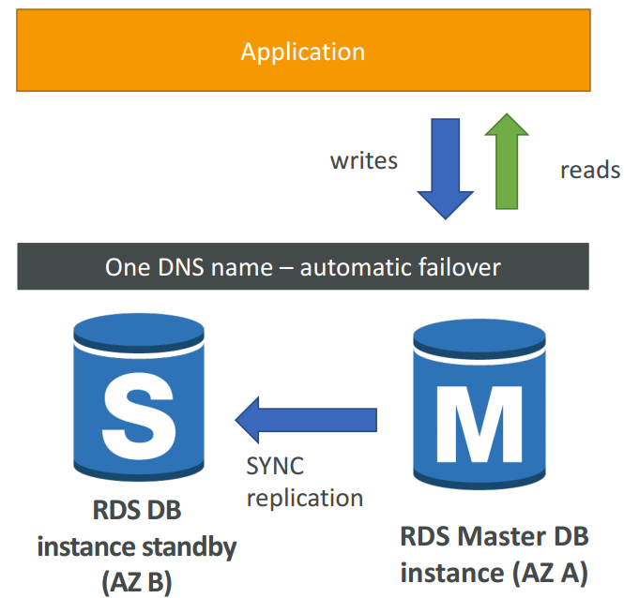
RDS Multi AZ (Disaster Recovery)
SYNC replication
One DNS name – automatic app failover to standby
Increase availability
Failover in case of loss of AZ, loss of network, instance or storage failure
No manual intervention in apps
Not used for scaling
Multi-AZ replication is free
Note : The Read Replicas be setup as Multi AZ for Disaster Recovery (DR)

Slide 8
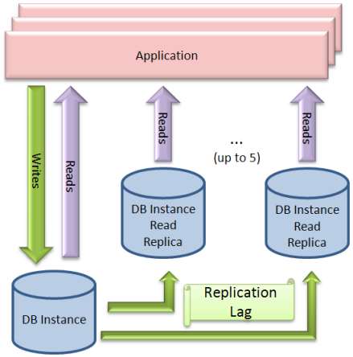
RDS Read Replicas
Read replicas are used for read-heavy DBs and replication is asynchronous.
Read replicas are for workload sharing and offloading.
Read replicas provide read-only DR.
Read replicas are created from a snapshot of the master instance.
You can have 5 read replicas of a production DB.

Slide 9
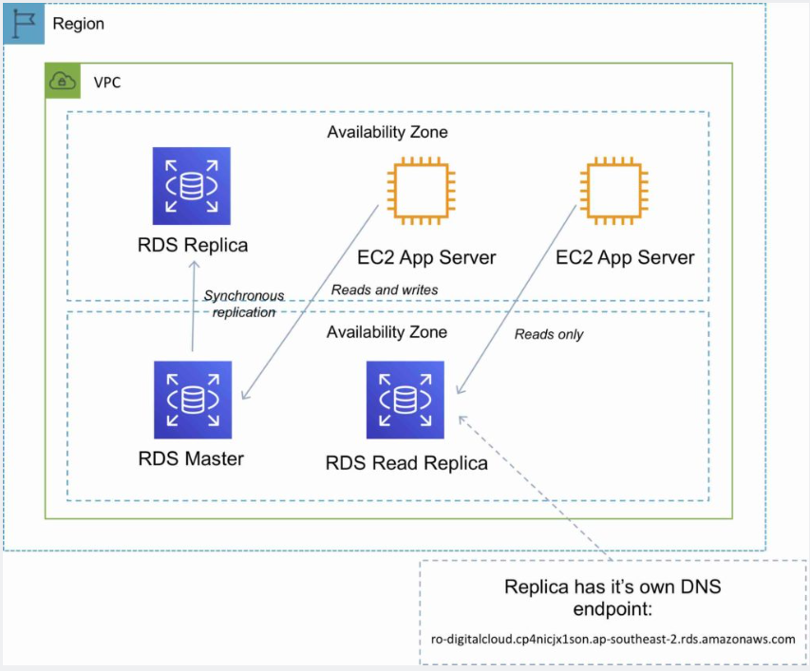
RDS Read Replicas

Slide 10
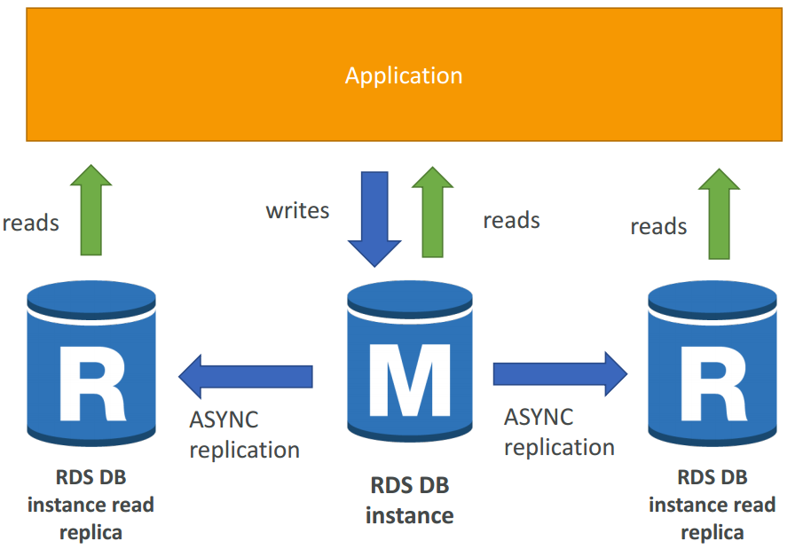
RDS Read Replicas for read scalability
Up to 5 Read Replicas
Within AZ, Cross AZ or Cross Region
Replication is ASYNC, so reads are eventually consistent
Replicas can be promoted to their own DB
Applications must update the connection string to leverage read replicas

Slide 11
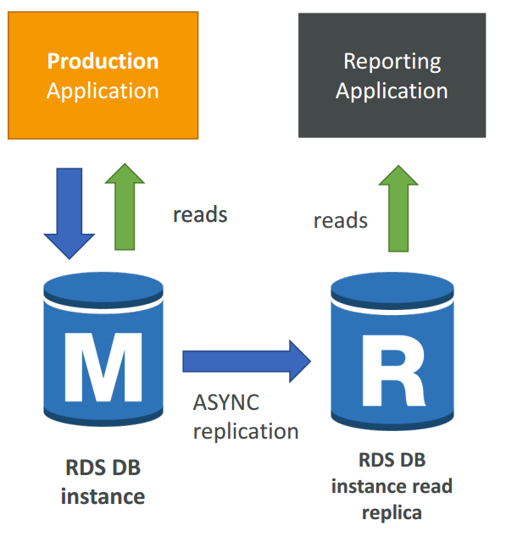
RDS Read Replicas – Use Cases
You have a production database that is taking on normal load
You want to run a reporting application to run some analytics
You create a Read Replica to run the new workload there
The production application is unaffected
Read replicas are used for SELECT (=read) only kind of statements (not INSERT, UPDATE, DELETE)

Slide 12
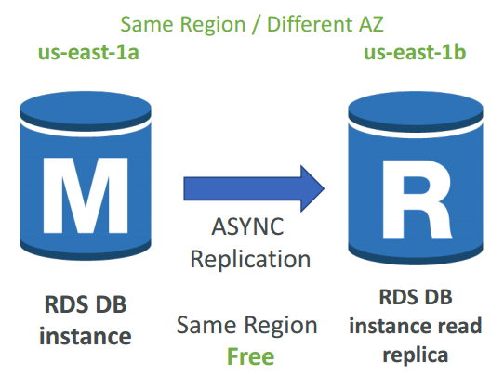
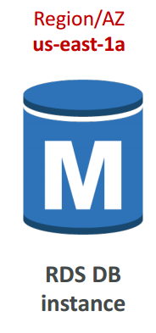
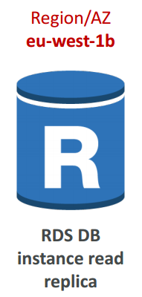
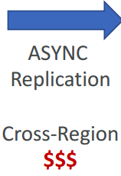
RDS Read Replicas – Network Cost
In AWS there’s a network cost when data goes from one AZ to another
For RDS Read Replicas within the same region, you don’t pay that fee

Slide 13
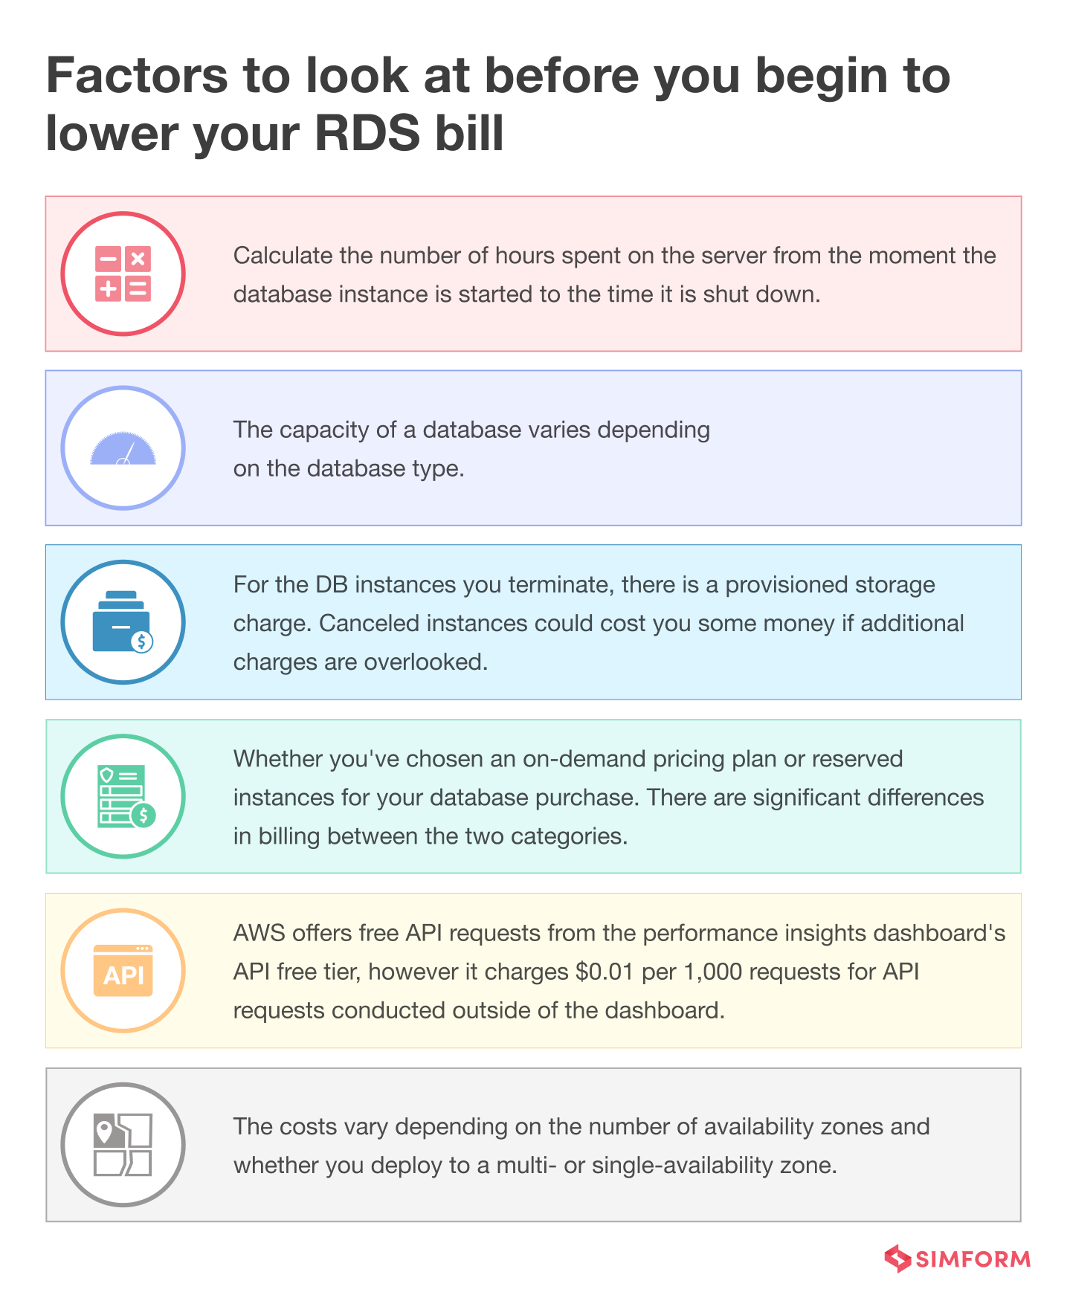
RDS - Billing and Provisioning
AWS Charge for:
DB instance hours (partial hours are charged as full hours).
Storage GB/month.
I/O requests/month – for magnetic storage.
Provisioned IOPS/month – for RDS provisioned IOPS SSD.
Egress data transfer.
Backup storage (DB backups and manual snapshots).
For multi-AZ you are charged for:
Multi-AZ DB hours.
Provisioned storage.
Double write I/Os.

Slide 14
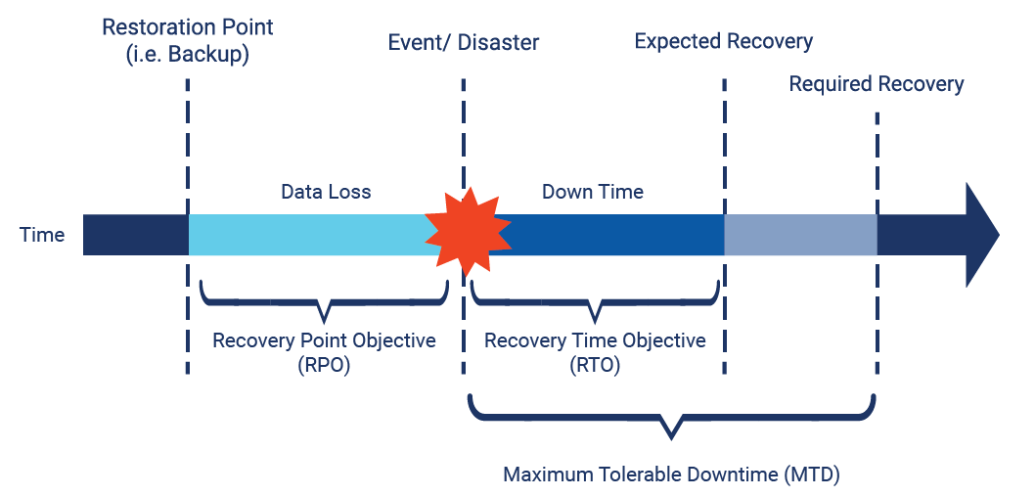
RDS Disaster Recovery: RTO & RPO
Recovery Time Objective (RTO)
RTO - can be understood as the amount of time after a disaster in which business operation is retaken, or resources are again available for use.
For example, if the RTO is 2 hours, then it means you want to resume delivery of products or services, or execution of activities, in 2 hours.
Recovery Point Objective (RPO)
RPO, can be understood the best if you ask yourself, for a given operation,
how much data loss can you afford in terms of time or in terms of amount of information.

Slide 15
RDS Disaster Recovery
 | RTO | RPO | Cost | Scope
Automated backups | Good | Better | Low | Single Region
Manual snapshots | Better | Good | Medium | Cross-Region
Read replicas | Best | Best | High | Cross-Region
Replica Lag - amount of time that replica is behind source DB
Replica lag can impact your recovery
Failover to an RDS Read Replica is a manual process

Slide 16
Rds Hands on
How to create DB
How to create read Replica
How to make failover?

Slide 17
RDS take away
Engines:
Amazon Aurora.
MySQL.
MariaDB.
Oracle.
SQL Server.
PostgreSQL.
The Amazon RDS managed service includes the following:
Security and patching of the DB instances.
Automated backup for the DB instances.
Software updates for the DB engine.
Easy scaling for storage and compute.
Multi-AZ option with synchronous replication.
Automatic failover for Multi-AZ option.
Read replicas option for read heavy workloads.
You can have 5 read replicas of a production DB
IAM Authentication
When using encryption at rest the following elements are also encrypted:
All DB snapshots.
Backups.
DB instance storage.
Read Replicas.
You cannot encrypt an existing DB, you need to create a snapshot, copy it, encrypt the copy, then build an encrypted DB from the snapshot.
Multi AZ & Read Replicas

Slide 18
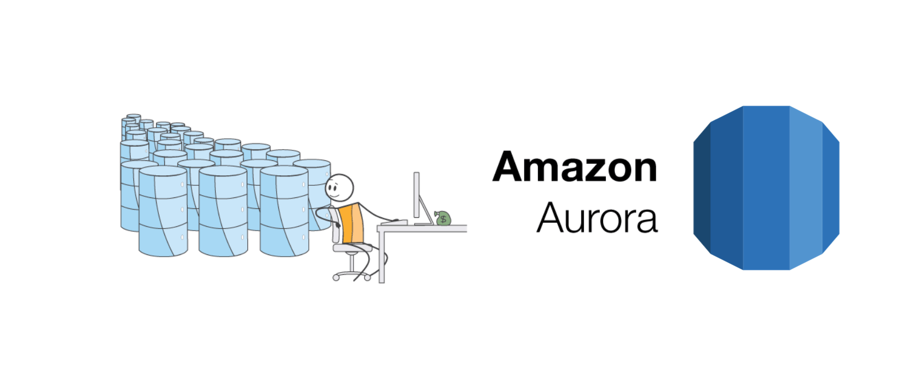
Amazon Aurora
Amazon Aurora is a relational database service that combines the speed and availability of high-end commercial databases with the simplicity and cost-effectiveness of open-source databases.
AWS proprietary database!
Fully managed service, high performance, low price.
Can handle the loss of up to two copies of data without affecting DB write availability and up to three copies without affecting read availability.
Aurora is “AWS cloud optimized” and claims 5x performance improvement over MySQL on RDS, over 3x the performance of Postgres on RDS
Aurora costs more than RDS (20% more) – but is more efficient.

Slide 19
Amazon Aurora DB clusters
An Amazon Aurora DB cluster consists of one or more DB instances and a cluster volume that manages the data for those DB instances. An Aurora cluster volume is a virtual database storage volume that spans multiple Availability Zones, with each Availability Zone having a copy of the DB cluster data.
Two types of DB instances make up an Aurora DB cluster:
Primary DB instance – Supports read and write operations, and performs all of the data modifications to the cluster volume. Each Aurora DB cluster has one primary DB instance.
Aurora Replica – Connects to the same storage volume as the primary DB instance and supports only read operations.
Maintain high availability by locating Aurora Replicas in separate Availability Zones.
Aurora automatically fails over to an Aurora Replica in case the primary DB instance becomes unavailable.

Slide 20
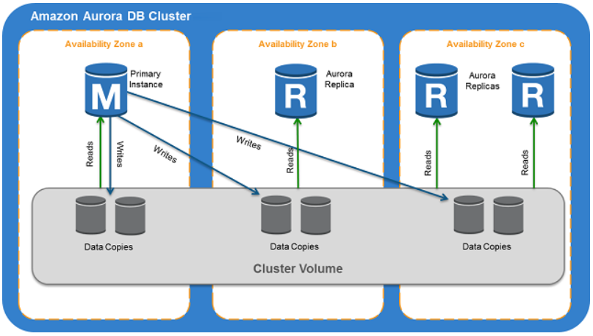
Amazon Aurora DB clusters
The following diagram illustrates the relationship between the cluster volume, the primary DB instance, and Aurora Replicas in an Aurora DB cluster.

Slide 21
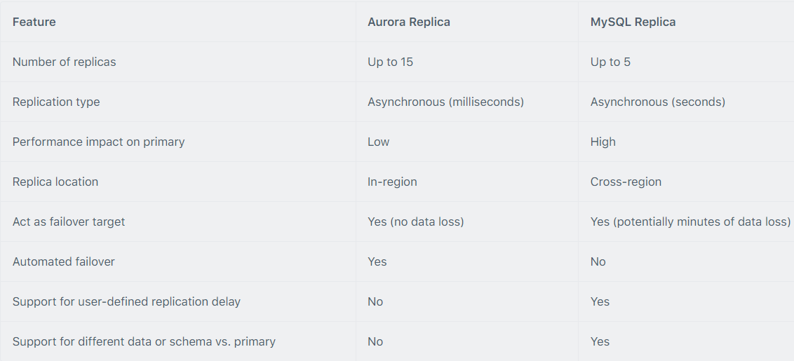
Aurora Replicas
There are two types of replication: Aurora replica (up to 15), MySQL Read Replica (up to 5).
You can create read replicas for an Amazon Aurora database in up to 5 AWS regions. This capability is available for Amazon Aurora with MySQL compatibility.
The table below describes the differences between the two replica options:

Slide 22
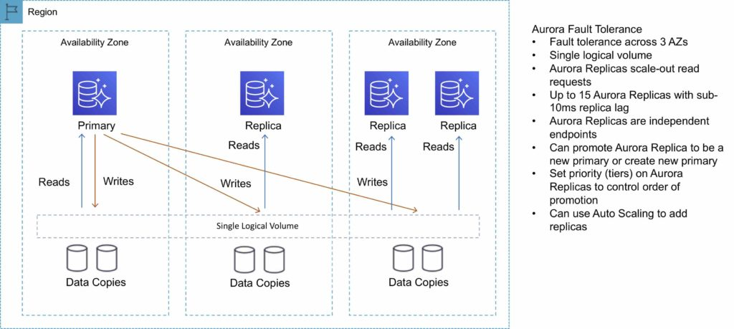
Aurora Replicas

Slide 23
Types of Aurora endpoints
A cluster endpoint (or writer endpoint) for an Aurora DB cluster connects to the current primary DB instance for that DB cluster.
This endpoint is the only one that can perform write operations.
Because of this, the cluster endpoint is the one that you connect to when you first set up a cluster or when your cluster only contains a single DB instance.
Each Aurora DB cluster has one cluster endpoint and one primary DB instance.
A reader endpoint for an Aurora DB cluster provides load-balancing support for read-only connections to the DB cluster.
Use the reader endpoint for read operations, such as queries. By processing those statements on the read-only Aurora Replicas, this endpoint reduces the overhead on the primary instance.
It also helps the cluster to scale the capacity to handle simultaneous SELECT queries, proportional to the number of Aurora Replicas in the cluster.
Each Aurora DB cluster has one reader endpoint.
A custom endpoint for an Aurora cluster represents a set of DB instances that you choose.
When you connect to the endpoint, Aurora performs load balancing and chooses one of the instances in the group to handle the connection.
You define which instances this endpoint refers to, and you decide what purpose the endpoint serves.

Slide 24
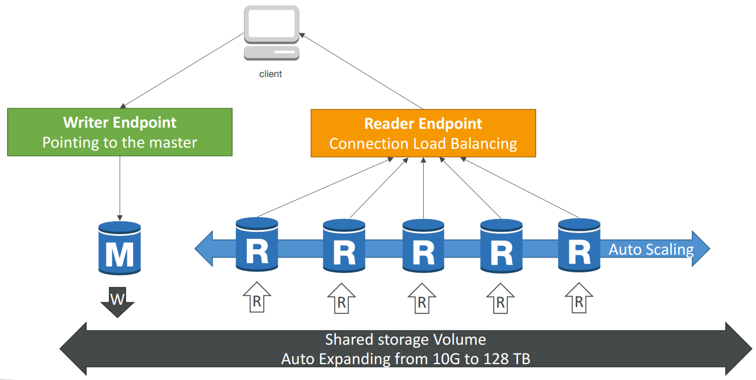
Aurora writer and reader endpoint

Slide 25
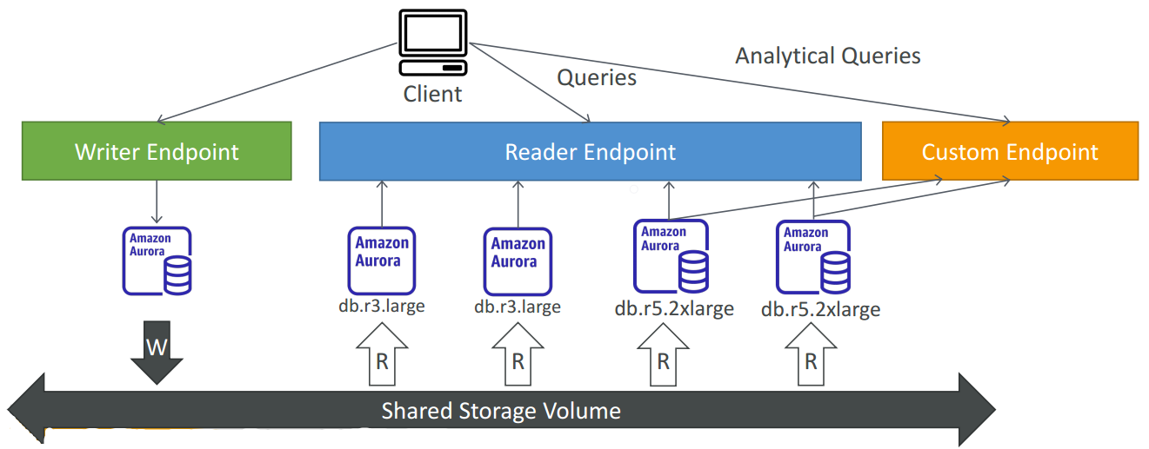
Custom endpoint

Slide 26
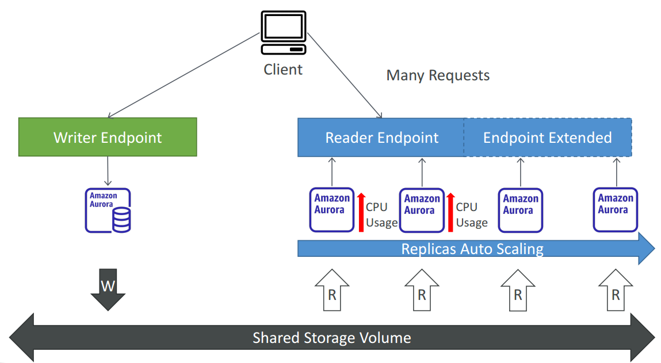
Aurora Replicas - auto scaling

Slide 27
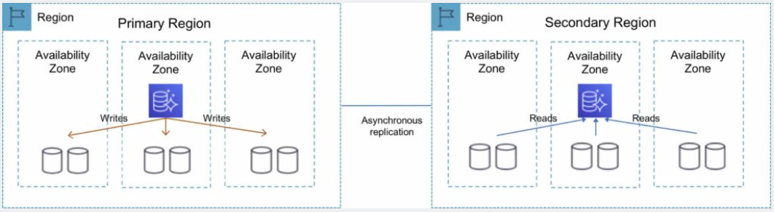
Amazon Aurora Global Database
Amazon Aurora Global Database is designed for globally distributed applications, allowing a single Amazon Aurora database to span multiple AWS Regions.
It replicates your data with no impact on database performance, enables fast local reads with low latency in each Region, and provides disaster recovery from Region-wide outages.
You can use a secondary region as a backup option in case you need to recover quickly from a regional degradation or outage.
A database in a secondary region can be promoted to full read/write capabilities in less than 1 minute.

Slide 28
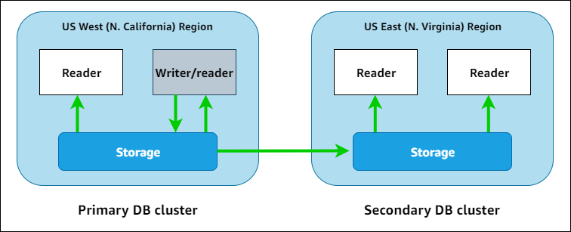
Amazon Aurora Global Database
Aurora Global Database (recommended):
1 Primary Region (read / write)
Up to 5 secondary (read-only) regions, replication lag is less than 1 second
Up to 16 Read Replicas per secondary region
Helps for decreasing latency
Promoting another region (for disaster recovery) has an RTO of < 1 minute
Typical cross-region replication takes less than 1 second

Slide 29
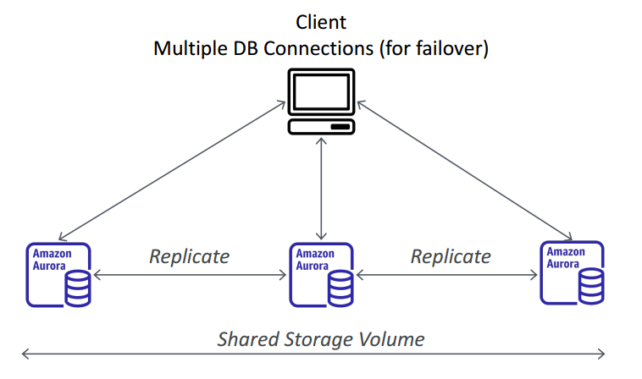
Amazon Aurora Multi-Master
Amazon Aurora Multi-Master is a new feature of the Aurora MySQL-compatible edition that adds the ability to scale out write performance across multiple Availability Zones, allowing applications to direct read/write workloads to multiple instances in a database cluster and operate with higher availability.
Aurora Multi-Master is designed to achieve high availability and ACID transactions across a cluster of database nodes with configurable read after write consistency.
Every node does R/W - vs promoting a RR as the new master.

Slide 30
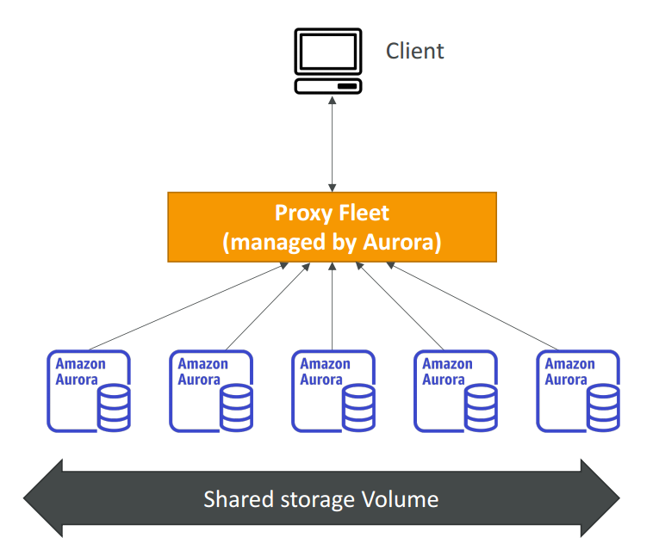
Aurora Serverless
Amazon Aurora Serverless is an on-demand, auto-scaling configuration for Amazon Aurora.
Available for MySQL-compatible and PostgreSQL-compatible editions.
The database automatically starts up, shuts down, and scales capacity up or down based on application needs.
It enables you to run a database in the cloud without managing any database instances. It’s a simple, cost-effective option for infrequent, intermittent, or unpredictable workloads.
You simply create a database endpoint and optionally specify the desired database capacity range and connect applications.
No capacity planning needed

Slide 31
Restoring a DB cluster to a specified time
You can restore a DB cluster to a specific point in time, creating a new DB cluster.
When you restore a DB cluster to a point in time, you can choose the default virtual private cloud (VPC) security group. Or you can apply a custom VPC security group to your DB cluster.
Restored DB clusters are automatically associated with the default DB cluster and DB parameter groups. However, you can apply custom parameter groups by specifying them during a restore.
Amazon Aurora uploads log records for DB clusters to Amazon S3 continuously. To see the latest restorable time for a DB cluster, use the AWS CLI describe-db-clusters command and look at the value returned in the LatestRestorableTime field for the DB cluster.
You can restore to any point in time within your backup retention period. To see the earliest restorable time for a DB cluster, use the AWS CLI describe-db-clusters command and look at the value returned in the EarliestRestorableTime field for the DB cluster.

Slide 32
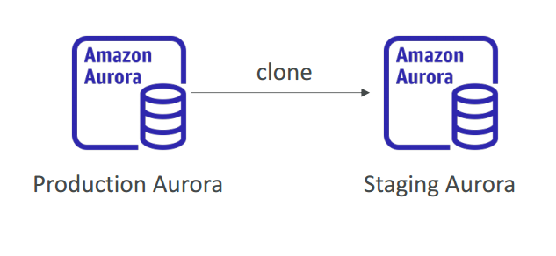
Aurora Cloning
By using Aurora cloning, you can create a new cluster that uses the same Aurora cluster volume and has the same data as the original.
The process is designed to be fast and cost-effective.
The new cluster with its associated data volume is known as a clone.
Creating a clone is faster and more space-efficient than physically copying the data using other techniques, such as restoring a snapshot.
The new DB cluster uses the same cluster volume and data as the original but will change when data updates are made
Useful to create a “staging” database from a “production” database without impacting the production database

Slide 33
Aurora Hands On
How to create aurora cluster?
How to create serverless cluster?

Slide 34
Aurora take away
2 copies of data are kept in each AZ with a minimum of 3 AZ’s (6 copies).
Aurora replica (up to 15),
Cross-region read replicas allow you to improve your disaster recovery posture, scale read operations in regions closer to your application users, and easily migrate from one region to another.
For globally distributed applications you can use Global Database, where a single Aurora database can span multiple AWS regions to enable fast local reads and quick disaster recovery.
Aurora Auto Scaling dynamically adjusts the number of Aurora Replicas provisioned for an Aurora DB cluster using single-master replication.
Amazon Aurora Serverless is an on-demand, auto-scaling configuration for Amazon Aurora.
Available for MySQL-compatible and PostgreSQL-compatible editions.
The database automatically starts up, shuts down, and scales capacity up or down based on application needs.
Amazon Aurora’s backup capability enables point-in-time recovery for your instance. This allows you to restore your database to any second during your retention period, up to the last five minutes.
There are two methods to backup and restore RDS DB instances:
Amazon RDS automated backups.
User initiated manual backups

