Slide 2
CloudFront
About CloudFront
Edge Locations and Regional Edge Caches
Origins
Distributions
Cache
Lambda@Edge
Signed URLs and Signed Cookies
Origin Access Identity
Security
Domain Names
Monitoring and Reporting
Logging and Auditing
Price

Slide 3
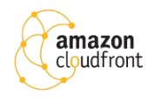
CloudFront
CloudFront is a web service that gives businesses and web application developers an easy and cost-effective way to distribute content with low latency and high data transfer speeds.
CloudFront is a good choice for distribution of frequently accessed static content that benefits from edge delivery—like popular website images, videos, media files or software downloads.
CloudFront means Content Delivery Network (CDN), improves read performance, content is cached at the edge
Used for dynamic, static, streaming, and interactive content.
CloudFront supports wildcard CNAME.
Supports wildcard SSL certificates, Dedicated IP, Custom SSL and SNI Custom SSL (cheaper).
Supports Perfect Forward Secrecy which creates a new private key for each SSL session.

Slide 4
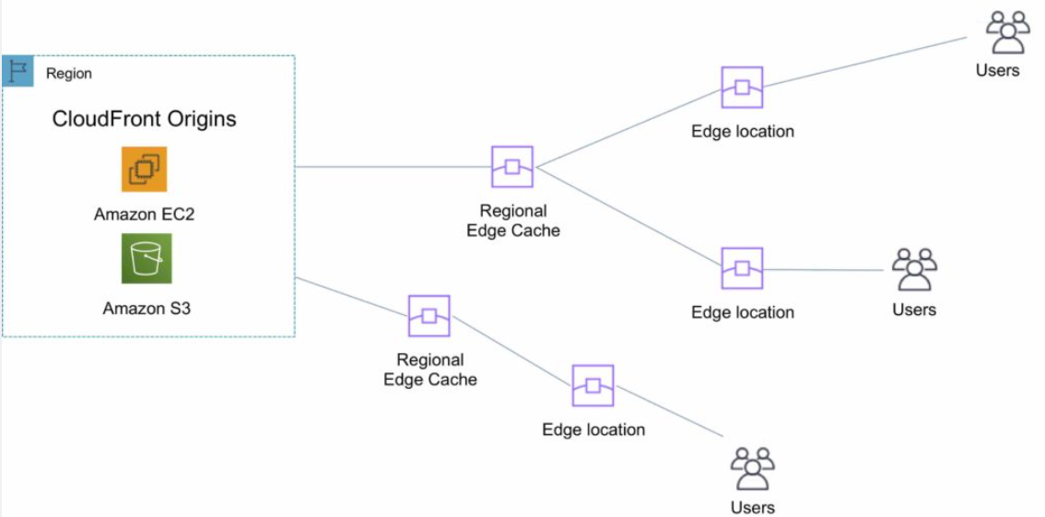
Edge Locations and Regional Edge Caches
An edge location is the location where content is cached (separate to AWS regions/AZs).
Requests are automatically routed to the nearest edge location.
Edge locations are not tied to Availability Zones or regions.
Regional Edge Caches are located between origin web servers and global edge locations and have a larger cache.
Regional Edge caches aim to get content closer to users.
Proxy methods PUT/POST/PATCH/OPTIONS/DELETE go directly to the origin from the edge locations and do not proxy through Regional Edge caches.
Dynamic content goes straight to the origin and does not flow through Regional Edge caches.
Edge locations are not just read only, you can write to them too.

Slide 5
Origins
An origin is the origin of the files that the CDN will distribute.
Origins can be either an S3 bucket, an EC2 instance, an Elastic Load Balancer, or Route 53 – can also be external (non-AWS).
When using Amazon S3 as an origin you place all your objects within the bucket.
You can use an existing bucket and the bucket is not modified in any way.
By default all newly created buckets are private.
You can setup access control to your buckets using:
Bucket policies.
Access Control Lists.
You can make objects publicly available or use CloudFront signed URLs.
Custom Origin (HTTP)
Application Load Balancer
EC2 instance
S3 website (must first enable the bucket as a static S3 website)
Any HTTP backend you want
Objects are cached for 24 hours by default.
The expiration time is controlled through the TTL.
The minimum expiration time is 0.

Slide 6
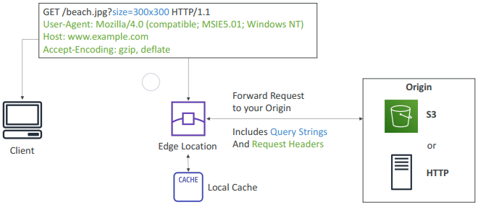
CloudFront at a high level

Slide 7
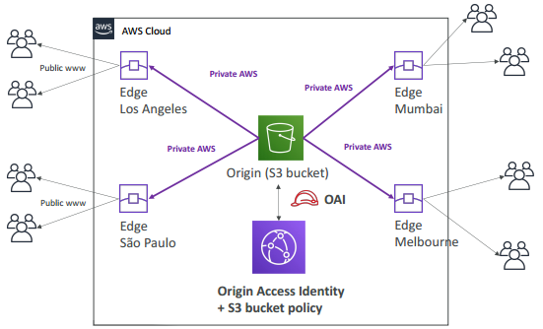
CloudFront – S3 as an Origin

Slide 8
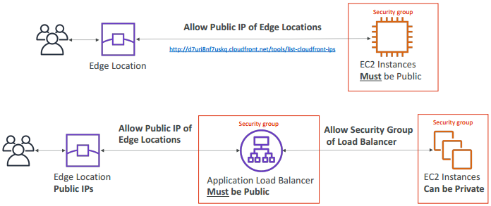
CloudFront – ALB or EC2 as an origin

Slide 9
CloudFront - Distributions
To distribute content with CloudFront you need to create a distribution.
There are two types of distribution.
Web Distribution:
Static and dynamic content including .html, .css, .php, and graphics files.
Distributes files over HTTP and HTTPS.
Add, update, or delete objects, and submit data from web forms.
Use live streaming to stream an event in real time.
RTMP:
Distribute streaming media files using Adobe Flash Media Server’s RTMP protocol.
Allows an end user to begin playing a media file before the file has finished downloading from a CloudFront edge location.
Files must be stored in an S3 bucket.

Slide 10
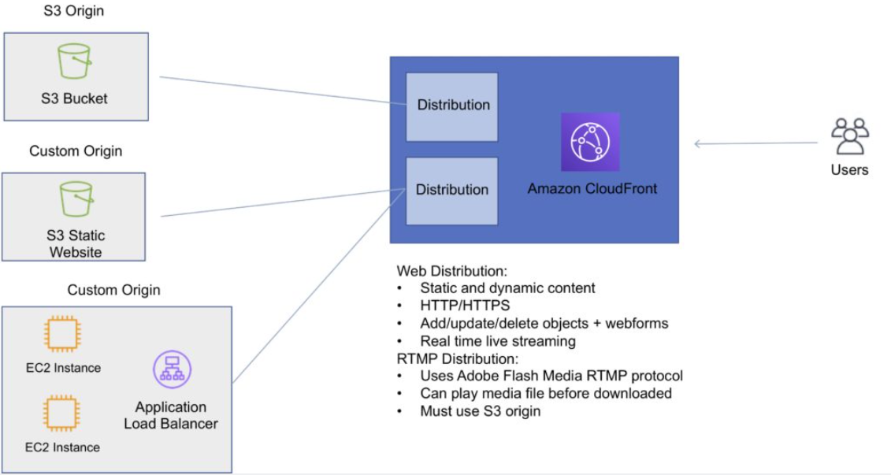
The diagram below depicts Amazon CloudFront Distributions and Origins:

Slide 11
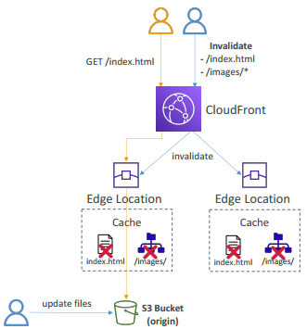
CloudFront - Cache Behavior
Allows you to configure a variety of CloudFront functionality for a given URL path pattern.
For each cache behavior you can configure the following functionality:
The path pattern (e.g. /images/*.jpg, /images*.php).
The origin to forward requests to (if there are multiple origins).
Whether to forward query strings.
Whether to require signed URLs.
Allowed HTTP methods.
Minimum amount of time to retain the files in the CloudFront cache (regardless of the values of any cache-control headers).
The default cache behavior only allows a path pattern of /*.
Additional cache behaviors need to be defined to change the path pattern following creation of the distribution.
A special type of user called an Origin Access Identity (OAI) can be used to restrict access to content in an Amazon S3 bucket.
By using an OAI you can restrict users so they cannot access the content directly using the S3 URL, they must connect via CloudFront.

Slide 12
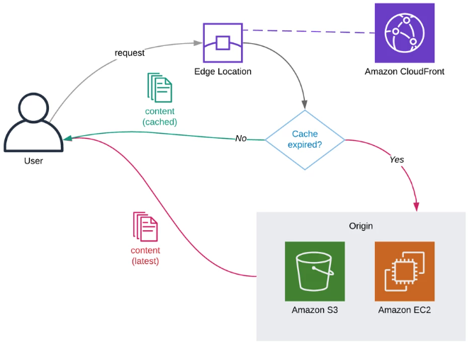
CloudFront - Cache Behavior
You can define the viewer protocol policy:
HTTP and HTTPS.
Redirect HTTP to HTTPS.
HTTPS only.
You can define the Allowed HTTP Methods:
GET, HEAD.
GET, HEAD, OPTIONS.
GET, HEAD, OPTIONS, PUT, POST, PATCH, DELETE.

Slide 13
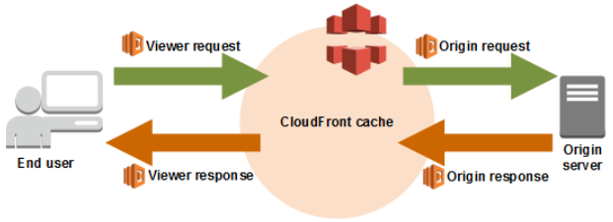
Lambda@Edge
For each cache behavior in a Amazon CloudFront distribution, you can add up to four triggers (associations) that cause a Lambda function to execute when one or more of the following CloudFront events occur:
CloudFront Viewer Request – The function executes when CloudFront receives a request from a viewer and before it checks to see whether the requested object is in the edge cache
CloudFront Origin Request – The function executes only when CloudFront forwards a request to your origin. When the requested object is in the edge cache, the function doesn’t execute.
CloudFront Origin Response – The function executes after CloudFront receives a response from the origin and before it caches the object in the response.
CloudFront Viewer Response – The function executes before returning the requested object to the viewer. The function executes regardless of whether the object is already in the edge cache.

Slide 14
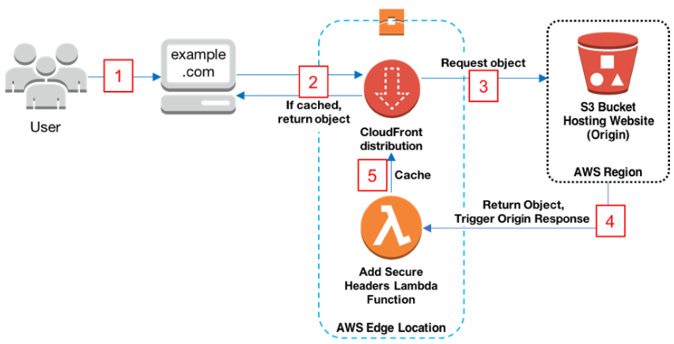
Lambda@Edge
The following diagram illustrates the sequence of events for triggering our Lambda@Edge function:
Here is how the process works:
Viewer requests website www.example.com.
If the object is cached already, CloudFront returns the object from the cache to the viewer, otherwise it moves on to step 3.
CloudFront requests the object from the origin, in this case an S3 bucket.
S3 returns the object, which in turn causes CloudFront to trigger the origin response event.
Our Add Security Headers Lambda function triggers, and the resulting output is cached and served by CloudFront.

Slide 15
Lambda@Edge
Lambda@Edge can do the following:
Inspect cookies and rewrite URLs to perform A/B testing.
Send specific objects to your users based on the User-Agent header.
Implement access control by looking for specific headers before passing requests to the origin.
Add, drop, or modify headers to direct users to different cached objects.
Generate new HTTP responses.
Cleanly support legacy URLs.
Modify or condense headers or URLs to improve cache utilization.
Make HTTP requests to other Internet resources and use the results to customize responses.
Exam tip: Lambda@Edge can be used to load different resources based on the User-Agent HTTP header.

Slide 16
CloudFront - Restrictions
Blacklists and whitelists can be used for geography – you can only use one at a time.
Whitelist: Allow your users to access your content only if they're in one of the countries on a list of approved countries.
Blacklist: Prevent your users from accessing your content if they're in one of the countries on a blacklist of banned countries
There are two options available for geo-restriction (geo-blocking):
Use the CloudFront geo-restriction feature (use for restricting access to all files in a distribution and at the country level).
Use a 3rd party geo-location service (use for restricting access to a subset of the files in a distribution and for finer granularity at the country level).

Slide 17
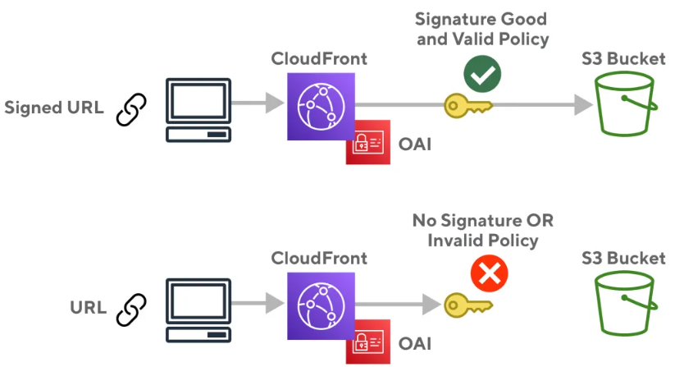
CloudFront - Signed URLs and Signed Cookies
A signed URL includes additional information, for example, an expiration date and time, that gives you more control over access to your content. This additional information appears in a policy statement, which is based on either a canned policy or a custom policy.
CloudFront signed cookies allow you to control who can access your content when you don’t want to change your current URLs or when you want to provide access to multiple restricted files, for example, all the files in the subscribers’ area of a website.
Application must authenticate user and then send three Set-Cookie headers to the viewer; the viewer stores the name-value pair and adds them to the request in a Cookie header when requesting access to content.

Slide 18
CloudFront - Signed URLs and Signed Cookies : Use cases
Use signed URLs in the following cases:
You want to restrict access to individual files, for example, an installation download for your application.
Your users are using a client (for example, a custom HTTP client) that doesn’t support cookies.
Use signed cookies in the following cases:
You want to provide access to multiple restricted files, for example, all the files for a video in HLS format or all the files in the subscribers’ area of website.
You don’t want to change your current URLs.

Slide 19
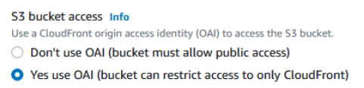
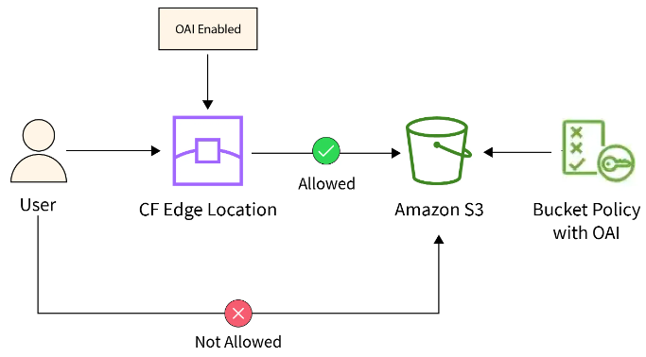
CloudFront Origin Access Identity
Amazon CloudFront OAI is a simple function of CloudFront distribution that you can enable when you select S3 buckets as origin. If you don’t use an OAI, the S3 bucket must allow public access.
Used in combination with signed URLs and signed cookies to restrict direct access to an S3 bucket (prevents bypassing the CloudFront controls).
An origin access identity (OAI) is a special CloudFront user that is associated with the distribution.
Permissions must then be changed on the Amazon S3 bucket to restrict access to the OAI.
If users request files directly by using Amazon S3 URLs, they’re denied access.
The origin access identity has permission to access files in your Amazon S3 bucket, but users don’t.

Slide 20
CloudFront - Security
PCI DSS compliant but recommended not to cache credit card information at edge locations.
HIPAA compliant as a HIPAA eligible service.
Distributed Denial of Service (DDoS) protection:
CloudFront distributes traffic across multiple edge locations and filters requests to ensure that only valid HTTP(S) requests will be forwarded to backend hosts. CloudFront also supports geo-blocking, which you can use to prevent requests from geographic locations from being served.

Slide 21
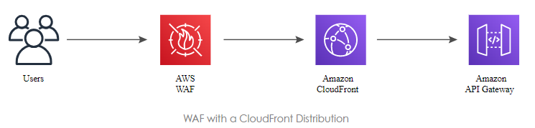
CloudFront with WAF
AWS WAF is a web application firewall that lets you monitor HTTP and HTTPS requests that are forwarded to CloudFront and lets you control access to your content.
With AWS WAF you can shield access to content based on conditions in a web access control list (web ACL) such as:
Origin IP address.
Values in query strings.
CloudFront responds to requests with the requested content or an HTTP 403 status code (forbidden).
CloudFront can also be configured to deliver a custom error page.
Need to associate the relevant distribution with the web ACL.

Slide 22
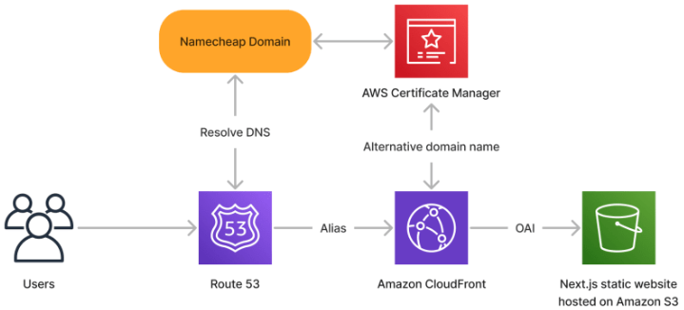
CloudFront - Domain Names
CloudFront typically creates a domain name such as a232323.cloudfront.net.
Alternate domain names can be added using an alias record (Route 53).
For other service providers use a CNAME (cannot use the zone apex with CNAME).
Moving domain names between distributions:
You can move subdomains yourself.
For the root domain you need to use AWS support.

Slide 23
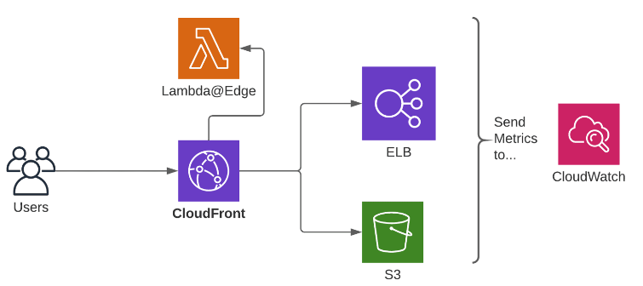
CloudFront Monitoring
When using CloudFront, your architecture looks similar to the following diagram. All of this you can monitoring with CloudWatch.
CloudFront, the Content Delivery Network.
S3 or ELB, the origins of your content.
Lambda@Edge (optional),
CloudWatch collects metrics from all AWS services.

Slide 24
CloudFront - Logging and Auditing
You can configure CloudFront to create log files that contain detailed information about every user request that CloudFront receives. These are called standard logs, also known as access logs. If you enable standard logs, you can also specify the Amazon S3 bucket that you want CloudFront to save files in.
You can enable standard logs when you create or update a distribution.
S3 buckets can be configured to create access logs and cookie logs which log all requests made to the S3 bucket.
Amazon Athena can be used to analyze access logs.
CloudFront is integrated with CloudTrail.
CloudTrail saves logs to the S3 bucket you specify.
CloudTrail captures information about all requests whether they were made using the CloudFront console, the CloudFront API, the AWS SDKs, the CloudFront CLI, or another service.
CloudTrail can be used to determine which requests were made, the source IP address, who made the request etc.
To view CloudFront requests in CloudTrail logs you must update an existing trail to include global services.

Slide 25
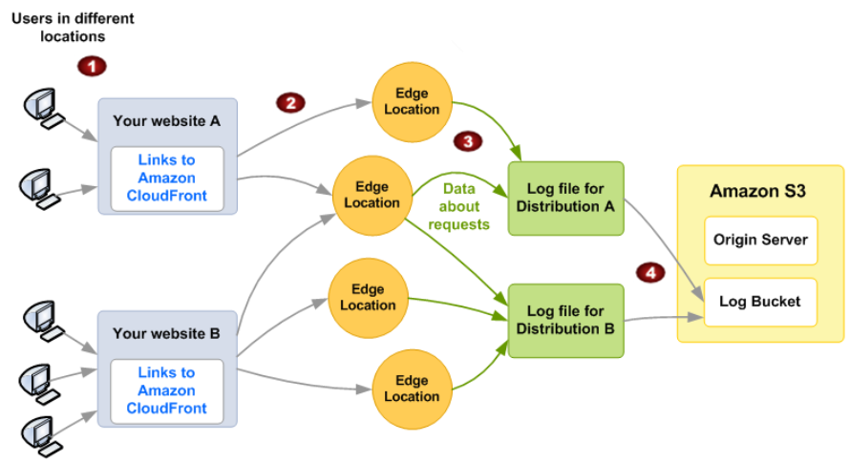
CloudFront - Logging and Auditing
The following diagram shows how CloudFront logs information about requests for your objects.
In this diagram, you have two websites, A and B, and two corresponding CloudFront distributions. Users request your objects using URLs that are associated with your distributions.
CloudFront routes each request to the appropriate edge location.
CloudFront writes data about each request to a log file specific to that distribution. In this example, information about requests related to Distribution A goes into a log file just for Distribution A, and information about requests related to Distribution B goes into a log file just for Distribution B.
CloudFront periodically saves the log file for a distribution in the Amazon S3 bucket that you specified when you enabled logging. CloudFront then starts saving information about subsequent requests in a new log file for the distribution.

Slide 26
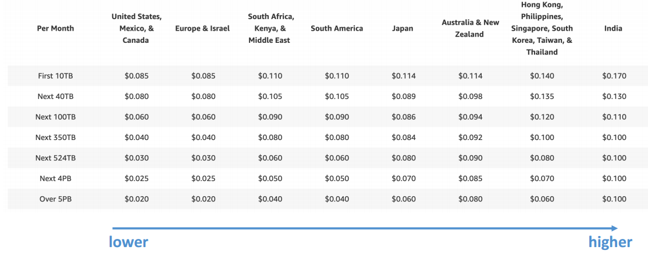
CloudFront - Pricing
CloudFront Edge locations are all around the world
The cost of data out per edge location varies

Slide 27
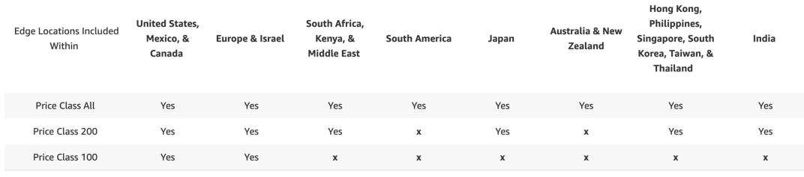
CloudFront - Price Classes
You can reduce the number of edge locations for cost reduction
Three price classes:
Price Class All: all regions – best performance
Price Class 200: most regions, but excludes the most expensive regions
Price Class 100: only the least expensive regions

Slide 28
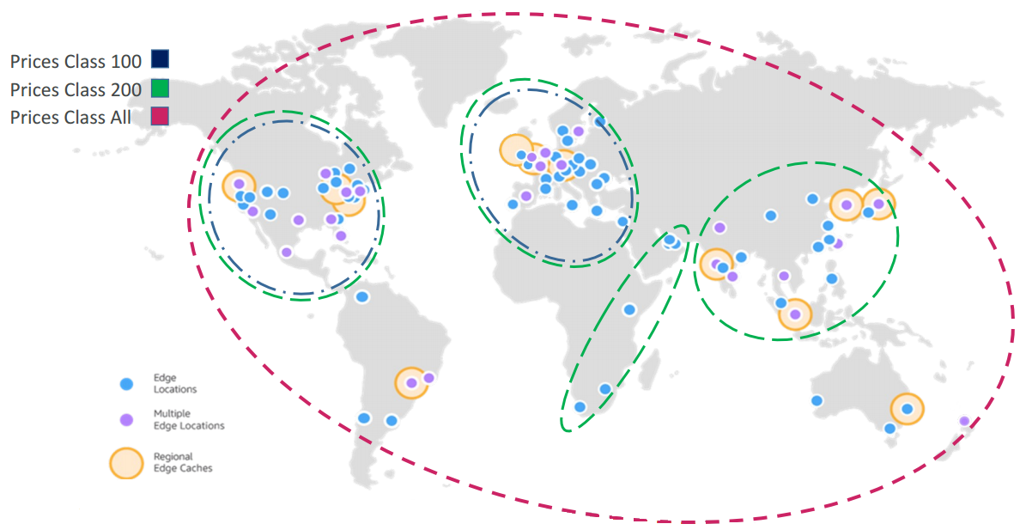
CloudFront - Price Class

Slide 29
Amazon CloudFront Origin Shield
CloudFront Origin Shield is an additional layer in the CloudFront caching infrastructure that helps to minimize your origin’s load, improve its availability, and reduce its operating costs. With CloudFront Origin Shield, you get the following benefits:
Better cache hit ratio
Origin Shield can help improve the cache hit ratio of your CloudFront distribution because it provides an additional layer of caching in front of your origin. When you use Origin Shield, all requests from all of CloudFront’s caching layers to your origin go through Origin Shield, increasing the likelihood of a cache hit.
Reduced origin load
Origin Shield can further reduce the number of simultaneous requests that are sent to your origin for the same object. Requests for content that is not in Origin Shield’s cache are consolidated with other requests for the same object, resulting in as few as one request going to your origin. Handling fewer requests at your origin can preserve your origin’s availability during peak loads or unexpected traffic spikes, and can reduce costs for things like just-in-time packaging, image transformations, and data transfer out (DTO).
Better network performance
When you enable Origin Shield in the AWS Region that has the lowest latency to your origin, you can get better network performance. For origins in an AWS Region, CloudFront network traffic remains on the high throughput CloudFront network all the way to your origin. For origins outside of AWS, CloudFront network traffic remains on the CloudFront network all the way to Origin Shield, which has a low latency connection to your origin.

Slide 30
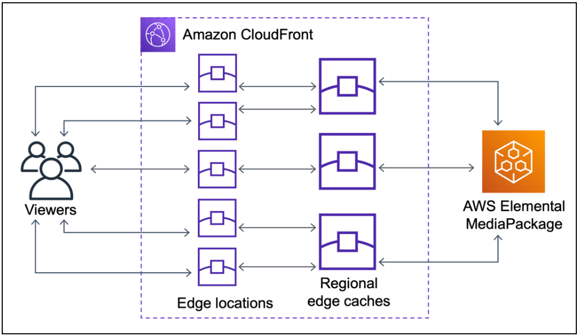
Amazon CloudFront Origin Shield
Without Origin Shield, your origin might receive duplicate requests for the same content, as shown in the following diagram.

Slide 31
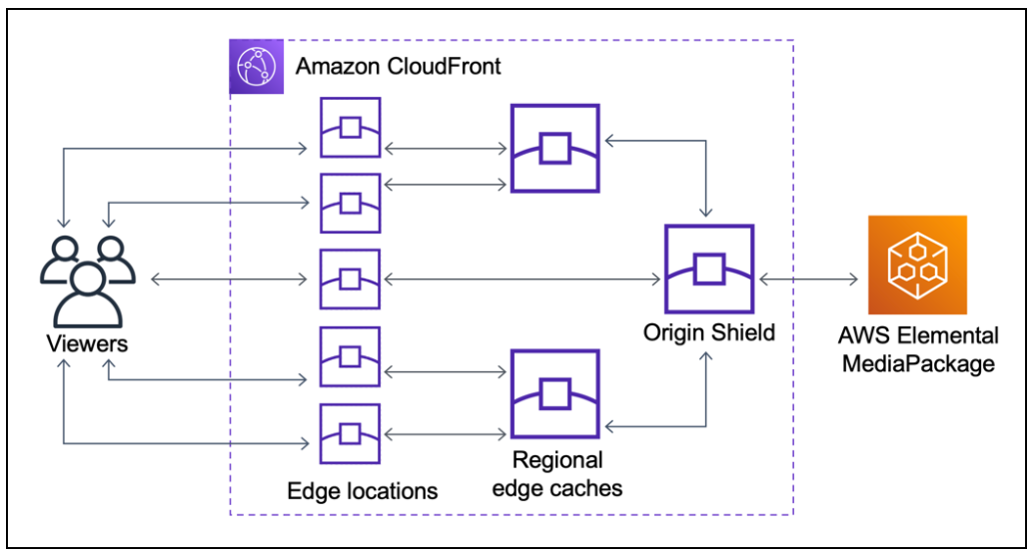
Amazon CloudFront Origin Shield
Using Origin Shield can help reduce the load on your origin, as shown in the following diagram.

Slide 32
Amazon CloudFront Multiple CDNs
To serve live video events or popular on-demand content, you might use multiple content delivery networks (CDNs). Using multiple CDNs can offer certain advantages, but it also means that your origin might receive many duplicate requests for the same content, each coming from different CDNs or different locations within the same CDN. These redundant requests might adversely affect the availability of your origin or cause additional operating costs for processes like just-in-time packaging or data transfer out (DTO) to the internet.
When you combine Origin Shield with using your CloudFront distribution as the origin for other CDNs, you can get the following benefits:
Fewer redundant requests received at your origin, which helps to reduce the negative effects of using multiple CDNs.
A common cache key across CDNs, and centralized management for origin-facing features.
Improved network performance. Network traffic from other CDNs is terminated at a nearby CloudFront edge location, which might provide a hit from the local cache. If the requested object is not in the edge location cache, the request to the origin remains on the CloudFront network all the way to Origin Shield, which provides high throughput and low latency to the origin. If the requested object is in Origin Shield’s cache, the request to your origin is avoided entirely.

Slide 33
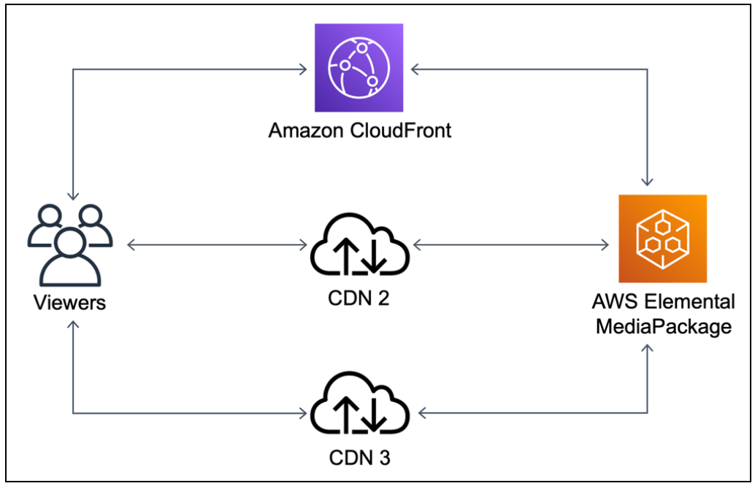
Amazon CloudFront Origin Shield
Without Origin Shield, your origin might receive many duplicate requests for the same content, each coming from a different CDN, as shown in the following diagram.

Slide 34
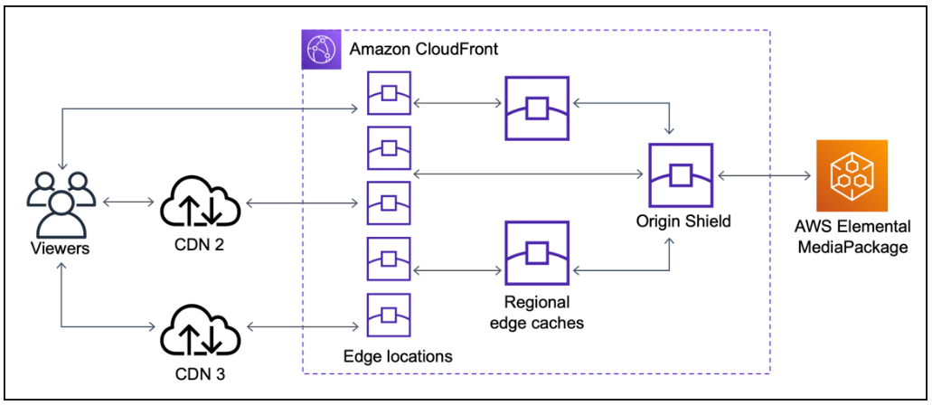
Amazon CloudFront Origin Shield
Using Origin Shield, with CloudFront as the origin for your other CDNs, can help reduce the load on your origin, as shown in the following diagram.

Slide 35
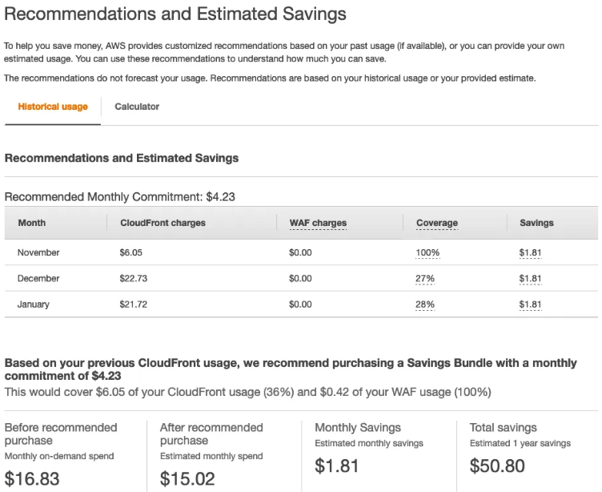
Amazon CloudFront Security Savings Bundle
The CloudFront Security Savings Bundle is a flexible self-service pricing plan that helps you save up to 30% on your CloudFront bill in exchange for a monthly spend commitment for a 1 year term. This savings is not limited to data delivered by CloudFront, but applies to all CloudFront usage types including Lambda@Edge. The CloudFront Security Savings Bundle also includes free AWS WAF (Web Application Firewall) usage up to 10% of your committed amount.
Below you can see the suggestion and the actual cost from Cost Explorer.

Slide 36
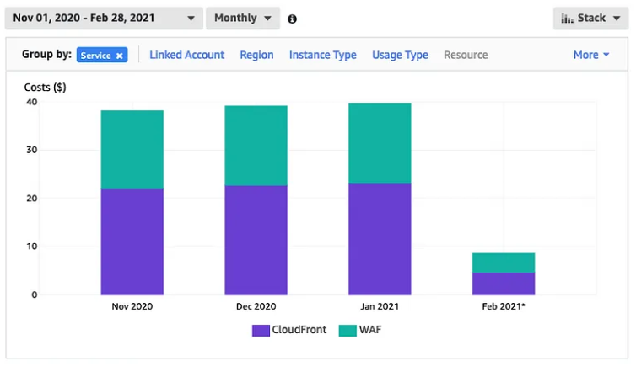
Amazon CloudFront and WAF usage

Slide 37
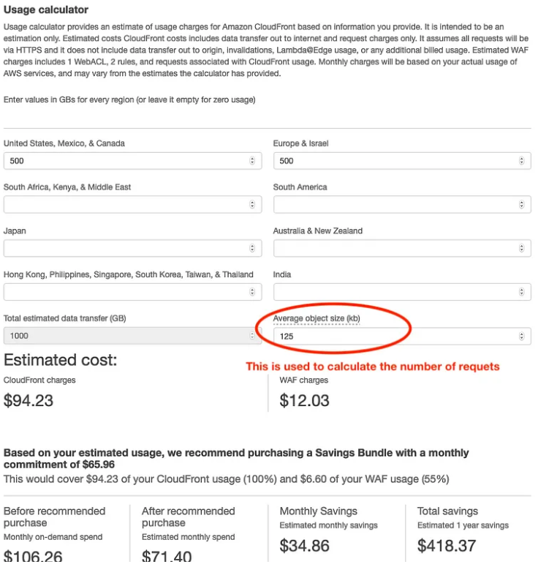
Amazon CloudFront Savings calculator
There is a calculator in the savings tool, where you enter the expected size in GB pr month and average size of the requests. Be aware that you are paying for the requests going through CloudFront so you would need to enter the average size carefully as it is used to calculate the number of requests. If you set the object-size to large, your cost will likely be too low.

Slide 38
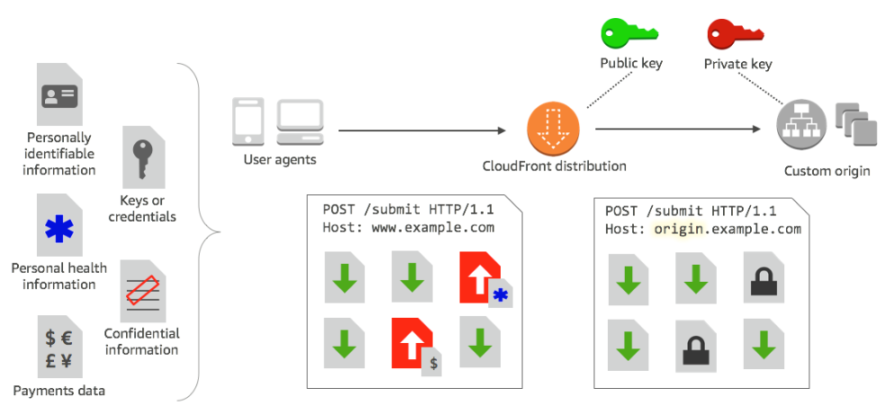
Amazon CloudFront field level encryption
With Amazon CloudFront, you can enforce secure end-to-end connections to origin servers by using HTTPS. Field-level encryption adds an additional layer of security that lets you protect specific data throughout system processing so that only certain applications can see it.
Field-level encryption allows you to enable your users to securely upload sensitive information to your web servers. The sensitive information provided by your users is encrypted at the edge, close to the user, and remains encrypted throughout your entire application stack. This encryption ensures that only applications that need the data—and have the credentials to decrypt it—are able to do so.
To use field-level encryption, when you configure your CloudFront distribution, specify the set of fields in POST requests that you want to be encrypted, and the public key to use to encrypt them. You can encrypt up to 10 data fields in a request. (You can’t encrypt all of the data in a request with field-level encryption; you must specify individual fields to encrypt.)

Slide 39
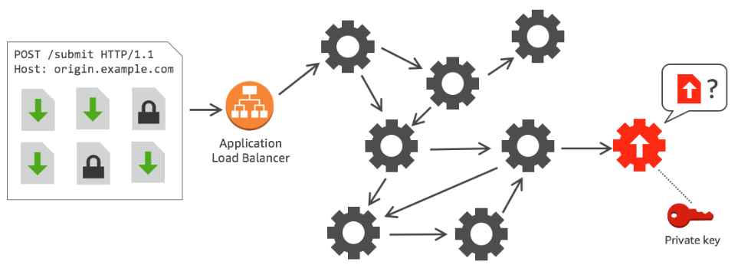
Amazon CloudFront field level encryption
CloudFront field-level encryption uses asymmetric encryption, also known as public key encryption. You provide a public key to CloudFront, and all sensitive data that you specify is encrypted automatically. The key you provide to CloudFront cannot be used to decrypt the encrypted values; only your private key can do that.

Slide 40
CloudFront Functions
With CloudFront Functions in Amazon CloudFront, you can write lightweight functions in JavaScript for high-scale, latency-sensitive CDN customizations. Your functions can manipulate the requests and responses that flow through CloudFront, perform basic authentication and authorization, generate HTTP responses at the edge, and more. The CloudFront Functions runtime environment offers submillisecond startup times, scales immediately to handle millions of requests per second, and is highly secure. CloudFront Functions is a native feature of CloudFront, which means you can build, test, and deploy your code entirely within CloudFront.
CloudFront Functions is ideal for lightweight, short-running functions for use cases like the following:
Cache key normalization – You can transform HTTP request attributes (headers, query strings, cookies, even the URL path) to create an optimal cache key, which can improve your cache hit ratio.
Header manipulation – You can insert, modify, or delete HTTP headers in the request or response. For example, you can add a True-Client-IP header to every request.
Status code modification and body generation – You can evaluate headers and respond back to viewers with customized content.
URL redirects or rewrites – You can redirect viewers to other pages based on information in the request, or rewrite all requests from one path to another.
Request authorization – You can validate hashed authorization tokens, such as JSON web tokens (JWT), by inspecting authorization headers or other request metadata.

Slide 41
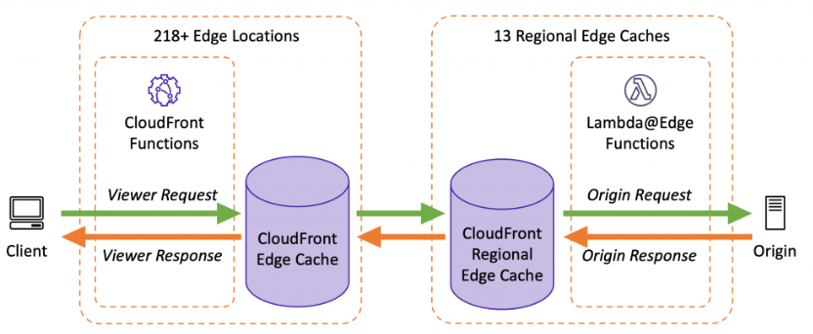
CloudFront Functions
Similar to Lambda@Edge, CloudFront Functions runs your code in response to events generated by CloudFront. More specifically, CloudFront Functions can be triggered after CloudFront receives a request from a viewer (viewer request) and before CloudFront forwards the response to the viewer (viewer response).
Lambda@Edge can also be triggered before CloudFront forwards the request to the origin (origin request) and after CloudFront receives the response from the origin (origin response). You can use CloudFront Functions and Lambda@Edge together, depending on whether you need to manipulate content before, or after, being cached.

Slide 42
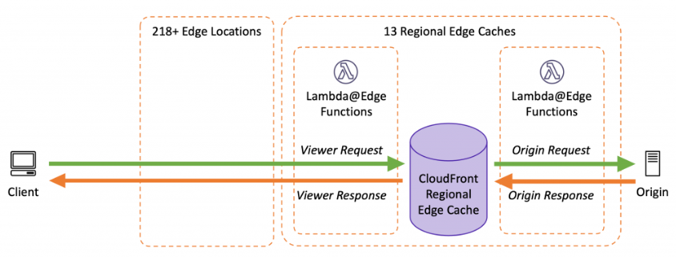
CloudFront Functions
If you need some of the capabilities of Lambda@Edge that are not available with CloudFront Functions, such as network access or a longer execution time, you can still use Lambda@Edge before and after content is cached by CloudFront.

Slide 43
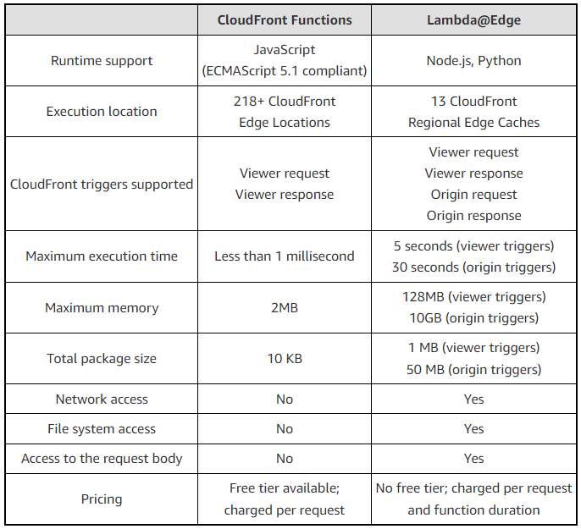
Difference between CloudFront Functions and Lambda@Edge

Slide 44
CloudFront - Prices
There is an option for reserved capacity over 12 months or longer (starts at 10TB of data transfer in a single region).
You pay for:
Data Transfer Out to Internet.
Data Transfer Out to Origin.
Number of HTTP/HTTPS Requests.
Invalidation Requests.
Dedicated IP Custom SSL.
Field level encryption requests.
You do not pay for:
Data transfer between AWS regions and CloudFront.
Regional edge cache.
AWS ACM SSL/TLS certificates.
Shared CloudFront certificates.

Slide 45
Amazon CloudFront Best Practices
Use HTTP/2 for improved performance
Configure caching behavior to optimize delivery
Use AWS WAF for enhanced security
Utilize signed URLs and cookies for secure content delivery
Minimize origin latency by using regional edge locations
Leverage CloudFront’s custom error pages feature
Monitor your usage with Amazon CloudWatch metrics
Take advantage of Lambda@Edge functions for dynamic content delivery
Create multiple origins for failover scenarios

Slide 46
AWS Exam take away
Edge Locations and Regional Edge Caches
Origins
CloudFront - Cache Behavior
Lambda@Edge
CloudFront - Restrictions
CloudFront - Signed URLs and Signed Cookies
CloudFront - Origin Access Identity
CloudFront - Origin Shield
CloudFront - field level encryption
CloudFront - Functions

