Slide 1
Event Bridge

Slide 2
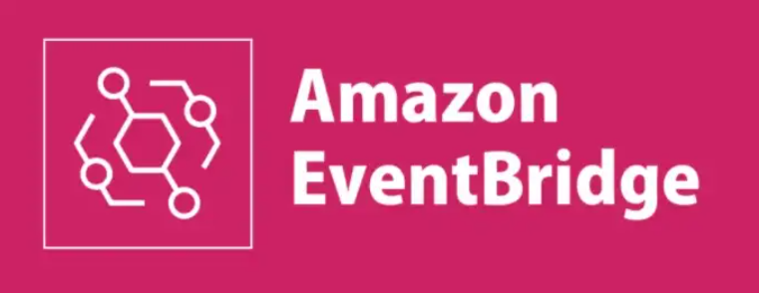
What Is Amazon EventBridge?
EventBridge is a serverless service that uses events to connect application components together, making it easier for you to build scalable event-driven applications. EventBridge provides a simple and consistent way to ingest, filter, transform, and deliver events so you can build new applications quickly.

Slide 3
EventBridge Components Overview
An event is a real-time change in a system, data, or environment. This change can be either in your application or in an AWS service or a SaaS partner service.
An event source is used to ingest events from a SaaS partner, AWS Services, or your own applications.
An event bus is a pipeline that receives events. Rules associated with the event bus evaluate events as they arrive. Each rule checks whether an event matches the rule’s criteria.
A rule matches incoming events and sends them to targets for processing. A single rule can send an event to multiple targets, which then run in parallel. Rules are based either on an event pattern or a schedule.
An event pattern defines the event structure and the fields that a rule matches.
Rules that are based on a schedule perform an action at regular intervals.
A target is a resource or endpoint that EventBridge sends an event to when the event matches the event pattern defined for a rule. The rule processes the event data and sends the pertinent information to the target. To deliver event data to a target, EventBridge needs permission to access the target resource. You can define up to five targets for each rule.
A schema defines the structure and content of events that are passed on an event bus in Amazon EventBridge.

Slide 4
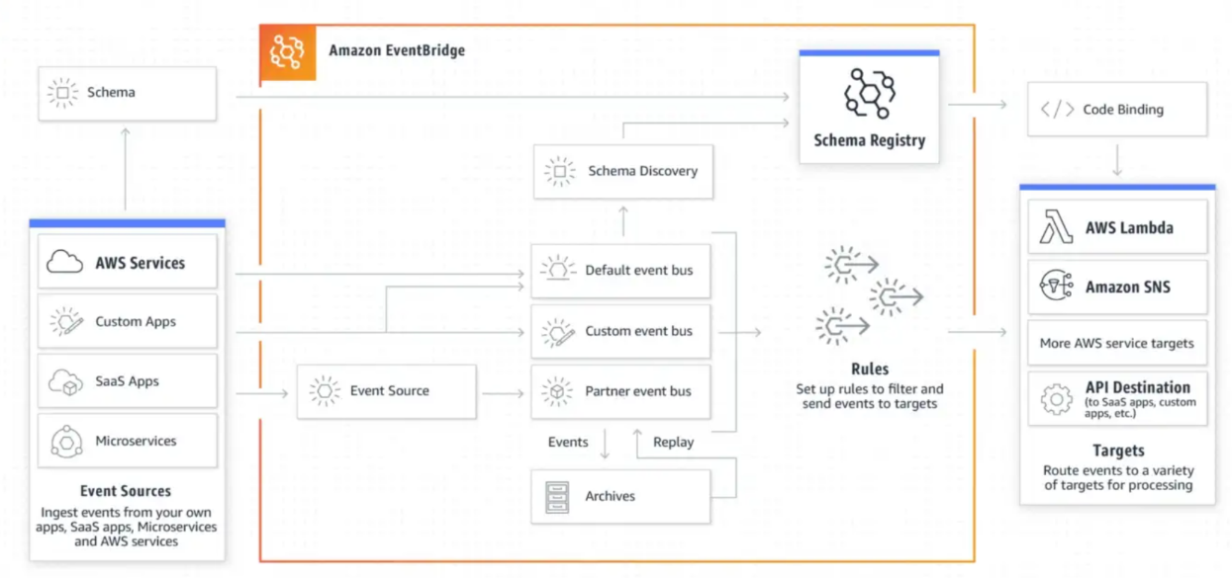
EventBridge Components diagram Overview

Slide 5
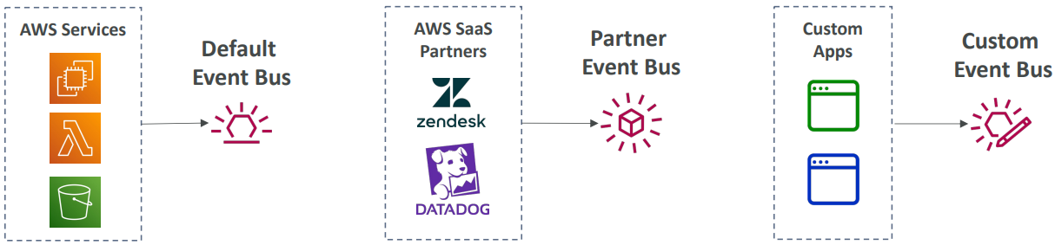
Event Bus
An event bus is a pipeline that receives events. Rules associated with the event bus evaluate events as they arrive. Each rule checks whether an event matches the rule’s criteria.
Event Bus Types:
Default event bus: Created by default and receives events from any AWS service.
Custom event bus: Receives events from custom applications you create and must be created manually.
Partner event bus: Receives events from SaaS partner applications and must be created manually.

Slide 6
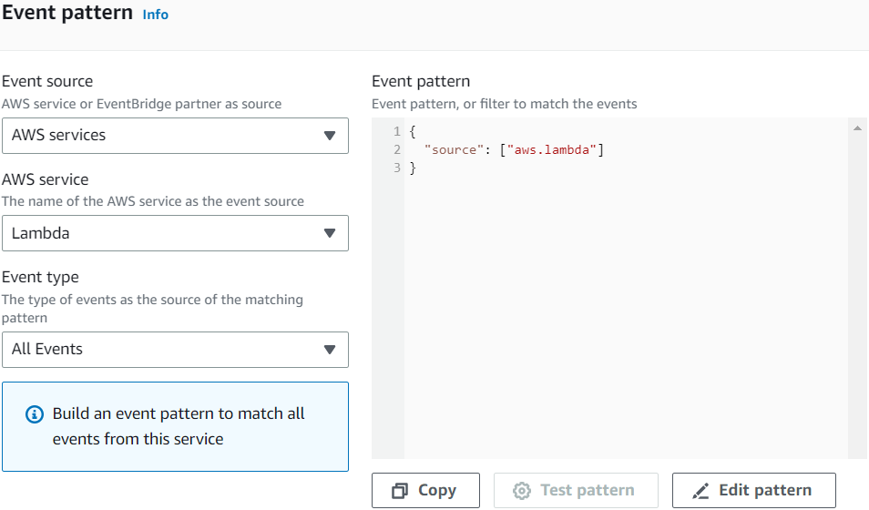
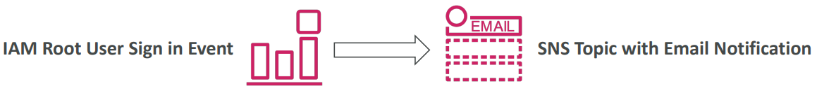
Rule with Event pattern
An event pattern defines the event structure and the fields that a rule matches. Rules use event patterns to select events and send them to targets. An event pattern either matches an event or it doesn't.
Event rules to react to a service doing something :

Slide 7
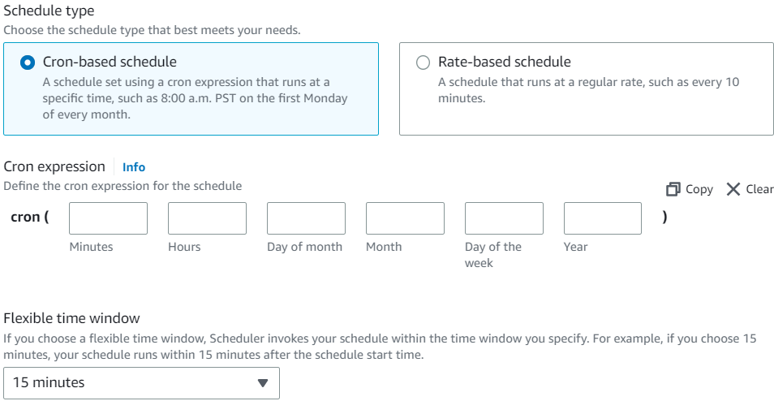
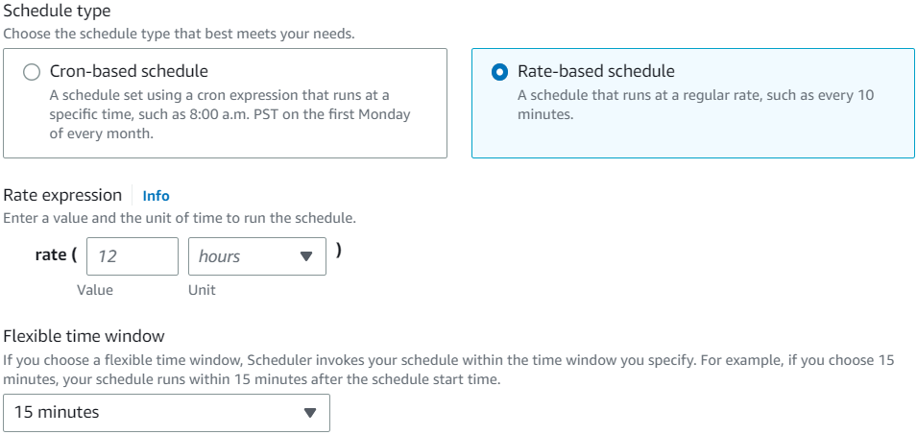
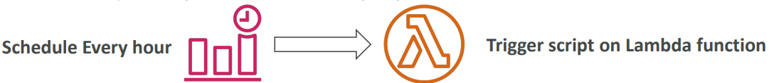
Schedule Rule
A rule can run in response to an event or at certain time intervals. For example, to periodically run an AWS Lambda function, you can create a rule to run on a schedule.
EventBridge supports cron expressions and rate expressions. Rate expressions are simpler to define and cron expressions offer the detailed schedule control.
For example, with a cron expression, you can define a rule that runs at a specified time on a certain day of each week or month.
In contrast, rate expressions run a rule at a regular rate, such as once every hour or once every day.

Slide 8
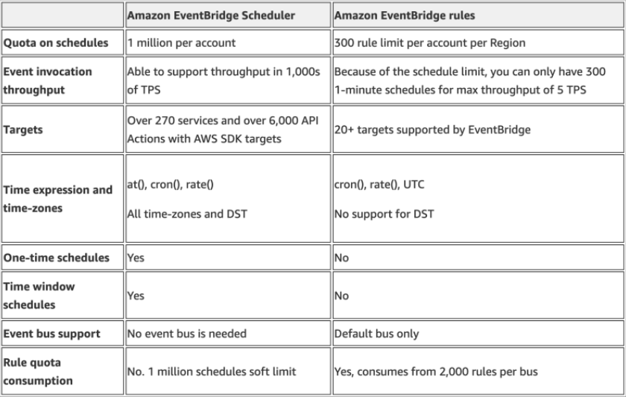
EventBridge Scheduler & EventBridge Rules
EventBridge now offers a new scheduling capability, Amazon EventBridge Scheduler. EventBridge Scheduler is a serverless scheduler that allows you to create, run, and manage tasks from one central, managed service.
EventBridge Scheduler is highly customizable, and offers improved scalability over EventBridge scheduled rules, with a wider set of target API operations and AWS services.

Slide 9
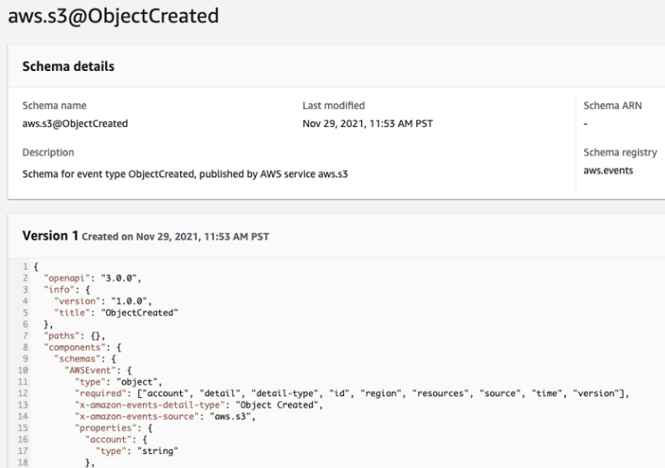
Amazon EventBridge – Schema Registry
EventBridge can analyze the events in your bus and infer the schema
The Schema Registry allows you to generate code for your application, that will know in advance how data is structured in the event bus
Schema can be versioned
A schema registry is a repository that stores a collection of schemas. You can use a schema registry to search for, find, and track different schemas used and generated by your application.

Slide 10
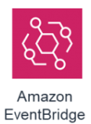
Use cases
Increase developer agility
Remove the need to coordinate across service teams with decoupled microservices using AWS, SaaS apps, or your own custom apps.
Extend functionality via SaaS integrations
Connect your applications to other SaaS applications. You can send a custom event to EventBridge, and then send it through API Destinations to Zendesk CRM.
Monitoring and auditing
Monitor and audit your AWS environments, and respond to operational changes in your applications in real time to prevent infrastructure vulnerabilities.
Scheduling in your applications
Use EventBridge Scheduler in your applications and platforms to provide scheduling services to your customers with reminders, delayed actions, or prompts to continue where they left off.

Slide 11
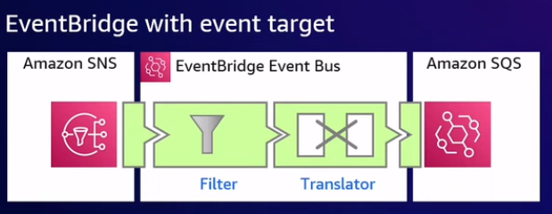
Amazom EventBridge Event Bus

Slide 12
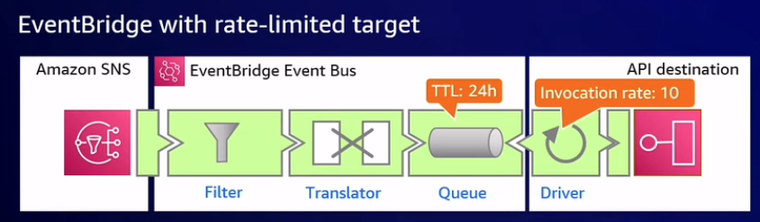
Amazom EventBridge Event Bus

Slide 13
Hands on
Add and retrieve all orders from DynamoDB table using API Gateway and Lambda. Add X-ray
RDS + Lambda + Load Balancer (POST Get for rds table) Add x-ray Add layer for RDS dependencies. Add version and Alias
Event bridge Cron job with lambda and xray

