Slide 1
Cloud Native vs Cloud Agnostic

Slide 2
Introduction to Cloud Computing Approaches
Definitions:
CloudNative: Designing and running applications that fully embrace the strengths of cloud computing.
Characteristics: Scalable, elastic, resilient, and agile.
Utilizes cloud-specific features and services.
Cloud Agnostic: Creating applications that operate on any cloud platform without needing modification.
Emphasizes portability and interoperability.
Relies on common standards and avoids proprietary services.
Philosophical and Implementation Differences:
CloudNative Approach:
Tailored to leverage a specific cloud provider’s infrastructure and services.
Often involves using managed services and serverless architectures.
Cloud Agnostic Approach:
Focuses on flexibility and the ability to work across multiple cloud environments.
Often involves containerization and use of open-source tools to ensure portability.
Importance in Today's Landscape:
Adaptability and Scalability: As cloud computing evolves, these approaches determine how well an organization can adapt and scale.
Strategic Business Decisions: Influences decisions on cloud spending, vendor relationships, and long-term IT infrastructure planning.
Market Trends and Innovations: Understanding both approaches is critical to navigating emerging technologies and market trends in cloud computing.

Slide 3
What is CloudNative?
Designed for Cloud Environments:
Built from the ground up specifically for cloud computing.
Tailored to leverage cloud infrastructure and operational models.
Utilization of Cloud Provider's Services:
Maximizes the use of a cloud provider's native services and capabilities.
Includes managed services, serverless architectures, and platform-specific tools.
Key Architectural Focus:
Microservices Architecture:
Application is a collection of small, independent, and loosely coupled services.
Containerization:
Use of containers (like Docker) for consistency across different environments and efficient resource utilization.
Orchestration:
Automated management of containerized applications, typically using Kubernetes or specific cloud services.
Streamlines deployment, scaling, and operations of application containers.
Primary Benefits:
Scalability: Easily scale applications in response to demand.
Resilience: Enhanced fault tolerance and robustness.
Agility: Quick deployment and updates, leading to faster innovation cycles.

Slide 4
What is Cloud Agnostic?
Independence from Specific Cloud Providers:
Crafted to operate across any cloud platform without dependencies on a specific provider’s infrastructure.
Focuses on universal design principles applicable in various cloud environments.
Emphasis on Portability and Interoperability:
Ensures that applications and data can move seamlessly between different cloud environments.
Designed to work in multi-cloud or hybrid cloud setups without substantial modifications.
Use of Open Standards:
Prefers technologies and platforms that adhere to open standards.
Avoids proprietary services and tools to maintain flexibility and avoid vendor lock-in.
Benefits of Cloud Agnostic Approach:
Flexibility: Enables organizations to switch cloud providers easily, adapt to changing business needs.
Reduced Vendor Lock-In: Avoids being tied to a single cloud provider’s ecosystem and pricing structures.
Wider Compatibility: Ensures applications are compatible across different cloud platforms, broadening potential market reach.
Facilitates Multi-Cloud Strategies: Ideal for businesses looking to leverage the strengths of different cloud providers.

Slide 5
Advantages of CloudNative
Optimal Use of Cloud Provider's Strengths:
Tailors applications to fully leverage the specific features and services of a cloud provider.
Makes the most of advanced cloud capabilities like AI, analytics, and IoT services.
Enhanced Performance and Efficiency:
Applications run more efficiently in the environment they are specifically designed for.
Better utilization of underlying cloud infrastructure leads to improved performance.
Seamless Integration with Cloud Provider's Tools:
Native integration with a cloud provider’s development, monitoring, and management tools.
Simplifies workflows, from deployment to monitoring and scaling.
Support and Community in the Provider’s Ecosystem:
Access to extensive support resources, including documentation, forums, and customer service.
Benefits from a community of developers and companies using the same cloud platform.
Opportunities for collaboration and learning from best practices within the ecosystem.

Slide 6
Advantages of Cloud Agnostic
Flexibility in Switching Providers:
Ability to change cloud providers without extensive redevelopment.
Supports adapting to changing business needs and technological advancements.
Avoidance of Vendor Lock-in:
Reduces dependency on a single cloud provider’s infrastructure and pricing model.
Provides more leverage in negotiations with cloud service providers due to the ability to switch.
Broader Audience Reach:
Compatibility with multiple cloud platforms expands the potential user base.
Facilitates serving customers in different regions and with different cloud preferences.
Suitability for Multi-Cloud Strategies:
Ideal for organizations looking to distribute their services across various cloud environments.
Enhances business continuity and risk management by not relying on a single provider.

Slide 7
Choosing the Right Approach
Key Considerations:
Specific Business Needs: Understanding unique organizational requirements and goals.
Scalability Requirements: Assessing the need for scaling up or down based on demand.
Budget Constraints: Evaluating financial resources and cost implications of each approach.
When to Choose CloudNative:
Opt for CloudNative when the goal is to fully leverage a specific cloud provider's advanced features and capabilities.
Ideal for businesses seeking deep integration with a single cloud platform’s services and ecosystem.
Recommended when scalability and resilience within a single cloud environment are top priorities.
When to Choose Cloud Agnostic:
Cloud Agnostic is preferable for maintaining flexibility and avoiding dependence on a single provider.
Suited for organizations aiming to ensure compatibility and portability across multiple cloud environments.
A strategic choice for businesses with a focus on mitigating vendor lock-in risks and ensuring long-term flexibility.
Alignment with Long-Term Strategies:
The decision between CloudNative and Cloud Agnostic should be in harmony with the organization's long-term IT and business strategies.
Consider future growth projections, potential market changes, and the evolving nature of cloud technologies.
Factor in long-term cost implications, potential scalability, and the need for innovation agility.

Slide 8
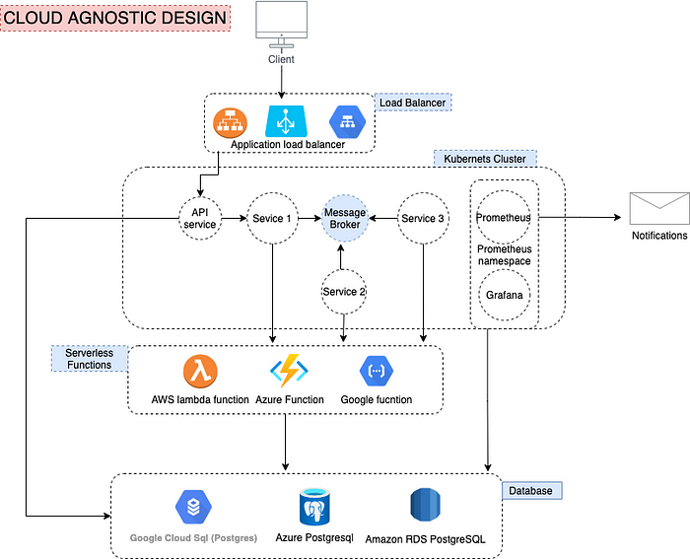
Cloud Agnostic System Design

Slide 9
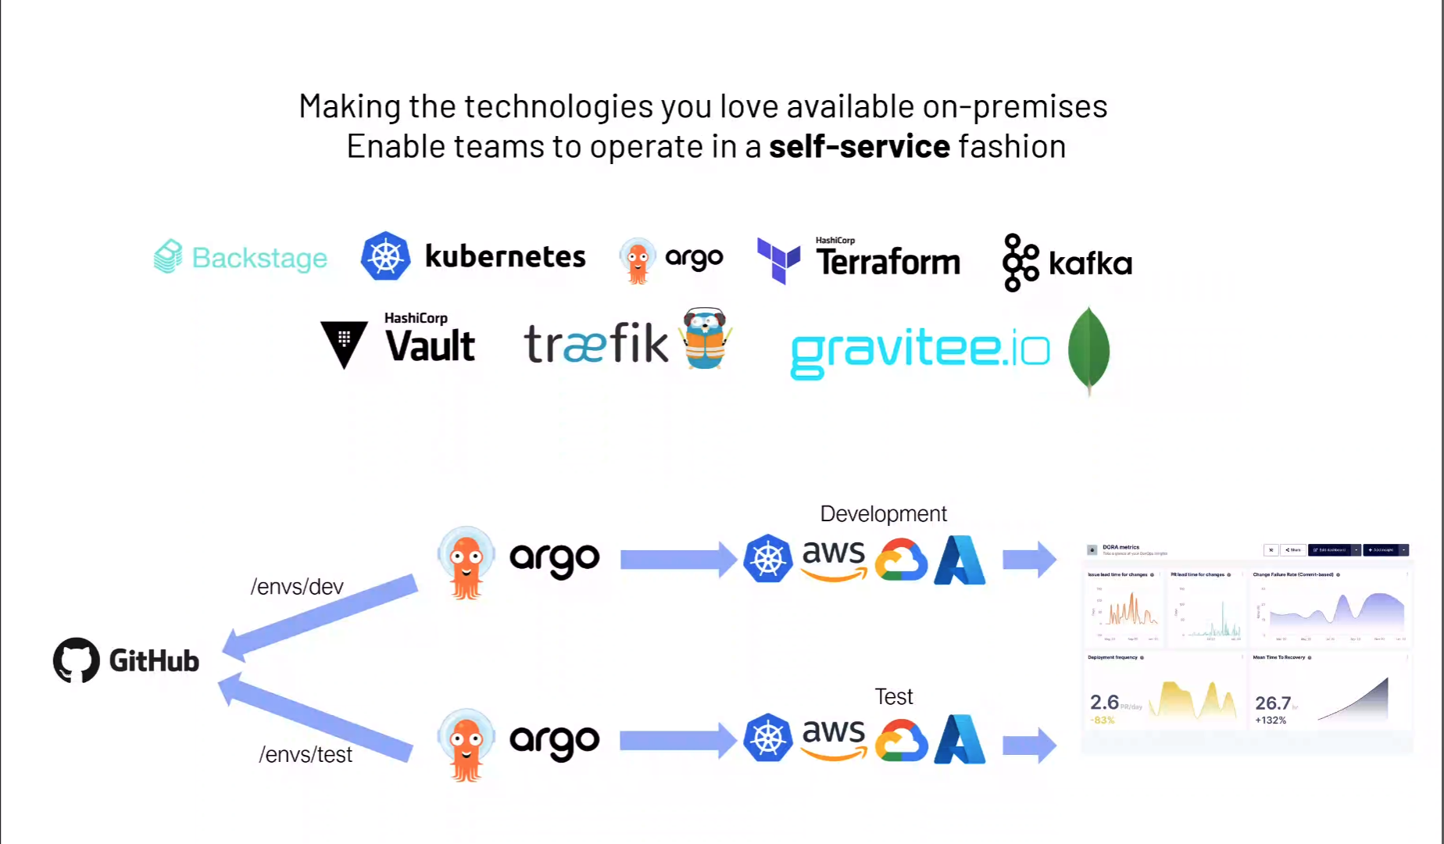
Cloud Agnostic Future

Slide 10
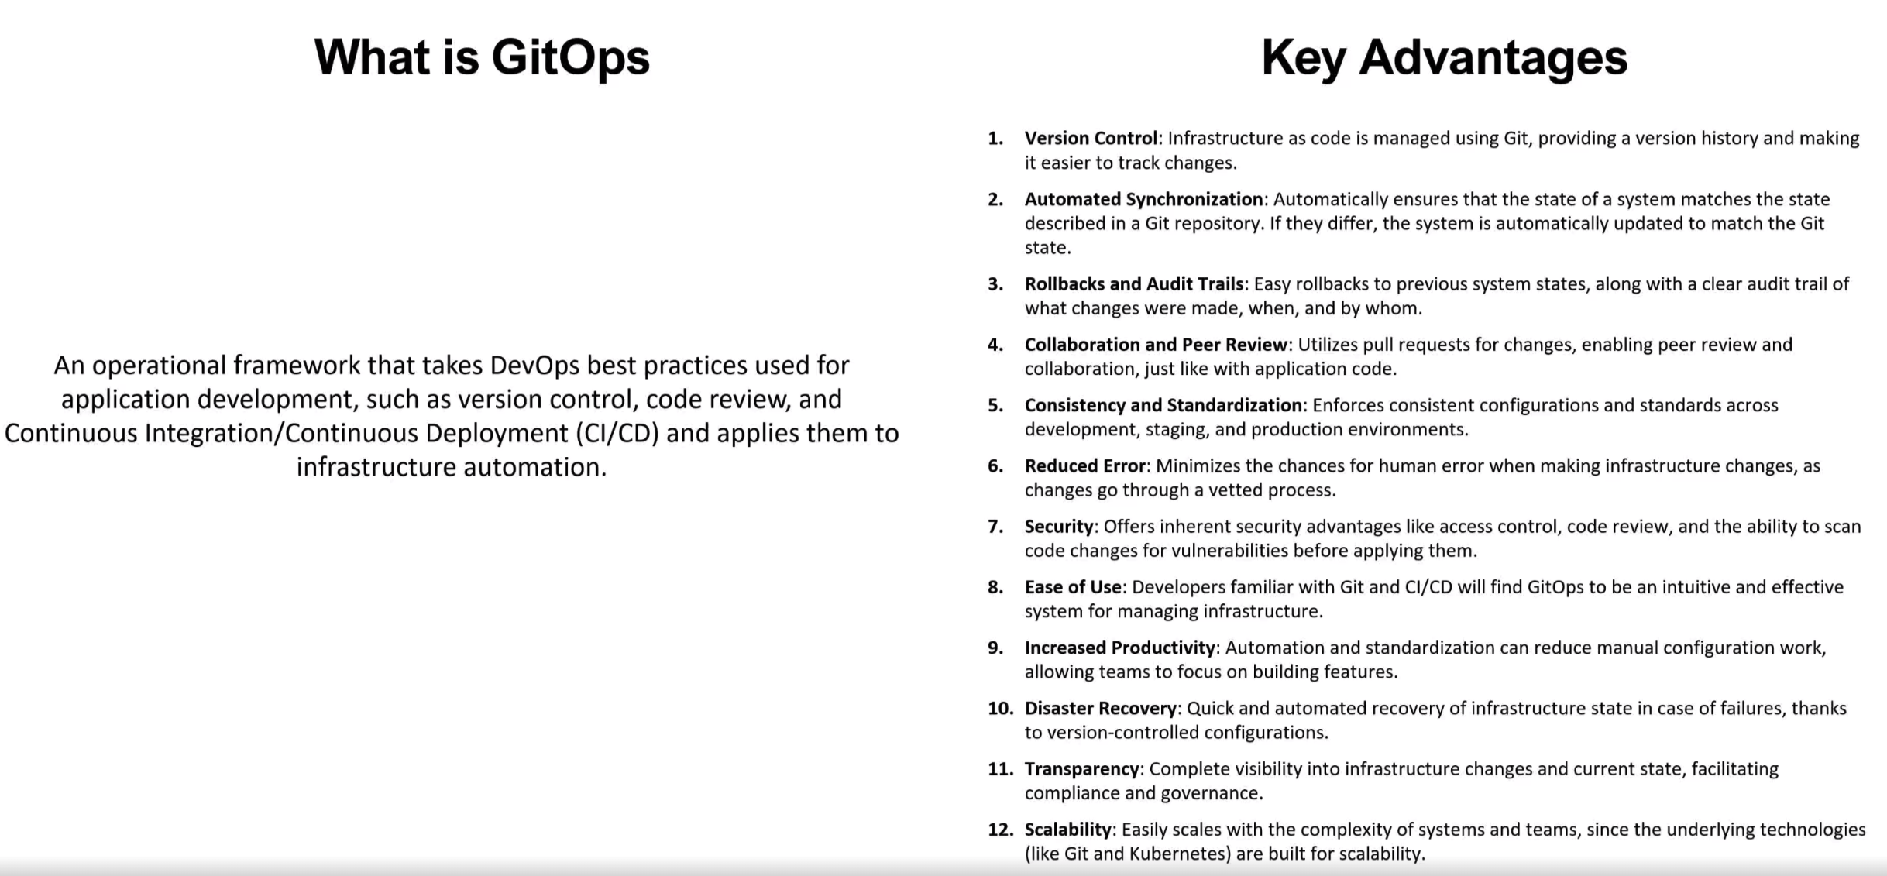
What is GitOps?

Slide 11
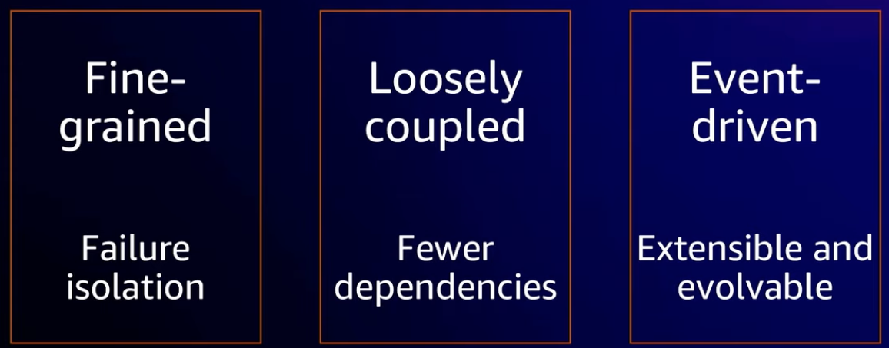
Modern Cloud application are

