Slide 1
Amazon AppFlow
Automate data flows between software as a service (SaaS) and AWS services

Slide 2
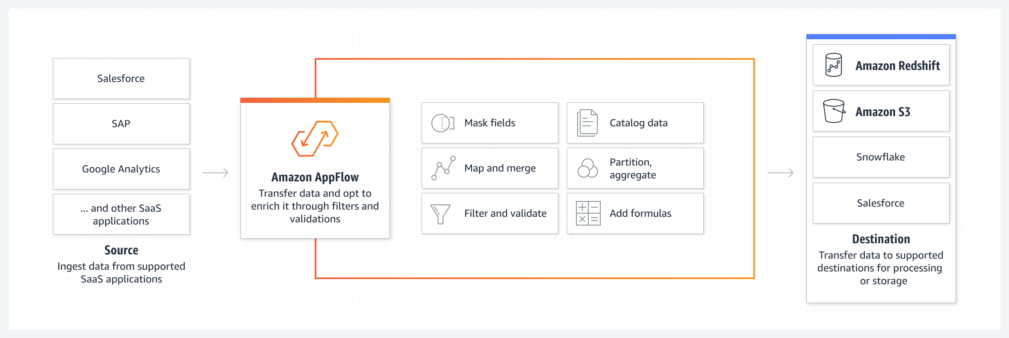
AWS AppFlow
AWS AppFlow is a fully managed integration service that enables you to securely transfer data between Software as a Service (SaaS) applications like Salesforce, ServiceNow, Slack, and AWS services like Amazon S3 and Amazon Redshift, in just a few clicks.
This service is designed to simplify the process of data ingestion and data transformation without the need for writing custom integration code or managing underlying infrastructure

