Slide 1
SNS

Slide 2
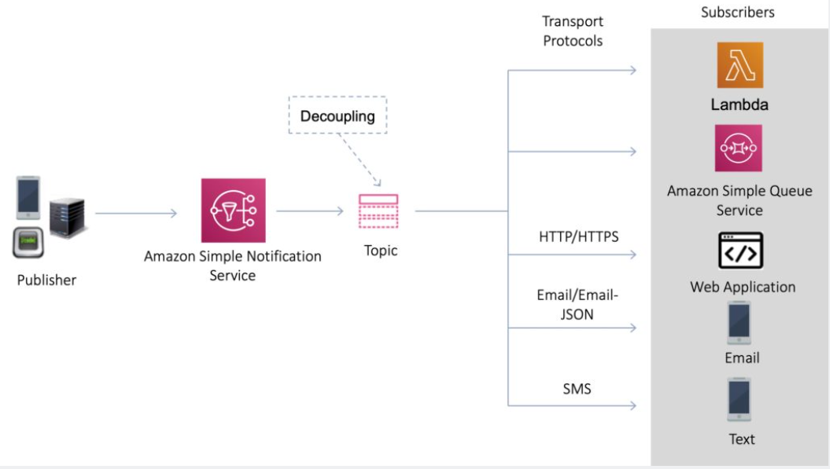
What is Amazon SNS?
Amazon Simple Notification Service (Amazon SNS) is a fully managed messaging service for both application-to-application (A2A) and application-to-person (A2P) communication.
The pub/sub functionality provides messaging for high-throughput, push-based, many-to-many use cases.
Amazon SNS is used for sending notifications between distributed systems, microservices, and event-driven serverless applications.
Amazon SNS can also send notifications via SMS text message, email, SQS queues or to any HTTP endpoint.
Amazon SNS notifications can also trigger Lambda functions.
Amazon SNS is inexpensive and based on a pay-as-you-go model with no upfront costs.
SNS uses a pub-sub model whereby users or applications subscribe to SNS topics.

Slide 3
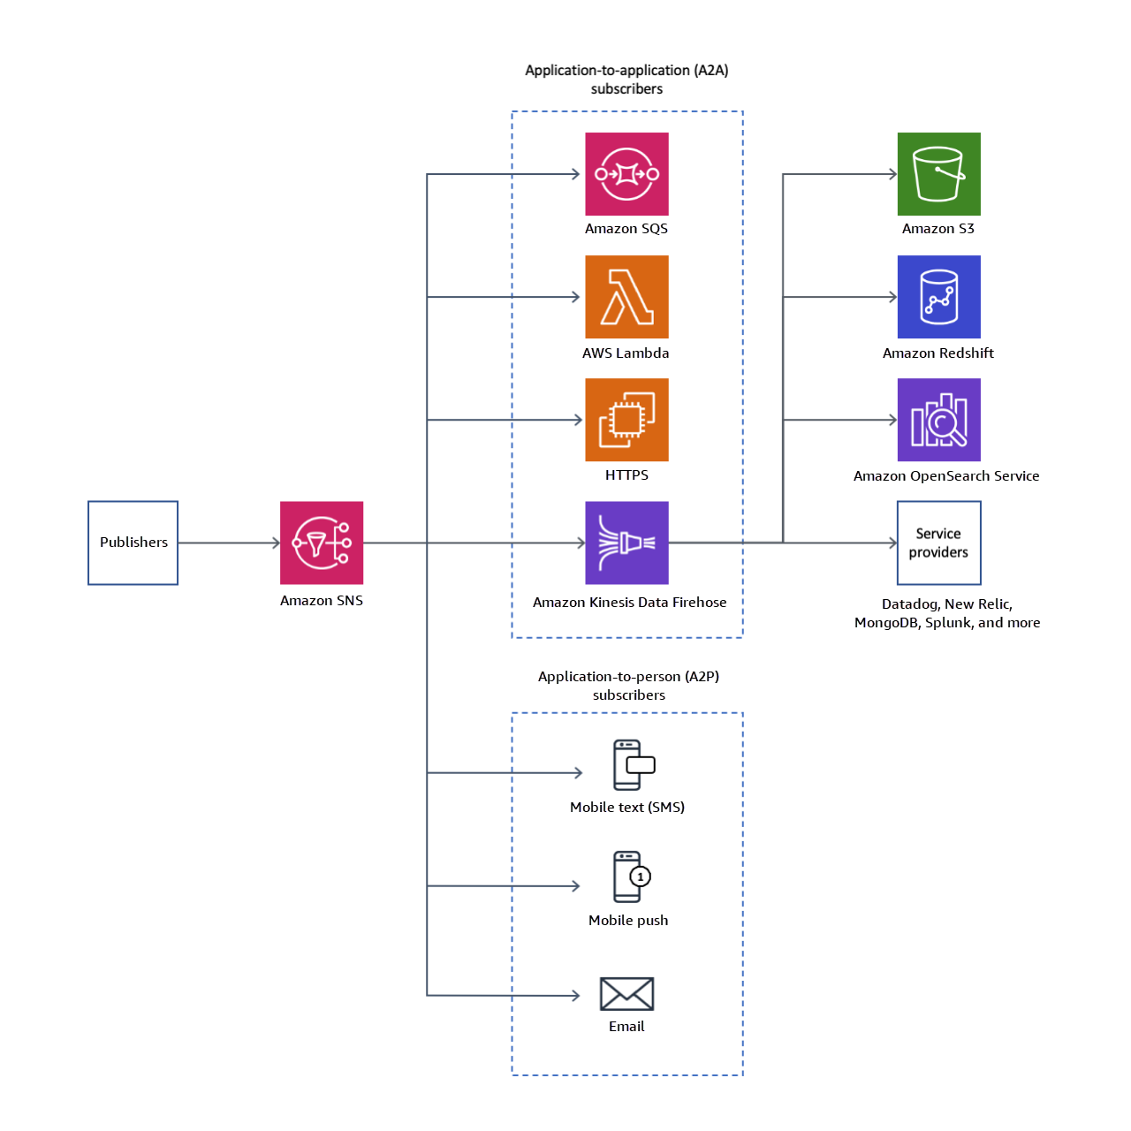

Slide 4
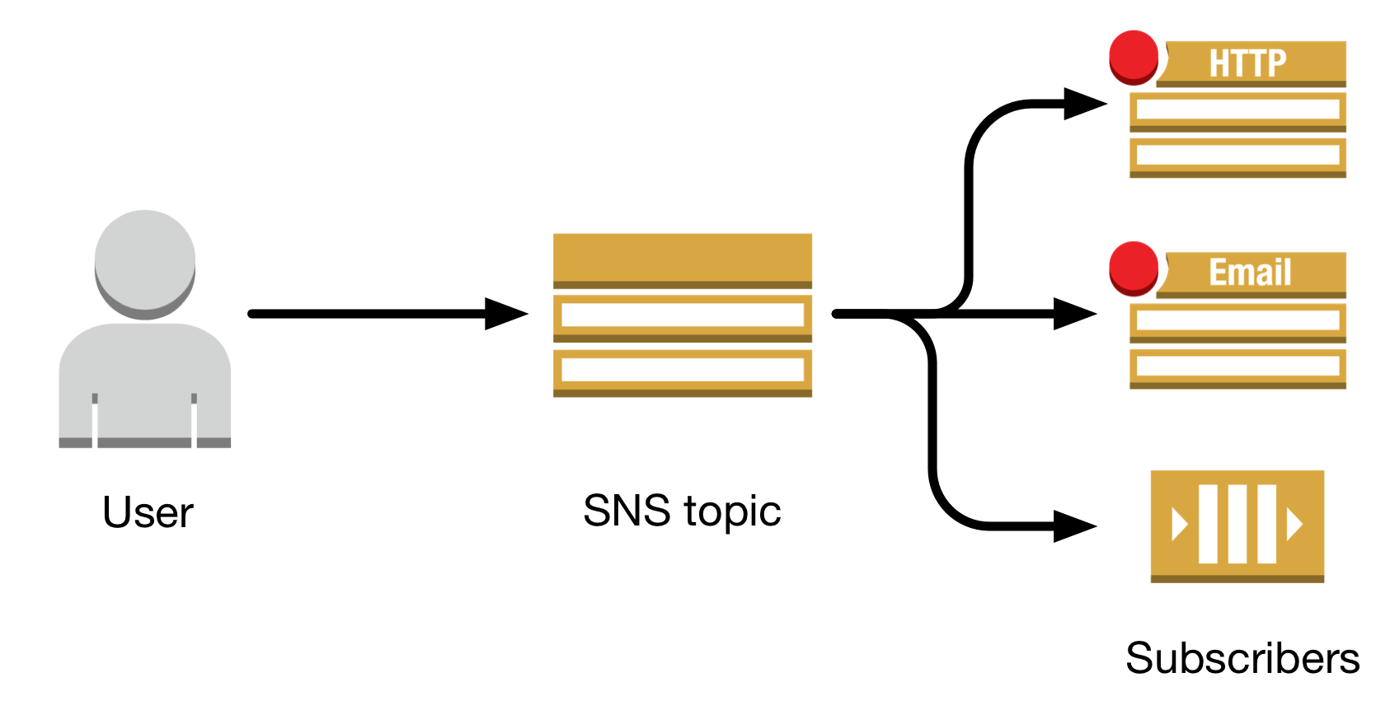
SNS Topics
Multiple recipients can be grouped using Topics.
A topic is an “access point” for allowing recipients to dynamically subscribe for identical copies of the same notification.
One topic can support deliveries to multiple endpoint types.
All messages are stored redundantly across multiple availability zones.
Provides instantaneous, push-based delivery.
Flexible message delivery is provided over multiple transport protocols.

Slide 5
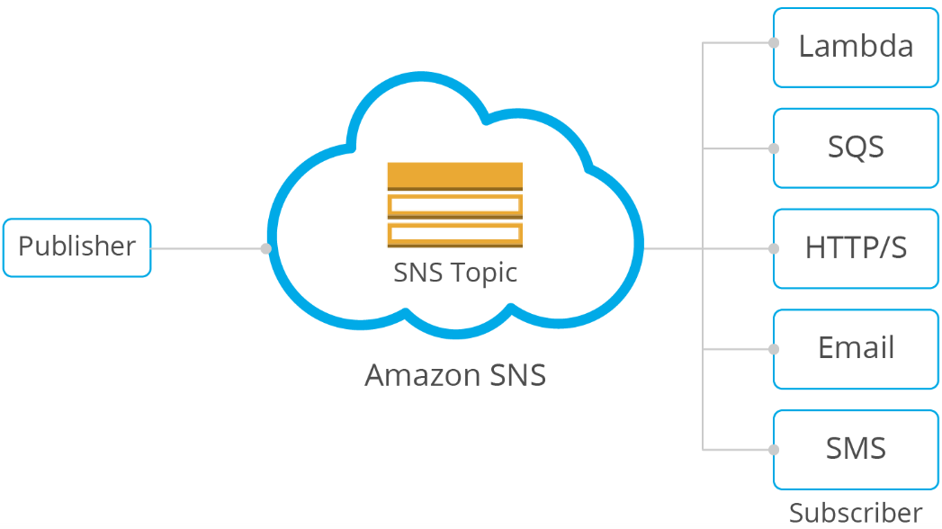
SNS Subscribers and Endpoints
When subscribing to an SNS topic the following endpoint types are supported:
HTTP/HTTPS.
Email/Email-JSON.
Amazon Kinesis Data Firehose.
Amazon SQS.
AWS Lambda.
Platform application endpoint (mobile push).
SMS.

Slide 6
SNS FIFO topics use case. Serverless Architecture
Use Case Description:
Inventory managers use a price management application to set the price for each item in stock.
The price management application uses an AWS Lambda function that publishes price updates to an SNS FIFO topic whenever prices change.
A wholesale application provides the backend for a website where auto body shops and car manufacturers can buy the company's auto parts in bulk
A retail application provides the backend for another website where car
owners and car tuning enthusiasts can purchase individual auto parts for their vehicles
Pictures -> next slides

Slide 7
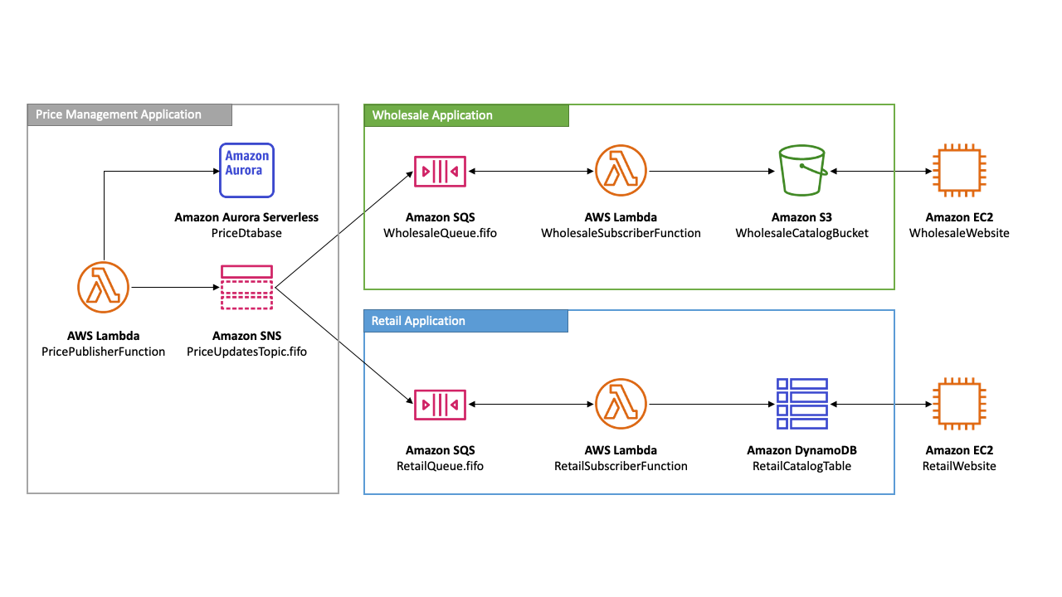
SNS FIFO topics use case. Serverless Architecture

Slide 8
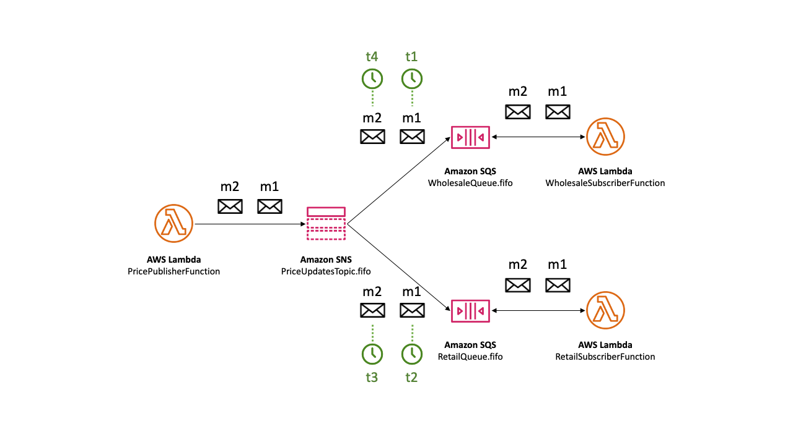
SNS Message Ordering Details (Happy path)
An Amazon SNS FIFO topic delivers messages to subscribed Amazon SQS FIFO queues in the exact order that the messages are published to the topic.
Note that we do not have exact order of subscribers.

Slide 9
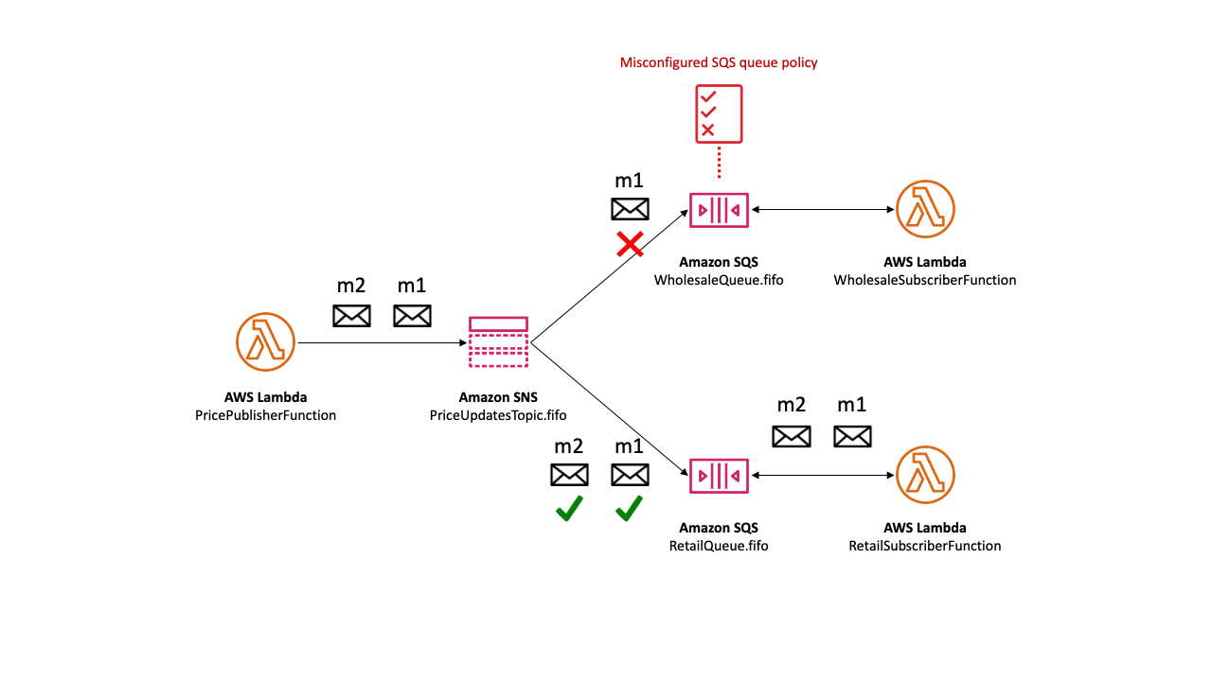
SNS Message Ordering Details (Unreachable subscriber)

Slide 10
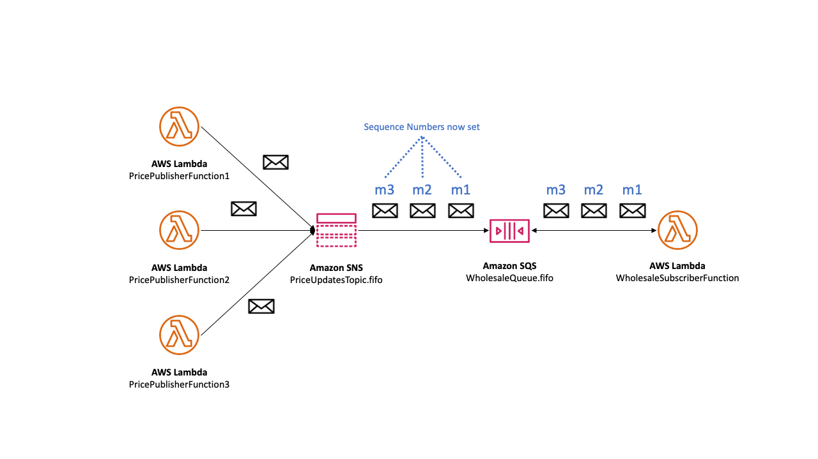
SNS Message Ordering Details: Multiple writers
We are effectively delegate message sequencing to the Amazon SNS service.
To determine the established sequence of messages, you can check the sequence number.
The sequence number is a large, non-consecutive, ever-increasing number that Amazon SNS assigns to each message that you publish.
The sequence number is passed to the subscribed SQS FIFO queues as part of the message body.
No metadata with raw message delivery

Slide 11
SNS + SQS: Sequence Number
In the context of SNS, the concept of sequence numbers is relevant when discussing SNS with SQS for message ordering. When using SNS topics to send messages to SQS queues, there's a feature to ensure the order of message delivery, which is particularly important when using FIFO (First-In-First-Out) queues.
Publishing to SNS: When a message is published to an SNS topic configured with FIFO settings, SNS automatically generates a unique sequence number for the message as part of the message metadata.
Message Delivery to SQS: The message, along with its sequence number, is delivered to the SQS FIFO queue. SQS uses this sequence number to order messages within the same message group.
Processing Order: Messages are processed in sequence number order within each message group, ensuring that the order of messages sent is the order of messages received and processed.
Message Group ID: Both SNS and SQS FIFO services use the concept of a message group ID to group messages. The sequence number ordering is maintained within each message group, allowing multiple ordered streams within the same SNS-SQS setup.
Duplication Prevention: The combination of the sequence number and message deduplication ID (provided when the message is published) ensures that messages are delivered in order and without duplicates within the deduplication interval.
Automatic Handling: This sequencing and ordering are handled automatically by AWS, requiring minimal setup from the user, aside from ensuring that the SNS topic and SQS queue are correctly configured to use FIFO capabilities.
In summary, the sequence number in the context of AWS SNS and SQS (FIFO) is a system-generated identifier that ensures messages are delivered and processed in the exact order they were sent

Slide 12
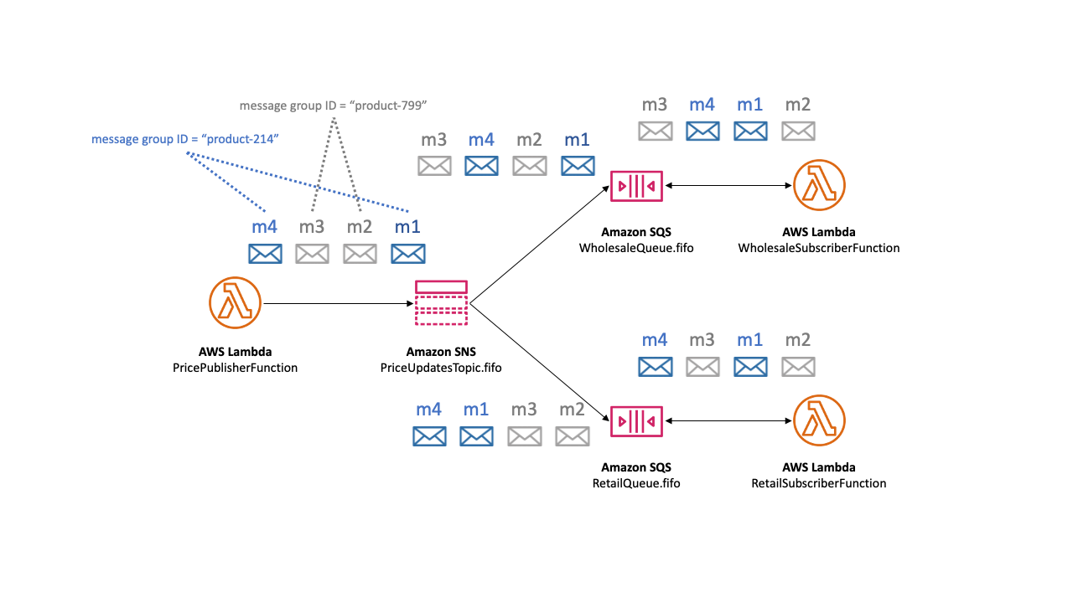
SNS Message grouping for FIFO topics
Messages that belong to the same group are processed one by one, in a strict order relative to the group.
When you publish messages to an Amazon SNS FIFO topic, you set the message group ID.
The group ID is a mandatory token that specifies that a message belongs to a specific message group
The SNS FIFO topic passes the group ID to the subscribed Amazon SQS FIFO queues
There's no affinity between a message group and a subscription, Therefore, messages that are published to any message group are delivered to all subscribed queues, subject to any filter policies attached to subscriptions

Slide 13
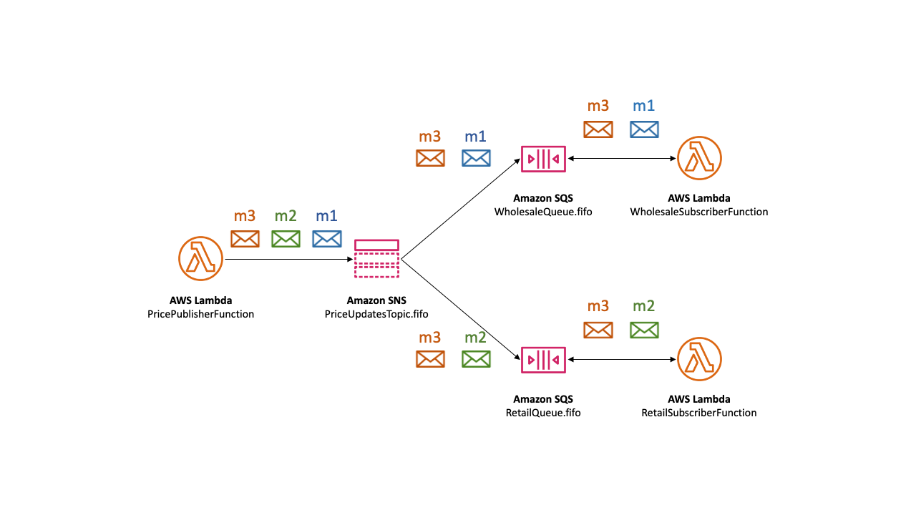
Message filtering for FIFO topics
Amazon SNS FIFO topics support message filtering.
Using message filtering simplifies your architecture by offloading the message routing logic from your publisher systems and the message filtering logic from your subscriber systems.
When you subscribe an Amazon SQS FIFO queue to an SNS FIFO topic, you can use message filtering to specify that the subscriber receives a subset of messages, rather than all of them.
Each subscriber can set its own filter policy as subscription attributes.

Slide 14
SNS Message deduplication for FIFO topics
Amazon SNS FIFO topics and Amazon SQS FIFO queues support message deduplication, which provides exactly-once message delivery and processing as long as the following conditions are met:
The subscribed SQS FIFO queue exists and has permissions that allow the Amazon SNS service principal to deliver messages to the queue.
The SQS FIFO queue consumer processes the message and deletes it from the queue before the visibility timeout expires.
The Amazon SNS subscription topic has no message filtering. When you configure message filtering, SNS FIFO topics support at-most-once delivery, as messages can be filtered out based on your subscription filter policies.
In practical terms, when you use message filtering with FIFO topics, you're shaping the traffic of messages to ensure that subscribers only receive messages that are relevant to them, based on the filter policies. The at-most-once delivery guarantee still applies, but it's now in the context of filtered messages. Messages that don't match the filter criteria are effectively ignored for that particular subscriber, even though they are part of the FIFO topic.
There are no network disruptions that prevent acknowledgment of the message delivery. (Network is stable)
!!! Message deduplication applies to an entire SNS FIFO topic, not to an individual message group.

Slide 15
SNS Message deduplication for FIFO topics: Flow
When you publish a message to an SNS FIFO topic, the message must include a deduplication ID.
This ID is included in the message that the SNS FIFO topic delivers to the subscribed SQS FIFO queues.
If a message with a particular deduplication ID is successfully published to an SNS FIFO topic, any message published with the same deduplication ID, within the five-minute deduplication interval, is accepted but not delivered. (internal is not configurable)
The SNS FIFO topic continues to track the message deduplication ID, even after the message is delivered to subscribed endpoints.
Unique Body. SNS + SQS ->
If the message body is guaranteed to be unique for each published message, you can enable content-based deduplication for an Amazon SNS FIFO topic and the subscribed SQS FIFO queues.
Amazon SNS uses the message body to generate a unique hash value to use as the deduplication ID for each message, so you don't need to set a deduplication ID when you send each message.

Slide 16
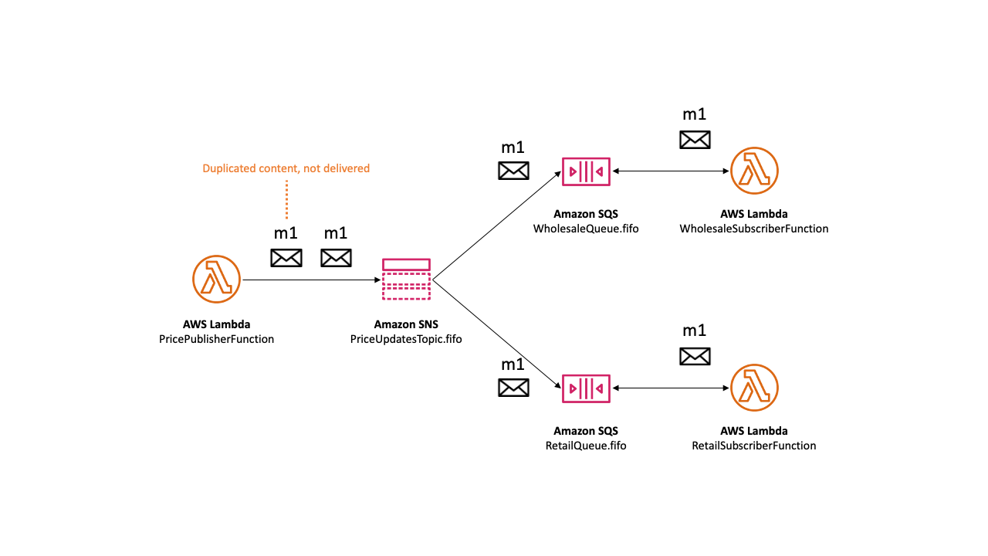
SNS Message deduplication for FIFO topics: Example

Slide 17
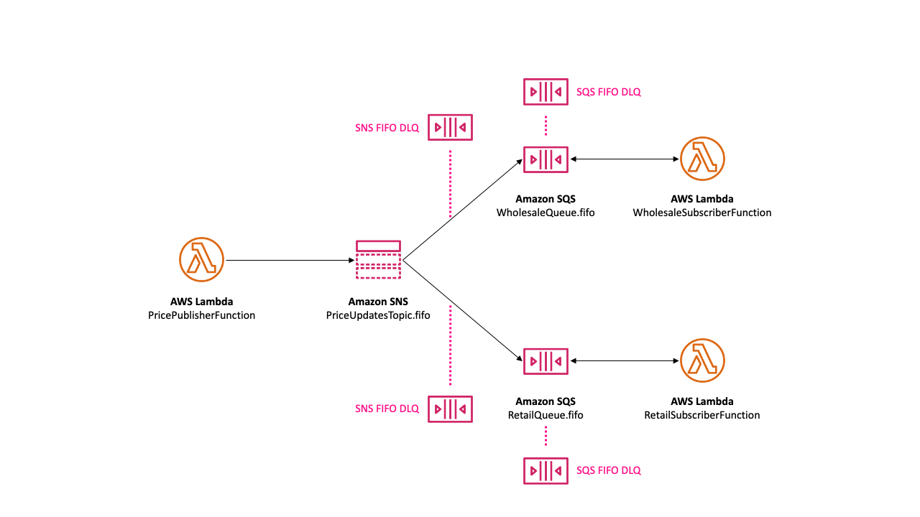
SNS Message Durability

Slide 18
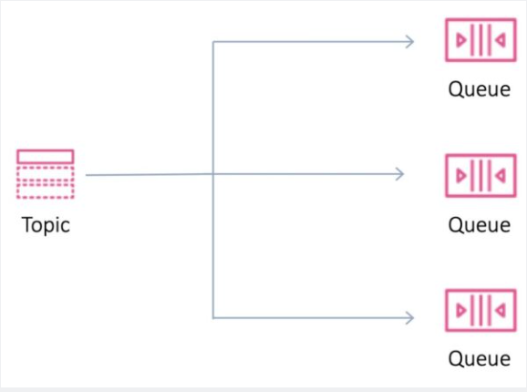
SNS - Fanout
Your publisher systems can fanout messages to many subscriber systems including Amazon SQS queues, AWS Lambda functions and HTTPS endpoints, for parallel processing, and Amazon Kinesis Data Firehose.
You can subscribe one or more Amazon SQS queues to an Amazon SNS topic from a list of topics available for the selected queue.
Amazon SQS manages the subscription and any necessary permissions.
When you publish a message to a topic, Amazon SNS sends the message to every subscribed queue.
Fanout is supported for application-to-application (A2A) messaging

Slide 19
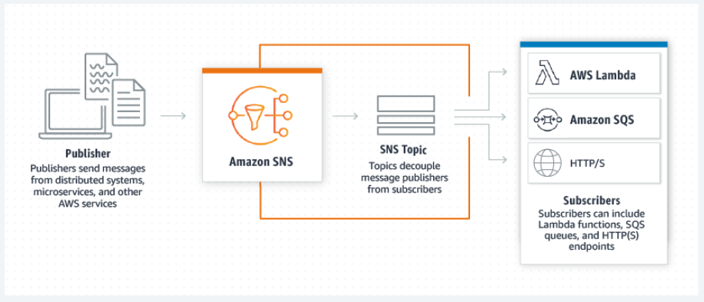
SNS – Application-to-application (A2A)
A2A - interaction or data exchange between different software applications
Amazon SNS is a managed messaging service that lets you decouple publishers from subscribers.
This is useful for application-to-application messaging for microservices, distributed systems, and serverless applications.
Options:
Fanout to Kinesis Data Firehose delivery streams
Fanout to Lambda functions
Fanout to Amazon SQS queues
Fanout to HTTP/S endpoints
Fanout to AWS Event Fork Pipelines

Slide 20
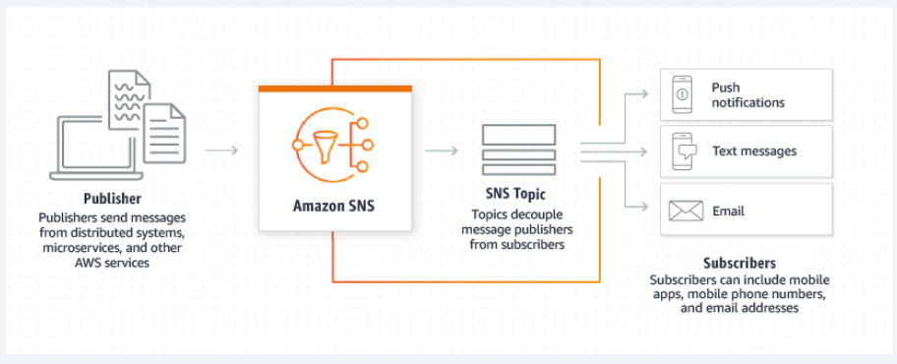
SNS - Application-to-person (A2P)
A2P - the process of sending messages from an application directly to a user, typically via SMS, email, or mobile push notifications
Amazon SNS lets you send push notifications to mobile apps, text messages to mobile phone numbers, and plain-text emails to email addresses.
You can fan out messages with a topic, or publish to mobile endpoints directly.
Options:
Mobile text messaging (SMS)
Mobile push notifications
Email notifications

Slide 21
Common Amazon SNS scenarios
The Fanout scenario is when a message published to an SNS topic is replicated and pushed to multiple endpoints, such as Kinesis Data Firehose delivery streams, Amazon SQS queues, HTTP(S) endpoints, and Lambda functions. This allows for parallel asynchronous processing.
Amazon SNS can send push email messages and text messages (SMS messages) to individuals or groups. For example, you could send e-commerce order confirmations as user notifications
Mobile push notifications enable you to send messages directly to mobile apps. For example, you can use Amazon SNS to send update notifications to an app.
Application and system alerts are notifications that are triggered by predefined thresholds. Amazon SNS can send these notifications to specified users via SMS and email. For example, you can receive immediate notification when an event occurs, such as a specific change to your Amazon EC2 Auto Scaling group, a new file uploaded to an Amazon S3 bucket, or a metric threshold breached in Amazon CloudWatch.

Slide 22
SNS Encryption
Encryption in Transit:
AWS SNS automatically encrypts messages in transit using HTTPS, which is a combination of HTTP and SSL/TLS. This means that the data is encrypted as it moves between your application and AWS SNS, protecting it from being intercepted by unauthorized parties.
This is the default behavior and does not require any additional configuration from the user.
Encryption at Rest:
AWS SNS supports encryption at rest using AWS Key Management Service (KMS). This means that when your messages are stored on AWS servers, they are encrypted to protect them from unauthorized access.
To enable encryption at rest, you need to configure it in your SNS topic settings. You can select a default encryption key provided by AWS, or you can use a custom AWS KMS key that you manage.
When you use a custom KMS key, you can set and manage permissions for who can use the key to encrypt and decrypt your SNS messages.
SSE doesn't encrypt the following:
Topic metadata (topic name and attributes)
Message metadata (subject, message ID, timestamp, and attributes)
Per-topic metrics
Logging and Monitoring:
For enhanced security, you can integrate AWS SNS with CloudTrail and CloudWatch. CloudTrail provides logs of all SNS API calls, helping you to monitor and audit usage, while CloudWatch can be used to set alarms and react to specific events.

Slide 23
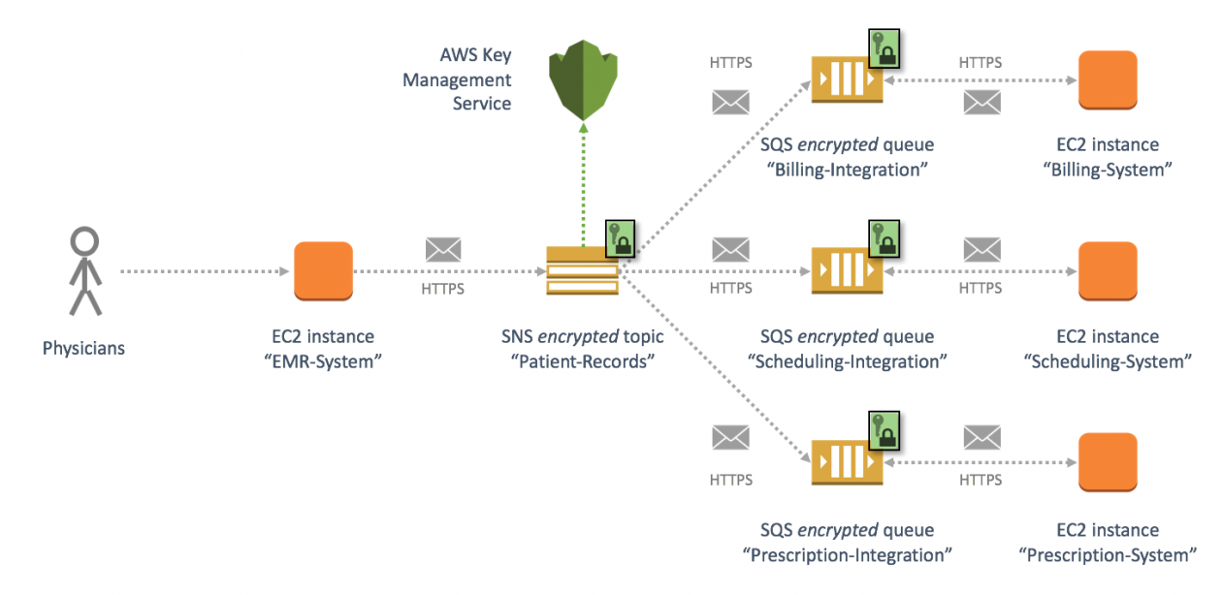
SNS Encryption

Slide 24
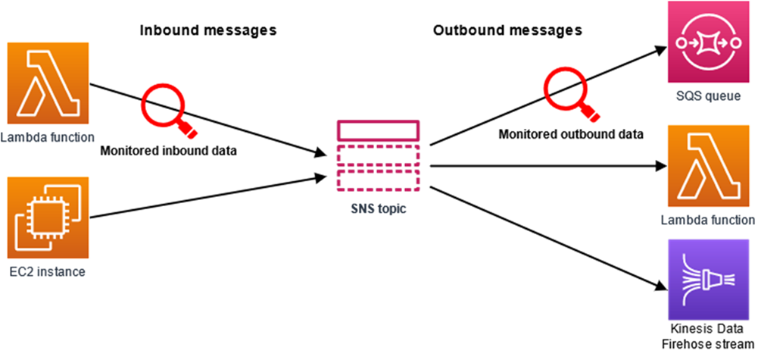
SNS Data protection policies
What is message data protection?
Message data protection safeguards the data that's published to your Amazon SNS topics by using data protection policies to audit, mask, redact or block the sensitive information that moves between applications or AWS services.
Message data protection scans data in motion for personally identifiable information (PII) and protected health information (PHI) using predefined data identifiers (name, address, etc.)
Using the scanned information, message data protection provides detailed audit logs, and allows you to take action to protect that data.

Slide 25
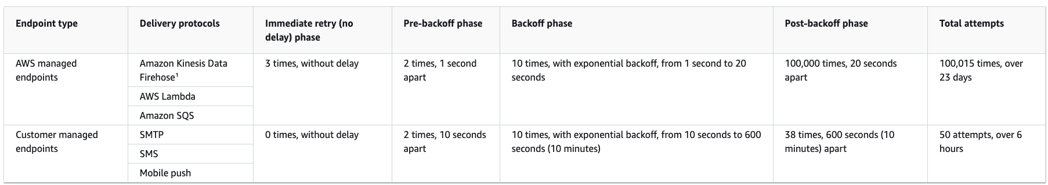
Amazon SNS message delivery retries
Note
With the exception of HTTP/S, you can't change Amazon SNS-defined delivery policies. Only HTTP/S supports custom policies. See Creating an HTTP/S delivery policy.
Amazon SNS applies jittering to delivery retries. For more information, see the Exponential Backoff and Jitter post on the AWS Architecture Blog.
The total policy retry time for an HTTP/S endpoint cannot be greater than 3,600 seconds. This is a hard limit and cannot be increased.
https://aws.amazon.com/blogs/architecture/exponential-backoff-and-jitter/

Slide 26
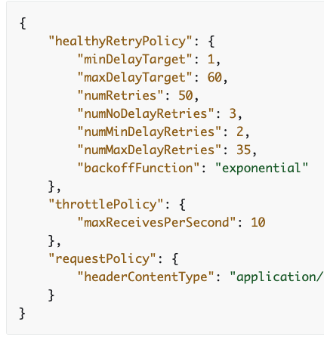
AWS SNS HTTP/S Retry Delivery Policy
You can use a delivery policy and its four phases to define how Amazon SNS retries the delivery of messages to HTTP/S endpoints.
Amazon SNS lets you override the default retry policy for HTTP endpoints when you might, for example, want to customize the policy based on your HTTP server's capacity.
The following JSON object represents a delivery policy that instructs Amazon SNS to retry a failed HTTP/S delivery attempt, as follows:
3 times immediately in the no-delay phase
2 times (1 second apart) in the pre-backoff phase
10 times (with exponential backoff from 1 second to 60 seconds)
35 times (60 seconds apart) in the post-backoff phase
In this sample delivery policy, Amazon SNS makes a total of 50 attempts before discarding the message
https://docs.aws.amazon.com/sns/latest/dg/sns-message-delivery-retries.html

Slide 27
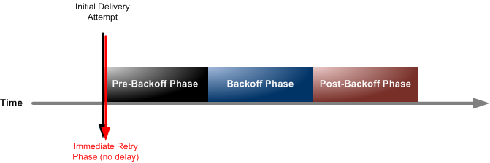
Amazon SNS message delivery retries: Delivery policy stages
Each delivery policy is comprised of four phases.
Immediate Retry Phase (No Delay) – This phase occurs immediately after the initial delivery attempt. There is no delay between retries in this phase.
Pre-Backoff Phase – This phase follows the Immediate Retry Phase. Amazon SNS uses this phase to attempt a set of retries before applying a backoff function. This phase specifies the number of retries and the amount of delay between them.
Backoff Phase – This phase controls the delay between retries by using the retry-backoff function. This phase sets a minimum delay, a maximum delay, and a retry-backoff function that defines how quickly the delay increases from the minimum to the maximum delay. The backoff function can be arithmetic, exponential, geometric, or linear.
Post-Backoff Phase – This phase follows the backoff phase. It specifies a number of retries and the amount of delay between them. This is the final phase.

Slide 28
Amazon SQS DLK – Redrive Policy
AWS SNS supports the use of Dead-Letter Queues (DLQs) to handle message delivery failures. A DLQ is a secondary queue where messages from the primary queue (or topic in the case of SNS) are sent if they can't be delivered successfully after a specified number of attempts. The use of a DLQ allows for better management and isolation of undeliverable messages.
Purpose of DLQs:
Isolate Undeliverable Messages: DLQs help in isolating messages that cannot be delivered due to various reasons, such as endpoint issues or message content problems.
Prevent Message Loss: They ensure that messages are not lost but are stored for further analysis and reprocessing.
Redrive Policy:
A Redrive Policy in AWS SNS is a set of rules that determines when a message should be moved to a DLQ. It typically specifies the maximum number of delivery attempts before a message is redirected to the DLQ.
You configure the Redrive Policy at the SNS topic level, specifying which SQS queue should act as the DLQ.
Use Cases for DLQs:
Debugging and Troubleshooting: DLQs provide a way to capture and store messages that failed to be processed, which is invaluable for debugging and resolving issues.
Safeguard Against Data Loss: In critical applications where every message is important, DLQs act as a safeguard against data loss due to processing failures.
Limitations:
Manual Intervention Required: The messages in a DLQ typically require manual intervention to investigate and reprocess.
Not a Substitute for Proper Error Handling: While DLQs are helpful, they should not replace robust error handling and retry logic in your application.

Slide 29
SQS vs SNS vs Kafka
Apache Kafka
Type: Distributed event streaming platform.
Use Cases: Kafka is designed for high-throughput, persistent, and real-time streaming of data records. It's well-suited for scenarios like log aggregation, stream processing, event sourcing, and real-time analytics.
Features:
Distributed: Kafka is run as a cluster on one or more servers.
High Throughput: Can handle thousands of messages per second.
Scalability: Scales horizontally with minimal downtime.
Durability: Stores streams of records in a fault-tolerant way.
Real-Time: Processes records as they arrive.
Data Retention: Configurable data retention policies allow storing data for a predetermined amount of time or until a certain size is reached.
Publisher/Subscriber Model: Supports both publishing/subscribing and point-to-point messaging through topics.
Cons: Complexity in setup and management.
Requires manual scaling efforts.
Kafka is ideal for real-time streaming and processing of large volumes of data.
Amazon Simple Notification Service (SNS)
Type: Fully managed pub/sub messaging service.
Use Cases: SNS is used for building and integrating loosely-coupled, distributed applications. It's great for notifications, mobile push notifications, and decoupling microservices architecture.
Features:
Fully Managed: No need to manage the underlying infrastructure.
Scalability: Automatically scales with the number of messages.
Flexibility: Supports multiple subscriber types including HTTP/HTTPS, email, SMS, Lambda, SQS, etc.
Simplicity: Easy to set up and start with.
Durability and Availability: Highly available and durable service provided by AWS.
Publisher/Subscriber Model: Emphasizes the pub/sub model, allowing a message to be sent to multiple subscribers simultaneously.
Cons: Limited message customization for different subscribers.
Primarily designed for notifications rather than heavy-duty message queuing or stream processing.
SNS is best for pub/sub scenarios, where a message needs to be pushed to multiple subscribers across various channels.
Amazon Simple Queue Service (SQS)
Type: Fully managed message queuing service.
Use Cases: SQS is used to decouple and scale microservices, distributed systems, and serverless applications. It's suitable for scenarios where you need to process messages in a controlled manner.
Features:
Two Types: Standard (high throughput, at-least-once delivery, best-effort ordering) and FIFO (first-in-first-out delivery, exactly-once processing).
Scalability: Automatically scales to handle high volumes of messages.
Fully Managed: Eliminates the overhead of managing message-oriented middleware.
Durability: Stores messages across multiple Availability Zones.
Polling Models: Supports both short and long polling to retrieve messages.
Use Pattern: Primarily focused on point-to-point messaging and ensuring messages are processed in order or exactly once (in the case of FIFO queues).
Cons: Limited message retention (up to 14 days).
Potential for higher latencies in comparison to Kafka.
SQS is designed for decoupling components of a cloud application, ensuring messages are processed in order or exactly once, depending on the queue type.

