Slide 1
SQS

Slide 2
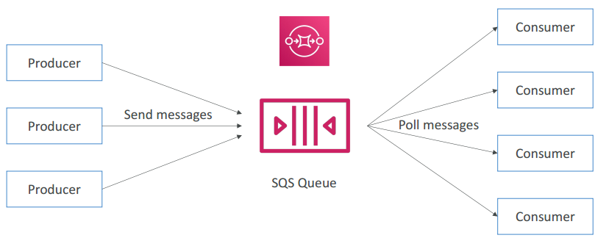
SQS
Amazon Simple Queue Service (Amazon SQS) offers a secure, durable, and available hosted queue that lets you integrate and decouple distributed software systems and components.
Amazon SQS enables you to send, store, and receive messages between software components.
An Amazon SQS queue is a temporary repository for messages that are awaiting processing.
Amazon SQS supports two types of queues – standard queues and FIFO queues.

Slide 3
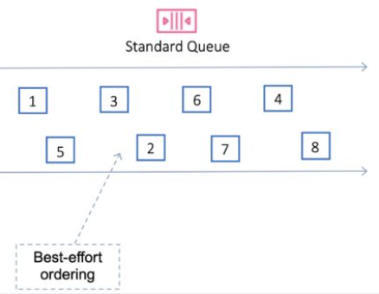
SQS Standard
Amazon SQS offers standard as the default queue type.
Standard queues support a nearly unlimited number of API calls per second, per API action (SendMessage, ReceiveMessage, or DeleteMessage).
Standard queues support at-least-once message delivery.
However, occasionally (because of the highly distributed architecture that allows nearly unlimited throughput), more than one copy of a message might be delivered out of order.
Standard queues provide best-effort ordering which ensures that messages are generally delivered in the same order as they're sent.

Slide 4
SQS Standard Scenarios
You can use standard message queues in many scenarios, as long as your application can process messages that arrive more than once and out of order, for example:
Decouple live user requests from intensive background work – Let users upload media while resizing or encoding it.
Allocate tasks to multiple worker nodes – Process a high number of credit card validation requests.
Batch messages for future processing – Schedule multiple entries to be added to a database.

Slide 5
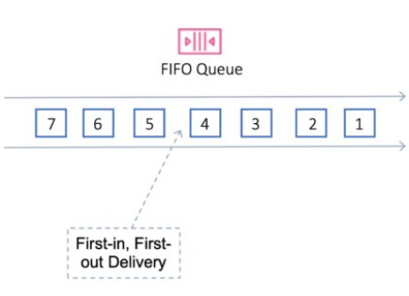
SQS FIFO
Amazon SQS FIFO (First-In-First-Out) queues have all the capabilities of the standard queues, but designed to enhance messaging between applications when the order of operations and events is critical, or where duplicates can't be tolerated.
Examples of situations where you might use FIFO queues include the following:
E-commerce order management system where order is critical
Integrating with a third-party systems where events need to be processed in order
Processing user-entered inputs in the order entered
Communications and networking – Sending and receiving data and information in the same order
Computer systems – Making sure that user-entered commands are run in the right order
Educational institutes – Preventing a student from enrolling in a course before registering for an account
Online ticketing system – Where tickets are distributed on a first come first serve basis

Slide 6
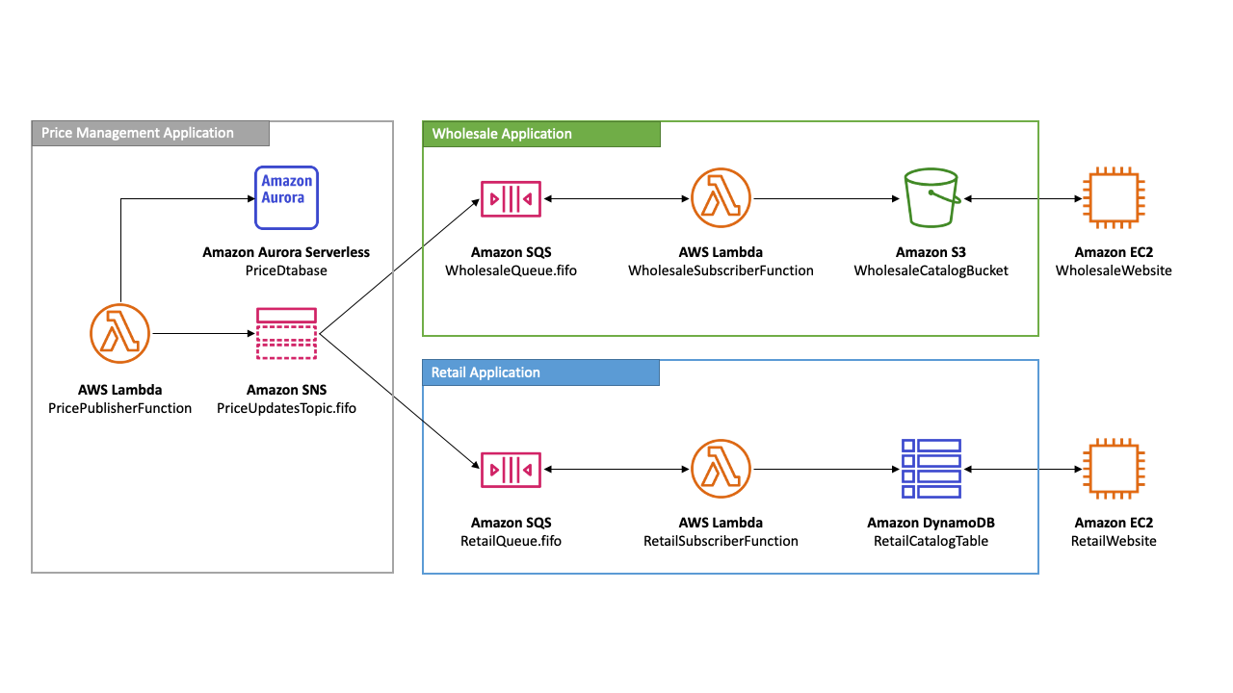
FIFO Example with SNS & SQS

Slide 7
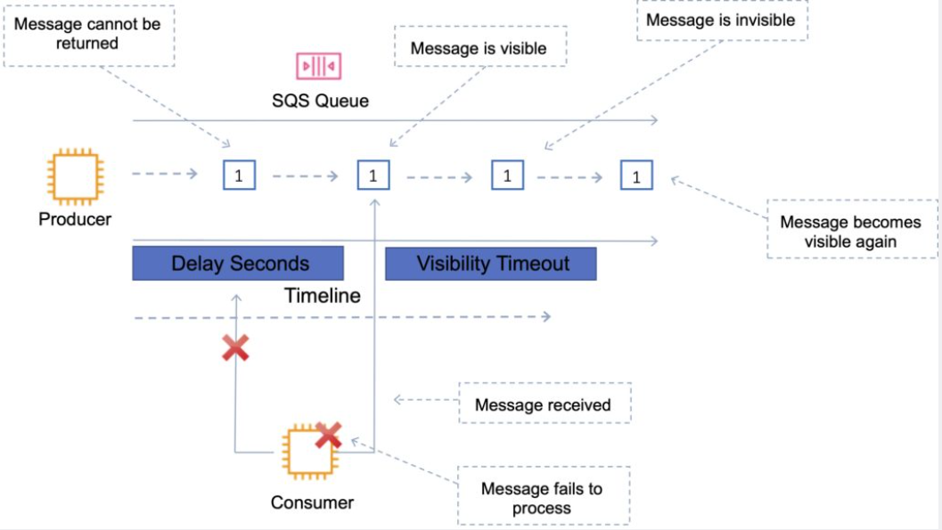
SQS - Visibility timeout
The amount of time a message is invisible in the queue after a reader picks it up.
Provided the job is processed before the visibility timeout expires, the message will then be deleted from the queue.
If the job is not processed within the visibility timeout, the message will become visible again and another reader will process it.
This could result in the same message being delivered twice.
The default visibility timeout is 30 seconds.
Increase it if your task takes > 30 seconds.
The maximum is 12 hours.

Slide 8
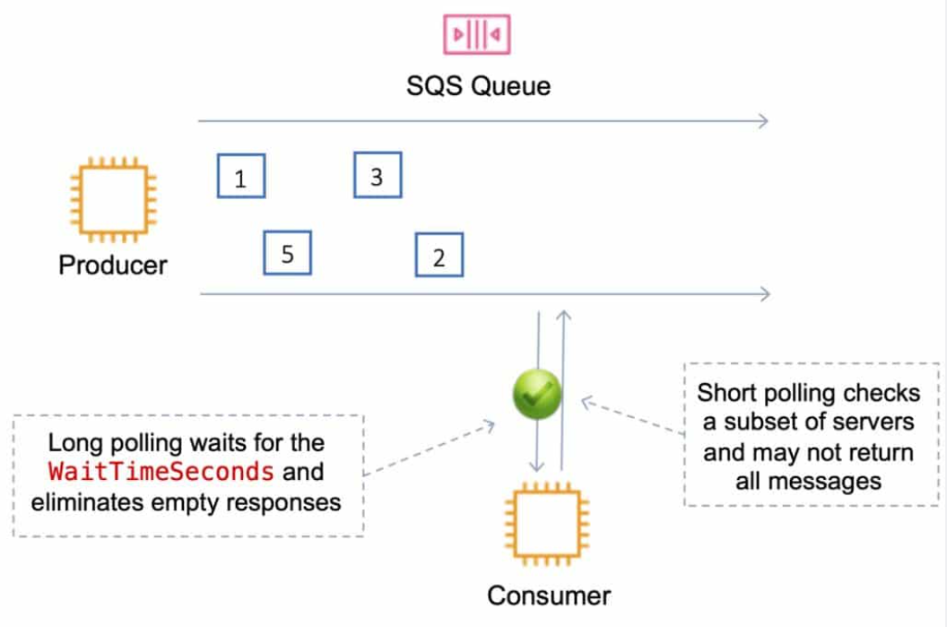
SQS Polling: Short and Long polling
SQS uses short polling and long polling:
Amazon SQS long polling is a way to retrieve messages from SQS queues.
Short polling returns immediately (even if the message queue is empty).
Long polling doesn’t return a response until a message arrives in the message queue or the long poll times out.
Long polling can be enabled at the queue level or at the API level using WaitTimeSeconds.
Long polling is in effect when the Receive Message Wait Time is a value greater than 0 seconds and up to 20 seconds.

Slide 9
SQS Polling
Long polling:
Uses fewer requests and reduces cost.
Eliminates false empty responses by querying all servers.
SQS waits until a message is available in the queue before sending a response.
Requests contain at least one of the available messages up to the maximum number of messages specified in the ReceiveMessage action.
Shouldn’t be used if your application expects an immediate response to receive message calls.
ReceiveMessageWaitTime is set to a non-zero value (up to 20 seconds).
Same charge per million requests as short polling.
Short polling:
Does not wait for messages to appear in the queue.
It queries only a subset of the available servers for messages (based on weighted random execution).
Short polling is the default.
ReceiveMessageWaitTime is set to 0.
More requests are used, which implies higher cost.

Slide 10
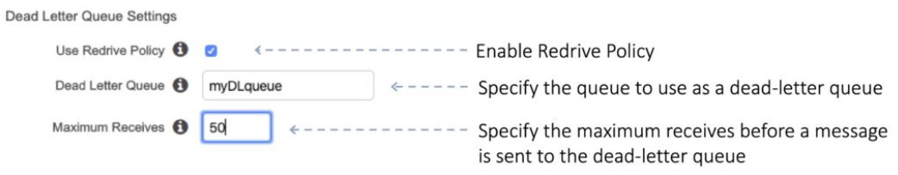
SQS - Dead-Letter Queue
The main task of a dead-letter queue is handling message failure.
A dead-letter queue lets you set aside and isolate messages that can’t be processed correctly to determine why their processing didn’t succeed.
It is not a queue type; it is a standard or FIFO queue that has been specified as a dead-letter queue in the configuration of another standard or FIFO queue.

Slide 11
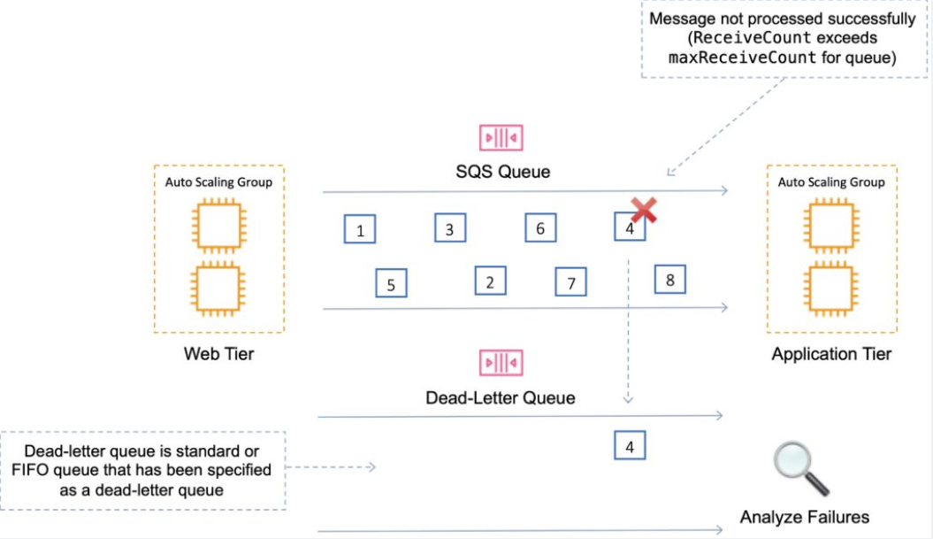
SQS - Dead-Letter Queue
Messages are moved to the dead-letter queue when the ReceiveCount for a message exceeds the maxReceiveCount for a queue.
Dead-letter queues should not be used with standard queues when your application will keep retrying transmission.
Dead-letter queues will break the order of messages in FIFO queues.
Consider using DLQs if your application does not have its own retry mechanism or if you want to isolate messages that repeatedly fail to be processed for investigation.
Why DLQs May Not Be Ideal with Standard Queues and Retries:
If your application logic includes retrying message processing multiple times (and especially if it's capable of handling duplicates), then using a DLQ with a standard queue might not be necessary or beneficial. This is because:
The application is already handling retries, reducing the need for a DLQ.
The nature of standard queues means there might be duplicate messages, and these duplicates could be falsely interpreted as failed messages and moved to the DLQ.
This could lead to unnecessary complexity and confusion, as the DLQ could be filled with messages that are not truly 'dead' but simply duplicates.

Slide 12
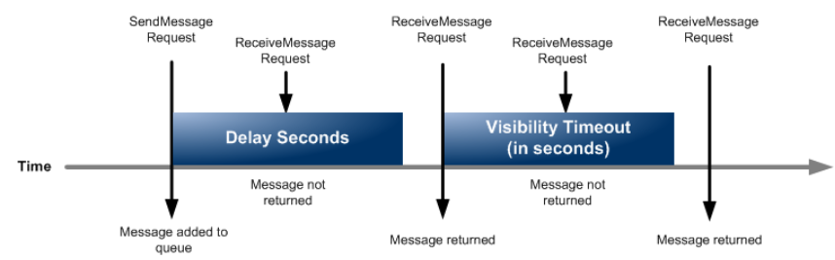
SQS Delay Queues
A delay queue postpones delivery of new messages to a queue for a number of seconds.
Messages sent to the Delay Queue remain invisible to consumers for the duration of the delay period.
Default delay is 0 seconds, maximum is 900 seconds (15 minutes).
For standard SQS queues, changing this setting doesn’t affect the delay of messages already in the queue, only new messages.
For FIFO queues, this affects the delay of messages already in the queue.
When to use a delay queue:
Large distributed applications which may need to introduce a delay in processing.
You need to apply a delay to an entire queue of messages.
For example, adding a delay of a few seconds to allow updates to sales or stock control databases before sending a notification to a customer confirming an online transaction.
DLQs must be the same type as the source.

Slide 13
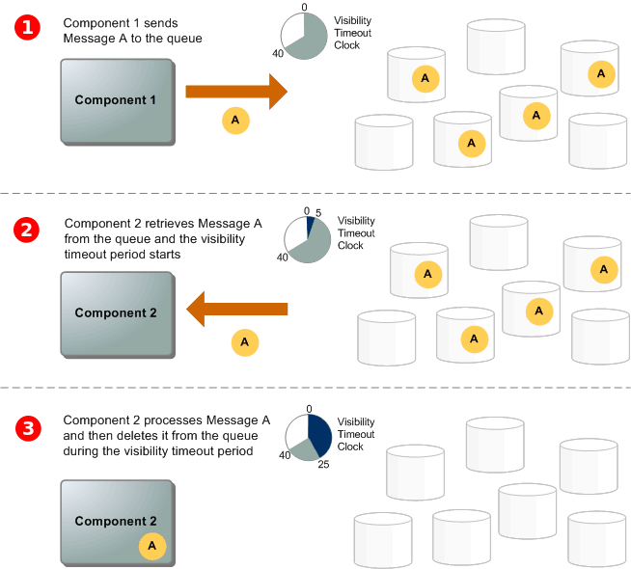
SQS Message lifecycle

Slide 14
SQS Monitoring
CloudWatch is integrated with SQS and you can view and monitor queue metrics.
CloudWatch metrics are automatically collected every 5 minutes.
CloudWatch considers a queue to be active for up to 6 hours if it contains any messages or if any API action accesses it.
No charge for CloudWatch (no detailed monitoring).
CloudTrail captures API calls from SQS and logs to a specified S3 bucket.

Slide 15
SQS Security
You can use IAM policies to control who can read/write messages.
Authentication can be used to secure messages within queues (who can send and receive).
SQS is PCI DSS level 1 compliant and HIPAA eligible.
In-flight security is provided using HTTPS.
Can enable server-side encryption (SSE) using KMS.
Can set the CMK you want to use.
Can set the data key reuse period.
SSE only encrypts the message body not the message attributes.
IAM policy must allow usage of SQS.
You can also specify permissions in an SQS queue access policy:
Providers finer grained control.
Control over the requests that come in.

Slide 16
SQS Recap
Standard queues:
Unlimited Throughput – Standard queues support a nearly unlimited number of API calls per second, per API action (SendMessage, ReceiveMessage, or DeleteMessage).
At-Least-Once Delivery – A message is delivered at least once, but occasionally more than one copy of a message is delivered.
Best-Effort Ordering – Occasionally, messages are delivered in an order different from which they were sent.
FIFO queues:
High Throughput – If you use batching, FIFO queues support up to 3,000 calls per second, per API method (SendMessageBatch, ReceiveMessage, or DeleteMessageBatch). The 3,000 calls per second represent 300 API calls, each with a batch of 10 messages. To request a quota increase, submit a support request. Without batching, FIFO queues support up to 300 API calls per second, per API method (SendMessage, ReceiveMessage, or DeleteMessage).
Exactly-Once Processing – A message is delivered once and remains available until a consumer processes and deletes it. Duplicates aren't introduced into the queue.
First-In-First-Out Delivery – The order in which messages are sent and received is strictly preserved.

Slide 17
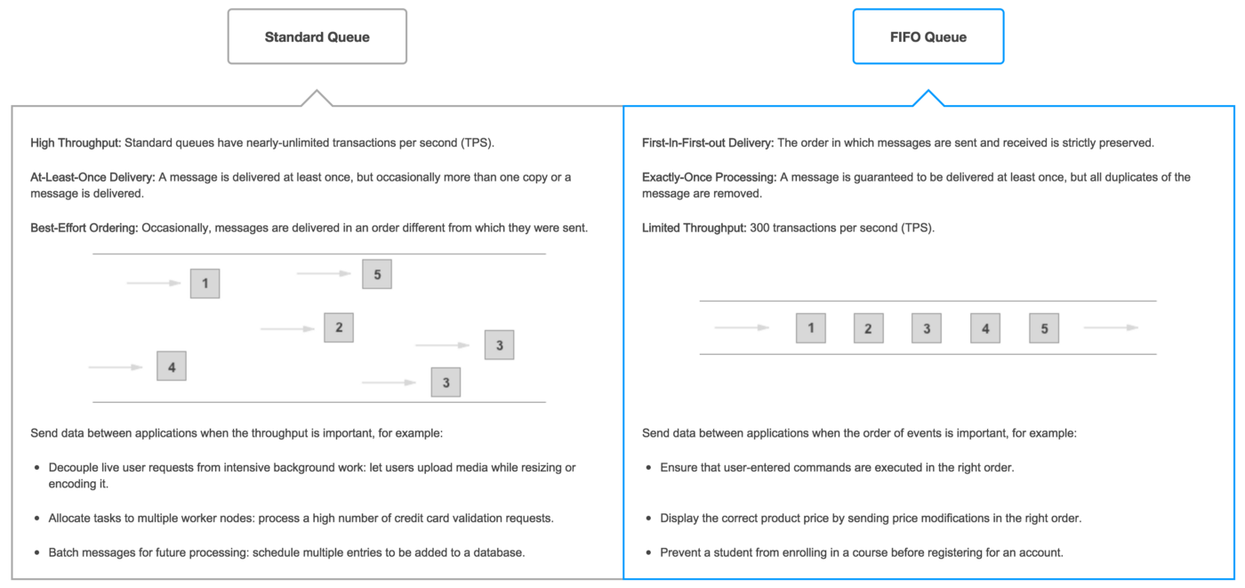
FIFO VS Standard

Slide 18
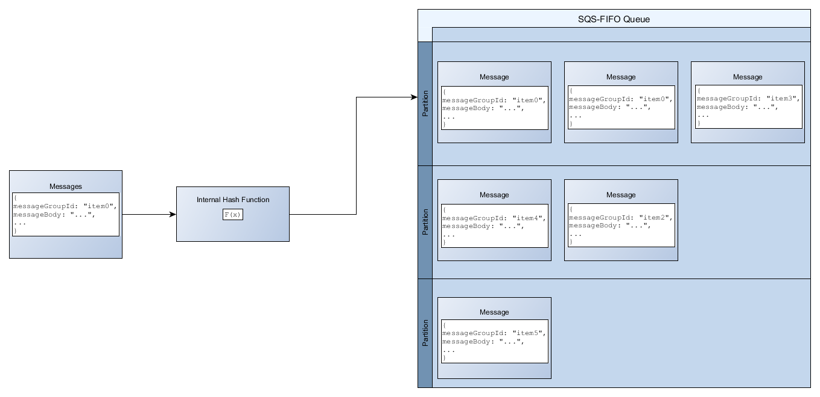
High throughput for FIFO queues: Distributing data by message group IDs
To add a message to a FIFO queue, Amazon SQS uses the value of each message’s message group ID as input to an internal hash function.
The output value from the hash function determines which partition stores the message.

Slide 19
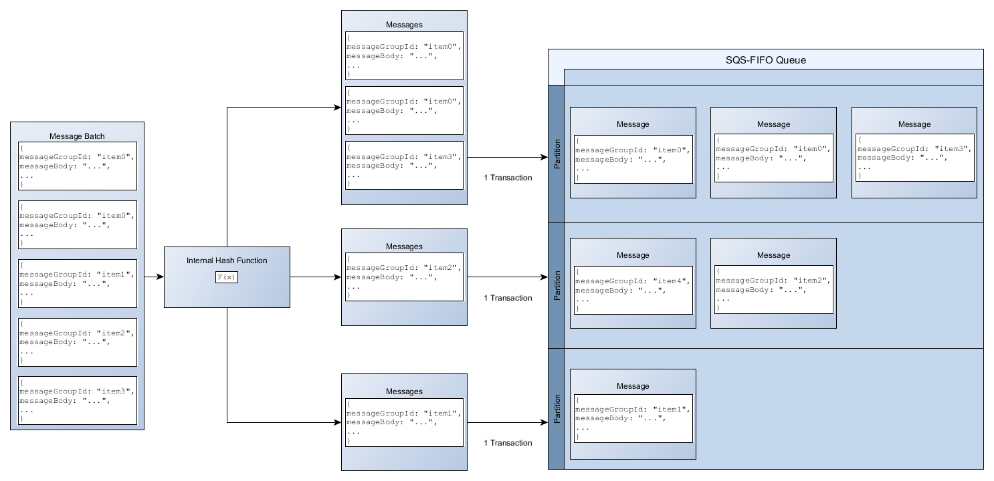
High throughput for FIFO queues: Optimizing partition utilization
https://docs.aws.amazon.com/AWSSimpleQueueService/latest/SQSDeveloperGuide/high-throughput-fifo.html
Each partition supports up to 3,000 messages per second with batching, or up to 300 messages per second for send, receive, and delete operations in supported regions.
When using batch APIs, each message is routed based on the process described in Distributing data by message group IDs.
Messages that are routed to the same partition are grouped and processed in a single transaction.
To optimize partition utilization for the SendMessageBatch API, AWS recommends batching messages with the same message group IDs when possible.

Slide 20
Differences between Amazon SQS, Amazon MQ, and Amazon SNS
Resource type | Amazon SNS | Amazon SQS | Amazon MQ
Synchronous | No | No | Yes
Asynchronous | Yes | Yes | Yes
Queues | No | Yes | Yes
Publisher-subscriber messaging | Yes | No | Yes
Message brokers | No | No | Yes
Amazon SQS offers hosted queues that integrate and decouple distributed software systems and components. Amazon SQS provides a generic web services API that you can access using any programming language supported by AWS SDK. Messages in the queue are typically processed by a single subscriber. Amazon SQS and Amazon SNS are often used together to create a fanout messaging application.
Amazon SNS is a publish-subscribe service that provides message delivery from publishers (producers) to multiple subscriber endpoints(consumers). Publishers communicate asynchronously with subscribers by sending messages to a topic, which is a logical access point and communication channel. Subscribers can subscribe to an Amazon SNS topic and receive published messages using a supported endpoint type, such as Amazon Kinesis Data Firehose, Amazon SQS, Lambda, HTTP, email, mobile push notifications, and mobile text messages (SMS). Amazon SNS acts as a message router and delivers messages to subscribers in real time. If a subscriber is not available at the time of message publication, the message is not stored for later retrieval.
Amazon MQ is a managed message broker service that provides compatibility with industry standard messaging protocols such as Advanced Message Queueing Protocol (AMQP) and Message Queuing Telemetry Transport (MQTT). Amazon MQ currently supports Apache ActiveMQ and RabbitMQ engine types.
Both Amazon SQS and Amazon SNS are recommended for new applications that can benefit from nearly unlimited scalability and simple APIs. We recommend Amazon MQ for migrating applications from existing message brokers that rely on compatibility with APIs such as JMS or protocols such as Advanced Message Queuing Protocol (AMQP), MQTT, OpenWire, and Simple Text Oriented Message Protocol (STOMP).

Slide 21
Hands one!!!
Goal: We have an order processing system.
Some system uploads json order in s3 bucket
On file uploading lambda A should be invoked and publish event into SNS topic OrderReceiverTopic
OrderReceiverTopic in SNS
OrderReceiverTopic invokes lambda Bfor order processing
On fail message should go to DLQ. OrdersQueqeDLQ
On success message should go to SNS and send email

Slide 22
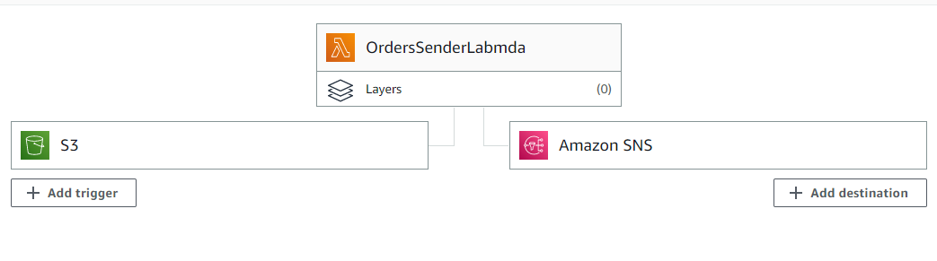
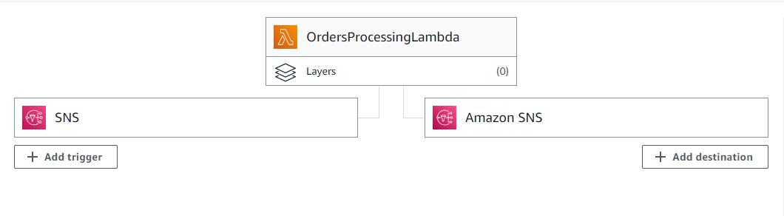
Hands On

Slide 23
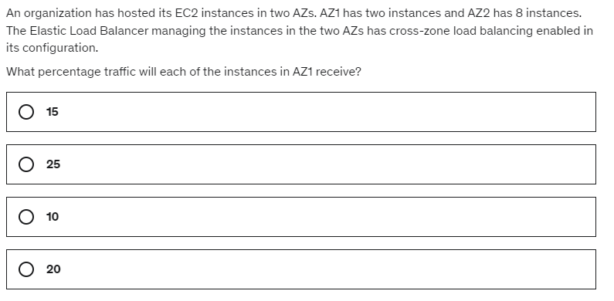
Questions Section

Slide 24
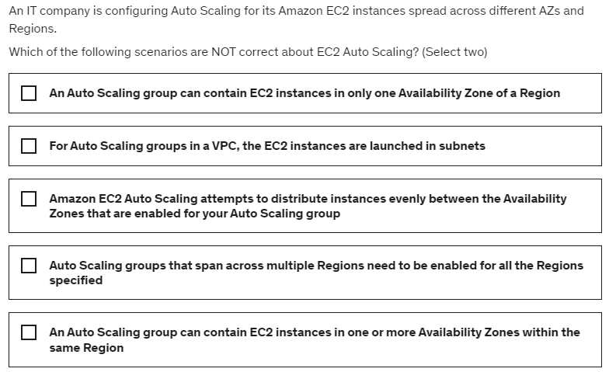
Questions Section

Slide 25
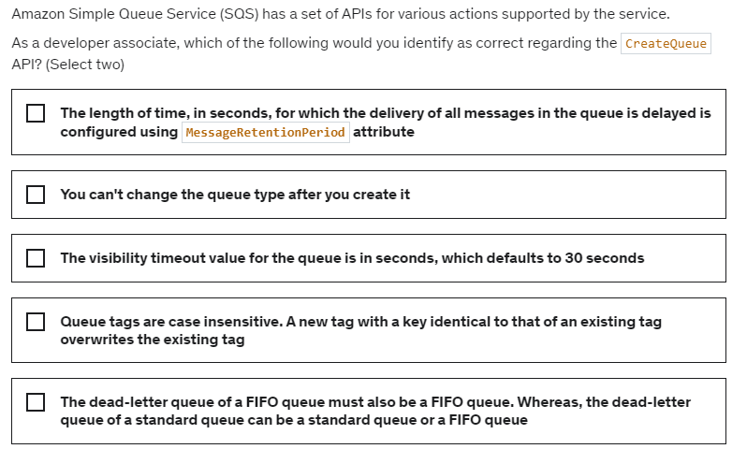
Questions Section

Slide 26
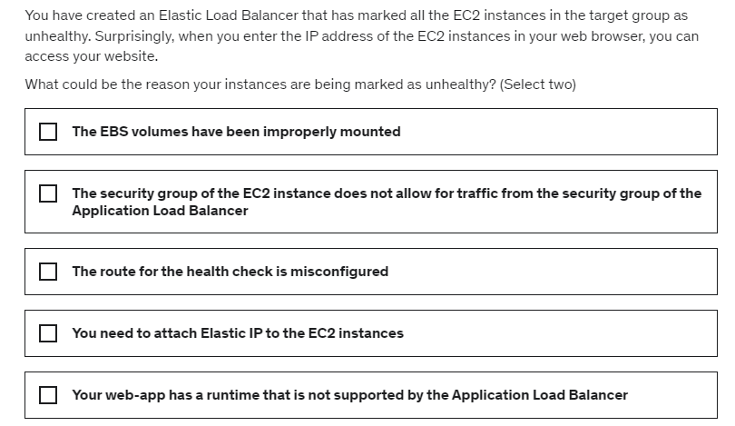
Questions Section

Slide 27
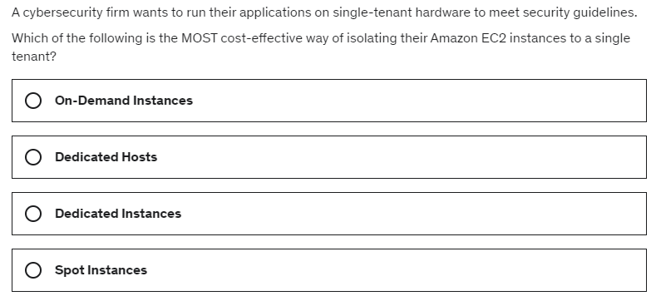
Questions Section

Slide 28
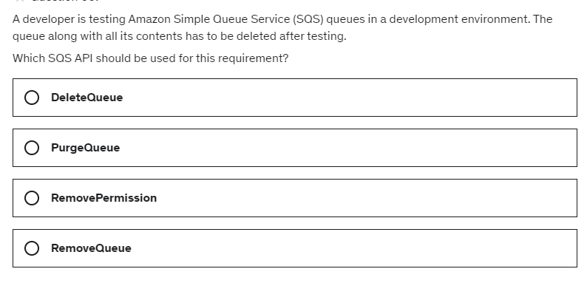
Questions Section

Slide 29
