Slide 1
AWS Batch

Slide 2
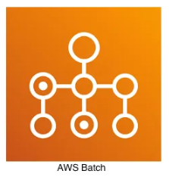
What Is AWS Batch?
AWS Batch helps you to run batch computing workloads of any scale.
AWS Batch automatically provisions compute resources and optimizes the workload distribution based on the quantity and scale of the workloads.
With AWS Batch, there's no need to install or manage batch computing software, so you can focus your time on analyzing results and solving problems.
EC2
Fargate
EKS
Supports EFA -> HPC

Slide 3
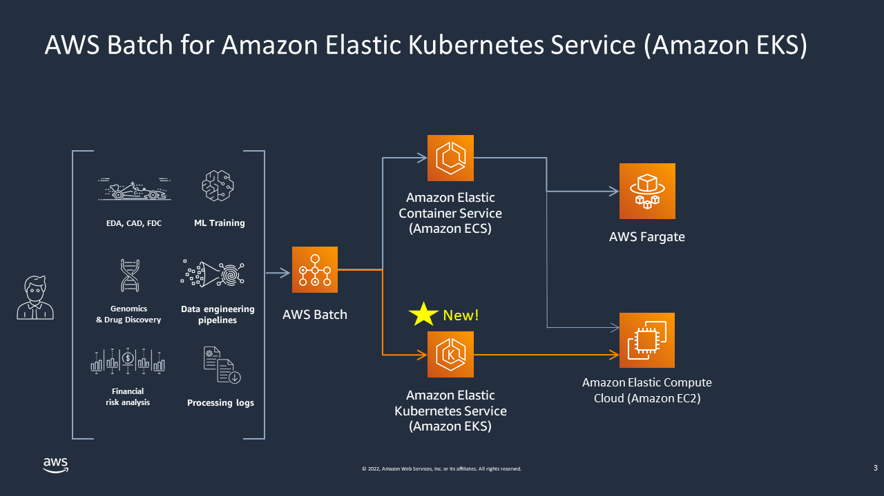

Slide 4
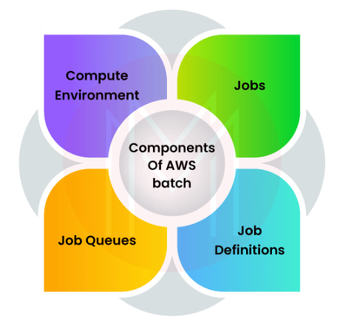
Components of AWS Batch:
Jobs — the unit of work submitted to AWS Batch, whether it be implemented as a shell script, executable, or Docker container image.
Job Definition — describes how your work is be executed, including the CPU and memory requirements and IAM role that provides access to other AWS services.
Job Queues — listing of work to be completed by your Jobs. You can leverage multiple queues with different priority levels.
Compute Environment — the compute resources that run your Jobs.
Environments can be configured to be managed by AWS or on your own as well as the number of and type(s) of instances on which Jobs will run.
You can also allow AWS to select the right instance type.

Slide 5
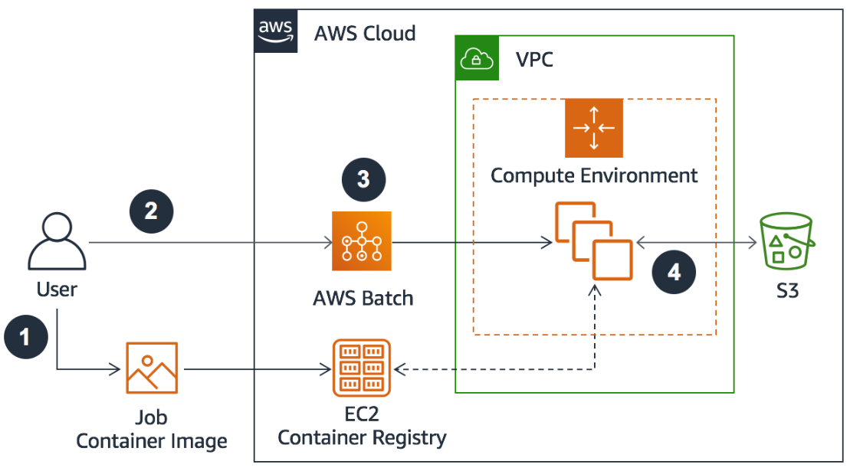
Example AWS Batch architecture
Workflow steps:
User creates a job container, uploads the container to the Amazon Elastic Container Registry or another container registry (for example, DockerHub), and creates a job definition to AWS Batch.
User submits jobs to a job queue in AWS Batch.
AWS Batch pulls the image from the container registry and processes the jobs in the queue
Input and output data from each job is stored in an S3 bucket.

Slide 6
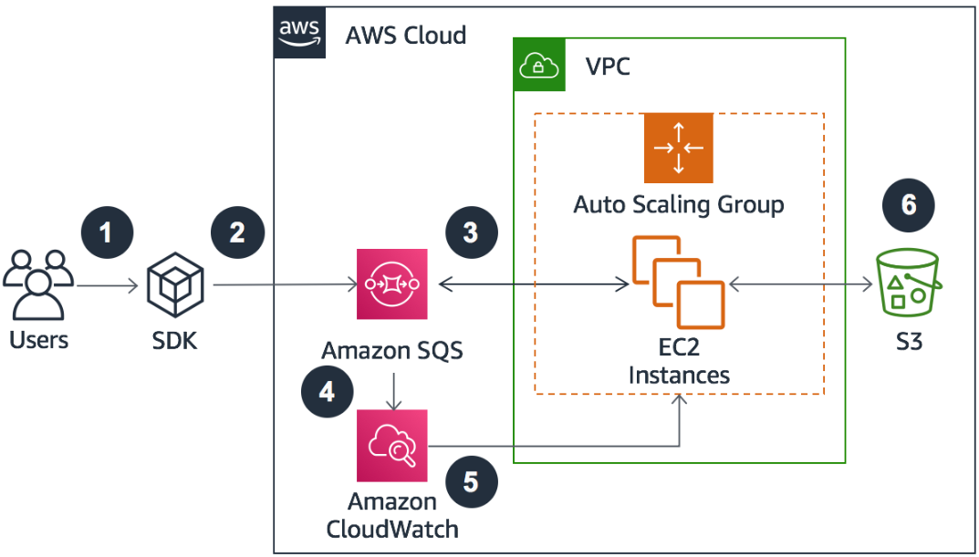
Amazon SQS deployed for a loosely coupled workload
Workflow steps:
Multiple users submit jobs with the AWS CLI or SDK.
The jobs are queued as messages in Amazon SQS.
EC2 Instances poll the queue and start processing jobs.
Amazon SQS emits metrics based on the number of messages (jobs) in the queue.
An Amazon CloudWatch alarm is configured to notify Auto Scaling if the queue is longer than a specified length. Auto Scaling increases the number of EC2 instances.
The EC2 instances pull source data and store result data in an S3 bucket.

Slide 7
Benefits
Operating third-party commercial or open-source batch processing systems is no longer necessary thanks to AWS Batch.
Because it is fully connected with the AWS platform, you can leverage its networking, scalability, and administration features.
It enables users to take advantage of the services without worrying about setting up and managing the required infrastructure.
Fully managed
Integrated with AWS
Cost-optimized resource provisioning

Slide 8
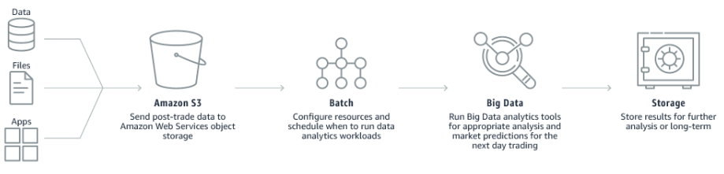
AWS Batch Use Cases
Financial services: Post-trade analytics :
It automates the evaluation of market performance, execution reporting, and transaction expenses for the day.

Slide 9
AWS Batch Security
By default, IAM users don’t have permission to create or modify AWS Batch resources or perform tasks using the AWS Batch API.
Take advantage of IAM policies, roles, and permissions.
You can control access to AWS Batch resources based on the tag values.

Slide 10
AWS Batch Monitoring
You can use the AWS Batch event stream for CloudWatch Events to receive near real-time notifications regarding the current state of jobs that have been submitted to your job queues.
Events from the AWS Batch event stream are ensured to be delivered at least one time.
CloudTrail captures all API calls for AWS Batch as events.

Slide 11
AWS Batch Best Practices
https://docs.aws.amazon.com/batch/latest/userguide/best-practices.html

