Slide 1
ECS & ECR

Slide 2
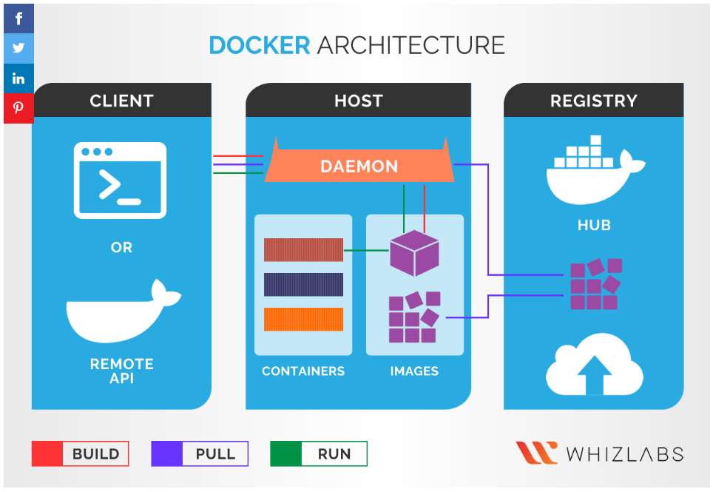
Docker Refresher
Docker is an open source platform that enables developers to build, deploy, run, update and manage containers—standardized, executable components that combine application source code with the operating system (OS) libraries and dependencies required to run that code in any environment.
A Docker Image is a read-only file with a bunch of instructions. When these instructions are executed, it creates a Docker container.
A host system that is installed with a docker application is technically termed as a docker engine.
Docker Desktop is an easy-to-install application for your Mac, Windows or Linux environment that enables you to build and share containerized applications and microservices.
A Docker registry stores Docker images.
Docker Hub is a public registry that anyone can use, and Docker is configured to look for images on Docker Hub by default. You can even run your own private registry.

Slide 3
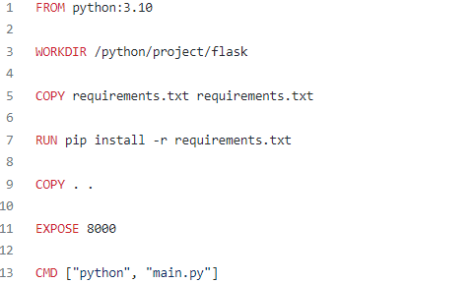
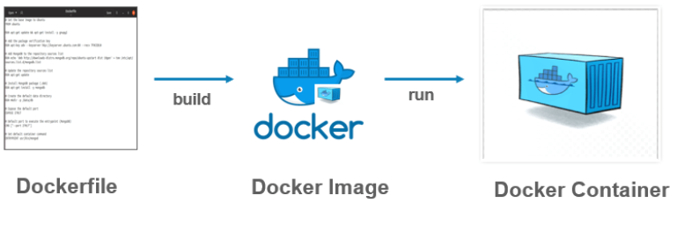
DockerFile
Dockerfile is a simple text file that consists of instructions to build Docker images.
Example

Slide 4
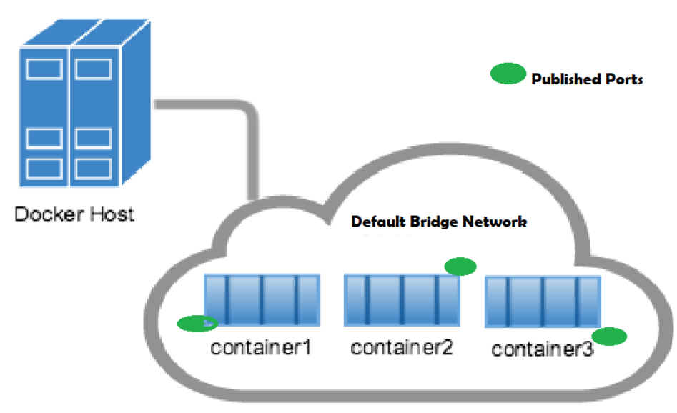
Network inside Docker
Docker networking is primarily used to establish communication between Docker containers and the outside world via the host machine where the Docker daemon is running.
When you install docker it creates three networks automatically - Bridge, Host, and None. Of which, Bridge is the default network a container gets attached to when it is run.

Slide 5
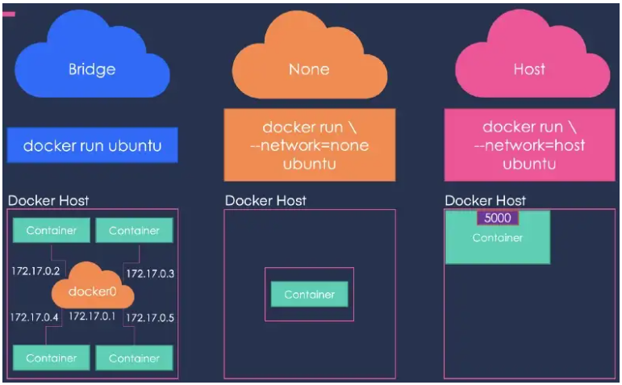
Network inside Docker
The Bridge network assigns IPs in the range of 172.17.x.x to the containers within it. To access these containers from outside you need to map the ports of these containers to the ports on the host.
Selecting the Host network will remove any network isolation between the docker host and the containers. For instance, if you run a container on port 5000, it will be accessible on the same port on the docker host without any explicit port mapping. The only downside of this approach is that you can not use the same port twice for any container.
Finally, the None network keeps the container in complete isolation, i.e. they are not connected to any network or container.

Slide 6
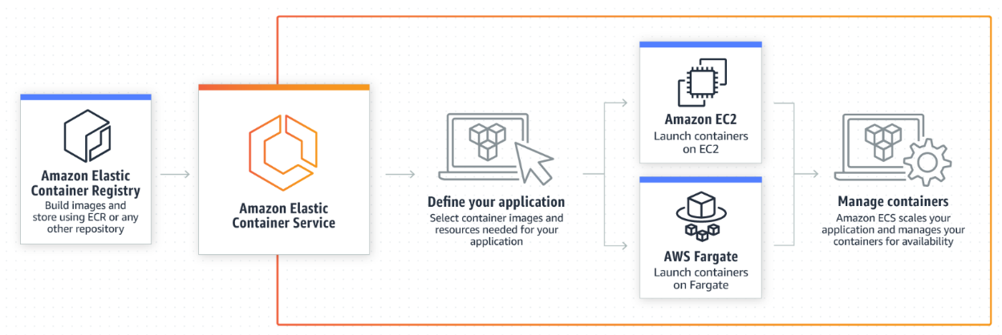
Amazon ECS
Amazon Elastic Container Service (Amazon ECS) is a highly scalable and fast container management service.
You can use it to run, stop, and manage containers on a cluster.
With Amazon ECS, your containers are defined in a task definition that you use to run an individual task or task within a service.
In this context, a service is a configuration that you can use to run and maintain a specified number of tasks simultaneously in a cluster.
You can run your tasks and services on a serverless infrastructure that's managed by AWS Fargate.
Alternatively, for more control over your infrastructure, you can run your tasks and services on a cluster of Amazon EC2 instances that you manage.

Slide 7
ECS Benefits
Easy and simple deployment—ECS eliminates the need to set up and maintain the infrastructure of Kubernetes clusters by taking responsibility over these tasks.
Scheduling capabilities—that enable you to schedule services, applications, and batch processes.
Managed availability—ECS is responsible for maintaining application availability and helps you scale up or down as needed to ensure capacity demands are met.
Native integration—with a wide range of features like AWS ELB, Amazon Virtual Private Cloud (Amazon VPC), IAM, and EBS.
Integration with existing tools—ECS provides simple APIs that let you integrate with your CI/CD pipeline and your existing tools.
Spot instances: Because containers are immutable, you can run many workloads using Amazon EC2 Spot Instances (which can be shut down with no advance notice) and save 90% on on-demand instance costs.

Slide 8
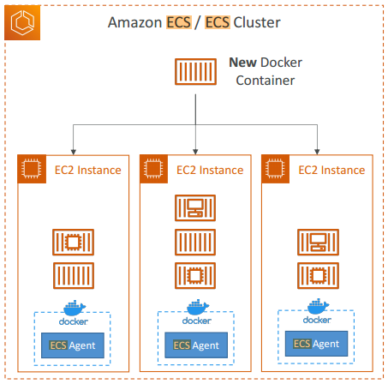
Amazon ECS - Launch types
EC2 launch type - Configure and deploy EC2 instances in your cluster to run your containers.
The EC2 launch type is suitable for the following workloads:
Workloads that require consistently high CPU core and memory usage
Large workloads that need to be optimized for price
Your applications need to access persistent storage
You must directly manage your infrastructure

Slide 9
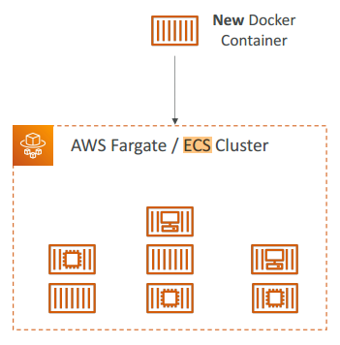
Amazon ECS - Launch types
Fargate launch type - This is a serverless pay-as-you-go option.
You can run containers without needing to manage your infrastructure.
The Fargate launch type is suitable for the following workloads:
Large workloads that need to be optimized for low overhead
Small workloads that have occasional burst
Tiny workloads
Batch workloads

Slide 10
Amazon ECS Overview
An Amazon ECS cluster is a logical grouping of tasks or services. You can use clusters to isolate your applications. This way, they don't use the same underlying infrastructure. When your tasks are run on Fargate, your cluster resources are also managed by Fargate.
A task definition is a text file that describes one or more containers that form your application. It's in JSON format. You can use it to describe up to a maximum of ten containers. The task definition functions as a blueprint for your application. It specifies the various parameters for your application.
A task is the instantiation of a task definition within a cluster. After you create a task definition for your application within Amazon ECS, you can specify the number of tasks to run on your cluster. You can run a standalone task, or you can run a task as part of a service.
The container agent runs on each container instance within an Amazon ECS cluster. The agent sends information about the current running tasks and resource utilization of your containers to Amazon ECS. It starts and stops tasks whenever it receives a request from Amazon ECS.
You can use an Amazon ECS service to run and maintain your desired number of tasks simultaneously in an Amazon ECS cluster. How it works is that, if any of your tasks fail or stop for any reason, the Amazon ECS service scheduler launches another instance based on your task definition. It does this to replace it and thereby maintain your desired number of tasks in the service.

Slide 11
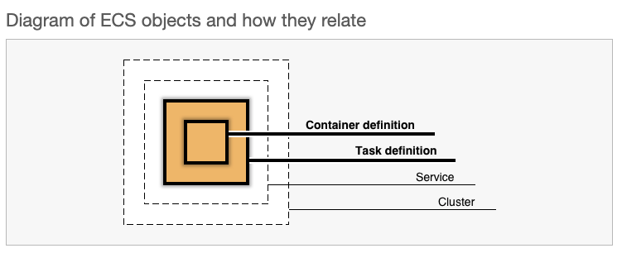
ECS Task Definition
A task definition is required to run Docker containers in Amazon ECS. You can define multiple containers in a task definition. After you create a task definition, you can run the task definition as a task or a service.
A task is the instantiation of a task definition within a cluster. After you create a task definition for your application within Amazon ECS, you can specify the number of tasks to run on your cluster.
You can follow one of the two following models to run your containers:
Fargate launch type - This is a serverless pay-as-you-go option. You can run containers without having to manage your infrastructure.
EC2 launch type - Configure and deploy EC2 instances in your cluster to run your containers.

Slide 12
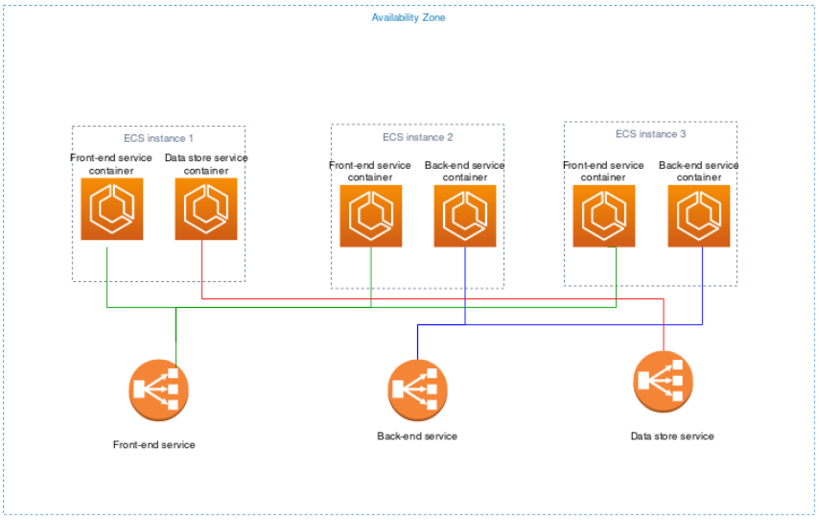

Slide 13
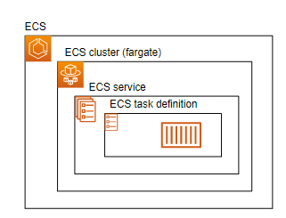
ECS Cluster
An Amazon ECS cluster groups together tasks, and services, and allows for shared capacity and common configurations. An Amazon ECS cluster is a logical grouping of tasks or services.
Your tasks and services are run on infrastructure that is registered to a cluster. Clusters are AWS Region specific.
The following are the possible states that a cluster can be in.
ACTIVE - The cluster is ready to accept tasks and, if applicable, you can register container instances with the cluster.
PROVISIONING - The cluster has capacity providers associated with it and the resources needed for the capacity provider are being created.
DEPROVISIONING - The cluster has capacity providers associated with it and the resources needed for the capacity provider are being deleted.
FAILED - The cluster has capacity providers associated with it and the resources needed for the capacity provider have failed to create.
INACTIVE - The cluster has been deleted. Clusters with an INACTIVE status may remain discoverable in your account for a period of time. However, this behavior is subject to change in the future, so make sure you do not rely on INACTIVE clusters persisting.

Slide 14
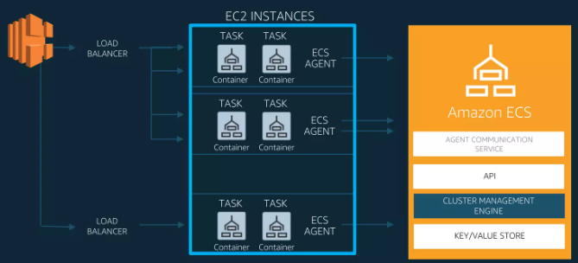

Slide 15
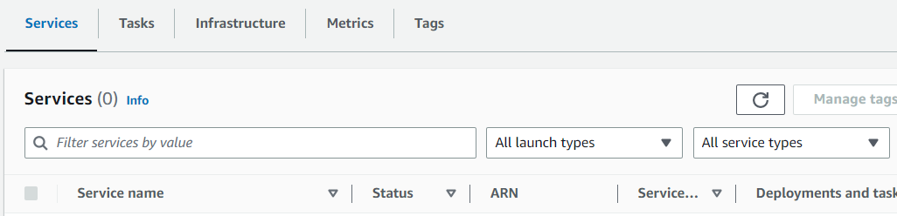
ECS Service
An Amazon ECS service runs and maintains your desired number of tasks simultaneously in an Amazon ECS cluster.
How it works is that, if any of your tasks fail or stop for any reason, the Amazon ECS service scheduler launches another instance based on your task definition.
It does this to replace it and thereby maintain your desired number of tasks in the service.
There are two service scheduler strategies available:
REPLICA
The replica scheduling strategy places and maintains the desired number of tasks across your cluster.
By default, the service scheduler spreads tasks across Availability Zones.
You can use task placement strategies and constraints to customize task placement decisions.
DAEMON
The daemon scheduling strategy deploys exactly one task on each active container instance that meets all of the task placement constraints that you specify in your cluster.
The service scheduler evaluates the task placement constraints for running tasks and will stop tasks that do not meet the placement constraints.
When using this strategy, there is no need to specify a desired number of tasks, a task placement strategy, or use Service Auto Scaling policies.

Slide 16
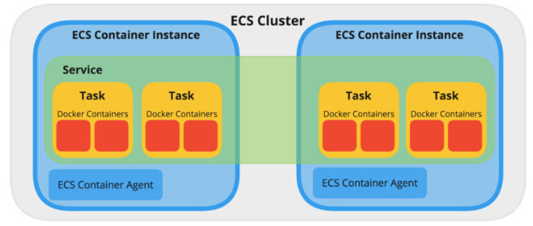
ECS Container Agent
The container agent runs on each container instance within an Amazon ECS cluster.
The agent sends information about the current running tasks and resource utilization of your containers to Amazon ECS.
It starts and stops tasks whenever it receives a request from Amazon ECS.
The container agent takes care of the communication between ECS and the instance, providing the status of running containers and managing running new ones.
/etc/ecs/ecs.config
An example ECS cluster, with one Service running four Tasks across two ECS Container Instances

Slide 17
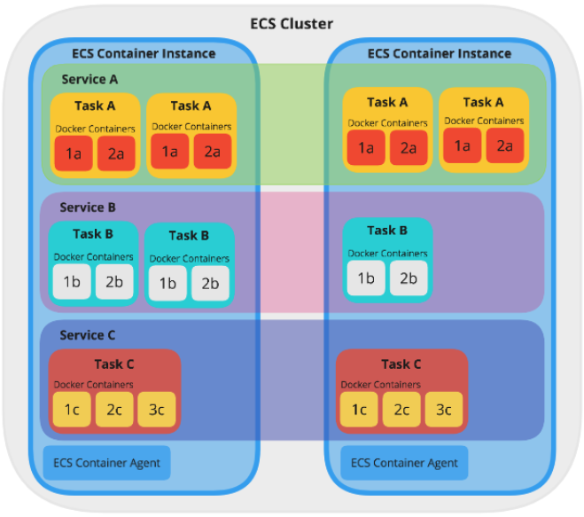
ECS Container Agent example
A Cluster running 3 Services, each running a different amount of Tasks, across two ECS Container Instances

Slide 18
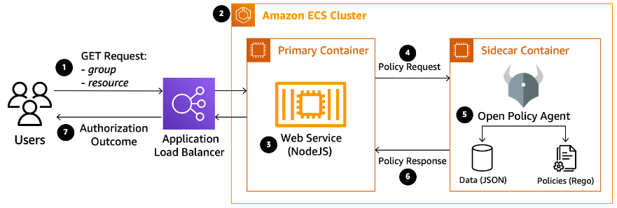
ECS SideCar Pattern
A sidecar is a container that runs alongside an application container in an Amazon ECS task.
While the application container runs core application code, processes running in sidecars can augment the application.
Sidecars help you segregate application functions into dedicated containers, making it easier for you to update parts of your application.

Slide 19
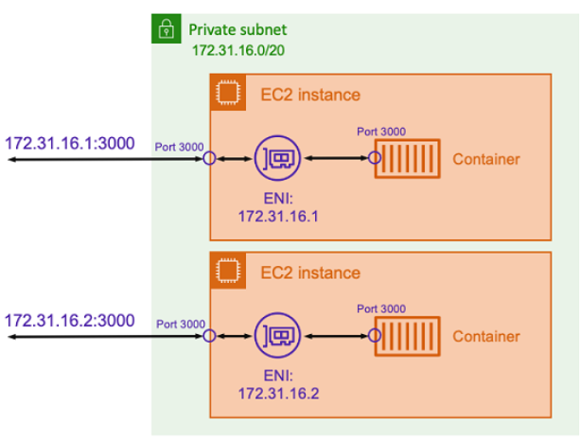
ECS Network Types - Host
The host network mode is the most basic network mode that's supported in Amazon ECS.
Using host mode, the networking of the container is tied directly to the underlying host that's running the container.
Example : Assume that you're running a Node.js container with an Express application that listens on port 3000 similar to the one illustrated in the preceding diagram.
When the host network mode is used, the container receives traffic on port 3000 using the IP address of the underlying host Amazon EC2 instance.
The host network mode is only supported for Amazon ECS tasks hosted on Amazon EC2 instances.
It's not supported when using Amazon ECS on Fargate.

Slide 20
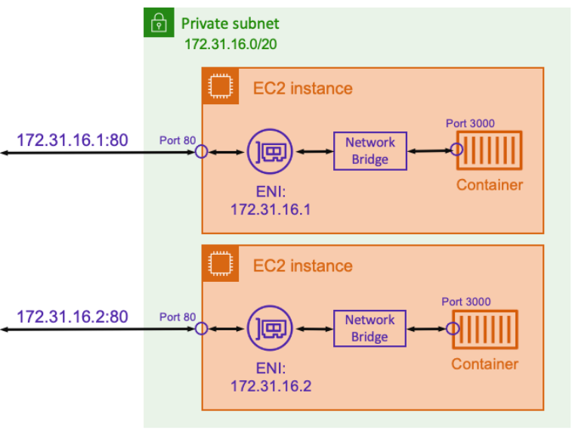
ECS Network Types - Bridge
With bridge mode, you're using a virtual network bridge to create a layer between the host and the networking of the container.
This way, you can create port mappings that remap a host port to a container port.
The mappings can be either static or dynamic.
With a static port mapping, you can explicitly define which host port you want to map to a container port.
Using the example above, port 80 on the host is being mapped to port 3000 on the container.
To communicate to the containerized application, you send traffic to port 80 to the Amazon EC2 instance's IP address.
From the containerized application’s perspective it sees that inbound traffic on port 3000.
https://docs.aws.amazon.com/AmazonECS/latest/developerguide/task_definition_parameters.html

Slide 21
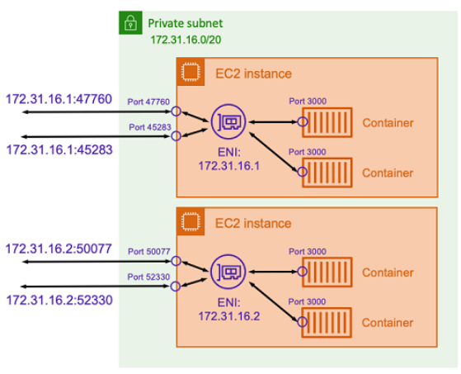
ECS Network Types - Bridge
Consider using the bridge network mode with a dynamic port mapping as shown in the following diagram.
By not specifying a host port in the port mapping, you can have Docker choose a random, unused port from the ephemeral port range and assign it as the public host port for the container.
For example, the Node.js application listening on port 3000 on the container might be assigned a random high number port such as 47760 on the Amazon EC2 host.
Doing this means that you can run multiple copies of that container on the host.
Moreover, each container can be assigned its own port on the host. Each copy of the container receives traffic on port 3000.
However, clients that send traffic to these containers use the randomly assigned host ports.
The bridge network mode is only supported for Amazon ECS tasks hosted on Amazon EC2 instances. It is not supported when using Amazon ECS on Fargate.

Slide 22
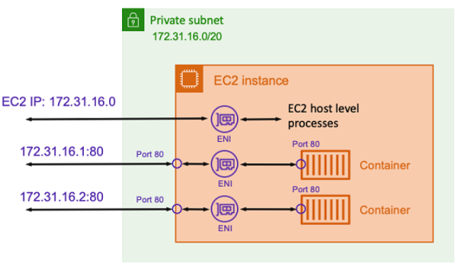
ECS Network Types - Awsvpc
With the awsvpc network mode, Amazon ECS creates and manages an Elastic Network Interface (ENI) for each task and each task receives its own private IP address within the VPC.
This ENI is separate from the underlying hosts ENI.
If an Amazon EC2 instance is running multiple tasks, then each task’s ENI is separate as well.
The advantage of using the awsvpc network mode is that each task has a separate security group to allow or deny traffic.
This means you have greater flexibility to control communications between tasks and services at a more granular level.
You can also configure a task to deny incoming traffic from another task located on the same host.
The awsvpc network mode is supported for Amazon ECS tasks hosted on both Amazon EC2 and Fargate.
Be mindful that, when using Fargate, the awsvpc network mode is required.

Slide 23
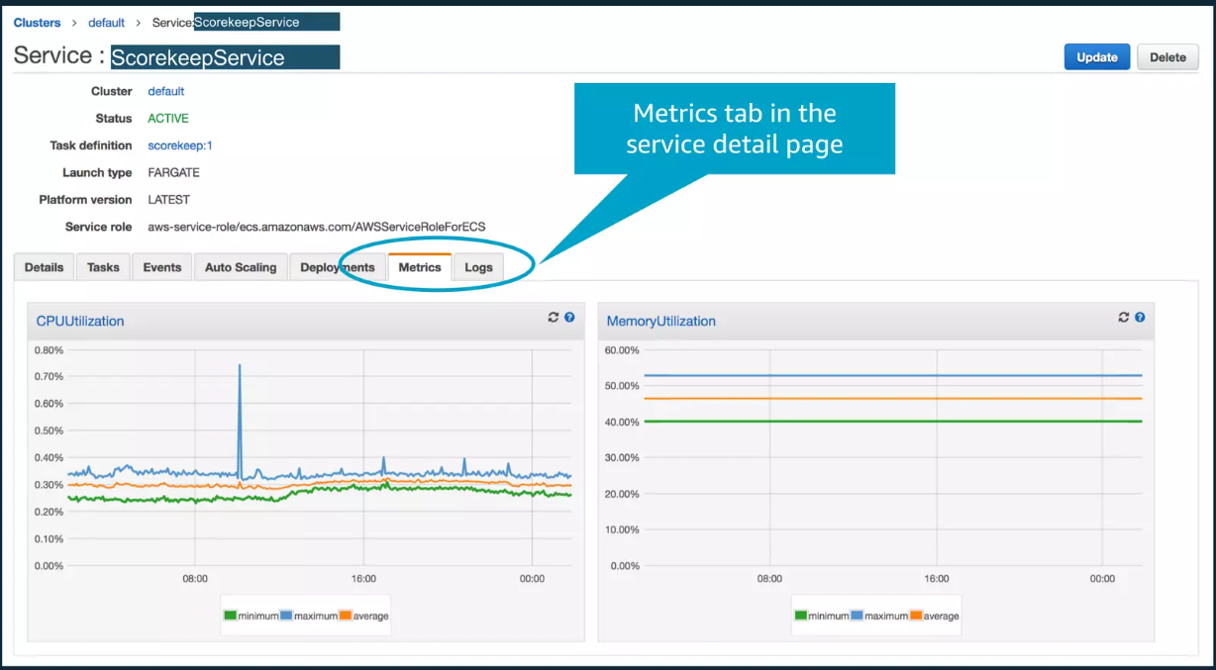
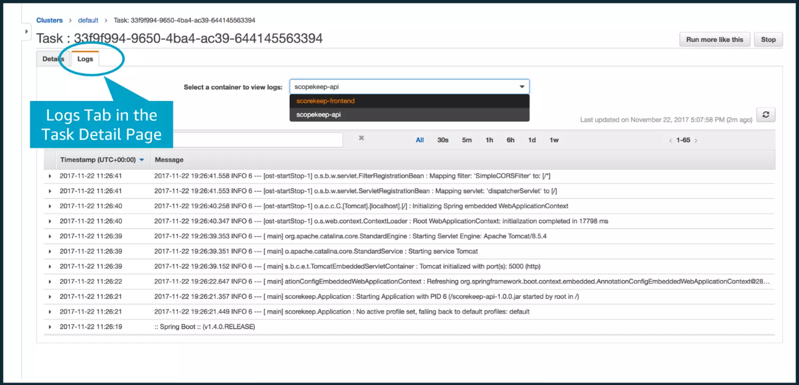
ECS Monitoring
You can monitor your Amazon ECS resources using Amazon CloudWatch, which collects and processes raw data from Amazon ECS into readable, near real-time metrics.
These statistics are recorded for a period of two weeks, so that you can access historical information and gain a better perspective on how your clusters or services are performing. Amazon ECS metric data is automatically sent to CloudWatch in 1-minute periods.

Slide 24
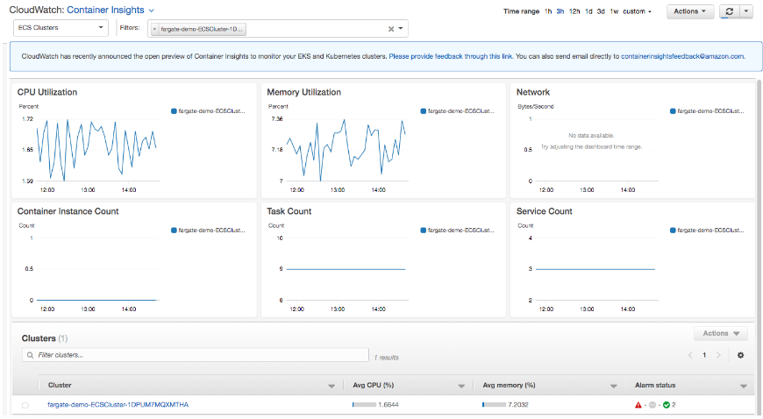
ECS Metrics Insights
The CloudWatch Container Insights dashboard gives you access to the following information:
CPU and memory utilization
Task and service counts
Read/write storage
Network Rx/Tx
Container instance counts for clusters, services, and tasks
and more
With CloudWatch Container Insights, you can:
Gain access to CloudWatch Container Insights dashboard metrics
Integrate with CloudWatch Logs Insights to dynamically query and analyze container application and performance logs
Create CloudWatch alarm notifications to track performance and potential issues
Enable Container Insights with one click, no need for additional configuration or the use of sidecars to monitor your tasks.

Slide 25
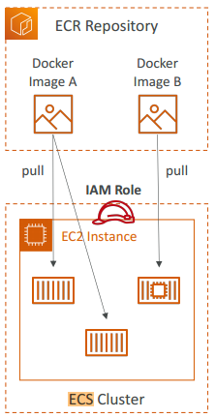
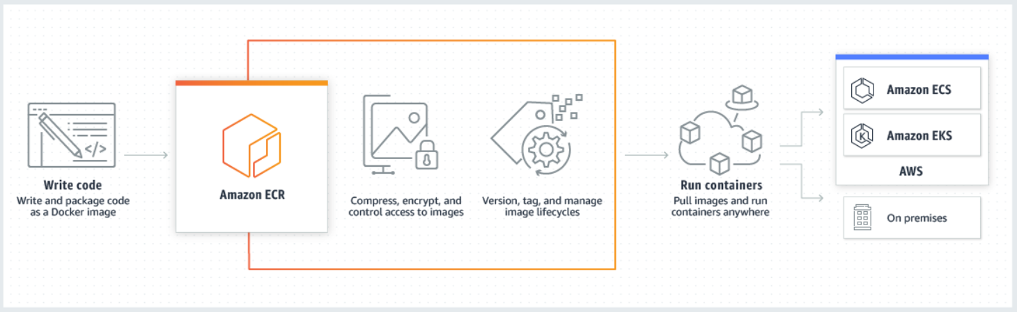
Amazon ECR
Amazon Elastic Container Registry (Amazon ECR) is an AWS managed container image registry service that is secure, scalable, and reliable.
Amazon ECR supports private repositories with resource-based permissions using AWS IAM.
This is so that specified users or Amazon EC2 instances can access your container repositories and images.

Slide 26
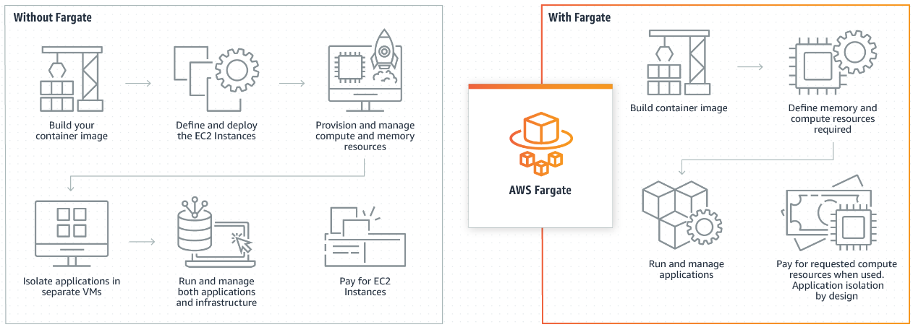
Fargate In deep
AWS Fargate is a compute engine for Amazon Elastic Container Service(ECS) that allows you to run containers without having to provision, configure & scale clusters of VMs that host container applications.
When you run your tasks and services with the Fargate launch type, you package your application in containers, specify the CPU and memory requirements, define networking and IAM policies, and launch the application.
Each Fargate task has its own isolation boundary and does not share the underlying kernel, CPU resources, memory resources, or elastic network interface with another task.

Slide 27
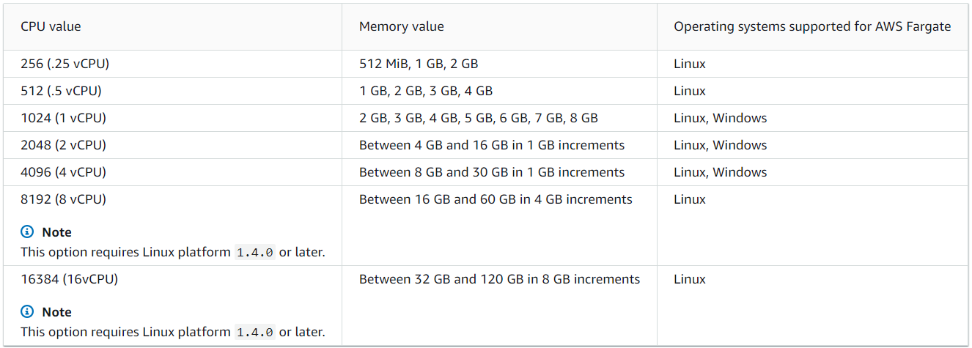
Fargate Task CPU architecture
There are 2 architectures available for the Amazon ECS task definition, ARM and X86_64.
When you run Windows containers on AWS Fargate, you must have the X86_64 CPU architecture.
When you run Linux containers on AWS Fargate, you can use the X86_64 CPU architecture, or the ARM64 architecture for your ARM-based applications.
The table shows the valid combinations of task-level CPU and memory.

Slide 28
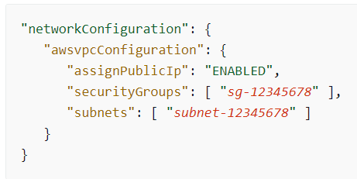
Fargate Task networking
The following is an example of the networkConfiguration section for a Fargate service:
Amazon ECS tasks for AWS Fargate require the awsvpc network mode, which provides each task with an elastic network interface.
When you run a task or create a service with this network mode, you must specify one or more subnets to attach the network interface and one or more security groups to apply to the network interface.

Slide 29
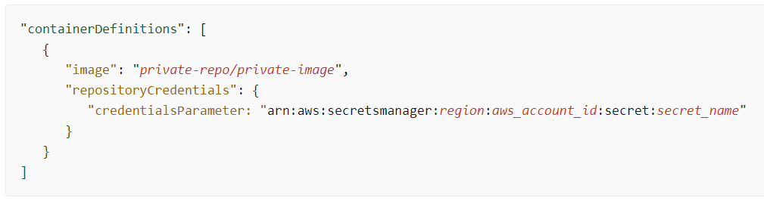
Fargate Private registry authentication
Amazon ECS tasks for AWS Fargate can authenticate with private image registries, including Docker Hub, using basic authentication.
When you enable private registry authentication, you can use private Docker images in your task definitions.
To use private registry authentication, you create a secret with AWS Secrets Manager containing the credentials for your private registry.
Then, within your container definition, you specify repositoryCredentials with the full ARN of the secret that you created. The following snippet of a task definition shows the required parameters:

Slide 30
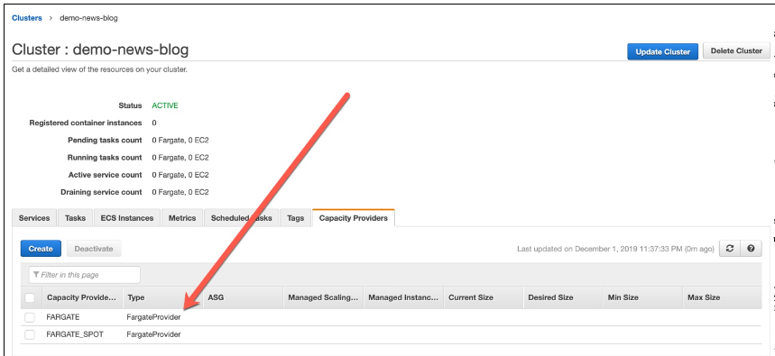
Fargate Fargate Spot
Amazon ECS capacity providers enable you to use both AWS Fargate and Fargate Spot capacity with your Amazon ECS tasks.
Windows containers on AWS Fargate cannot use the Fargate Spot capacity provider.
With Fargate Spot you can run interruption tolerant Amazon ECS tasks at a discounted rate compared to the AWS Fargate price.
Fargate Spot runs tasks on spare compute capacity.
When AWS needs the capacity back, your tasks will be interrupted with a two-minute warning.

Slide 31
ECS Hands On by hands

Slide 32
ECS Hands on CloudFormation + Route53

Slide 33
ECS VS K8 (EKS for AWS world)
Small deployments prefer ECS due to its seamless deployment and configuration.
Large or hybrid deployments prefer EKS due to stronger customization and improved portability between clouds and on-premise systems.
Legacy workloads transitioning to a containerized environment may gain the most from using plain Kubernetes, as it will allow you to build a dev/test/production environment on-premises, and then move it to the cloud if and when required.
Simplicity vs Flexibility
Pricing
Portability
Networking

Slide 34
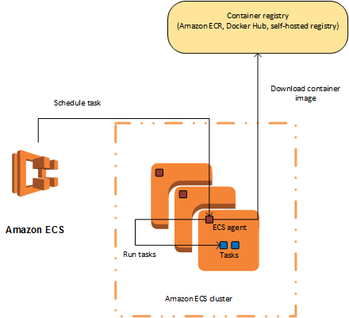
ECS Container Agent on host
The container agent runs on each container instance in an Amazon ECS cluster.
The agent sends information about currently running tasks, and resource utilization, to Amazon ECS. Amazon ECS can use the agent to start and stop tasks as needed.

Slide 35
Architectures

Slide 36
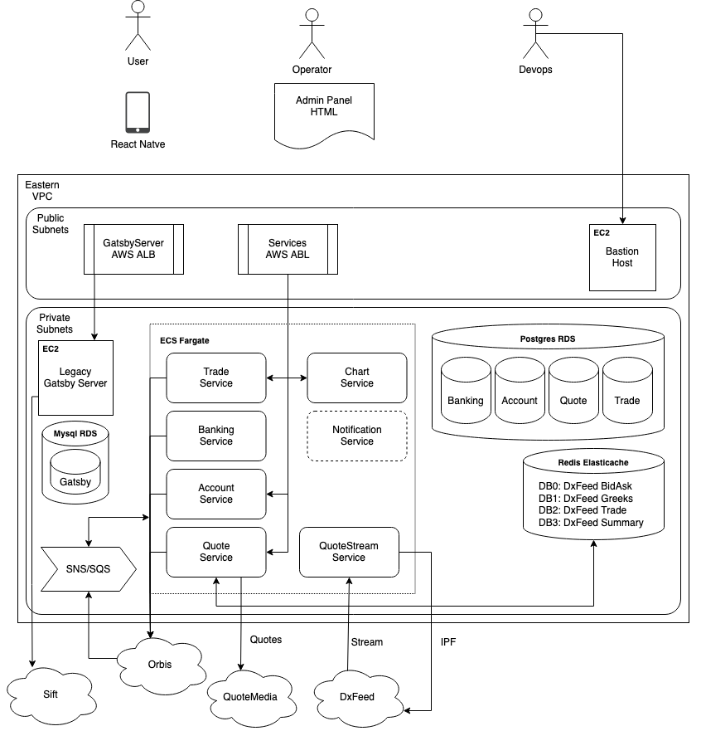

Slide 37
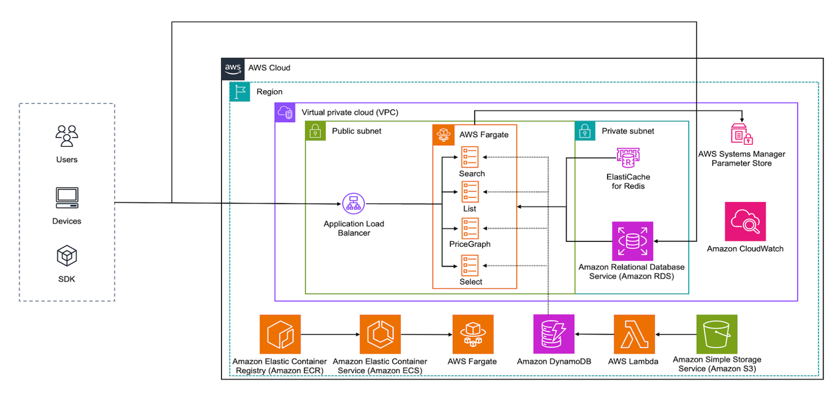
ECS Default AWS Diagram

Slide 38
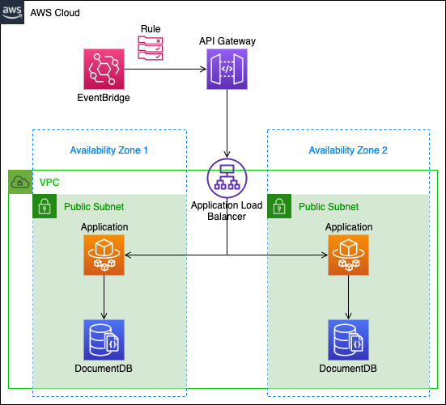
ECS + EventBridge (cron job example)

Slide 39
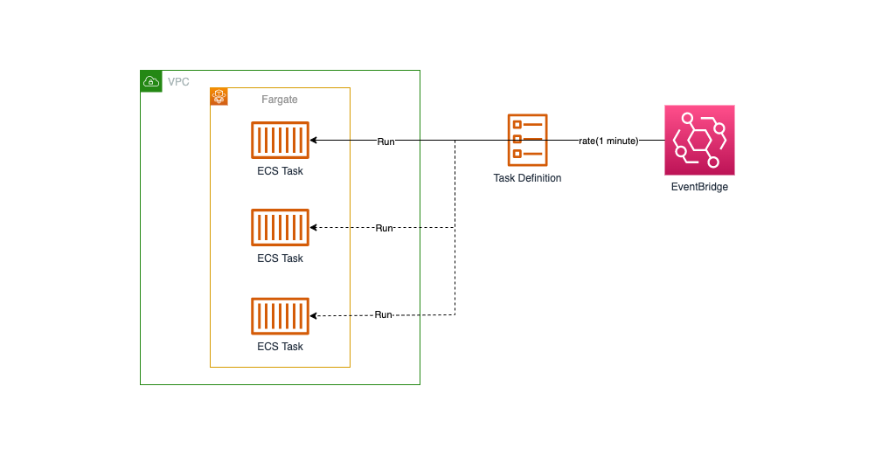
EventBridge triggers ECS Task

Slide 40
Questions:

Slide 41
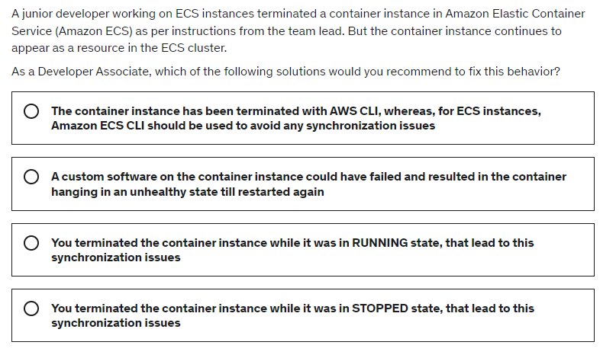

Slide 42
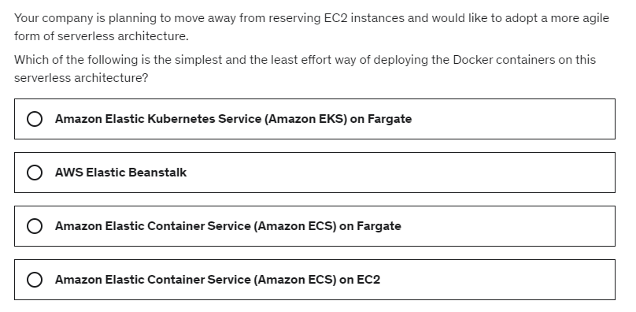

Slide 43
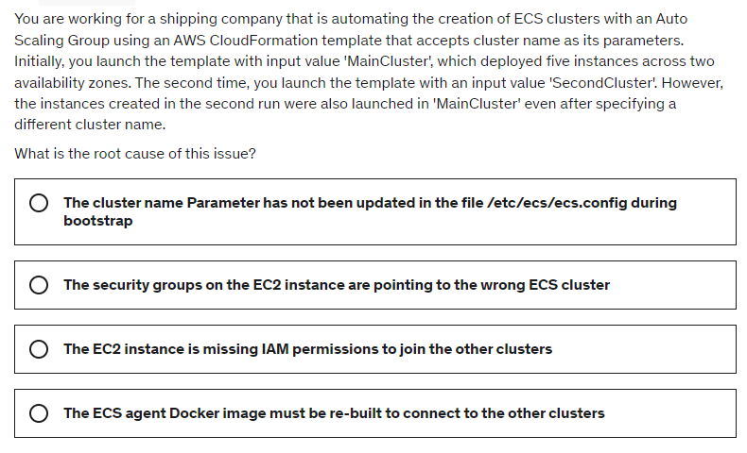

Slide 44
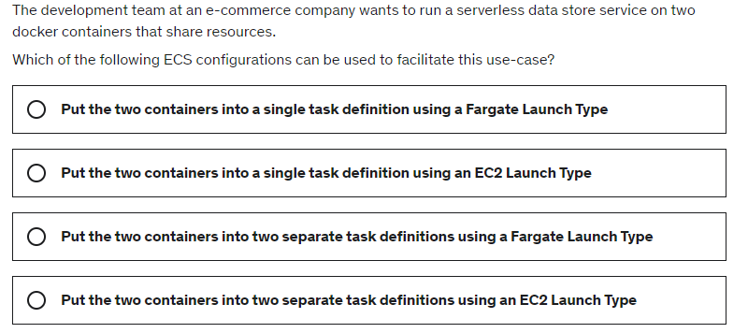

Slide 45
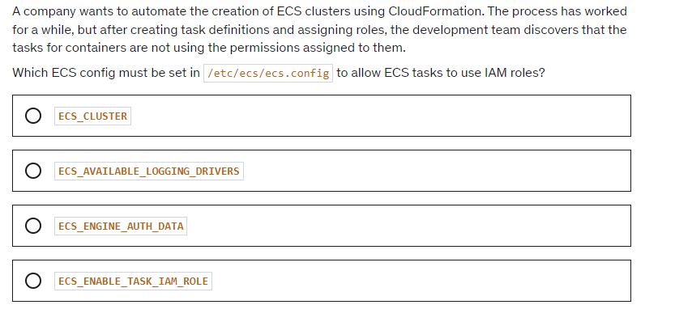

Slide 46
