Slide 1
VPC Peering

Slide 2
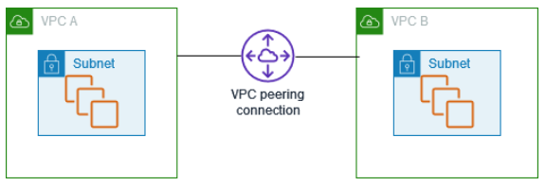
What is VPC peering?
A VPC peering connection is a networking connection between two VPCs that enables you to route traffic between them using private IPv4 addresses or IPv6 addresses.
Instances in either VPC can communicate with each other as if they are within the same network.
You can create a VPC peering connection between your own VPCs, or with a VPC in another AWS account. The VPCs can be in different Regions (also known as an inter-Region VPC peering connection).
A VPC peering connection helps you to facilitate the transfer of data.
For example, if you have more than one AWS account, you can peer the VPCs across those accounts to create a file sharing network.
You can also use a VPC peering connection to allow other VPCs to access resources you have in one of your VPCs.
No Overlapping CIDR Blocks:
Each VPC in a peering relationship must have a non-overlapping CIDR block. AWS does not support overlapping IP address ranges for peered VPCs.
No Transitive Peering:
VPC peering is not transitive; to route traffic between multiple VPCs, each VPC must be directly peered with every other VPC in the network.

Slide 3
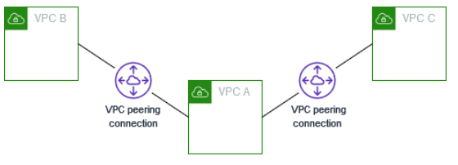
Multiple VPC peering connections
A VPC peering connection is a one-to-one relationship between two VPCs.
You can create multiple VPC peering connections for each VPC that you own, but transitive peering relationships are not supported.
You do not have any peering relationship with VPCs that your VPC is not directly peered with.
The following diagram is an example of one VPC peered to two different VPCs.
There are two VPC peering connections: VPC A is peered with both VPC B and VPC C.
VPC B and VPC C are not peered, and you cannot use VPC A as a transit point for peering between VPC B and VPC C.
If you want to enable routing of traffic between VPC B and VPC C, you must create a unique VPC peering connection between them.
Cannot Create VPC Peering with VPCs in Your AWS Account Managed by Different Organizations:
VPC peering between VPCs in different AWS accounts is possible, but if the accounts are managed by different AWS Organizations, certain restrictions apply.

Slide 4
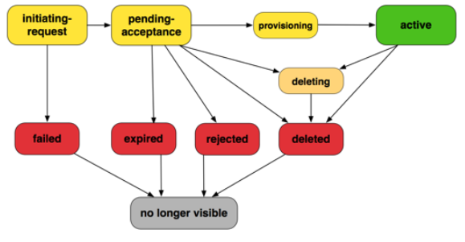
VPC peering connection lifecycle 1
Initiating-request: A request for a VPC peering connection has been initiated. At this stage, the peering connection can fail, or can go to pending-acceptance.
Failed: The request for the VPC peering connection has failed. While in this state, it cannot be accepted, rejected, or deleted. The failed VPC peering connection remains visible to the requester for 2 hours.
Pending-acceptance: The VPC peering connection request is awaiting acceptance from the owner of the accepter VPC. During this state, the owner of the requester VPC can delete the request, and the owner of the accepter VPC can accept or reject the request. If no action is taken on the request, it expires after 7 days.
Expired: The VPC peering connection request has expired, and no action can be taken on it by either VPC owner. The expired VPC peering connection remains visible to both VPC owners for 2 days.
Rejected: The owner of the accepter VPC has rejected a pending-acceptance VPC peering connection request. While in this state, the request cannot be accepted. The rejected VPC peering connection remains visible to the owner of the requester VPC for 2 days, and visible to the owner of the accepter VPC for 2 hours. If the request was created within the same AWS account, the rejected request remains visible for 2 hours.

Slide 5
VPC peering connection lifecycle 2
Provisioning: The VPC peering connection request has been accepted and will soon be in the active state.
Active: The VPC peering connection is active, and traffic can flow between the VPCs (provided that your security groups and route tables allow the flow of traffic). While in this state, either of the VPC owners can delete the VPC peering connection but cannot reject it.
Deleting: Applies to an inter-Region VPC peering connection that is in the process of being deleted. The owner of either VPC has submitted a request to delete an active VPC peering connection, or the owner of the requester VPC has submitted a request to delete a pending-acceptance VPC peering connection request.
Deleted: An active VPC peering connection has been deleted by either of the VPC owners, or a pending-acceptance VPC peering connection request has been deleted by the owner of the requester VPC. While in this state, the VPC peering connection cannot be accepted or rejected. The VPC peering connection remains visible to the party that deleted it for 2 hours, and visible to the other party for 2 days. If the VPC peering connection was created within the same AWS account, the deleted request remains visible for 2 hours.

Slide 6
VPC Peering Security Group Referencing
VSecurity groups in a VPC can be used to control the traffic that is allowed to and from instances within that VPC.
When your VPC is peered with another VPC, you can reference security groups from the peered VPC in your security group rules, which allows for a more granular control over the traffic between the two VPCs.
Cross-account Permissions: You can reference security groups from the peered VPC in your security group rules, even if the VPCs are in different AWS accounts.
Ingress and Egress Rules: When setting up security group rules, you can specify inbound (ingress) and outbound (egress) rules that reference the security group ID of the peered VPC's security group.
Security Group Membership: The instances associated with the referenced security group in the peered VPC are automatically allowed or denied as specified by the rules.
Fine-grained Control: Referencing a security group from a peered VPC is often more convenient and offers finer-grained control than using CIDR blocks because it automatically adapts to changes in the instances' IP addresses.
Update on Membership Changes: When an instance is added to or removed from a referenced security group in a peered VPC, the changes are automatically reflected in the rules. This dynamic membership update avoids the need for manual intervention every time there’s a change in the network configuration.
Security groups for your VPC peering connection must be within the same region: The ability to reference a security group from a peered VPC is limited to peering connections in the same region.

Slide 7
Vpc peering Hands on
Create a VPC B and pair it with VPC A

