Slide 1
AWS Simple Workflow Service
SWF

Slide 2
AWS SWF
The Amazon Simple Workflow Service (Amazon SWF) makes it easy to build applications that coordinate work across distributed components.
In Amazon SWF, a task represents a logical unit of work that is performed by a component of your application.
Coordinating tasks across the application involves managing intertask dependencies, scheduling, and concurrency in accordance with the logical flow of the application.
Amazon SWF gives you full control over implementing tasks and coordinating them without worrying about underlying complexities such as tracking their progress and maintaining their state.
When using Amazon SWF, you implement workers to perform tasks.
These workers can run either on cloud infrastructure, such as Amazon Elastic Compute Cloud (Amazon EC2), or on your own premises.
You can create tasks that are long-running, or that may fail, time out, or require restarts—or that may complete with varying throughput and latency.
Amazon SWF stores tasks and assigns them to workers when they are ready, tracks their progress, and maintains their state, including details on their completion.
To coordinate tasks, you write a program that gets the latest state of each task from Amazon SWF and uses it to initiate subsequent tasks.
Amazon SWF maintains an application's execution state durably so that the application is resilient to failures in individual components.
With Amazon SWF, you can implement, deploy, scale, and modify these application components independently.
Amazon SWF offers capabilities to support a variety of application requirements.
It is suitable for a range of use cases that require coordination of tasks, including media processing, web application back-ends, business process workflows, and analytics pipelines.

Slide 3
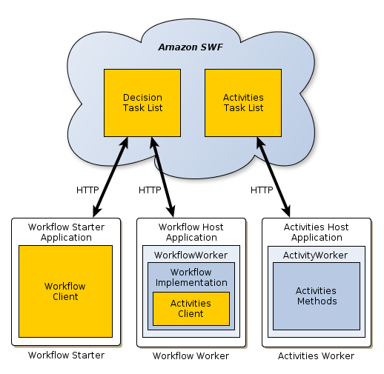
AWS SWF Conception
Conceptually, an AWS Flow Framework application consists of three basic components: workflow starters, workflow workers, and activity workers.
One or more host applications are responsible for registering the workers (workflow and activity) with Amazon SWF, starting the workers, and handling cleanup.
The workers handle the mechanics of executing the workflow and may be implemented on several hosts.

Slide 4
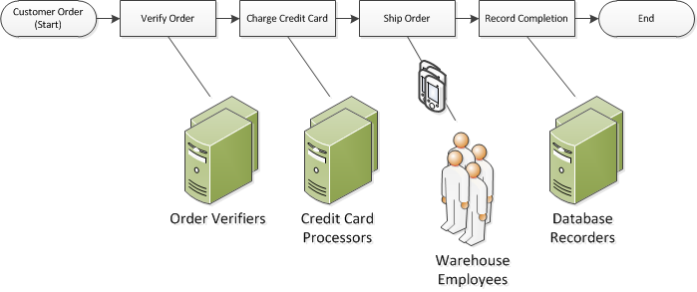
AWS SWF Workflows
Using the Amazon Simple Workflow Service (Amazon SWF), you can implement distributed, asynchronous applications as workflows.
Workflows coordinate and manage the execution of activities that can be run asynchronously across multiple computing devices and that can feature both sequential and parallel processing.
When designing a workflow, you analyze your application to identify its component tasks.
In Amazon SWF, these tasks are represented by activities.
The order in which activities are performed is determined by the workflow's coordination logic.
This workflow starts when a customer places an order. It includes four tasks:
Verify the order.
If the order is valid, charge the customer.
If the payment is made, ship the order.
If the order is shipped, save the order details.

Slide 5
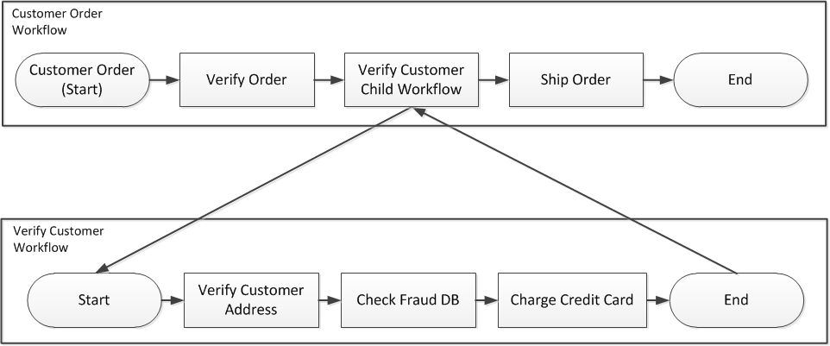
AWS SWF Child Workflow
Complicated workflows can be broken into smaller, more manageable, and potentially reusable components by using child workflows.
A child workflow is a workflow execution that is initiated by another (parent) workflow execution.
To initiate a child workflow, the decider for the parent workflow uses the StartChildWorkflowExecution decision.
Input data specified with this decision is made available to the child workflow through its history.

Slide 6
AWS Step Functions vs AWS Workflow
AWS Step Functions
Visual workflow service that defines workflows as state machines. It allows you to visualize the components of your application as steps in a visual interface.
Integration: Provides deep integration with AWS Lambda, making it ideal for orchestrating Lambda functions. It also supports other AWS services.
Use Cases: Designed for microservices orchestration, data processing, and building complex workflows involving AWS services.
Ease of Use: Simplifies the orchestration of different services with less code required, using JSON to define the state machine.
Maintenance: AWS handles the underlying infrastructure, so there is less operational overhead.
Scalability: Automatically scales the workflow execution rate to meet demand.
Execution History: Retains the execution history for 90 days, providing a detailed view of each step's input and output.
Error Handling: Offers built-in error handling, retry logic, and conditional branching.
Pricing: Charged based on the number of state transitions.
AWS Simple Workflow Service (SWF)
Framework for building applications that coordinate work across distributed components. Workflows are defined through code.
Integration: Offers more flexibility for integrating with non-AWS services or human actors. It's designed to coordinate tasks that can last from a few seconds to several years.
Use Cases: Suitable for long-running, human-intensive processes, and operations that require complex coordination of tasks, such as in e-commerce platforms.
Ease of Use: Requires more boilerplate code to implement decision tasks and worker tasks, providing granular control over the workflow.
Maintenance: Requires you to manage the activity workers and decider logic, which can result in more operational overhead.
Scalability: Can scale activity workers horizontally based on the workload.
Execution History: Keeps the complete execution history for the duration of the workflow, which can be up to 1 year.
Error Handling: Requires custom implementation of error handling and retry logic within your application code.
Pricing: Charged based on the number of workflow executions, activity tasks, and decision tasks.

Slide 7
AWS Step Functions vs AWS SWF
Key Differences
Workflow Definition: Step Functions uses JSON-defined state machines, while SWF workflows are defined in code.
Execution Duration: Step Functions are designed for shorter executions (up to 1 year), while SWF can support executions that last up to 10 years.
Visual Interface: Step Functions provides a graphical console to visualize workflows, whereas SWF does not have a visual interface for workflow execution.
Task Assignment: SWF provides more control over task assignment, which can include automated processes and human workers; Step Functions is more automated and service-oriented.
Managed Service: Step Functions is more of a fully managed service compared to SWF, which requires more manual setup and management.

