Slide 1
AWS Step Functions

Slide 2
AWS Step Functions
AWS Step Functions is a serverless orchestration service that lets you integrate with AWS Lambda functions and other AWS services to build business-critical applications.
Through Step Functions' graphical console, you see your application’s workflow as a series of event-driven steps.
Step Functions is based on state machines and tasks.
In Step Functions, a workflow is called a state machine, which is a series of event-driven steps.
Each step in a workflow is called a state.
A Task state represents a unit of work that another AWS service, such as AWS Lambda, performs.
A Task state can call any AWS service or API.
With Step Functions' built-in controls, you examine the state of each step in your workflow to make sure that your application runs in order and as expected.
Depending on your use case, you can have Step Functions call AWS services, such as Lambda, to perform tasks. You can create workflows that process and publish machine learning models.
You can have Step Functions control AWS services, such as AWS Glue, to create extract, transform, and load (ETL) workflows.
You also can create long-running, automated workflows for applications that require human interaction.

Slide 3
AWS Step Functions WorkFlows: Standard
Standard workflows specifications
2,000 per second execution rate
4,000 per second state transition rate
Priced by state transition
Show execution history and visual debugging
Support all service integrations and patterns
Executions are instances where you run your workflow to perform tasks.
Standard workflows are ideal for long-running, auditable workflows, as they show execution history and visual debugging.

Slide 4
AWS Step Functions WorkFlows: Express
Express workflows specifications
100,000 per second execution rate
Nearly unlimited state transition rate
Priced by number and duration of executions
Send execution history to Amazon CloudWatch
Show execution history and visual debugging based on the Log level enabled
Support all service integrations and most patterns
Express workflows are ideal for high-event-rate workloads, such as streaming data processing and IoT data ingestion.

Slide 5
AWS Step Functions WorkFlows: Express vs Standard
 | Standard Workflows | Express Workflows: Synchronous and Asynchronous
Maximum duration | One year | Five minutes
Supported execution start rate | For information about quotas related to supported execution start rate, see Quotas related to API action throttling. | For information about quotas related to supported execution start rate, see Quotas related to API action throttling.
Supported state transition rate | For information about quotas related to supported state transition rate, see Quotas related to state throttling. | No limit
Pricing | Priced by number of state transitions. A state transition is counted each time a step in your execution is completed. | Priced by the number of executions you run, their duration, and memory consumption.
Execution history | Executions can be listed and described with Step Functions APIs. Executions can be visually debugged through the console. They can also be inspected in CloudWatch Logs by enabling logging on your state machine. For more information about debugging Standard Workflow executions in the console, see Standard and Express Workflow executions in the console and Viewing and debugging executions. | Unlimited execution history, that is, as many execution history entries are maintained as you can generate within a 5-minute period. Executions can be inspected in CloudWatch Logs or the Step Functions console by enabling logging on your state machine. For more information about debugging Express Workflow executions in the console, see Standard and Express Workflow executions in the console and Viewing and debugging executions.
Execution semantics | Exactly-once workflow execution. | Asynchronous Express Workflows: At-least-once workflow execution. Synchronous Express Workflows: At-most-once workflow execution.
Service integrations | Supports all service integrations and patterns. | Supports all service integrations.Note Express Workflows do not support Job-run (.sync) or Callback (.waitForTaskToken) service integration patterns.
Step Functions activities | Supports Step Functions activities. | Doesn't support Step Functions activities.

Slide 6
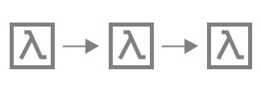
AWS Step Functions Use Cases: Function Orchestration
Use case #1: Function orchestration
You create a workflow that runs a group of Lambda functions (steps) in a specific order.
One Lambda function's output passes to the next Lambda function's input.
The last step in your workflow gives a result.
With Step Functions, you can see how each step in your workflow interacts with one other, so you can make sure that each step performs its intended function.

Slide 7
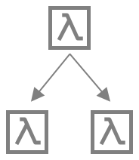
AWS Step Functions Use Cases: Branching
A customer requests a credit limit increase.
Using a Choice state, you can have Step Functions make decisions based on the Choice state’s input.
If the request is more than your customer’s pre-approved credit limit, you can have Step Functions send your customer's request to a manager for sign-off.
If the request is less than your customer’s pre-approved credit limit, you can have Step Functions approve the request automatically.

Slide 8
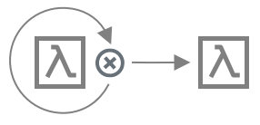
AWS Step Functions Use Cases: Error Handling
Retry
In this use case, a customer requests a username.
The first time, your customer’s request is unsuccessful.
Using a Retry statement, you can have Step Functions try your customer's request again.
The second time, your customer’s request is successful.
Catch
In a similar use case, a customer requests an unavailable username.
Using a Catch statement, you have Step Functions suggest an available username.
If your customer takes the available username, you can have Step Functions go to the next step in your workflow, which is to send a confirmation email.
If your customer doesn’t take the available username, you have Step Functions go to a different step in your workflow, which is to start the sign-up process over.

Slide 9
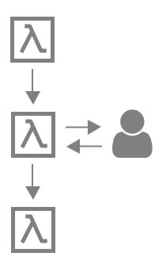
AWS Step Functions Use Cases: Human in the loop
Using a banking app, one of your customers sends money to a friend.
Your customer waits for a confirmation email.
With a callback and a task token, you have Step Functions tell Lambda to send your customer’s money and report back when your customer’s friend receives it.
After Lambda reports back that your customer’s friend received the money, you can have Step Functions go to the next step in your workflow, which is to send your customer a confirmation email.

Slide 10
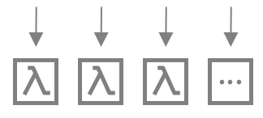
AWS Step Functions Use Cases: Parallel processing
A customer converts a video file into five different display resolutions, so viewers can watch the video on multiple devices.
Using a Parallel state, Step Functions inputs the video file, so Lambda can process it into the five display resolutions at the same time.

Slide 11
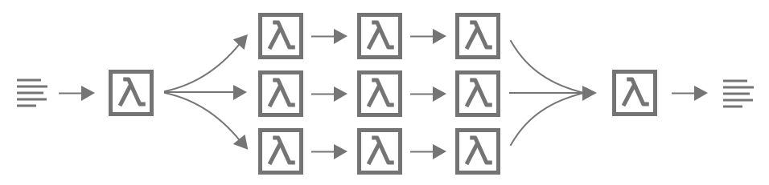
AWS Step Functions Use Cases: Dynamic parallelism
A customer orders three items, and you need to prepare each item for delivery.
You check each item's availability, gather each item, and then package each item for delivery.
Using a Map state, Step Functions has Lambda process each of your customer's items in parallel.
Once all of your customer's items are packaged for delivery, Step Functions goes to the next step in your workflow, which is to send your customer a confirmation email with tracking information.

