Slide 1
AWS X-ray

Slide 2
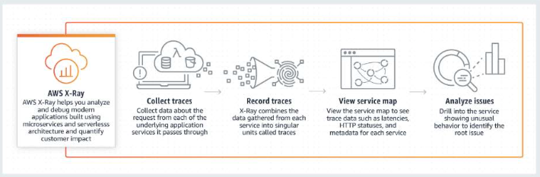
What is AWS X-Ray?
AWS X-Ray analyzes and debugs production, distributed applications, such as those built using a microservices architecture.
With X-Ray, you can identify performance bottlenecks, edge case errors, and other hard to detect issues.
AWS X-Ray receives data from services as segments.
X-Ray then groups segments that have a common request into traces.
X-Ray processes the traces to generate a service graph that provides a visual representation of your application.

Slide 3
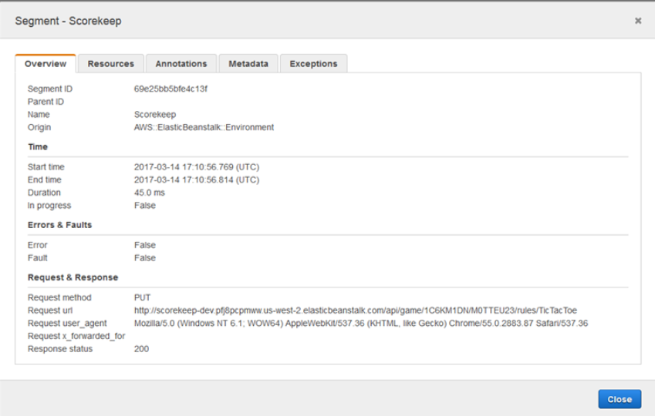
Segments
The compute resources running your application logic send data about their work as segments.
A segment provides the resource's name, details about the request, and details about the work done.
For example, when an HTTP request reaches your application, it can record the following data about:
The host – hostname, alias or IP address
The request – method, client address, path, user agent
The response – status, content
The work done – start and end times, subsegments
Issues that occur – errors, faults and exceptions, including automatic capture of exception stacks.

Slide 4
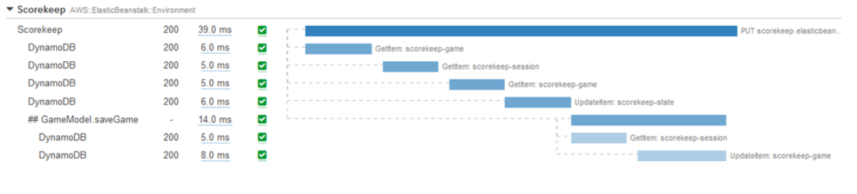
Subsegments
A segment can break down the data about the work done into subsegments.
Subsegments provide more granular timing information and details about downstream calls that your application made to fulfill the original request.
A subsegment can contain additional details about a call to an AWS service, an external HTTP API, or an SQL database.
You can even define arbitrary subsegments to instrument specific functions or lines of code in your application.

Slide 5
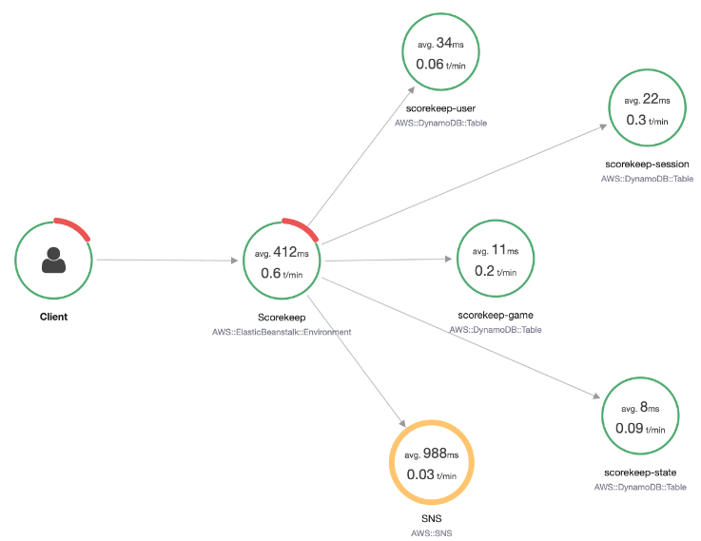
Service map (graph)
X-Ray uses the data that your application sends to generate a service graph.
Each AWS resource that sends data to X-Ray appears as a service in the graph.
Edges connect the services that work together to serve requests.
Edges connect clients to your application, and your application to the downstream services and resources that it uses.

Slide 6
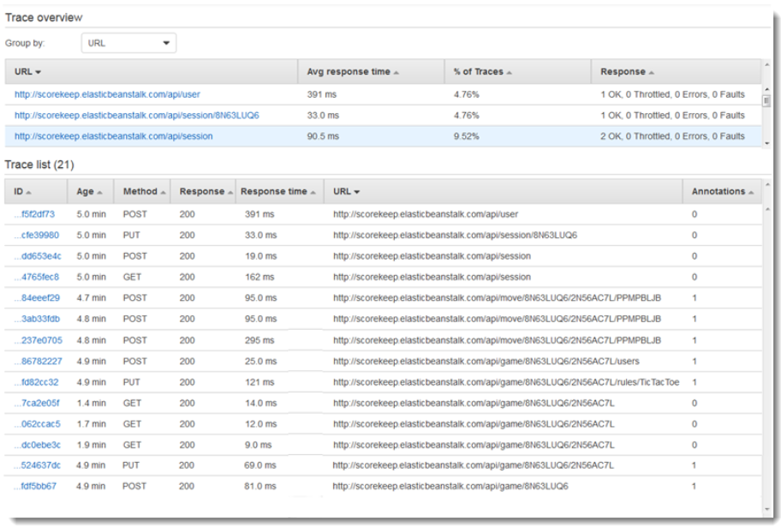
Traces
Use the Traces page in the X-Ray console to find traces by URL, response code, or other data from the trace summary.
After selecting a trace from the trace list, the Trace details page displays a map of service nodes involved in the selected trace, along with a timeline of trace segments.

Slide 7
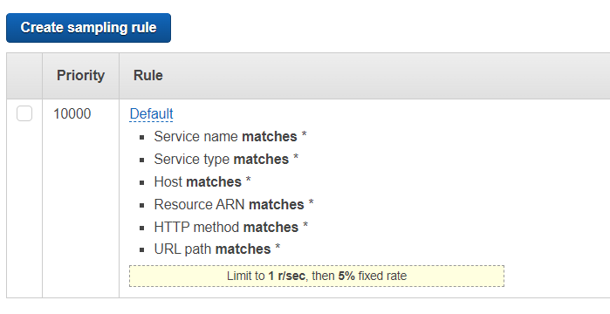
Sampling
Customize the default sampling strategy to control cost or filter out unwanted requests by applying sampling rules.
By default, you can create up to 25 sampling rules in addition to the default rule.
If you'd like to create more than 25 sampling rules, please contact customer support to get the limit increased.

Slide 8
X-ray Daemon
The AWS X-Ray daemon is a software application that listens for traffic on UDP port 2000, gathers raw segment data, and relays it to the AWS X-Ray API
The daemon works in conjunction with the AWS X-Ray SDKs and must be running so that data sent by the SDKs can reach the X-Ray service
On AWS Lambda and AWS Elastic Beanstalk, use those services' integration with X-Ray to run the daemon

Slide 9
X-Ray daemon on Amazon ECS
In Amazon ECS, create a Docker image that runs the X-Ray daemon, upload it to a Docker image repository, and then deploy it to your Amazon ECS cluster.
You can use port mappings and network mode settings in your task definition file to allow your application to communicate with the daemon container.
{
"name": "xray-daemon",
"image": "amazon/aws-xray-daemon",
"cpu": 32,
"memoryReservation": 256,
"portMappings" : [
{
"hostPort": 0, "containerPort": 2000, "protocol": "udp"
}]
}

Slide 10
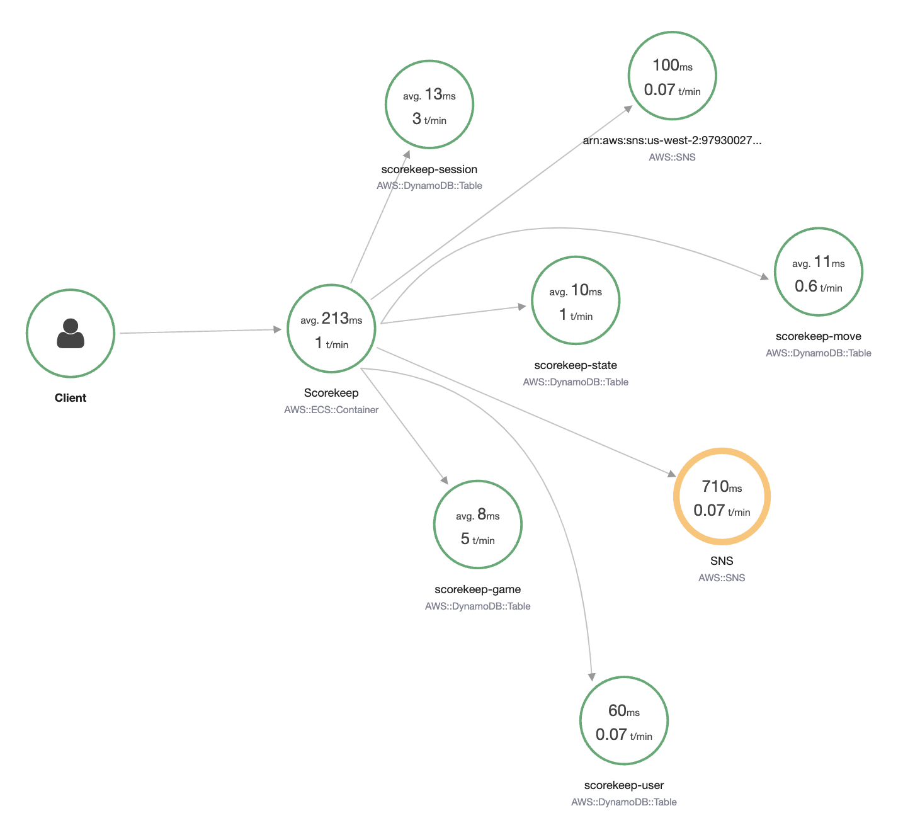
AWS X-Ray sample application
https://docs.aws.amazon.com/xray/latest/devguide/xray-scorekeep.html

