Slide 1
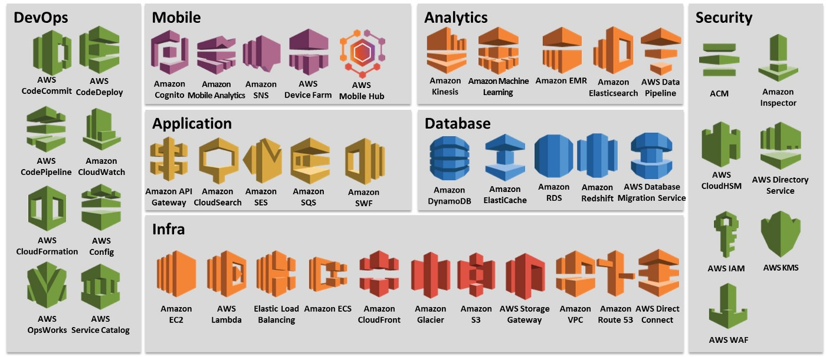
AWS Services

Slide 2
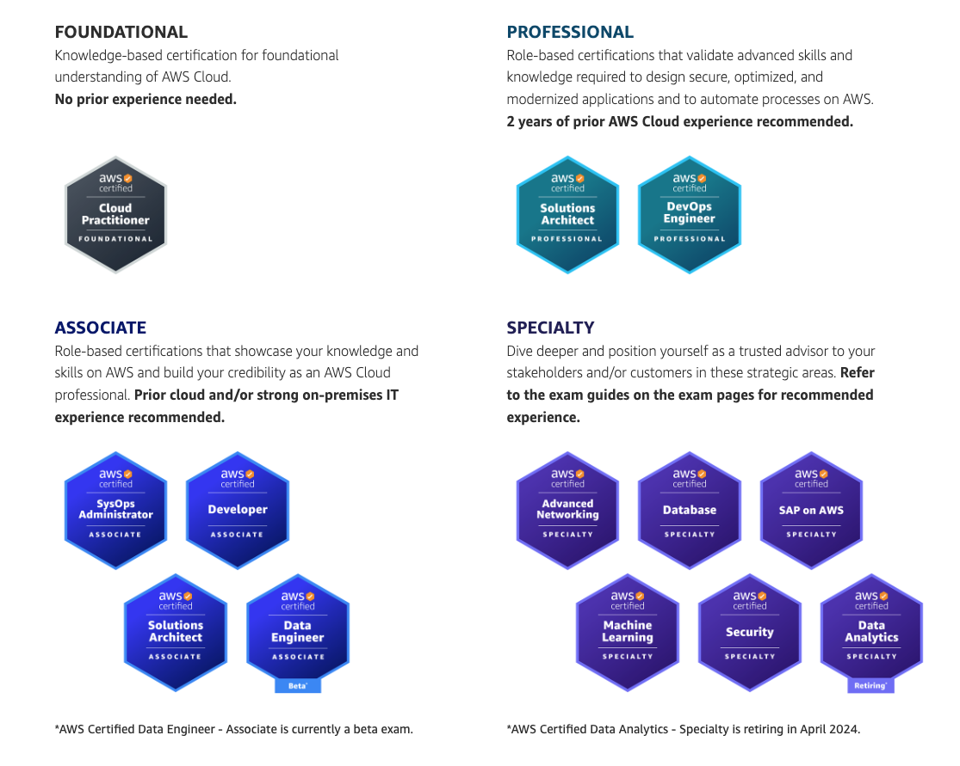
AWS Certifications

Slide 3
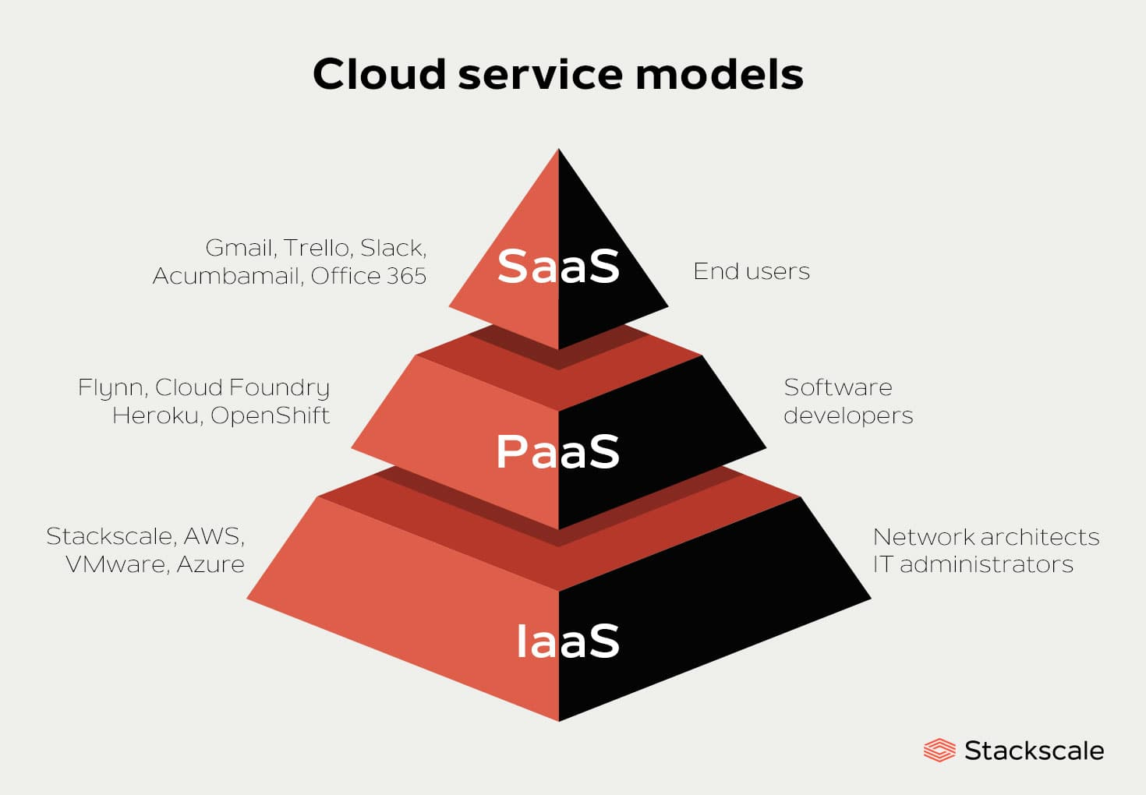
AWS Computing Model

Slide 4
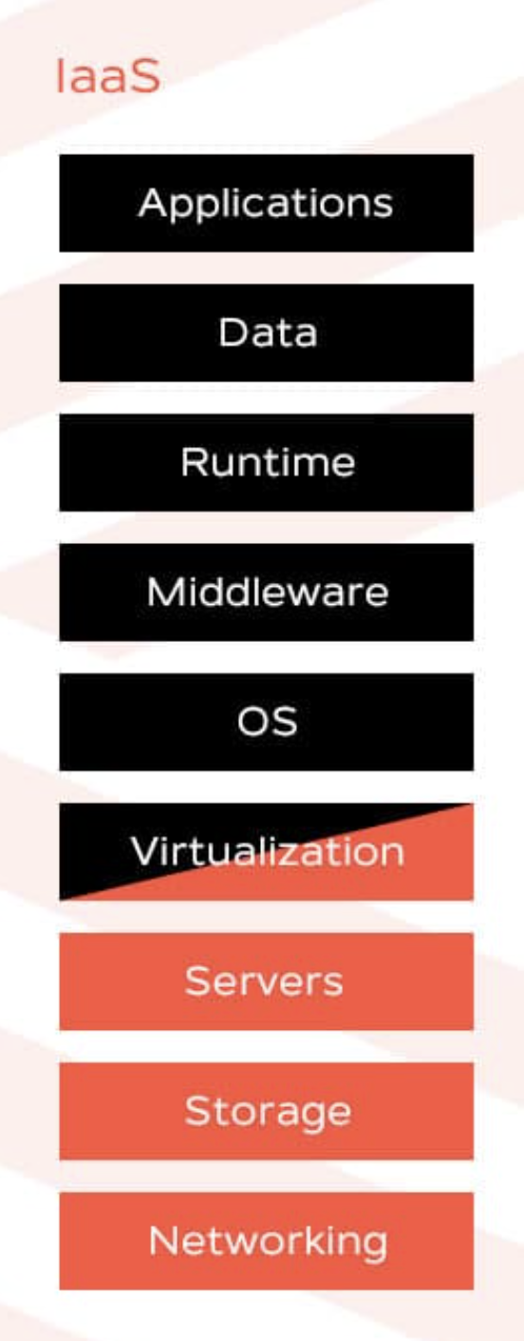
Infrastructure as a Service (IaaS)
Main IaaS benefits
Control
Cost-efficiency
Automation
Scalability
Main IaaS concerns
Based on cloud provider

Slide 5
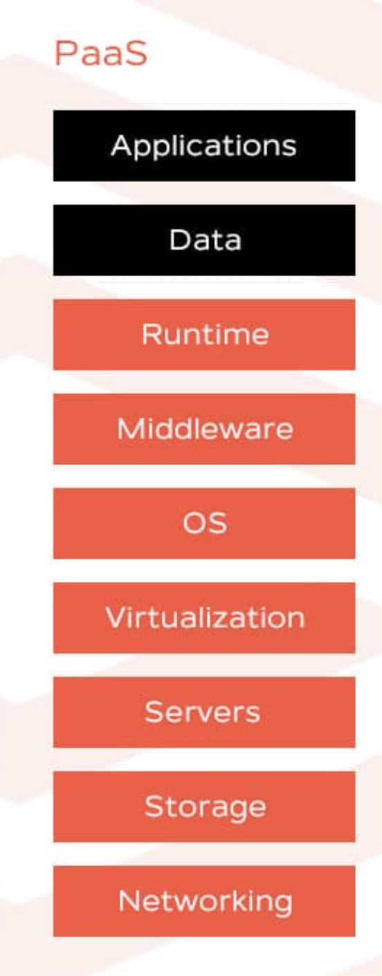
Platform as a Service (PaaS)
Main PaaS benefits
Easy to use
Productivity
Agility
Collaboration
Main PaaS concerns
Data security.
Interoperability and vendor lock-in.
Integrations and compatibility.
Operational limitations.
Runtime.

Slide 6
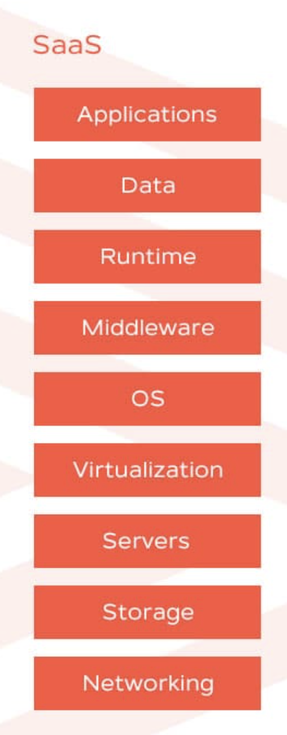
Software as a Service(SaaS)
Main SaaS benefits
Efficiency.
Time saving.
Regular updates.
Accessibility.
Main SaaS concerns
Data security.
Customization and feature limitations.
Interoperability and vendor lock-in. Integration support.
Performance.

Slide 7
Cloud computing deployment models
Cloud
A cloud-based application is fully deployed in the cloud and all parts of the application run in the cloud
On-premises
The deployment of resources on-premises, using virtualization and resource management tools, is sometimes called the “private cloud.” On-premises deployment doesn’t provide many of the benefits of cloud computing but is sometimes sought for its ability to provide dedicated resources
Hybrid
A hybrid deployment is a way to connect infrastructure and applications between cloud-based resources and existing resources that are not located in the cloud.

Slide 8
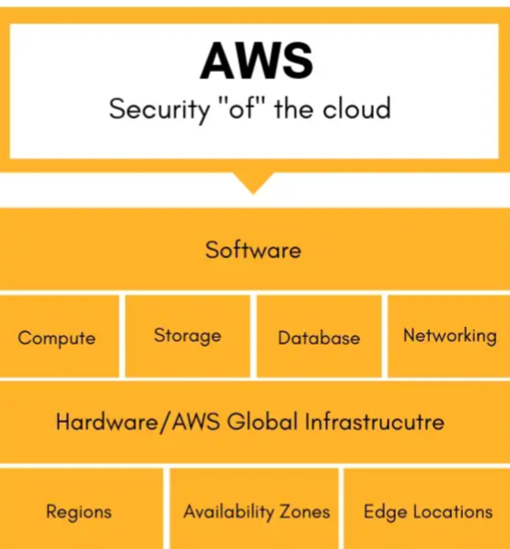
Security
AWS responsibility
Being responsible for security of the cloud means that AWS protects and secures the infrastructure that runs the services offered in the AWS Cloud. AWS is responsible for:
Protecting and securing AWS Regions, Availability Zones, and data centers, down to the physical security of the buildings
Managing the hardware, software, and networking components that run AWS services, such as the physical servers, host operating systems, virtualization layers, and AWS networking components.

Slide 9
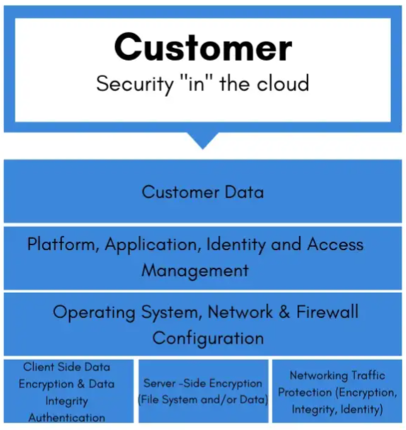
Security
Customer responsibility
Customers, or anyone building on the cloud, are responsible for security in the cloud. When using any AWS service, you’re responsible for properly configuring the service and your applications, in addition to ensuring that your data is secure.
Your level of responsibility depends on the AWS service. Some services require you to perform all the necessary security configuration and management tasks, while other more abstracted services require you to only manage the data and control access to your resources.
Due to the varying levels of effort, customers must consider which AWS services they use and review the level of responsibility required to secure each service. They must also review how the shared security model aligns with the security standards in their IT environment, in addition to any applicable laws and regulations.
A key concept is that customers maintain complete control of their data and are responsible for managing the security.related to their content.

Slide 10
Security
Inherited Controls – Controls which a customer fully inherits from AWS.
Physical and Environmental controls
Shared Controls – Controls which apply to both the infrastructure layer and customer layers, but in completely separate contexts or perspectives. In a shared control, AWS provides the requirements for the infrastructure and the customer must provide their own control implementation within their use of AWS services. Examples include:
Patch Management – AWS is responsible for patching and fixing flaws within the infrastructure, but customers are responsible for patching their guest OS and applications.
Configuration Management – AWS maintains the configuration of its infrastructure devices, but a customer is responsible for configuring their own guest operating systems, databases, and applications.
Awareness & Training - AWS trains AWS employees, but a customer must train their own employees.
Customer Specific – Controls which are solely the responsibility of the customer based on the application they are deploying within AWS services. Examples include:
Service and Communications Protection or Zone Security which may require a customer to route or zone data within specific security environments.

Slide 11
