Slide 1
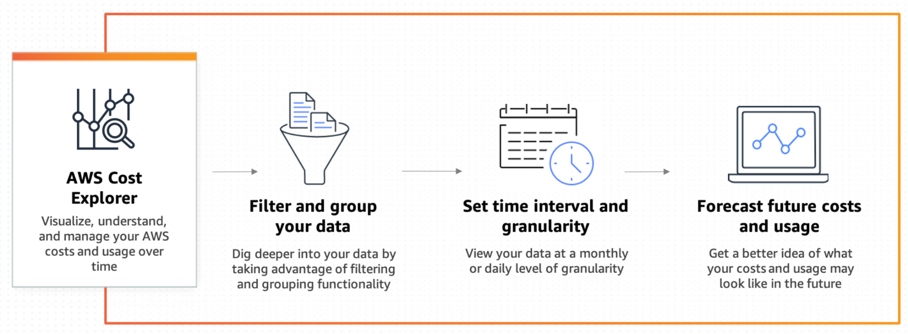
Amazon Cost Explorer
Amazon Cost Explorer has an easy-to-use interface that lets you visualize, understand, and manage your Amazon costs and usage over time.

Slide 2
Amazon Cost Explorer
With Cost Explorer, you can do the following:
Review charges and usage associated with your account.
View and create reports for your cost and usage data.
Forecast estimated spending for the next three months.
Get recommendations on utilization and coverage of your Reserved Instances (RIs).
Get recommendations on utilization and coverage of your Savings Plans.

