Slide 1
Savings Plans
Savings Plans is a flexible pricing model that can help you reduce your bill by up to 72% compared to On-Demand prices, in exchange for a one- or three-year hourly spend commitment.
AWS offers three types of Savings Plans:
Compute Savings Plans
EC2 Instance Savings Plans
Amazon SageMaker Savings Plans

Slide 2
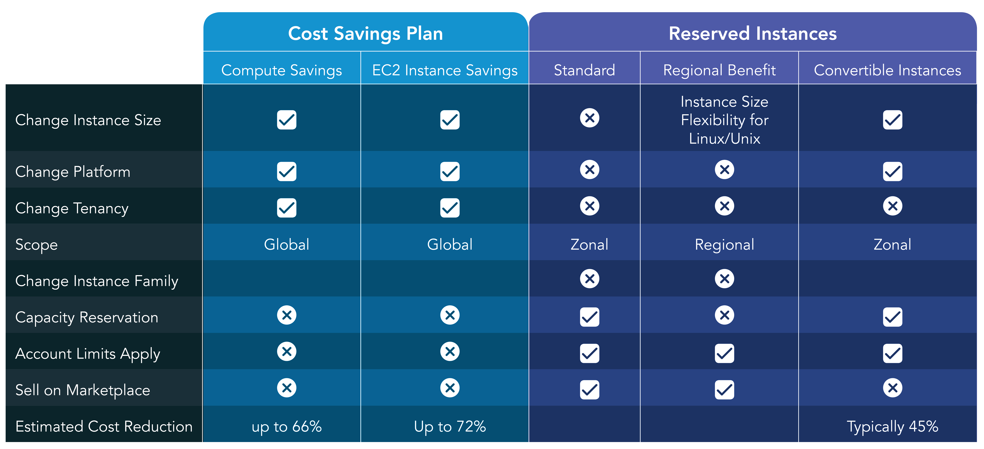
Svaing Plan vs Reserved Instance

