Slide 1
AWS Database Comparison

Slide 2
Database Comparison
Amazon RDS (Relational Database Service):
Use Case: Relational Databases
Choose RDS if your application requires a traditional relational database.
Supports popular databases such as MySQL, PostgreSQL, Oracle, SQL Server, and MariaDB.
Provides automated backups, patch management, and easy scalability.
Amazon DynamoDB:
Use Case: NoSQL Databases
Choose DynamoDB for highly scalable, low-latency NoSQL databases.
Ideal for applications with variable and unpredictable workloads.
Fully managed, serverless, and offers seamless scaling.
Amazon Aurora:
Use Case: High-Performance Relational Databases
Choose Aurora for high-performance relational databases with compatibility for MySQL or PostgreSQL.
Provides the performance of commercial databases with the cost-effectiveness of open-source databases.
Fully managed, scalable, and offers automatic backups.
Amazon DocumentDB (with MongoDB compatibility):
Use Case: MongoDB-Compatible Document Databases
Choose DocumentDB if you need a fully managed, scalable, and highly available MongoDB-compatible database.
Designed for applications using the MongoDB API.
Offers built-in security, automated backups, and easy scalability.
Amazon Neptune:
Use Case: Graph Databases
Choose Neptune for graph databases, suitable for highly connected data.
Supports both Property Graph and RDF models.
Ideal for applications requiring graph analysis and traversal.

Slide 3
Database Comparison
Amazon ElastiCache:
Use Case: In-Memory Caching
Choose ElastiCache for in-memory caching to improve application performance.
Supports Redis and Memcached.
Ideal for reducing database load and accelerating data access.
Amazon Redshift:
Use Case: Data Warehousing
Choose Redshift for large-scale data warehousing and analytics.
Supports high-performance querying on large datasets.
Fully managed, scalable, and integrates with popular BI tools.
Amazon Timestream:
Use Case: Time-Series Data
Choose Timestream for ingesting, querying, and analyzing time-series data at scale.
Suitable for IoT applications, telemetry, and operational monitoring.
Fully managed and optimized for time-series data.
Amazon Keyspaces (for Apache Cassandra):
Use Case: Cassandra-Compatible Databases
Choose Keyspaces for a fully managed, serverless, and scalable Apache Cassandra-compatible database.
Ideal for applications with variable and unpredictable workloads.
Amazon Quantum Ledger Database (QLDB):
Use Case: Ledger Databases
Choose QLDB for building transparent, immutable, and cryptographically verifiable transaction logs.
Ideal for applications requiring a centralized, tamper-resistant ledger.

Slide 4
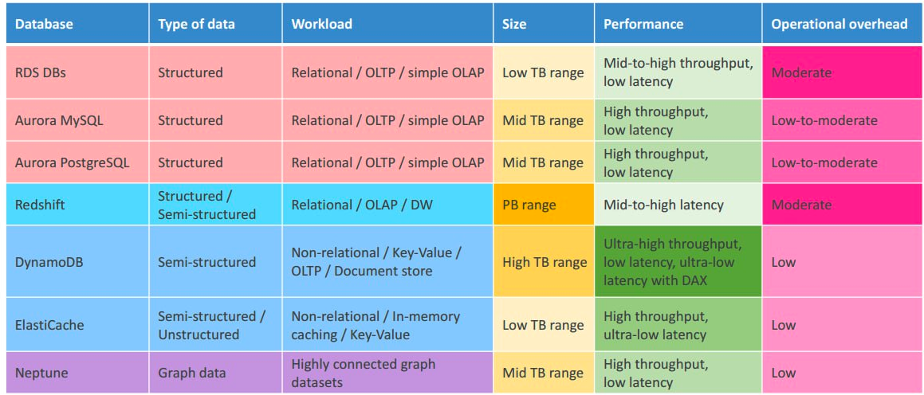
Databases Comparison

Slide 5
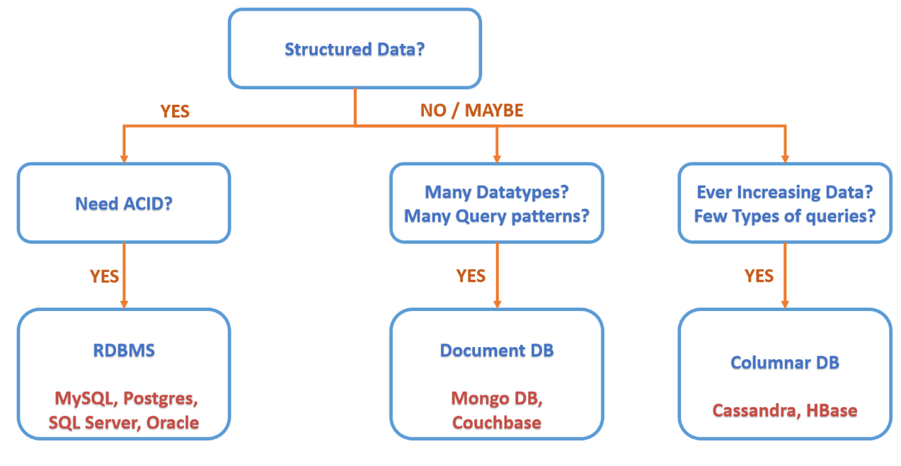
Choose database

