Slide 1

Elastic Cache

Slide 2

Amazon ElastiCache
Amazon ElastiCache is a web service that makes it easy to set up, manage, and scale a distributed in-memory data store or cache environment in the cloud. It provides a high-performance, scalable, and cost-effective caching solution. At the same time, it helps remove the complexity associated with deploying and managing a distributed cache environment.
Fully managed implementations of two popular in-memory data stores – Redis and Memcached.
The in-memory caching provided by ElastiCache can be used to significantly improve latency and throughput for many read-heavy application workloads or compute-intensive workloads
Best for scenarios where the DB load is based on Online Analytics Processing (OLAP) transactions.
Helps reduce load off of databases for read intensive workload.

Slide 3
ElasticSearch Use cases
Apps requiring sub-millisecond latency
Real-time analytics
Gaming leaderboards
Session stores
Chat apps
Machine learning
Streaming media apps
Message queques

Slide 4
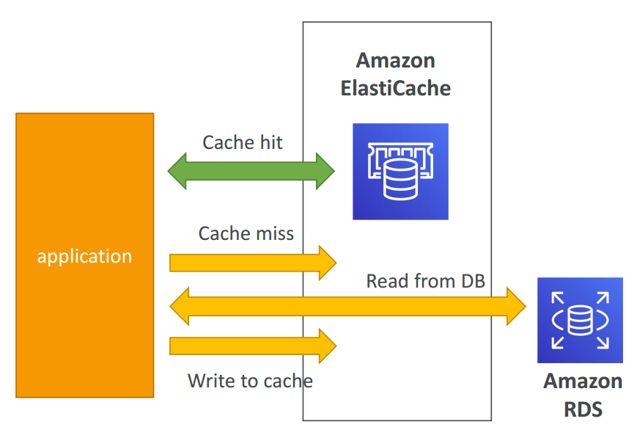
ElastiCache Solution Architecture - DB Cache
Applications queries ElastiCache, if not available, get from RDS and store in ElastiCache.
Helps relieve load in RDS
Cache must have an invalidation strategy to make sure only the most current data is used in there.

Slide 5
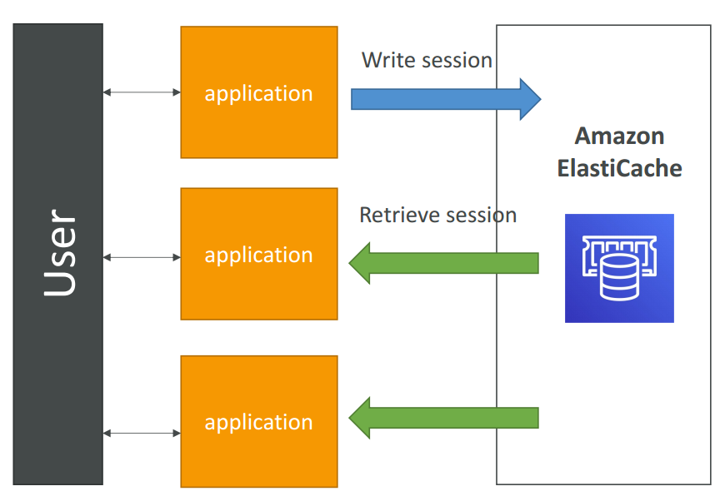
ElastiCache Solution Architecture – User Session Store
User logs into any of the application
The application writes the session data into ElastiCache
The user hits another instance of our application
The instance retrieves the data and the user is already logged in

Slide 6

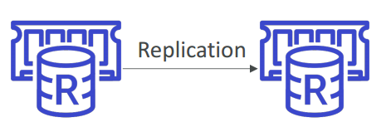
Two types of ElastiCache engine:
Memcached – simplest model, can run large nodes with multiple cores/threads, can be scaled in and out, can cache objects such as DBs.
Multi-node for partitioning of data (sharding)
No high availability (replication)
Non persistent
No backup and restore
Multi-threaded architecture
Does not support encryption
Redis – complex model, supports encryption, master / slave replication, cross AZ (HA), automatic failover and backup/restore.
Multi AZ with Auto-Failover
Read Replicas to scale reads and have high availability
Data Durability using AOF persistence
Backup and restore features
Encryption in transit

Slide 7
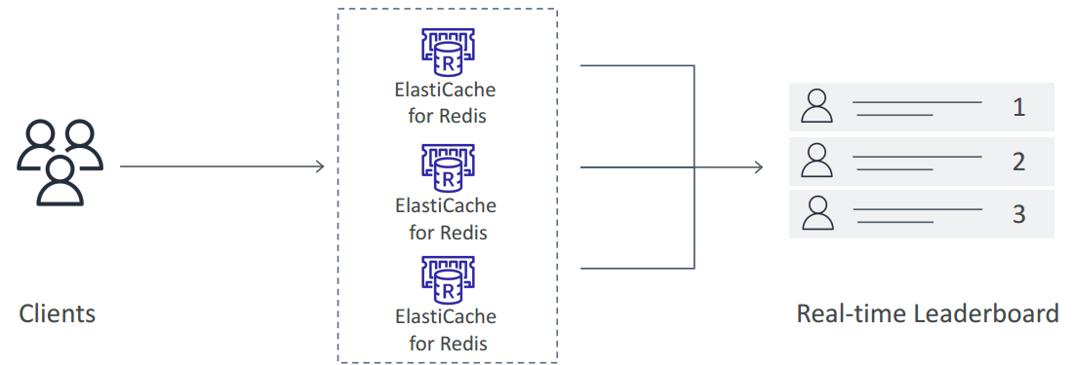
Use cases
Memcached
Cache the contents of a DB.
Cache data from dynamically generated web pages.
Transient session data.
High frequency counters for admission control in high volume web apps.
Redis
Gaming Leaderboards are computationally complex
Redis Sorted sets guarantee both uniqueness and element ordering
Each time a new element added, it’s ranked in real time, then added in correct order

Slide 8
Caching strategies

Slide 9
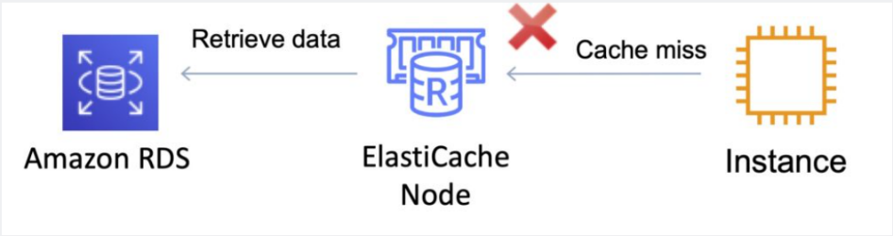
Caching strategies: Lazy Loading (Cache-Aside)
Lazy Loading
Loads the data into the cache only when necessary (if a cache miss occurs).
Lazy loading avoids filling up the cache with data that won’t be requested.
If requested data is in the cache, ElastiCache returns the data to the application.
If the data is not in the cache or has expired, ElastiCache returns a null.
The application then fetches the data from the database and writes the data received into the cache so that it is available for next time.
Data in the cache can become stale if Lazy Loading is implemented without other strategies (such as TTL).

Slide 10
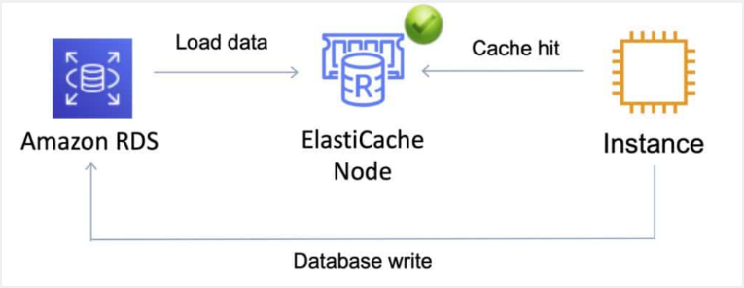
Caching strategies: Write Through
Write Through
When using a write-through strategy, the cache is updated whenever a new write or update is made to the underlying database.
Allows cache data to remain up to date.
This can add wait time to write operations in your application.
Without a TTL you can end up with a lot of cached data that is never read.

Slide 11
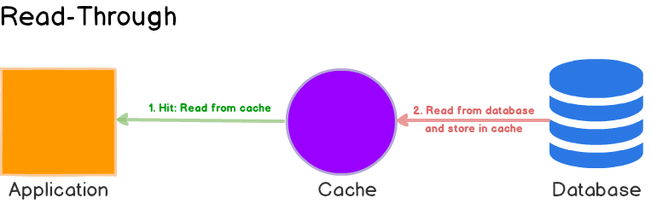
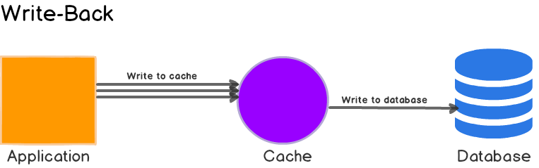
Caching strategies: Read Through
Caching strategies: Write Back

Slide 12
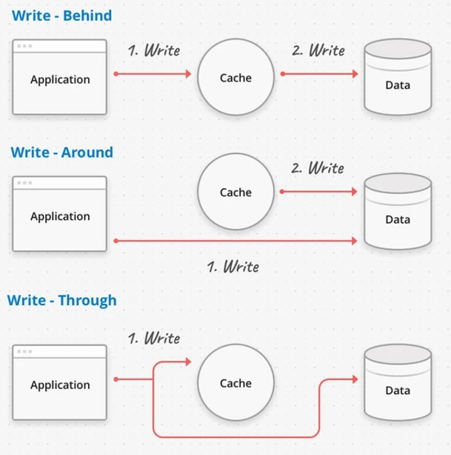
Caching strategies

Slide 13
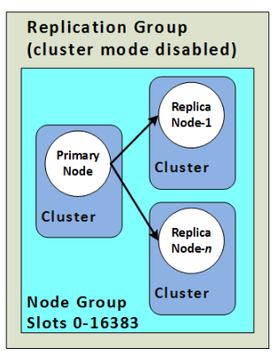
Redis Scaling
Cluster Mode Disabled
Vertical Scaling
Scale up/down node type
Minimal downtime
Horizontal scaling
add/remove replica nodes

Slide 14
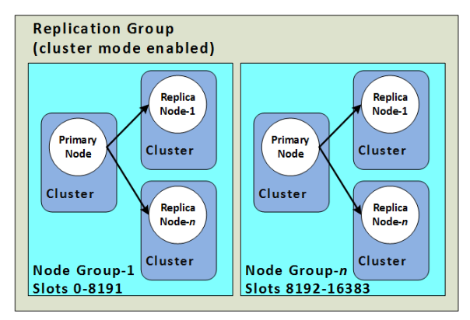
Redis Scaling
Cluster Mode Enabled
Vertical Scaling (Online)
Scale up/down node type
No downtime
Horizontal scaling
Allows partitioning across shards
add/remove/rebalance shards

Slide 15
Redis Online vs Offline mode comparison
 | Online Mode (no downtime) | Offline Mode (downtime)
Cluster availability during scaling up | yes | no
Can scale out scale in rebalance | yes | yes
Can scale up down (change node type) | no | yes
Can upgrade engine version | no | yes
Can specify the number of replica nodes in each shard independently | no | yes
Can specify the keyspace for shards independently | no | yes

Slide 16
Redis Replication
Cluster Mode Disabled
1 shart
0-5 replicas
0 replicas & primary fail -> total data loss
Multi Az supported
Supports scaling
Cluster Model Enabled
Up to 500 shards
0-5 replicas per shard
0 replicas & primary fail -> total data loss in That shard
Multi az required
Supports partitioning

Slide 17
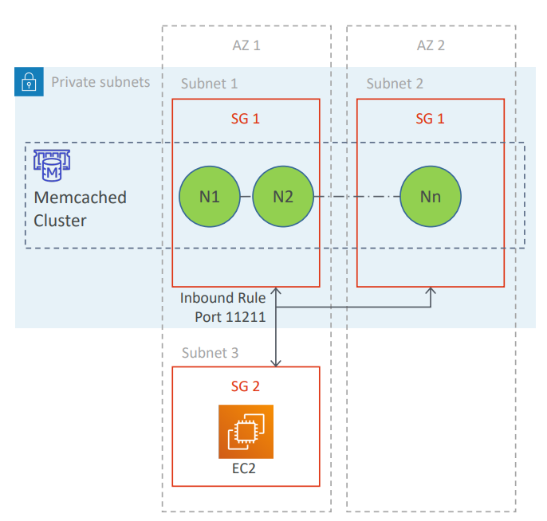
Memcached architecture
Memcached cluster is generally placed in private subnet
Accessed from EC2 instance placed in a public subnet in a VPC
Allows access only from EC2 network (apps should be hosted on whitelisted EC2 instances)
Whitelist using security groups
Up to 20 nodes per cluster
Data is distributed across the available nodes
Replicas are not supported
Node failure = data loss
Nodes can be deployed as Multi-AZ (to reduce data loss)

Slide 18
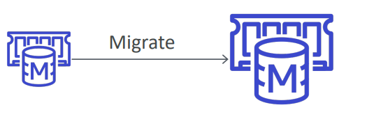
Memcached Scaling
Vertical scaling not supported
can resize by creating a new cluster and migrating your application
Horizontal scaling
allows you to partition your data across multiple nodes
up to 20 nodes per cluster and 100 nodes per region (soft limit)
no need to change endpoints post scaling (if you use auto -discovery)
must re -map at least some of your keyspace post scaling (evenly spread cache keys across all nodes)

Slide 19
Elastic Cache take away
ElastiCache is a web service that makes it easy to deploy and run Memcached or Redis protocol-compliant server nodes in the cloud.
ElastiCache EC2 nodes cannot be accessed from the Internet, nor can they be accessed by EC2 instances in other VPCs.
Can be on-demand or reserved instances too (but not Spot instances).
Each node runs an instance of the Memcached or Redis protocol-compliant service and has its own DNS name and port.
Memcached – simplest model, can run large nodes with multiple cores/threads, can be scaled in and out, can cache objects such as DBs.
Scales out/in (horizontally) by adding/removing nodes.
Scales up/down (vertically) by changing the node family/type.
Does not support multi-AZ failover or replication.
Does not support snapshots.
You can place nodes in different AZs.
Redis – complex model, supports encryption, master / slave replication, cross AZ (HA), automatic failover and backup/restore.
Redis is not multi-threaded.
Scales by adding shards, not nodes.
Supports master / slave replication and multi-AZ for cross-AZ redundancy.
Supports automatic failover and backup/restore.

Slide 20
Questions:

Slide 21
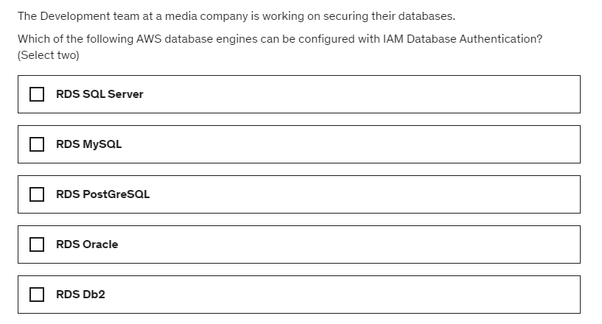

Slide 22
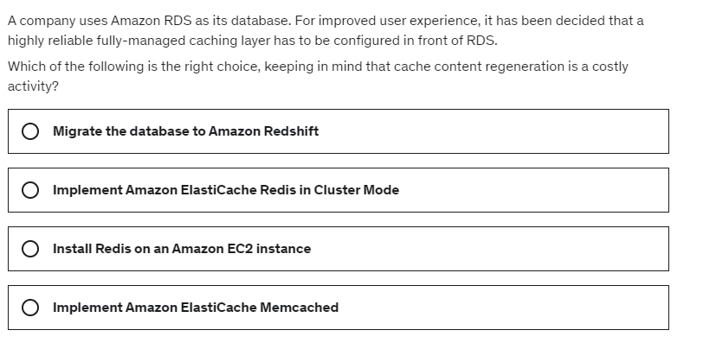

Slide 23
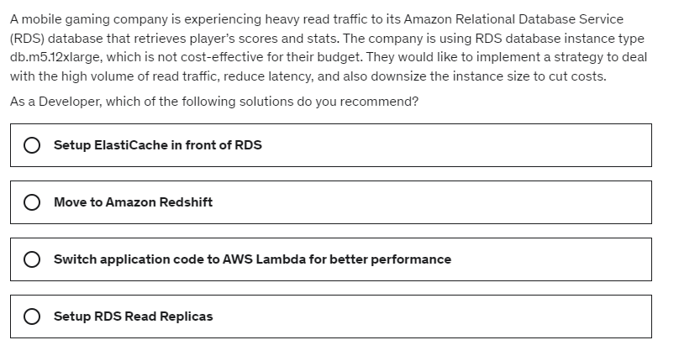

Slide 24
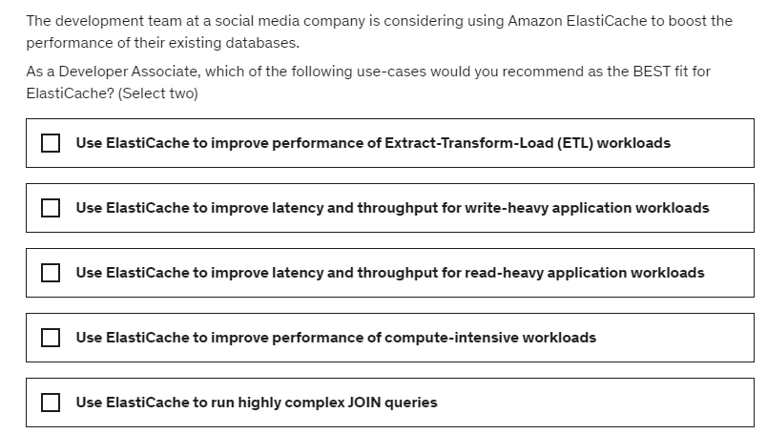

Slide 25
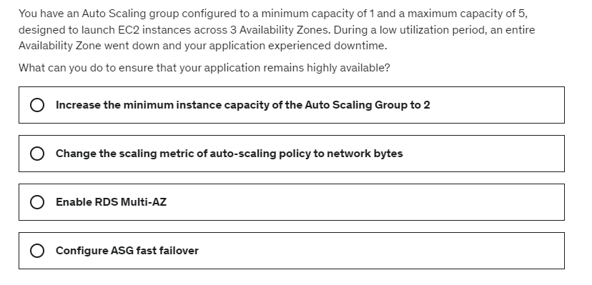

Slide 26
