Slide 1
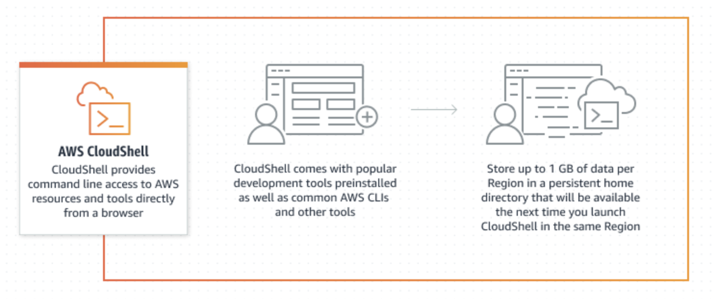
CloudShell
Using AWS CloudShell, a browser-based shell, you can quickly run scripts with the AWS Command Line Interface (CLI), experiment with service APIs using the AWS CLI, and use other tools to increase your productivity. The CloudShell icon appears in AWS Regions where CloudShell is available.

Slide 2
