Slide 1
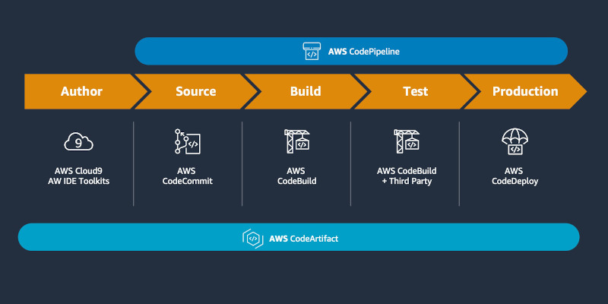
AWS CodeArtifact
AWS CodeArtifact is a secure, highly scalable, managed artifact repository service that helps organizations to store and share software packages for application development.
You can use CodeArtifact with popular build tools and package managers such as the NuGet CLI, Maven, Gradle, npm, yarn, pip, and twine.
CodeArtifact helps reduce the need for you to manage your own artifact storage system or worry about scaling its infrastructure.
There are no limits on the number or total size of the packages that you can store in a CodeArtifact repository.

Slide 2
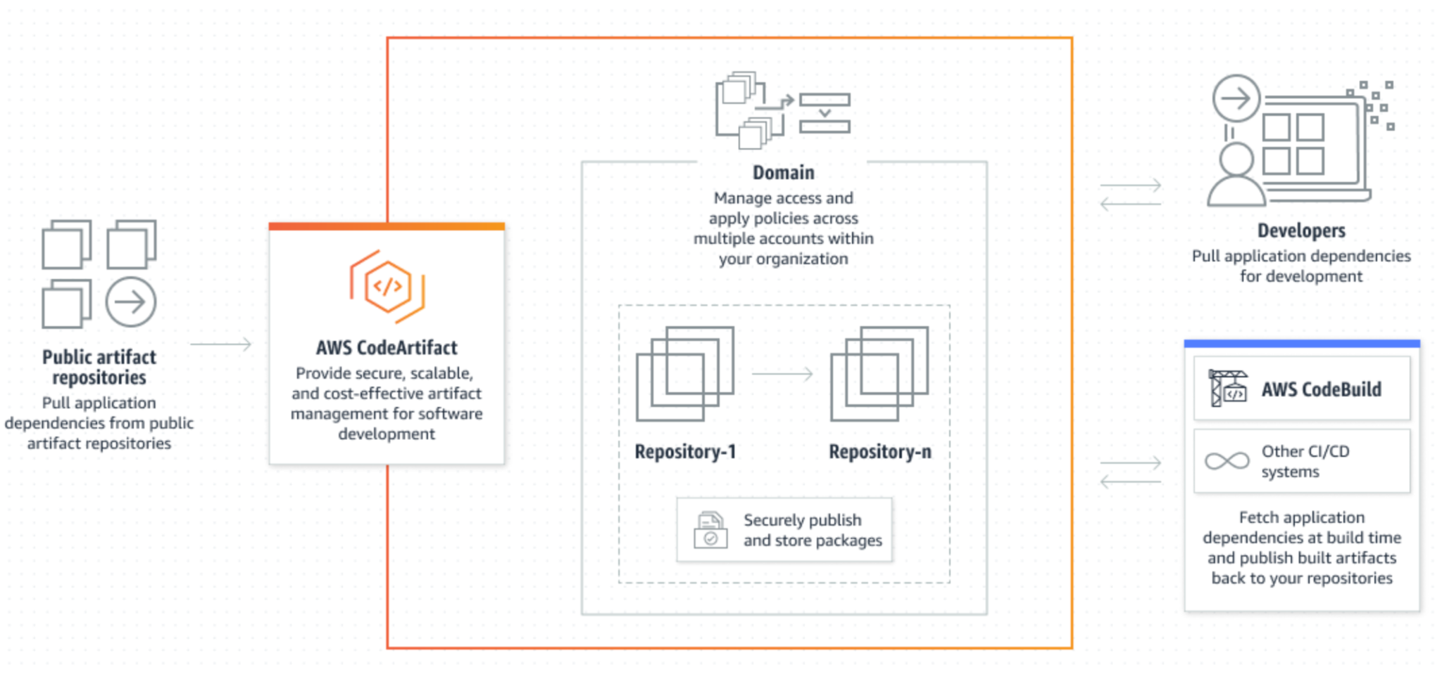
AWS CodeArtifact

