Slide 1
What is Amazon Organizations ?
Amazon Organizations is an account management service that enables you to consolidate multiple AWS accounts into an organization that you create and centrally manage.
Amazon Organizations includes account management and consolidated billing capabilities that enable you to better meet the budgetary, security, and compliance needs of your business.
As an administrator of an organization, you can create accounts in your organization and invite existing accounts to join the organization.
Amazon Organizations features
Centralized management of all of your Amazon Web Services accounts
Consolidated billing for all member accounts
Hierarchical grouping of your accounts to meet your budgetary, security, or compliance needs
Policies to centralize control over the Amazon services and API actions that each account can access
Policies that configure automatic backups for the resources in your organization's accounts
Global access - Amazon Organizations is a global service with a single endpoint that works from any and all Amazon Web Services Regions
Free to use - Amazon Organizations is a feature of your Amazon Web Services account

Slide 2
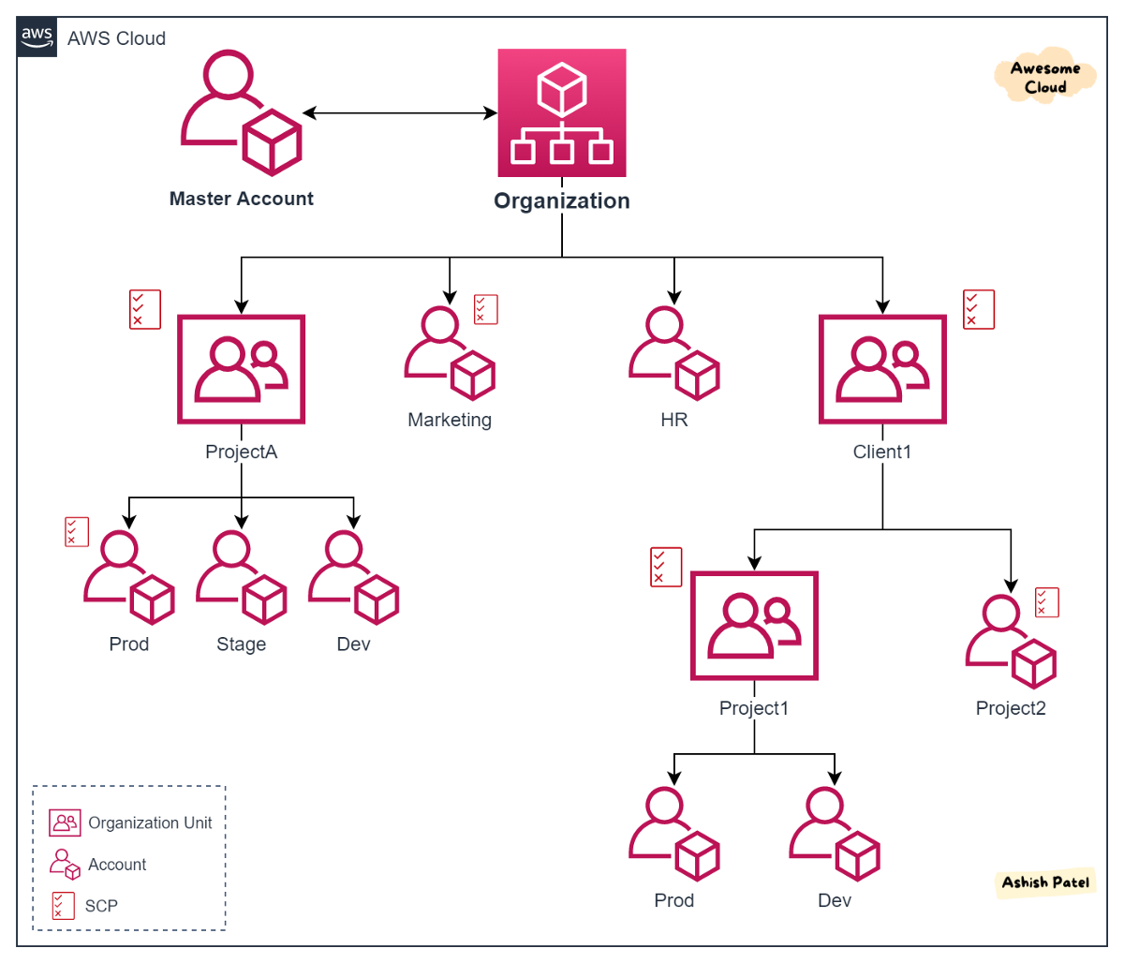
Amazon Organizations

Slide 3
AWS Organization Consolidated billing
Overview:
Primarily focuses on billing and cost management aspects within AWS Organizations.
Streamlines the financial aspects of managing multiple AWS accounts.
Key Features:
Single Payment: Receive a single bill for all linked AWS accounts.
Cost Allocation: Gain insights into detailed cost tracking across all linked accounts.
Volume Discounts: Benefit from volume discounts based on aggregate usage.
Use Cases:
Organizations seeking a simplified billing process for multiple AWS accounts.
Emphasis on cost visibility and cost management.

Slide 4
AWS Organization All Features
Overview:
Encompasses the complete suite of AWS Organizations features for comprehensive organizational and operational management.
Designed to provide a robust framework for governance, security, and resource management across multiple AWS accounts.
Key Features:
Service Control Policies (SCPs): Fine-grained access controls to regulate permissions across accounts.
Organizational Units (OUs): Allows structuring and organizing AWS accounts based on business units, applications, or environments.
Tag Policies: Enforcement of tagging standards for resources across accounts.
Consolidated Billing: The ability to centralize payment for multiple AWS accounts.
Cross-Account Access: Facilitates secure access across accounts.
Policy-Based Automation: Automate operational tasks using AWS Organizations policies.
Security and Compliance: Provides tools for enforcing security and compliance standards.
Use Cases:
Organizations with complex structures requiring detailed access controls and resource organization.
Emphasis on security, compliance, and efficient resource management.

Slide 5
Comparison: All Features vs Consolidated Billing
Scope:
All Features: Encompasses a broader set of features, including organizational structure, access controls, and security.
Consolidated Billing Features: Focused specifically on financial aspects, providing a consolidated view of costs and payments.
Primary Focus:
All Features: Governance, security, and resource management.
Consolidated Billing Features: Billing and cost management.
Comprehensive vs Specialized:
All Features: Comprehensive suite for overall organizational management.
Consolidated Billing Features: Specialized features addressing financial aspects.
Use Case Differentiation:
All Features: Suited for organizations with diverse governance and security requirements.
Consolidated Billing Features: Specifically tailored for organizations emphasizing billing simplicity and cost tracking.

