Slide 1
Certificate Manager

Slide 2
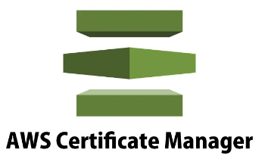
AWS Certificate Manager
Create, store, and renew SSL/TLS X.509 certificates
Single domains, multiple domain names and wildcards
Supports both public and private TLS certificates
Integrates with several AWS services including:
Elastic Load Balancing.
Amazon CloudFront.
AWS Elastic Beanstalk.
AWS CloudFormation.
Public certificates are signed by the AWS public Certificate Authority.
You can also create a Private CA with ACM.
Can then issue private certificates.
You can also import certificates from third-party issuers.

Slide 3
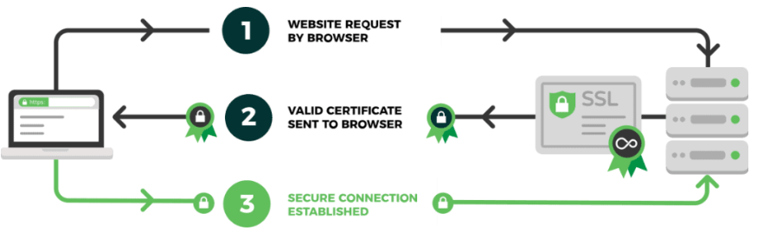
How SSL/TLS works
A server attempts to connect to a website (i.e. a web-server) secured with SSL. The server requests the web-server to identify itself.
The web-server sends the server a copy of its SSL certificate.
The server checks to see whether or not it trusts the SSL certificate. If so, it sends a message to the web-server.
The web-server sends back a digitally signed acknowledgement to start an SSL encrypted session.
Encrypted data is shared between the server and the web-server.

Slide 4
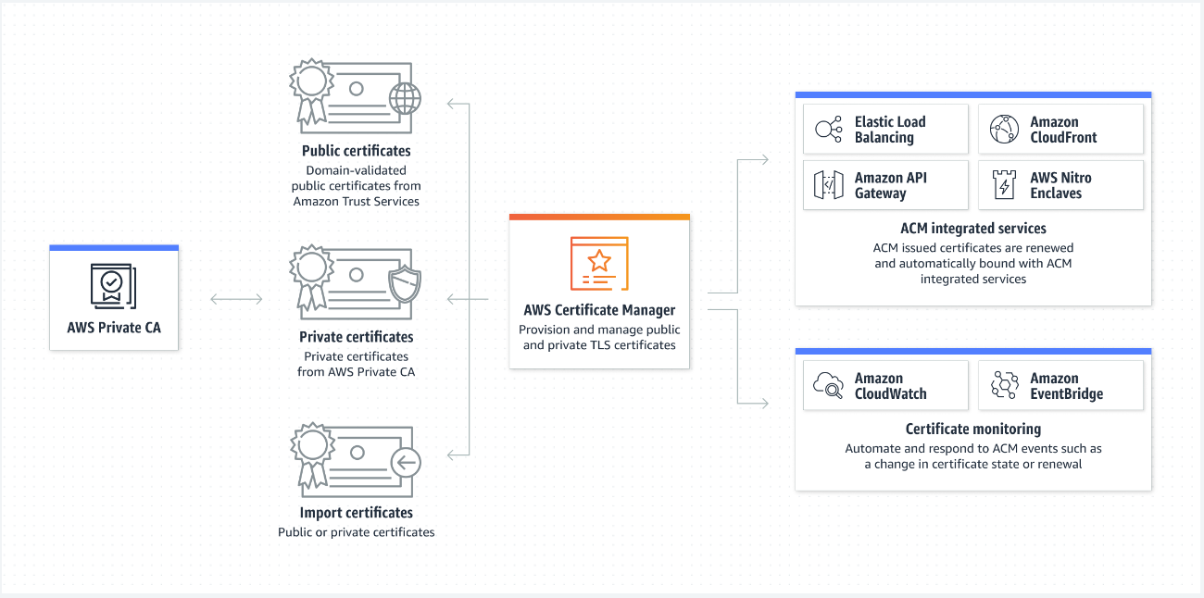
AWS Certificate Manager diagram

Slide 5
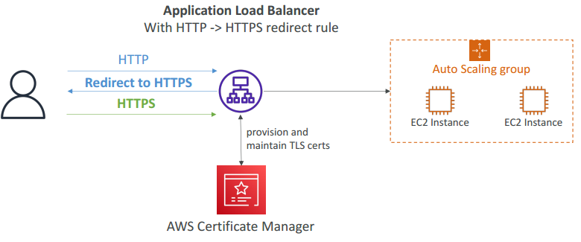
AWS Certificate Manager with ALB

Slide 6
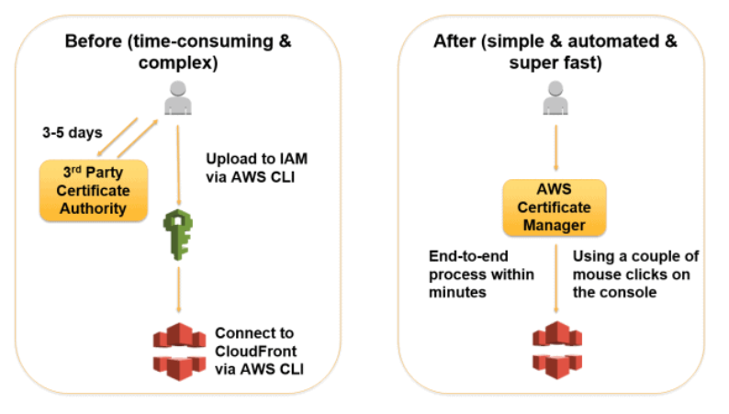
ACM & Third-party issuers
With AWS Certificate Manager, you will be able to quickly request a certificate, deploy it on ACM-integrated AWS resources, like Elastic Load Balancers, Amazon CloudFront distributions, and APIs on API Gateway, and let AWS Certificate Manager handle certificate renewals.

Slide 7
Requesting Public Certificates
1. List domain names to be included in the certificate
Fully Qualified Domain Name (FQDN): corp.example.com
Wildcard Domain: *.example.com
2. Select Validation Method: DNS Validation or Email validation
DNS Validation is preferred for automation purposes
Email validation will send emails to contact addresses in the WHOIS database
DNS Validation will leverage a CNAME record to DNS config (ex: Route 53)
3. It will take a few hours to get verified
4. The Public Certificate will be enrolled for automatic renewal
ACM automatically renews ACM-generated certificates 60 days before expiry

Slide 8
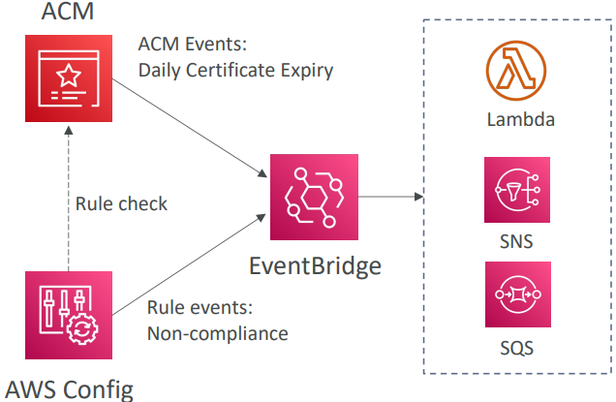
Importing Public Certificates
Option to generate the certificate outside of ACM and then import it
No automatic renewal, must import a new certificate before expiry
ACM sends daily expiration events starting 45 days prior to expiration
The # of days can be configured
Events are appearing in EventBridge
AWS Config has a managed rule named acm-certificate-expiration-check to check for expiring certificates (configurable number of days)

