Slide 1
AWS Storage Gateway
Provide on-premises applications with access to virtually unlimited cloud storage

Slide 2
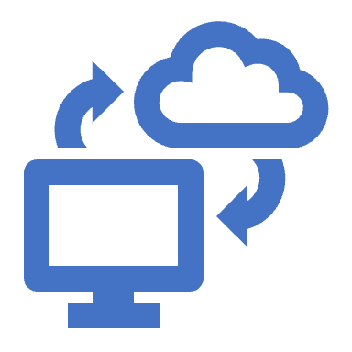
AWS Storage Gateway Use cases
Disaster Recovery: Corporations can employ AWS Storage Gateway to back up critical data and applications seamlessly, ensuring quick recovery in disaster scenarios, thereby enhancing business continuity with a cost-effective, hybrid cloud storage solution.
Data Migration: Companies looking to migrate substantial amounts of data to the cloud can use the service to streamline the migration process, ensuring a smooth transition by gradually moving data while maintaining local access.
Hybrid Cloud Deployments: Organizations can facilitate hybrid cloud environments, using AWS Storage Gateway to integrate on-premises IT environments with cloud resources, optimizing costs, and leveraging cloud scalability while retaining local data access.
Content Distribution: Media houses can use it to distribute content effectively by maintaining a local cache of frequently accessed data, enabling low-latency access to large datasets and simplifying the distribution workflows with centralized control.
Hybrid Cloud

Slide 3

AWS Storage Gateway
File Gateway
Store and access SMB and NFS file data with local caching Tape Gateway
Back up and archive on-premises data to virtual tapes in AWS
Volume Gateway
Hybrid cloud block storage with local caching
AWS Storage Gateway Hardware Appliance
A dedicated physical appliance for on-premises deployments

Slide 4
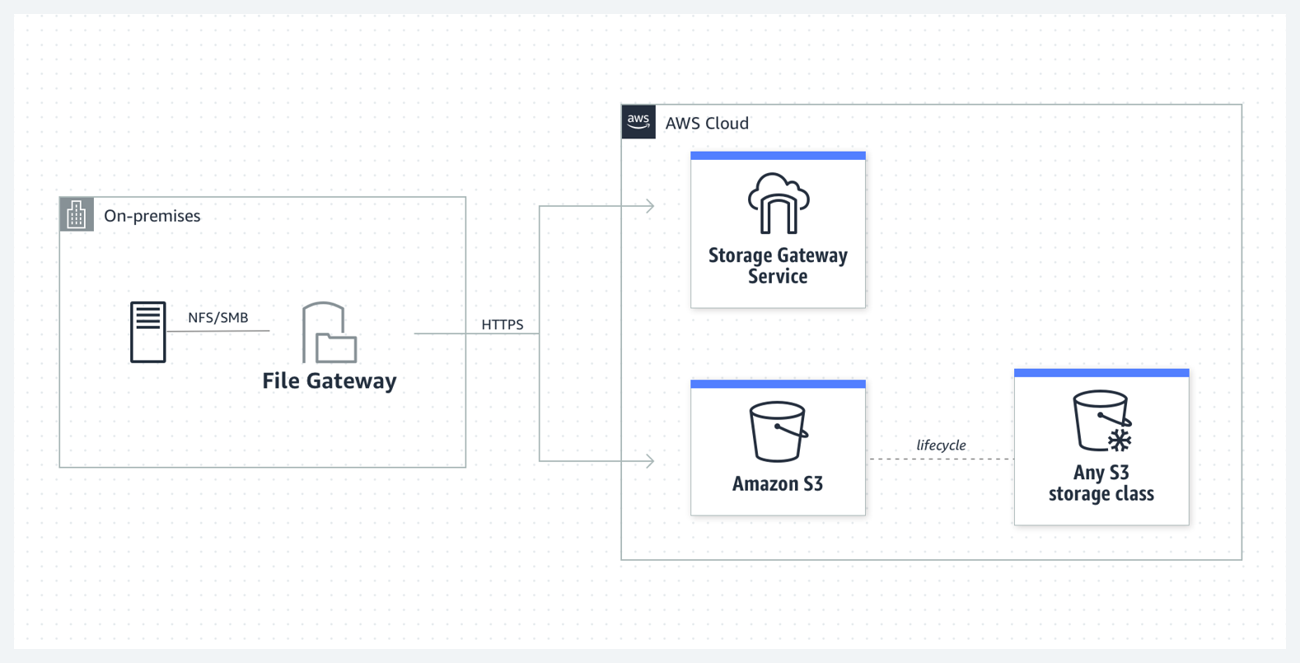
File Gateway: S3 File Gateway

Slide 5
File Gateway: S3 File Gateway
Amazon S3 File Gateway supports a file interface into S3
A S3 File Gateway simplifies file storage in Amazon S3, integrates to existing applications through industry-standard file system protocols, and provides a cost-effective alternative to on-premises storage.
It also provides low-latency access to data through transparent local caching.
With S3 File Gateway you can:
You can store and retrieve files directly using the NFS version 3 or 4.1 protocol.
You can store and retrieve files directly using the SMB file system version, 2 and 3 protocol.
You can access your data directly in Amazon S3 from any AWS Cloud application or service.
You can manage your S3 data using lifecycle policies, cross-region replication, and versioning. You can think of a S3 File Gateway as a file system mount on Amazon S3.

Slide 6

File Gateway: S3 File Gateway. How it works?
To deploy an S3 File Gateway, initially download a VM image for the gateway and activate it via the AWS Management Console or Storage Gateway API;
An Amazon EC2 image can alternatively be utilized for this setup.
Once activated, create and configure your file share, linking it to an Amazon S3 bucket, which then becomes accessible through NFS or SMB protocols — every file here mirrors an object in the S3 bucket
Maintaining a one-to-one mapping and benefiting from SSE-S3 encryption
while all transfers are facilitated securely through HTTPS
with integrity ensured by MD5 checksum verifications.
Leveraging multipart parallel uploads and byte-range downloads, the gateway optimizes data transmission, accompanied by features such as low-latency access through a local cache
CloudWatch metrics for monitoring resource utilization and CloudTrail for API call tracking, aiding in tasks like cloud workload ingestion, data archiving, and storage migration to AWS Cloud while offering insights into the system's functioning.

Slide 7
File Gateway: S3 File Gateway. How it works?
S3 File Gateway converts files to S3 objects when uploading files to Amazon S3.
The interaction between file operations performed against files shares on S3 File Gateway and S3 objects requires certain operations to be carefully considered when converting between files and objects.
When a file is written to the S3 File Gateway by an NFS or SMB client, the File Gateway uploads the file's data to Amazon S3 followed by its metadata
Uploading the file data creates an S3 object, and uploading the metadata for the file updates the metadata for the S3 object.
This process creates another version of the object, resulting in two versions of an object. If S3 Versioning is turned on, both versions will be stored.
When a file is modified in the S3 File Gateway by an NFS or SMB client after it has been uploaded to Amazon S3, the S3 File Gateway uploads the new or modified data instead of uploading the whole file. The file modification results in a new version of the S3 object being created.
You should monitor your S3 bucket to determine how many versions of an object exist before setting up lifecycle policies to move objects to different storage classes.
You should configure lifecycle expiration for previous versions to minimize the number of versions you have for an object in your S3 bucket.

Slide 8
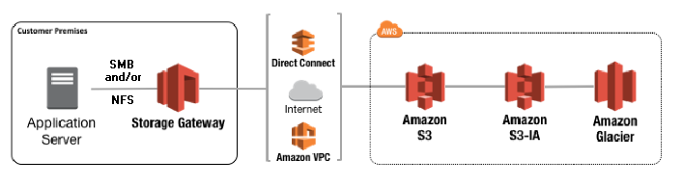
File Gateway: S3 File Gateway. How it works?

Slide 9
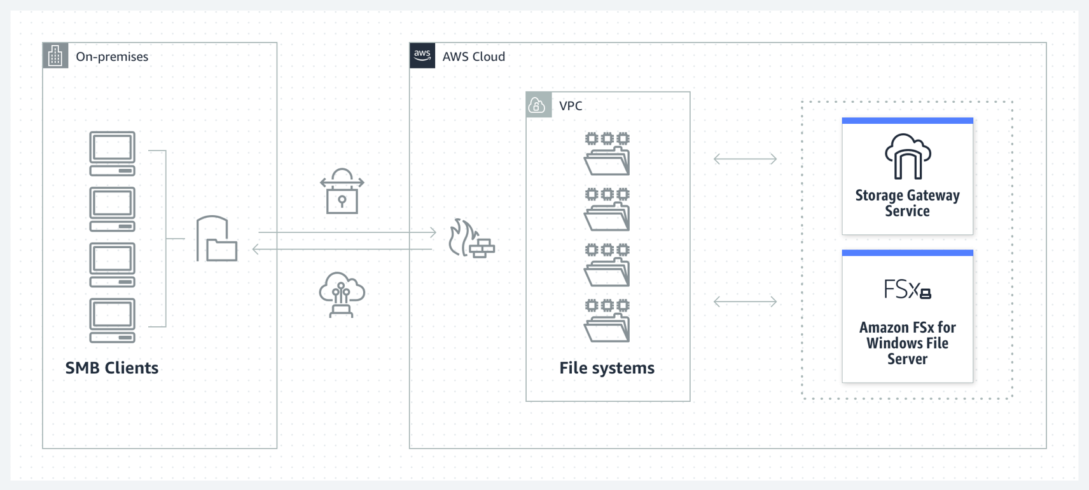
File Gateway: FSx File Gateway

Slide 10
File Gateway: S3 File Gateway. Use Cases
Remote Learning Resource Management: Educational institutions can utilize File Gateway to efficiently manage a vast repository of e-learning resources, allowing students and faculty remote access to educational materials through a simplified, secure, and scalable storage solution.
Digital Asset Management for Media Companies: Media enterprises can deploy File Gateway for storing and managing a plethora of digital assets centrally, ensuring streamlined access and collaboration on digital resources while reducing storage costs and complexity.
Regulatory Compliance in Financial Sector: Financial institutions can employ File Gateway to meet regulatory compliance requirements by archiving transaction data securely on AWS, facilitating secure, scalable, and cost-effective storage with easy retrieval options for audit purposes.
Healthcare Records Management: Healthcare organizations can use File Gateway to store and manage patients' electronic health records (EHRs) efficiently, providing a secure and compliant storage solution that ensures high availability and durability of critical health data.
Research Data Archiving in Life Sciences: Research institutions in the field of life sciences can leverage File Gateway to archive substantial volumes of research data, promoting a collaborative research environment by facilitating easy sharing and access to data while maintaining the integrity and security of sensitive information.

Slide 11
File Gateway: FSx File Gateway
Amazon FSx File Gateway (FSx File Gateway) is a new File Gateway type that provides low latency and efficient access to in-cloud FSx for Windows File Server file shares from your on-premises facility.
If you maintain on-premises file storage because of latency or bandwidth requirements, you can instead use FSx File Gateway for seamless access to fully managed, highly reliable, and virtually unlimited Windows file shares provided in the AWS Cloud by FSx for Windows File Server.
After the Amazon FSx File Gateway is activated and can access FSx for Windows File Server, use the Storage Gateway console to join it to your Microsoft Active Directory domain. After the gateway successfully joins a domain, you use the Storage Gateway console to attach the gateway to an existing FSx for Windows File Server. FSx for Windows File Server makes all the shares on the server available as shares on your Amazon FSx File Gateway
FSx File Gateway provides the following benefits:
Helps eliminate on-premises file servers and consolidates all their data in AWS to take advantage of the scale and economics of cloud storage.
Provides options that you can use for all your file workloads, including those that require on-premises access to cloud data.
Applications that need to stay on premises can now experience the same low latency and high performance that they have in AWS, without taxing your networks or impacting the latencies experienced by your most demanding applications.

Slide 12
File Gateway: FSx File Gateway
To use Amazon FSx File Gateway (FSx File Gateway), you must have at least one Amazon FSx for Windows File Server file system.
You must also have on-premises access to FSx for Windows File Server, either through a VPN or through an AWS Direct Connect connection
You deploy the gateway into your on-premises environment as a virtual machine (VM) running on VMware ESXi, Microsoft Hyper-V, or Linux Kernel-based Virtual Machine (KVM), or as a hardware appliance that you order from your preferred reseller. You can also deploy the Storage Gateway VM in VMware Cloud on AWS, or as an AMI in Amazon EC2. After deploying your appliance, you activate the FSx File Gateway from the Storage Gateway console or through the Storage Gateway API.

Slide 13
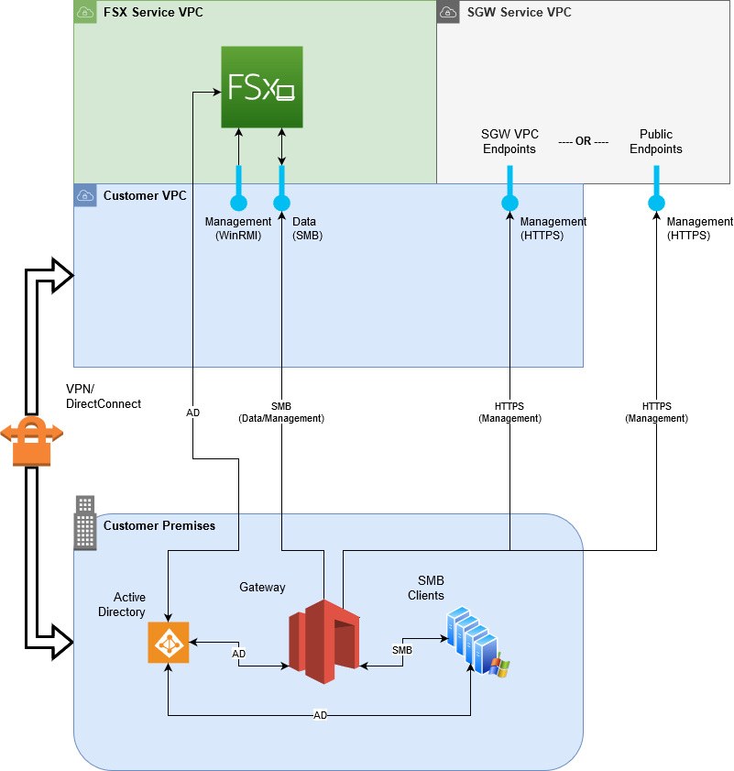
File Gateway: FSx File Gateway

Slide 14
File Gateway: FSx File Gateway. Use Cases
Geospatial Data Analysis: Environmental agencies can deploy Amazon FSx File Gateway to store and analyze massive datasets for geospatial analysis, leveraging the seamless integration with AWS tools to run complex analyses and visualize geospatial data more efficiently and at a large scale.
Media Production Archive Storage: Media houses can utilize FSx File Gateway to create a centralized storage solution for archiving digital assets, providing teams with a high-performance file system that facilitates quick retrieval of assets while maintaining data integrity and security.
Hybrid Cloud Solution for Financial Institutions: Financial organizations can deploy FSx File Gateway as part of a hybrid cloud solution, allowing for a secure and efficient storage system that integrates seamlessly with existing on-premises infrastructure, enabling regulatory compliance and safeguarding sensitive data.
Real-Time Analytics in Retail: Retail chains can integrate FSx File Gateway to store and analyze customer data in real-time, benefiting from the high-performance file storage to quickly process and analyze large datasets, thereby enabling data-driven decision-making and enhancing customer experiences.
Automotive Design and Simulation: Automotive companies can leverage FSx File Gateway to store and manage large datasets related to vehicle design and simulations, facilitating seamless collaboration among designers and engineers while ensuring data consistency and high-performance access to crucial design files.
Smart City Infrastructure Management: Governments can utilize FSx File Gateway in smart city initiatives to manage a wide array of data from different sensors and IoT devices deployed across urban areas, facilitating a centralized, high-performance data storage solution that aids in real-time analytics and informed decision-making for urban development and management.

Slide 15
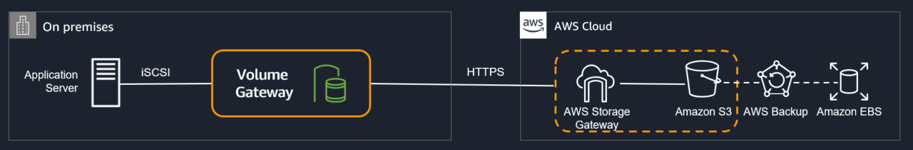
Volume Gateway
Block storage based on Internet Small Computer System Interface (iSCSI)
The gateway supports the following volume configurations:
Cached volumes – You store your data in Amazon Simple Storage Service (Amazon S3) and retain a copy of frequently accessed data subsets locally. Cached volumes offer a substantial cost savings on primary storage and minimize the need to scale your storage on-premises. You also retain low-latency access to your frequently accessed data.
Stored volumes – If you need low-latency access to your entire dataset, first configure your on-premises gateway to store all your data locally. Then asynchronously back up point-in-time snapshots of this data to Amazon S3. This configuration provides durable and inexpensive offsite backups that you can recover to your local data center or Amazon Elastic Compute Cloud (Amazon EC2). For example, if you need replacement capacity for disaster recovery, you can recover the backups to Amazon EC2.

Slide 16
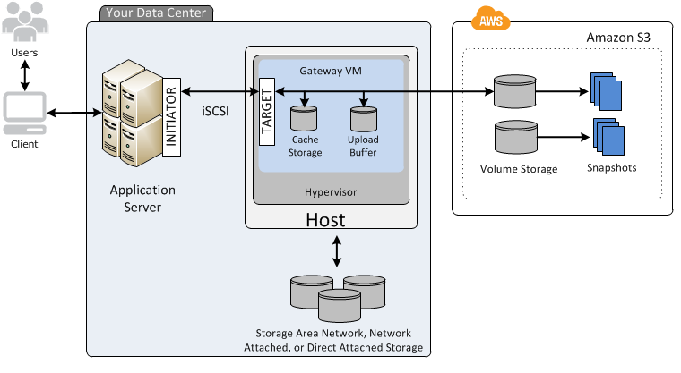
How Volume Gateway works: Cached Volumes

Slide 17
How Volume Gateway works: Cached Volumes
By using cached volumes, you can use Amazon S3 as your primary data storage, while retaining frequently accessed data locally in your Storage Gateway.
Cached volumes minimize the need to scale your on-premises storage infrastructure, while still providing your applications with low-latency access to their frequently accessed data.
You can create storage volumes up to 32 TiB in size and attach to them as iSCSI devices from your on-premises application servers.
Your gateway stores data that you write to these volumes in Amazon S3 and retains recently read data in your on-premises Storage Gateway's cache and upload buffer storage.
Cached volumes can range from 1 GiB to 32 TiB in size and must be rounded to the nearest GiB. Each gateway configured for cached volumes can support up to 32 volumes for a total maximum storage volume of 1,024 TiB (1 PiB).
In the cached volumes solution, Storage Gateway stores all your on-premises application data in a storage volume in Amazon S3.

Slide 18
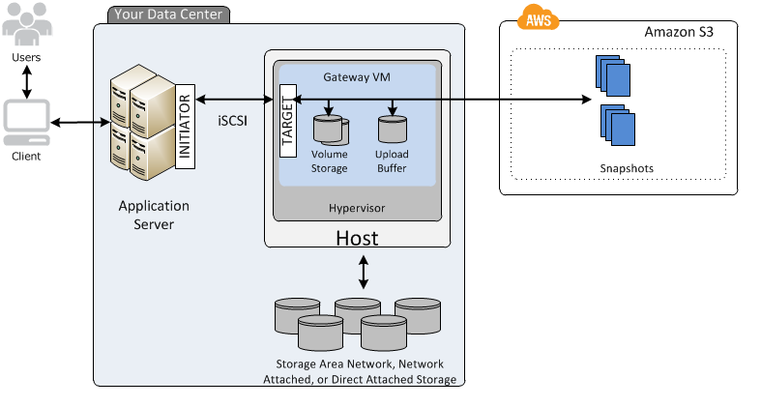
How Volume Gateway works: Stored volumes

Slide 19
How Volume Gateway works: Stored volumes
By using stored volumes, you can store your primary data locally, while asynchronously backing up that data to AWS.
Stored volumes provide your on-premises applications with low-latency access to their entire datasets.
At the same time, they provide durable, offsite backups.
You can create storage volumes and mount them as iSCSI devices from your on-premises application servers.
Data written to your stored volumes is stored on your on-premises storage hardware.
This data is asynchronously backed up to Amazon S3 as Amazon Elastic Block Store (Amazon EBS) snapshots.
Stored volumes can range from 1 GiB to 16 TiB in size and must be rounded to the nearest GiB. Each gateway configured for stored volumes can support up to 32 volumes and a total volume storage of 512 TiB (0.5 PiB).
With stored volumes, you maintain your volume storage on-premises in your data center.
That is, you store all your application data on your on-premises storage hardware. Then, using features that help maintain data security, the gateway uploads data to the Cloud for cost-effective backup and rapid disaster recovery.
This solution is ideal if you want to keep data locally on-premises, because you need to have low-latency access to all your data, and also to maintain backups in AWS.

Slide 20
Volume Gateway Use Cases
Backup and Archival Solutions: Businesses can use the Storage Gateway Volume Gateway to routinely backup critical data, where it acts as a secure and reliable solution to archive important business information, facilitating compliance with data retention policies and safeguarding against data loss.
Disaster Recovery: Companies can deploy Volume Gateway as a central part of their disaster recovery strategy, utilizing it to maintain updated copies of critical systems and data in AWS, ensuring a quick restoration of services in case of on-premises infrastructure failures.
Data Mirroring for Analytical Processing: Organizations involved in big data analytics can use Volume Gateway to mirror their on-premises data stores in AWS, providing a scalable environment to run complex analytical queries without impacting their primary data stores.
Content Delivery Networks (CDN) Optimization: Media companies can employ Volume Gateway to optimize their content delivery networks, leveraging AWS’s infrastructure to globally distribute multimedia content, ensuring lower latency and a higher throughput for their end users.
Hybrid Cloud Deployments for Healthcare Records: Healthcare institutions can make use of Volume Gateway in hybrid cloud setups to manage large repositories of patient data, thereby facilitating secure and compliant storage solutions that ensure the high availability and durability of sensitive health data, while still allowing for rapid access and retrieval when necessary.

Slide 21
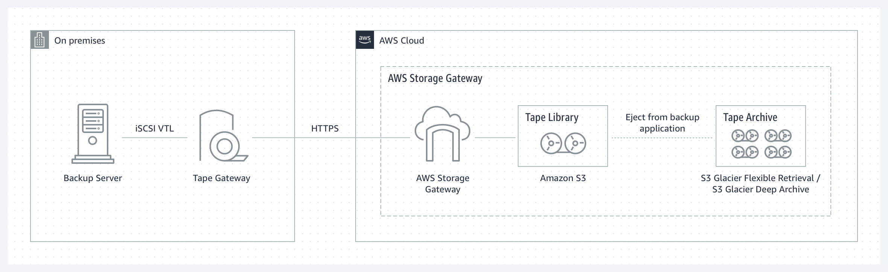
Tape Gateway
Use Tape Gateway to replace physical tapes on premises with virtual tapes on AWS—reducing your data storage costs without changing your tape-based backup workflows.
Tape Gateway supports all leading backup applications and caches virtual tapes on premises for low-latency data access.
It compresses your tape data, encrypts it, and stores it in a virtual tape library in Amazon Simple Storage Service (Amazon S3).
From there, you can transfer it to either Amazon S3 Glacier Flexible Retrieval or Amazon S3 Glacier Deep Archive to help minimize your long-term storage costs.

Slide 22
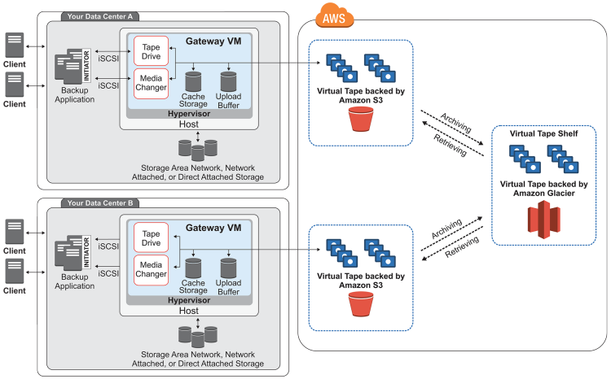
Tape Gateways Architecture

Slide 23
Tape Gateways Architecture
Tape Gateway offers a durable, cost-effective solution to archive your data in the Amazon Web Services Cloud.
With its virtual tape library (VTL) interface, you use your existing tape-based backup infrastructure to store data on virtual tape cartridges that you create on your Tape Gateway.
Each Tape Gateway is preconfigured with a media changer and tape drives.
These are available to your existing client backup applications as iSCSI devices.
You add tape cartridges as you need to archive your data.

Slide 24
Tape Gateways Architecture
Virtual tape – A virtual tape is like a physical tape cartridge. However, virtual tape data is stored in the AWS. Like physical tapes, virtual tapes can be blank or can have data written on them. You can create virtual tapes either by using the Storage Gateway console or programmatically by using the Storage Gateway API. Each gateway can contain up to 1,500 tapes or up to 1 PiB of total tape data at a time. The size of each virtual tape, which you can configure when you create the tape, is between 100 GiB and 15 TiB.
Virtual tape library (VTL) – A VTL is like a physical tape library available on-premises with robotic arms and tape drives. Your VTL includes the collection of stored virtual tapes. Each Tape Gateway comes with one VTL. The virtual tapes that you create appear in your gateway's VTL. Tapes in the VTL are backed up by Amazon S3. As your backup software writes data to the gateway, the gateway stores data locally and then asynchronously uploads it to virtual tapes in your VTL—that is, Amazon S3.
Tape drive – A VTL tape drive is analogous to a physical tape drive that can perform I/O and seek operations on a tape. Each VTL comes with a set of 10 tape drives, which are available to your backup application as iSCSI devices.
Media changer – A VTL media changer is analogous to a robot that moves tapes around in a physical tape library's storage slots and tape drives. Each VTL comes with one media changer, which is available to your backup application as an iSCSI device.
Archive – Archive is analogous to an offsite tape holding facility. You can archive tapes from your gateway's VTL to the archive. If needed, you can retrieve tapes from the archive back to your gateway's VTL.
Archiving tapes – When your backup software ejects a tape, your gateway moves the tape to the archive for long-term storage. The archive is located in the AWS Region in which you activated the gateway. Tapes in the archive are stored in the virtual tape shelf (VTS). The VTS is backed by S3 Glacier Flexible Retrieval or S3 Glacier Deep Archive, low-cost storage service for data archiving, backup, and long-term data retention.
Retrieving tapes – You can't read archived tapes directly. To read an archived tape, you must first retrieve it to your Tape Gateway by using either the Storage Gateway console or the Storage Gateway API.

Slide 25
Tape Gateway Use Case Direction
Backup to AWS
Tape Gateway presents cloud-backed storage through an iSCSI-based virtual tape library to your on-premises backup application. You can backup data directly from your backup application to Tape Gateway. Tape Gateway asynchronously copies your backups to AWS and enables you to scale backup storage needs on-premises with a pay-as-you-go pricing.
Archive to AWS
You can use Tape Gateway to archive data you need to preserve at another offsite location for disaster recovery or regulatory compliance needs. Tape Gateway enables you to replace magnetic tape libraries and physical tapes with AWS Cloud storage for long-term storage retention needs.

Slide 26
Tape Gateway Use Cases
Long-Term Data Archival: Companies in regulated industries can use Tape Gateway to comply with legal requirements for long-term data retention, utilizing it to replace physical tapes with a durable and cost-effective virtual tape infrastructure hosted in AWS.
Digital Media Asset Preservation: Media libraries can leverage Tape Gateway to preserve digital assets effectively, allowing for the archiving of digital media assets into virtual tapes, which ensures a secure and scalable solution to store invaluable media contents for the long term.
Healthcare Data Backup: Healthcare organizations can utilize Tape Gateway to back up patient records and other sensitive data, creating a virtual tape library in AWS that offers a secure, scalable, and compliant storage solution, safeguarding critical data while facilitating easy retrieval for analysis and reporting.
Scientific Research Data Archival: Research institutions can use Tape Gateway for the archival of large datasets generated through scientific research, offering a cost-effective and scalable solution to maintain access to historical data without the burden of managing a physical tape library.
Government Records Preservation: Government agencies can employ Tape Gateway to preserve essential governmental records securely, creating a virtual tape library that meets regulatory requirements for data retention and ensures the long-term preservation of vital records with the ability for quick retrieval in compliance audits or legislative processes

Slide 27
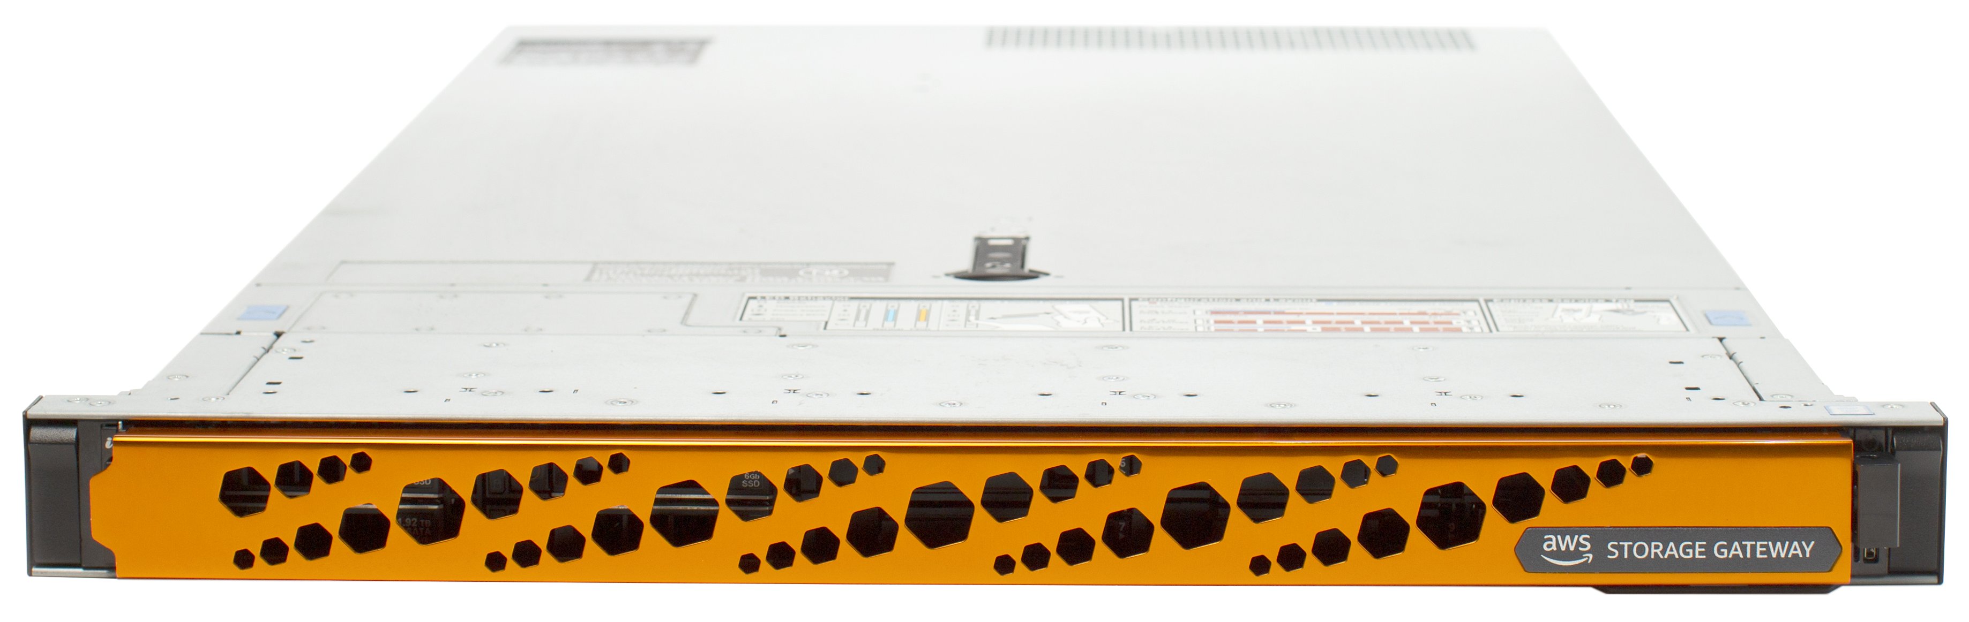
AWS Storage Gateway Hardware Appliance
The AWS Storage Gateway Hardware Appliance is a physical, standalone, validated server configuration for on-premises deployments.
It comes pre-loaded with Storage Gateway software, and provides all the required CPU, memory, network, and SSD cache resources for creating and configuring File Gateway, Volume Gateway, or Tape Gateway.
The Storage Gateway Hardware Appliance is designed to provide you with a simple out of the box experience that does not require any additional infrastructure and is managed from the AWS Console or API.

Slide 28
AWS Storage Gateway Hardware Appliance Use cases
Branch Office Data Consolidation: Organizations with multiple branch offices can deploy AWS Storage Gateway Hardware Appliance to centrally manage and store data generated across various locations, facilitating unified data governance and simplifying IT management through a physical appliance that integrates with AWS services.
Retail Inventory Management: Retail chains can implement AWS Storage Gateway Hardware Appliances in their stores to maintain real-time inventory data, leveraging the hardware appliance to secure and streamline the storage and retrieval of inventory information, integrating seamlessly with AWS for analytics and reporting.
Manufacturing Data Collection and Analysis: Manufacturing firms can use the AWS Storage Gateway Hardware Appliance to collect and store data from various production equipment and systems, creating a centralized repository that facilitates real-time monitoring and analysis to optimize manufacturing processes and maintain high-quality standards.
Healthcare EMR and PACS Integration: Healthcare facilities can use the hardware appliance to facilitate seamless integration between Electronic Medical Record (EMR) systems and Picture Archiving and Communication System (PACS), ensuring secure, scalable, and high-performance storage solution for critical healthcare data, promoting interoperability and efficient data management.
Legal Firm Case and Document Management: Legal firms can deploy AWS Storage Gateway Hardware Appliance for case and document management, providing a secure and reliable infrastructure to store sensitive legal documents, and facilitating quick retrieval and sharing of data with clients and within the firm, while ensuring compliance with legal regulations regarding data protection.

Slide 29
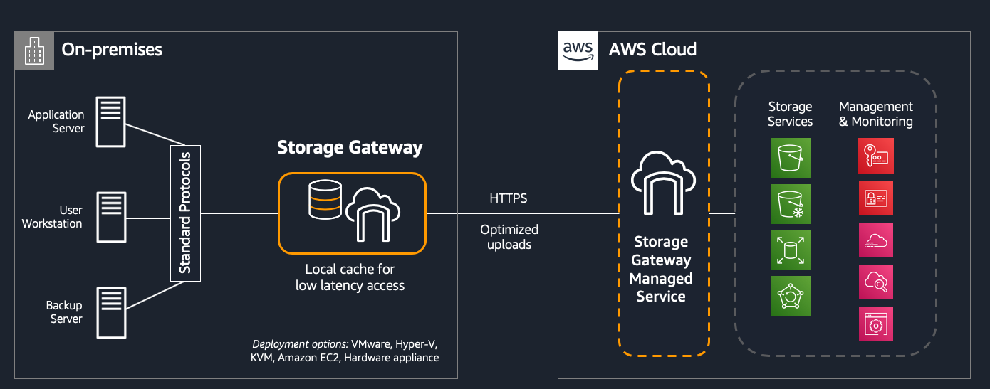
High-level architecture of Storage Gateway

