Slide 1
Amazon QLDB

Slide 2
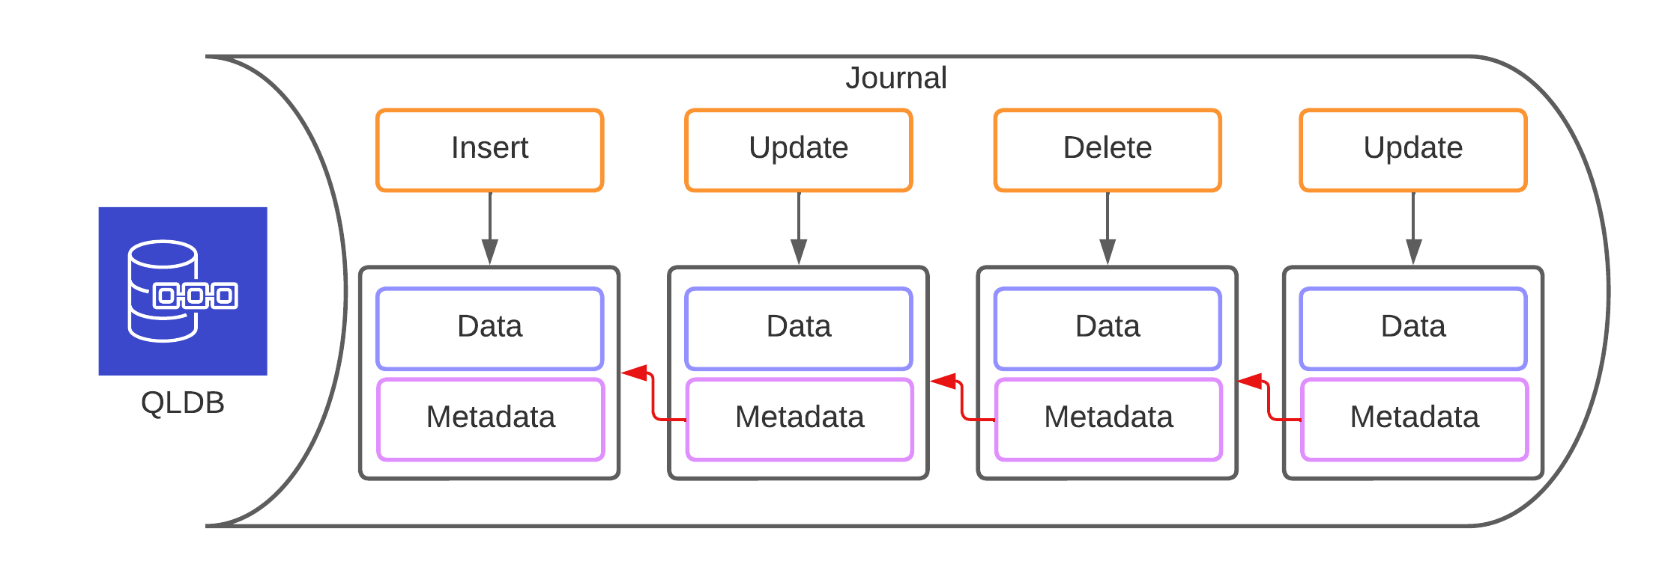
Amazon QLDB
QLDB = Quantum Ledger Database
Fully managed, serverless ledger database
Has built-in, immutable journal to record all the change history of your data
Transparent and cryptographically verifiable ledger
Tracks each application data change and maintains a complete and verifiable history of changes over time
Supports ACID transactions
Uses query language named PartiQL (SQL-like, Open standard)
Uses Amazon ION format
A Superset of JSON
Self-describing, hierarchical data serialization format
Offers interchangeable binary and text representations
Adds additional data types, type annotations and comments to JSON format
Supports nested JSON elements

Slide 3
Ledger
Good for
Tracking the history of credits and debits in banking transactions
Maintaining accurate records of vehicle ownership
Tracing the movement of an item though a supply chain
Audit Database
Blockchain alternative
Not good for:
Analytics
Nontransactional workloads
Characteristics:
Complete and immutable change history
Verifiable data integrity
Easily query data history

Slide 4
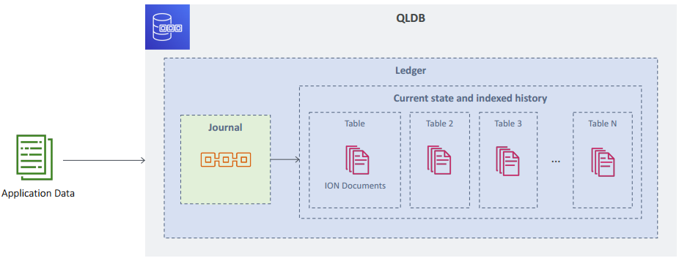
QLDB Architecture
It’s serverless (scales automatically to support the needs of your application)
Intended to support high-performance OLTP workloads

Slide 5
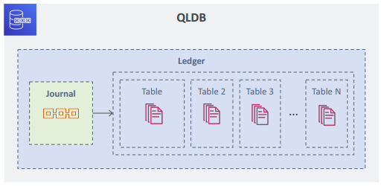
QLDB Architecture
Ledger = Journal + set of tables
Journal
Is append-only, immutable
No updates / overwrites / deletes
Stores a sequenced, cryptographically verifiable entry of each change to the table data
Changes are chained together as blocks (but not a blockchain implementation)
QLDB is centralized and not a distributed ledger (blockchain is used with decentralized use-cases)
Even if you delete data from the ledger (table), you can access its change history from the immutable journal

Slide 6
QLDB Architecture
Tables
Collection of documents and their revisions
Store the current and historical state of your data (indexed storage)
Can include document deletion records
Documents are in ION format

Slide 7
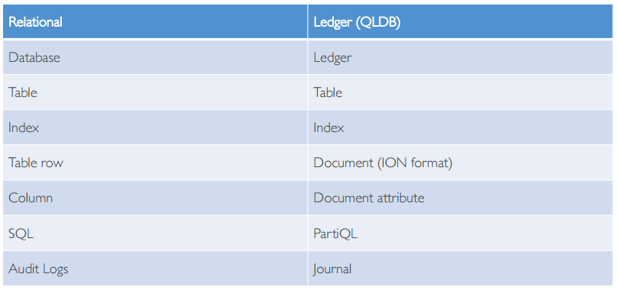
Relational vs Ledger

Slide 8
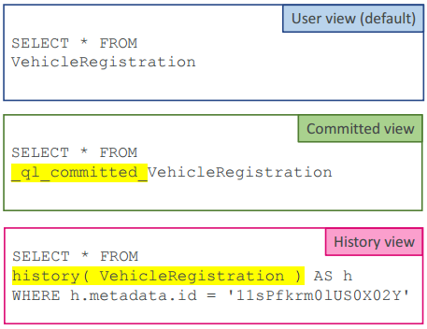
QLDB Views
QLDB offers three views of your data
User view
Committed view
History view
User view
latest version of your data
default view
Committed view
user view + system generated metadata
History view
contains all historical document revisions
i.e. all change history with metadata

Slide 9
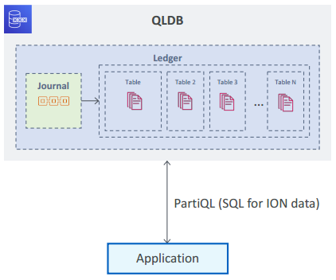
Working with QLDB
You create a ledger and define your tables
QLDB supports ACID semantics
We use PartiQL query language to query QLDB
It’s a SQL-like open standard query language
SQL-compatible access to relational, semistructured, and nested data
Extends SQL to support ION documents
PartiQL is also used with Redshift / S3 Select / Glacier Select

Slide 10
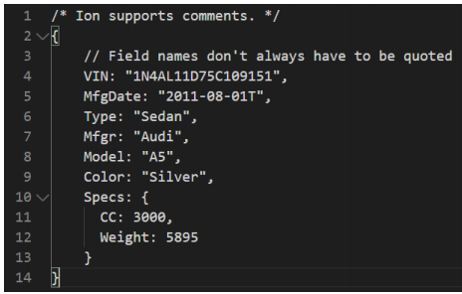
Amazon ION format
Originally developed by Amazon itself
Is a Superset of JSON
Self-describing, hierarchical data serialization format (=nested JSON)
Offers interchangeable binary and text representations
Adds additional data types, type annotations and comments to JSON format
Flexible data model

Slide 11
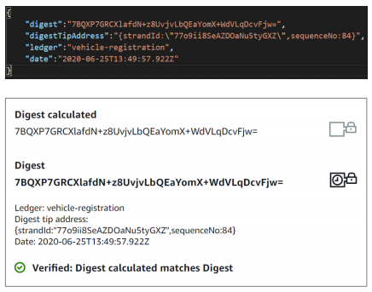
Data Verification in QLDB
Journal maintains immutable and verifiable transaction log
QLDB uses a digest for verification -> verification option
Digest
is a cryptographic representation of your journal
or a unique signature of your data’s entire change history as of a point in time
is generated using SHA-256 hash function with a Merkle tree-based model
Can verify the integrity of your data by calculating the digest and comparing it with QLDB’s digest
Can verify using the AWS console or QLDB API
Improper verification requests typically result in IllegalArgumentException

Slide 12
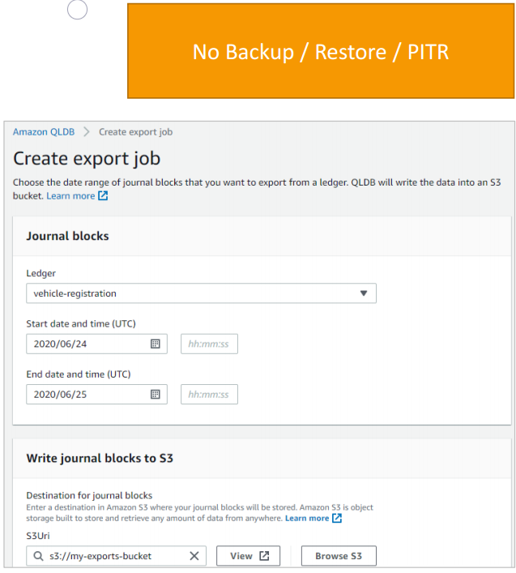
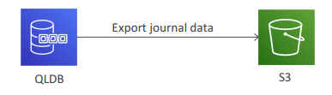
QLDB Backup and Restore
QLDB does not support a backup and restore feature (yet!)
PITR is also not supported (yet!)
Can only export your QLDB journal to S3
For analytics / auditing / data retention / verification / exporting to other systems
limit of two concurrent journal export jobs

Slide 13
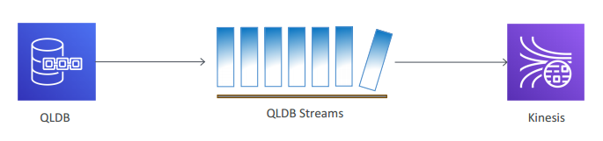
QLDB Streams
Continuous flow of data from your ledger's journal to a Kinesis data stream
Provides an at-least-once delivery guarantee
No ordering guarantees
Revisions can be produced in a Kinesis data stream out of order

Slide 14
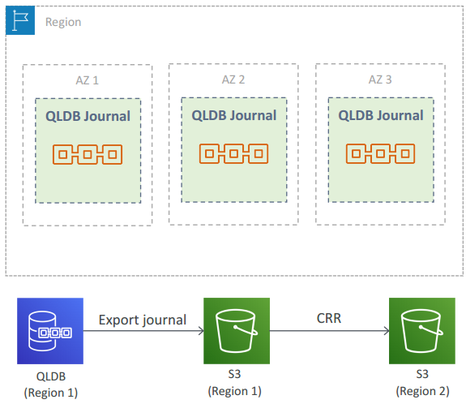
QLDB High Availability and Durability
QLDB ledger is replicated across multiple AZs within the region (=high availability)
With multiple copies per AZ (=strong durability)
Write is acknowledged only after being written to a durable storage in multiple AZs
CRR is not supported (yet!)
QLDB journal can be exported to an S3 bucket
S3 bucket can then be configured for CRR

Slide 15
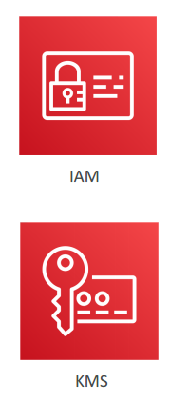
QLDB Security
IAM is used for authentication and authorization of QLDB resources
Supports encryption at rest and in transit
Uses Amazon-owned keys to encrypt QLDB data
Does not support CMKs

Slide 16
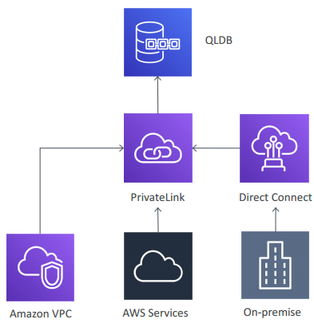
QLDB Security - Networking
Can use an interface VPC endpoint to allow VPC resources to connect to QLDB privately
Interface VPC endpoints are powered by AWS PrivateLink
PrivateLink provides private and secured connectivity between VPCs, AWS services, and on-premises applications
PrivateLink eliminates the need for IG / NAT device / VPN connection / or AWS Direct Connect connection

Slide 17
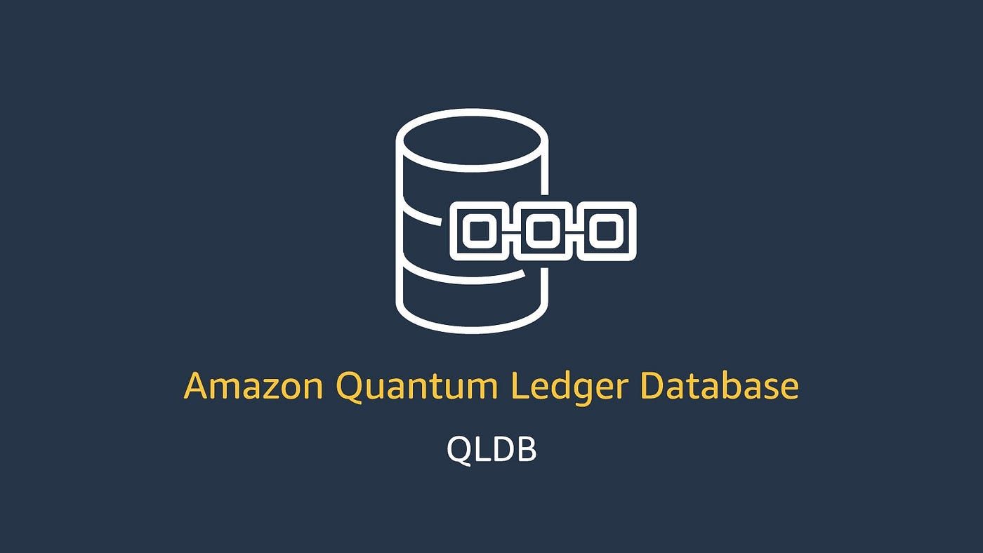
QLDB Monitoring
Integrated with CloudWatch (Alarms / Logs / Events)
Common metrics
JournalStorage
IndexedStorage
ReadIOs
WriteIOs
CommandLatency
QLDB log files provide additional information
API calls and user activity can be logged with CloudTrail

Slide 18
QLDB Pricing
You pay only for what you use
Storage – per GB per month
Journal Storage and Indexed Storage
IOs – per million requests
read IOs and write IOs
Data transfer

