Slide 1
Amazon Keyspaces

Slide 2
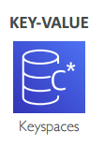
Amazon Keyspaces
A scalable, highly available, and fully-managed database service
Lets you run your Cassandra workloads on AWS
Cassandra is an open-source, wide-column, NoSQL data store
Is serverless, so you pay for what you use + autoscaling
Supports thousands of requests per second with virtually unlimited throughput and storage
Compatible with the CQL (Cassandra Query Language) API
Security through IAM, VPC and KMS
Data is encrypted by default, supports encryption at rest and in transit
Supports continuous backups with PITR
All writes replicated three times across multiple AZs for durability and availability
Offers 99.99% availability SLA within Region with no scheduled downtime
Monitoring through CloudWatch, DDL actions logged with CloudTrail
Use cases: IoT device metadata / User profiles / Time-series data / Transactions data (e.g. ecommerce)

Slide 3

What is Apache Cassandra?
Apache Cassandra is an open source NoSQL distributed database for scalability and high availability without compromising performance.
Created in 2008 by Facebook engineer. Now part of Apache
Linear scalability and proven fault-tolerance on commodity hardware or cloud infrastructure make it the perfect platform for mission-critical data.
No joins. Data stored with full denormalization.
Features:
Hybrid : Masterless architecture and low latency means Cassandra will withstand an entire data center outage with no data loss—across public or private clouds and on-premises.
Fault Tolerant : Cassandra’s support for replicating across multiple datacenters is best-in-class, providing lower latency for your users and the peace of mind of knowing that you can survive regional outages. Failed nodes can be replaced with no downtime.
Focus on Quality : To ensure reliability and stability, Cassandra is tested on clusters as large as 1,000 nodes and with hundreds of real world use cases and schemas tested with replay, fuzz, property-based, fault-injection, and performance tests.
Performant : Cassandra consistently outperforms popular NoSQL alternatives in benchmarks and real applications, primarily because of fundamental architectural choices.
You’re In Control : Choose between synchronous or asynchronous replication for each update. Highly available asynchronous operations are optimized with features like Hinted Handoff and Read Repair.
Security and Observability : The audit logging feature for operators tracks the DML, DDL, and DCL activity with minimal impact to normal workload performance, while the fqltool allows the capture and replay of production workloads for analysis.

Slide 4
CQL (Cassandra Query Language )
You use CQL for interacting with Cassandra database (and with Keyspaces)
To run CQL queries, you can use:
CQL editor in the AWS Console
cqlsh client (CQL shell)
Cassandra client driver (programmatic access)

Slide 5
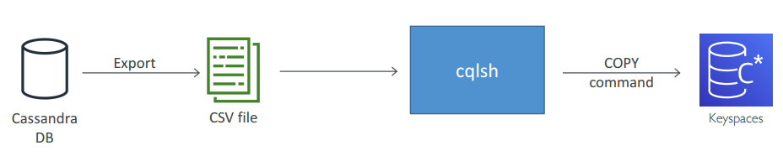
Migrating from Cassandra to Keyspaces
Export existing cluster data to CSV files
Import using cqlsh COPY command

Slide 6
Read and write consistency in Keyspaces
Two read consistency modes:
LOCAL_ONE consistency
LOCAL_QUORUM consistency
LOCAL_ONE optimizes for performance and availability by returning the first returned value from any storage replica
LOCAL_QUORUM optimizes for data correctness by requiring at least two replicas to return a value before it is returned to your application
All writes consistency use LOCAL_QUORUM for durability

Slide 7
Keyspaces pricing
On-demand mode
Uses RRUs and WRUs (read/write request units)
You pay for the actual reads and writes
Use with unpredictable application traffic
1 RRU = one 4KB read with LOCAL_QUORUM consistency
1 RRU = two 4KB reads with LOCAL_ONE consistency
1 WRU = one1KB write with LOCAL_QUORUM consistency
Provisioned mode
Uses RCUs and WCUs (read/write capacity units)
You specify the number of reads and writes per second
Lets you optimize costs if you have predictable application traffic and can forecast capacity requirements in advance
1 RCU = one 4KB read with LOCAL_QUORUM consistency
1 RCU = two 4KB reads with LOCAL_ONE consistency
1 WCU = one1KB write with LOCAL_QUORUM consistency
If a query returns multiple rows, you are billed based on the aggregate size of the data returned
For example, if your query returns four rows and each row has 2 KB of data (8 KB of data total), you are billed 2 RCUs using LOCAL_QUORUM consistency and 1 RCU using LOCAL_ONE consistency
Storage, backups and restore, and data transfer costs are additional

