Slide 1
Amazon Timestream

Slide 2
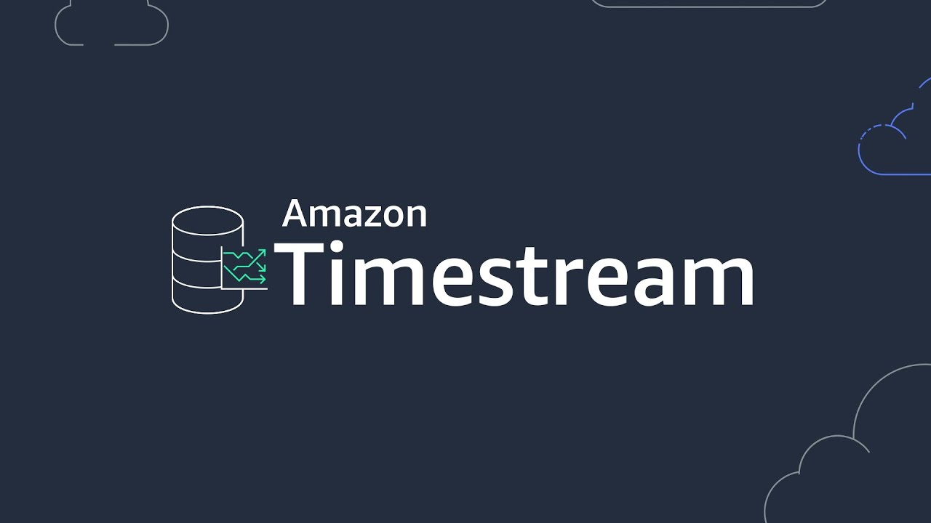
Amazon Timestream
Fully managed, fast, scalable, serverless time-series database service
Time-series data measures how things change over time
Store and analyze trillions of time-ordered events per day
1,000x faster query performance at 1/10th the cost of relational databases
Automates rollups, retention, tiering, and compression of data
Use cases:
Log data for DevOps
Sensor data for IoT applications
Customer clickstream data in web traffic monitoring
Industrial telemetry data for equipment maintenance

Slide 3
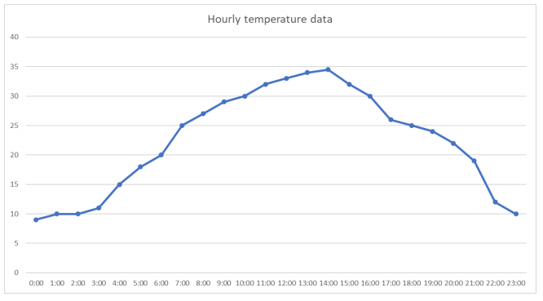
What is a time series
Series of data points ordered in time

Slide 4
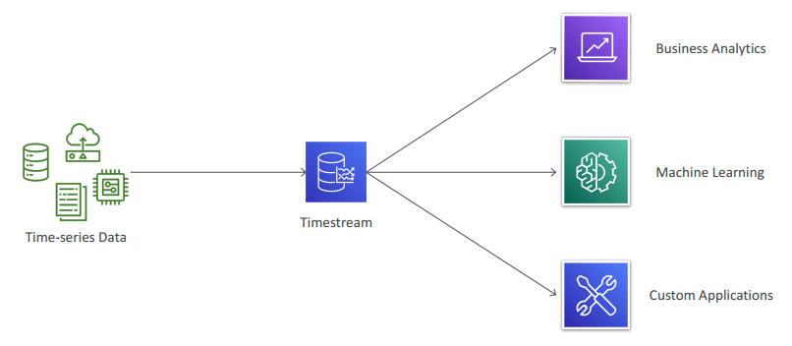
Timestream - Diagram

Slide 5
Timestream Pricing
You pay only for what you use
Writes – per million writes
Reads (query) – per TB of data scanned by queries
Storage – per GB (in-memory / SSD / magnetic)
Data transfer

Slide 6
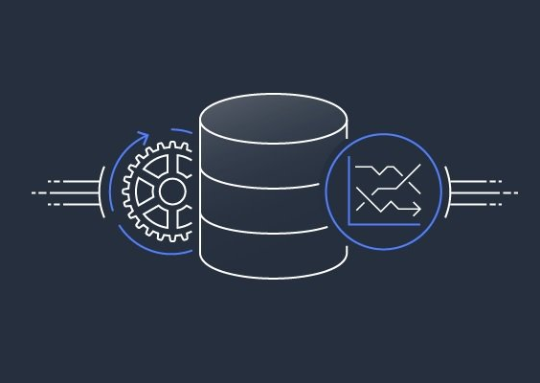
Timestream Exam Take away
It’s a serverless offering
Automatically scales writes, storage, and query capacity on demand
Can set the data retention policy for each table
Data is organized by time intervals
Uses time-series specific data compression (=less scanning, faster performance)
Separate data processing layer for data ingestion, storage sharing and queries
Uses an adaptive query engine that adapts to different time-series datasets
Offers built-in analytics (interpolation / smoothing / approximation)

