Slide 1
Amazon DocumentDB

Slide 2
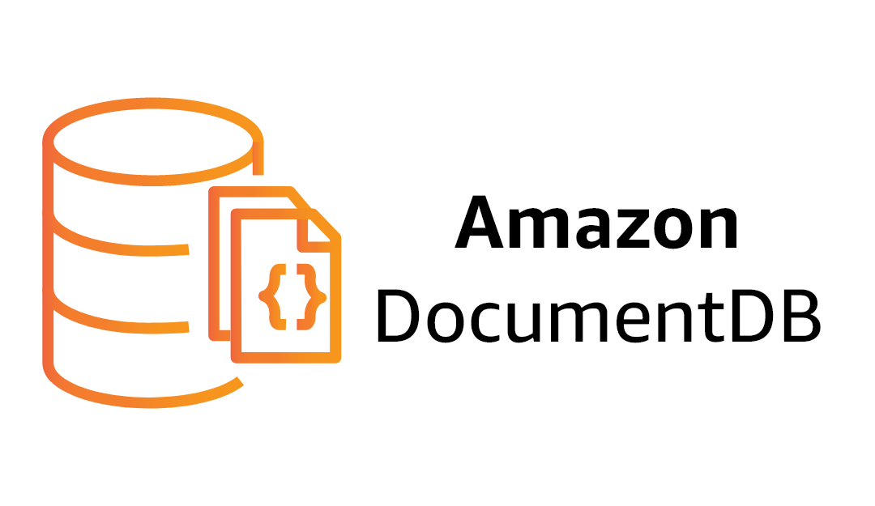
Amazon DocumentDB
• Fully-managed (non-relational) document database for MongoDB workloads
• JSON documents (nested key-value pairs) stored in collections (≈ tables)
• Compatible w/ majority of MongoDB applications, drivers, and tools
• High performance, scalability, and availability
• Support for flexible indexing, powerful ad-hoc queries, and analytics
• Storage and compute can scale independently
• Supports 15 low-latency read replicas (Multi-AZ)
• Auto scaling of storage from 10 GB to 64 TB
• Fault-tolerant and self-healing storage
• Automatic, continuous, incremental backups and PITR

Slide 3
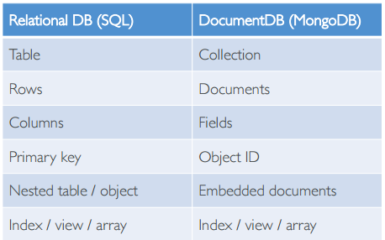
Document Database
Stores JSON documents (semi- structured data)
Key-value pairs can be nested

Slide 4
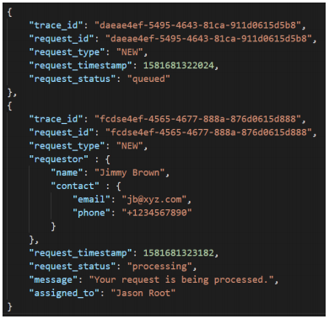
Document database explanations
JSON is the de-facto format for data exchange
DocumentDB makes it easy to insert, query, index, and perform aggregations over JSON data
Store JSON output from APIs straight into DB and start analysing it
flexible document model, data types, and indexing
Add / remove indexes easily
Run ad hoc queries for operational and analytics workloads
for known access patterns – use DynamoDB instead

Slide 5
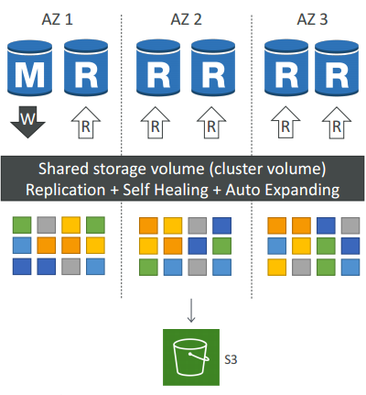
DocumentDB Architecture
6 copies of your data across 3 AZ (distributed design)
Lock-free optimistic algorithm (quorum model)
4 copies out of 6 needed for writes (4/6 write quorum - data considered durable when at least 4/6 copies acknowledge the write)
3 copies out of 6 needed for reads (3/6 read quorum)
Self healing with peer-to-peer replication, Storage is striped across 100s of volumes
One DocumentDB Instance takes writes (master)
Compute nodes on replicas do not need to write/replicate (=improved read performance)
Log-structured distributed storage layer – passes incremental log records from compute to storage layer (=faster)
Master + up to 15 Read Replicas serve reads
Data is continuously backed up to S3 in real time, using storage nodes (compute node performance is unaffected)

Slide 6
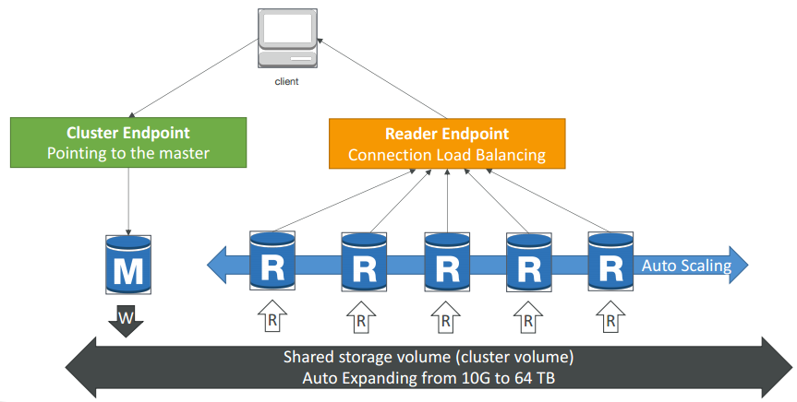
DocumentDB Cluster
Recommended to connect using the cluster endpoint in replica set mode (enables your SDK to auto-discover the cluster arrangement as instances get added or removed from the cluster.)

Slide 7
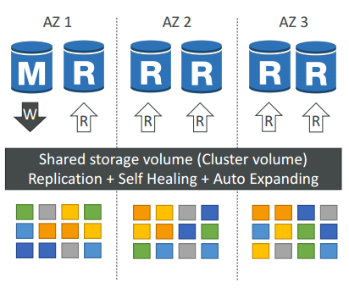
DocumentDB Replication
Up to 15 read replicas
ASYNC replication
Replicas share the same underlying storage layer
Typically take 10s of milliseconds (replication lag)
Minimal performance impact on the primary due to replication process
Replicas double up as failover targets (standby instance is not needed)

Slide 8
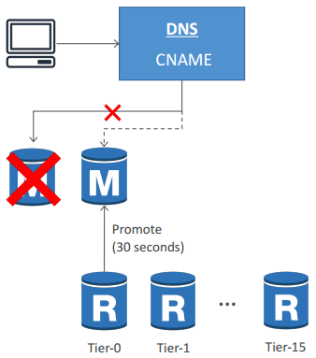
DocumentDB failovers
Failovers occur automatically
A replica is automatically promoted to be the new primary during DR
DocumentDB flips the CNAME of the DB instance to point to the replica and promotes it
Failover to a replica typically takes 30 seconds (minimal downtime)
Creating a new instance takes about 8-10 minutes (post failover)
Failover to a new instance happens on a best-effort basis and can take longer

Slide 9
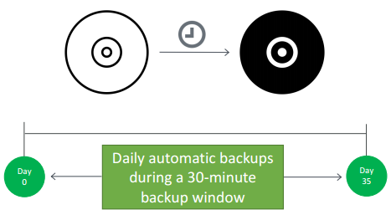
DocumentDB Backup and Restore
Supports automatic backups
Continuously backs up your data to S3 for PITR (max retention period of 35 days)
Latest restorable time for a PITR can be up to 5 mins in the past
The first backup is a full backup. Subsequent backups are incremental
Take manual snapshots to retain beyond 35 days
Backup process does not impact cluster performance

Slide 10
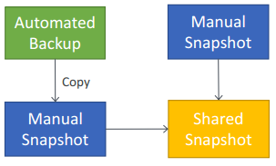
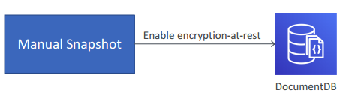
DocumentDB Backup and Restore
Can only restore to a new cluster
Can restore an unencrypted snapshot to an encrypted cluster (but not the other way round)
To restore a cluster from an encrypted snapshot, you must have access to the KMS key
Can only share manual snapshots (can copy and share automated ones)
Can't share a snapshot encrypted using the default KMS key of the a/c
Snapshots can be shared across accounts, but within the same region

Slide 11
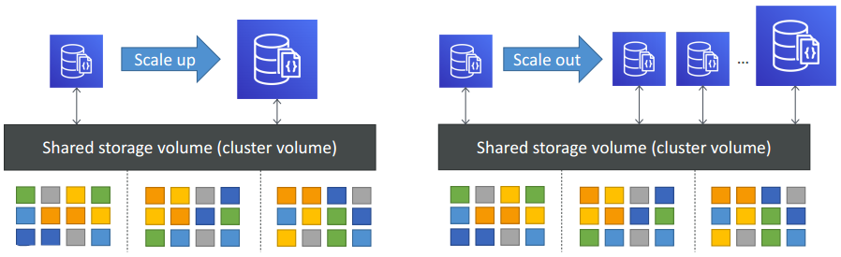
DocumentDB Scaling
MongoDB sharding not supported (instead offers read replicas / vertical scaling / storage scaling)
Vertical scaling (scale up / down) – by resizing instances
Horizontal scaling (scale out / in) – by adding / removing up to 15 read replicas
Can scale up a replica independently from other replicas (typically for analytical workloads)
Automatic scaling storage – 10 GB to 64 TB (no manual intervention needed)

Slide 12
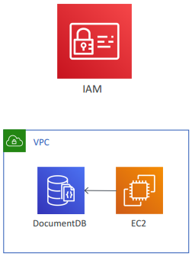
DocumentDB Security – IAM & Network
You use IAM to manage DocumentDB resources
Supports MongoDB default auth SCRAM (Salted Challenge Response Authentication Mechanism) for DB authentication
Supports built-in roles for DB users with RBAC (role-based access control)
DocumentDB clusters are VPC-only (use private subnets)
Clients (MongoDB shell) can run on EC2 in public subnets within VPC
Can connect to your on-premises IT infra via VPN

Slide 13
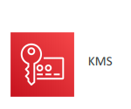
DocumentDB Security – Encryption
Encryption at rest – with AES-256 using KMS
Applied to cluster data / replicas / indexes / logs / backups / snapshots
Encryption in transit – using TLS
To enable TLS, set tls parameter in cluster parameter group
To connect over TLS:
Download the certificate (public key) from AWS
Pass the certificate key while connecting to the cluster

Slide 14
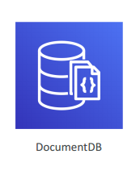
DocumentDB Pricing
On-demand instances – pricing per second with a 10-minute minimum
IOPS – per million IO requests
Each DB page reads operation from the storage volume counts as one IO (one page = 8KB)
Write IOs are counted in 4KB units.
DB Storage – per GB per month
Backups – per GB per month (backups up to 100% of your cluster’s data storage is free)
Data transfer – per GB
Can temporarily stop compute instances for up to 7 days

Slide 15

DocumentDB Monitoring
API calls logged with CloudTrail
Common CloudWatch metrics
CPU or RAM utilization – CPUUtilization / FreeableMemory
IOPS metrics –VolumeReadIOPS / VolumeWriteIOPS / WriteIOPS / ReadIOPS
Database connections – DatabaseConnections
Network traffic – NetworkThroughput
Storage volume consumption –VolumeBytesUsed
Two types of logs can be published/exported to CloudWatch Logs
Profiler logs
Audit logs

Slide 16
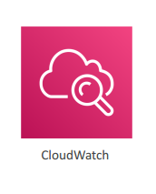
DocumentDB audit logs
Records DDL statements, authentication, authorization, and user management events to CloudWatch Logs
Exports your cluster’s auditing records (JSON documents) to CloudWatch Logs
Accessible from CloudWatch Logs
To enable auditing:
Set parameter audit_logs=enabled
Enable Logs Exports for Audit logs by modifying the instance
Both the steps above are mandatory

Slide 17
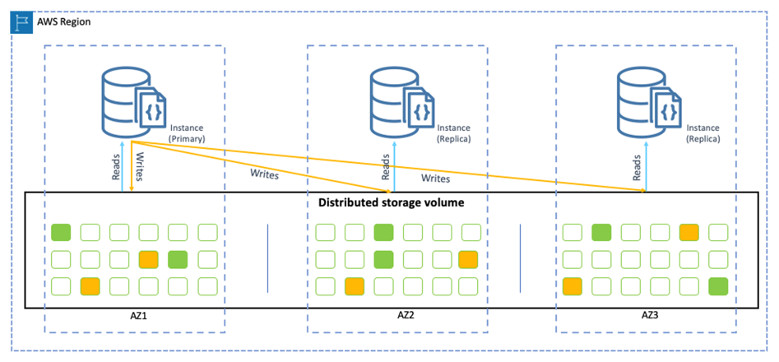
DocumentDB Architecture

