Slide 1
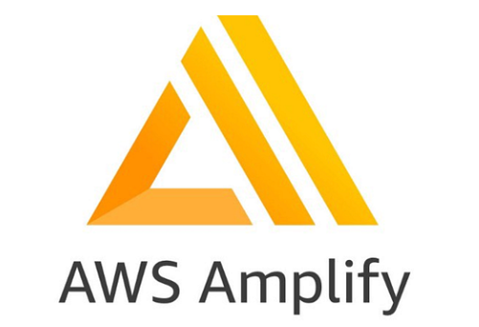
AWS Amplify
AWS Amplify is a set of purpose-built tools and features that enables frontend web and mobile developers to quickly and easily build full-stack applications on AWS.
Amplify provides two services: Amplify Hosting and Amplify Studio.

Slide 2
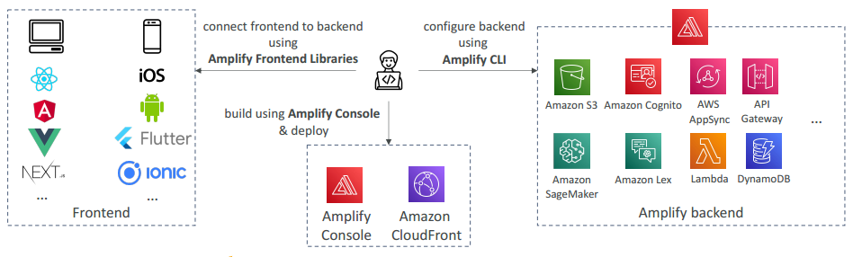
AWS Amplify - web and mobile applications
A set of tools and services that helps you develop and deploy scalable full stack web and mobile applications
Authentication, Storage, API (REST, GraphQL), CI/CD, PubSub, Analytics, AI/ML Predictions, Monitoring, …
Connect your source code from GitHub, AWS CodeCommit, Bitbucket, GitLab, or upload directly

Slide 3
Amplify Hosting features
Amplify Hosting supports the common SPA frameworks, for example, React, Angular, Vue.js, Ionic, and Ember, as well as static site generators like Gatsby, Eleventy, Hugo, VuePress, and Jekyll.
Manage production and staging environments for your frontend and backend by connecting new branches.
Connect your application to a custom domain.
Deploy and host SSR web apps created using the Next.js. framework.
Preview changes during code reviews by setting up pull request previews.
Improve your app quality with end to end tests.
Password protect your web app so you can work on new features without making them publicly accessible.
Set up rewrites and redirects to maintain SEO rankings and route traffic based on your client app requirements.
Instant cache invalidations ensure your app is updated instantly on every code commit.
Atomic deployments eliminate maintenance windows by ensuring that the web app is updated only after the entire deployment finishes. This eliminates scenarios where files fail to upload properly.
Get screen shots of your app rendered on different mobile devices to identify layout issues.

Slide 4
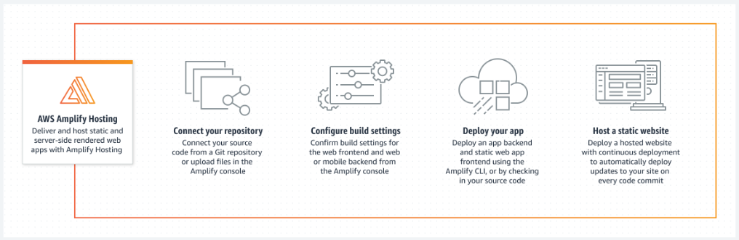
Amplify Hosting diagram

Slide 5
Amplify Studio features
Visual data modeling enables you to focus on your domain-specific objects instead of cloud infrastructure.
Set up authentication for your app.
Powerful and easy to understand authorization.
Infrastructure-as-code configures all backend capabilities with AWS CloudFormation.
Works with the Amplify Command Line Interface (CLI). All updates you make in Studio can be pulled into the CLI.
Invite users via email to configure and manage the backend. These users will also be able to log in to the Amplify CLI with their email.
Manage users and groups for your app.
Use Studio's visual designer to build frontend UI components. Choose from dozens of designs in the pre-built UI component library.
Import Figma prototypes built by designers into Studio as React code.
Customize your frontend UI with themes to apply global styles to your app's components.
Configure and test your UI components directly within Studio to see how they update and display data.
Bind your cloud-connected backend to your frontend UI in a few simple steps.

Slide 6
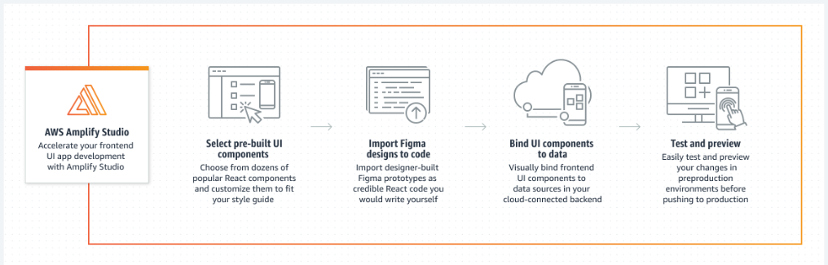
Amplify Studio diagram

Slide 7
Monitoring
AWS Amplify emits metrics through Amazon CloudWatch and provides access logs with detailed information about requests made to your app.
AWS Amplify is integrated with Amazon CloudWatch, allowing you to monitor metrics for your Amplify applications in near real-time.
You can create alarms that send notifications when a metric exceeds a threshold you set.

Slide 8
Notifications
You can set up notifications for an AWS Amplify app to alert stakeholders or team members when a build succeeds or fails.
Amplify Hosting creates an Amazon Simple Notification Service (SNS) topic in your account and uses it to configure email notifications.
Notifications can be configured to apply to all branches or specific branches of an Amplify app.

Slide 9
Logging Amplify API calls using AWS CloudTrail
AWS Amplify is integrated with AWS CloudTrail, a service that provides a record of actions taken by a user, role, or an AWS service in Amplify.
CloudTrail captures all API calls for Amplify as events.
The calls captured include calls from the Amplify console and code calls to the Amplify API operations.
If you create a trail, you can enable continuous delivery of CloudTrail events to an Amazon S3 bucket, including events for Amplify.
If you don't configure a trail, you can still view the most recent events in the CloudTrail console in Event history.
Using the information that CloudTrail collects, you can determine the request that was made to Amplify, the IP address from which the request was made, who made the request, when it was made, and additional details.

