Slide 1

AWS Artifact
Access AWS and ISV security and compliance reports

Slide 2
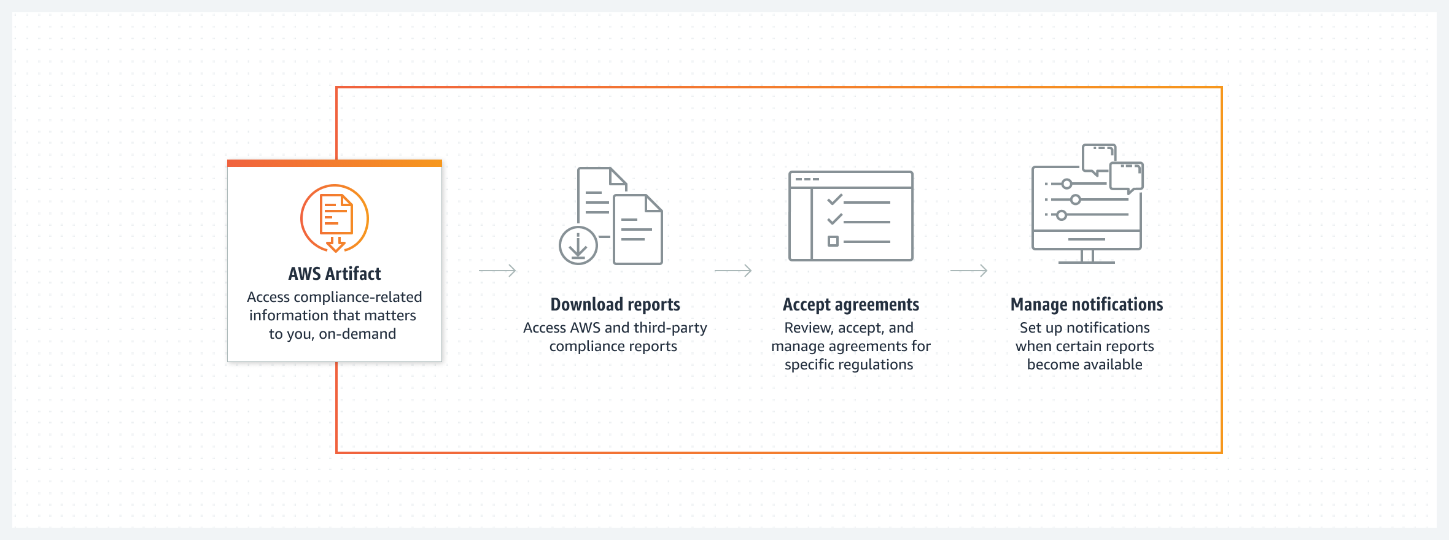
AWS Artifact

Slide 3
AWS Artifact use cases
Understand AWS security and compliance posture
Find auditor-issued reports, certifications, accreditations, and other third-party attestations of AWS in a comprehensive resource.
Manage select online agreements at scale
Review, accept, and manage your agreements with AWS and apply them to current and future accounts within your organization.
Assess third-party security and compliance
Perform due-diligence of ISVs that sell products on AWS Marketplace, with on-demand access to their security and compliance reports.

Slide 4
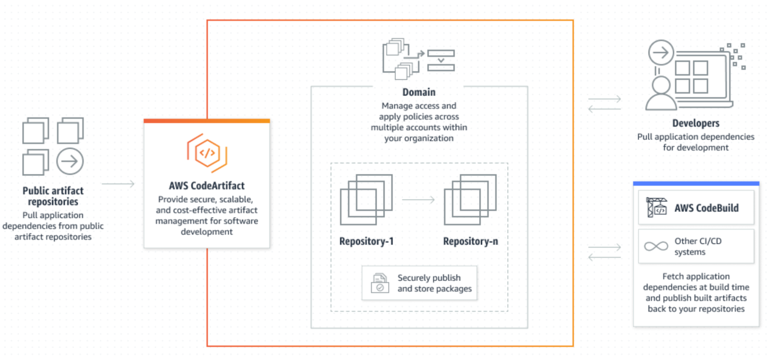
AWS CodeArtifact

Slide 5
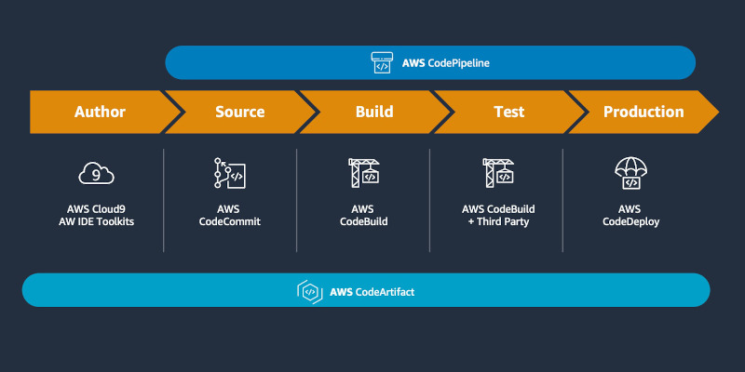
AWS CodeArtifact
AWS CodeArtifact is a secure, highly scalable, managed artifact repository service that helps organizations to store and share software packages for application development.
You can use CodeArtifact with popular build tools and package managers such as the NuGet CLI, Maven, Gradle, npm, yarn, pip, and twine.
CodeArtifact helps reduce the need for you to manage your own artifact storage system or worry about scaling its infrastructure.
There are no limits on the number or total size of the packages that you can store in a CodeArtifact repository.

