Slide 1

What is Amazon Pinpoint?
Amazon Pinpoint is an AWS service that you can use to engage with your customers across multiple messaging channels.
You can use Amazon Pinpoint to send push notifications, emails, SMS text messages, or voice messages.

Slide 2
How to send geofenced marketing messages using Amazon Pinpoint - example
Geofencing, which creates a virtual geographical boundary that triggers a marketing action to a mobile device when a user enters or exits that boundary, can be used in marketing messages to drive more traffic and increase conversions.
Amazon Pinpoint, AWS’ multichannel communication tool, can be used to create mobile notifications using geofencing technology, so customers receive notifications about a business when they’re close by that physical location.

Slide 3
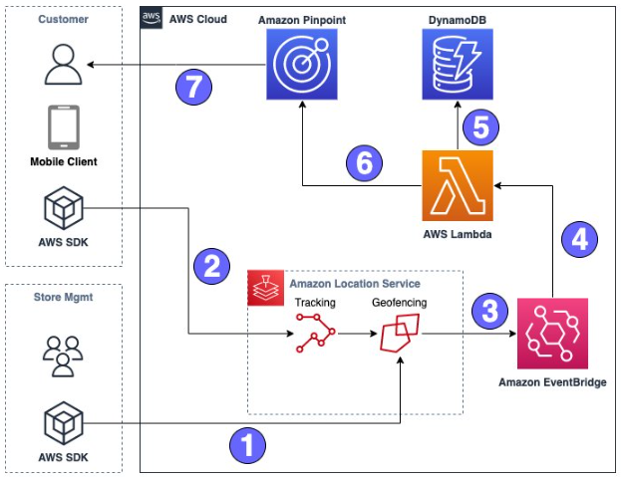
Architecture Example Overview
Store Management defines a Geofence around store locations they wish to enroll using Amazon Location Service Geofencing and circular geofences.
A customer who has opted into location tracking using the app will update an Amazon Location Service Tracker Resource. This tracker will be evaluated against the store geofences.
If a geofence ENTER event is triggered, a message is sent to Amazon EventBridge.
EventBridge will trigger an AWS Lambda function.
The Lambda function looks up the Store Information in an Amazon DynamoDB table that matches the geofence ID in order to enrich the email.
Event is sent to a Pinpoint Journey with information from the Geofence event as well as store info.
Personalized email is sent to customer via Pinpoint

Slide 4
Amazon Pinpoint features
Amazon Pinpoint includes a One-Time Password (OTP) management feature. You can use this feature to generate new one-time passwords and send them to your recipients as SMS messages. Your applications can then call the Amazon Pinpoint API to verify these passwords.
Amazon Pinpoint includes a phone number validation service that you can use to determine if a phone number is valid, and to obtain additional information about the phone number itself.
You can use the Amazon Pinpoint API and the AWS SDKs to send transactional messages directly from your apps. Transactional messages are messages that you send to specific recipients, as opposed to messages that you send to segments. For example, you can send an order confirmation by email when a customer places an order. You could also send a one-time password by SMS or voice that a customer can use to complete the process of creating an account for your service.
Amazon Pinpoint is integrated with AWS CloudTrail, which is a service that provides a record of actions taken by a user, role, or AWS service in Amazon Pinpoint. CloudTrail captures API calls for Amazon Pinpoint as events. The calls that are captured include calls from the Amazon Pinpoint console and code calls to Amazon Pinpoint API operations.

