Slide 1
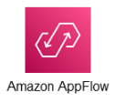
Amazon AppFlow
Amazon AppFlow, a fully managed integration service, enables you to securely transfer data between Software-as-a-Service (SaaS) applications, including Salesforce, Zendesk, Slack, ServiceNow, and AWS services like Amazon S3 and Amazon Redshift, in just a few clicks.
AWS AppFlow is a codeless integration for business users that focuses on empowering non-technical users to integrate their siloed data sources. It provides the ability to exchange data between AWS services and other SaaS applications without writing a single line of code.

Slide 2
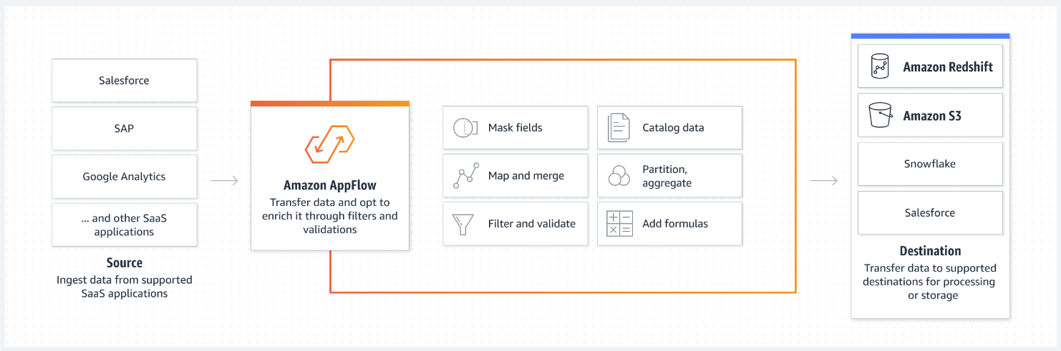
How is it work?

Slide 3
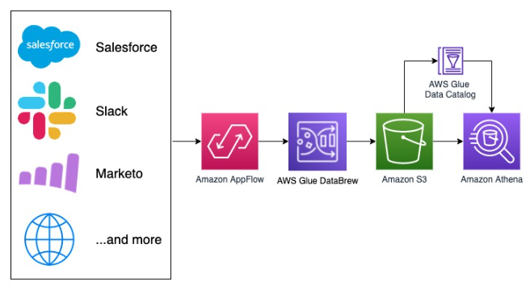
Architecture example
The workflow includes the following steps:
Create an S3 bucket for the raw and transformed data.
Create a connection to Salesforce.
Create a flow to extract the data from Salesforce.com.
Create a dataset and project.
Prepare the data and create a recipe.
Create a job to pull the data from the Amazon AppFlow flow, run the transformations, and load the data in Amazon S3.
Create a crawler to catalog the data.
Analyze data using Athena.

Slide 4
Benefits Of AWS AppFlow
Speed and agility: Amazon AppFlow allows you to integrate applications in just a few minutes without waiting days or weeks to code custom connectors.
Privacy and security: AppFlow encrypts data at rest and in motion. You can encrypt data with AWS-managed keys or bring your custom keys.
Scalability: AppFlow easily scales up without the need to plan or provide resources to help you move large volumes of data without breaking it down into multiple batches.
Reliability: AppFlow uses a highly available architecture with redundant, isolated resources to prevent any single points of failure while running within the resilient AWS infrastructure.

