Slide 1

Cloud OPS

Slide 2
What is Cloud Operations?
Cloud Operations (CloudOps) is the practice of managing delivery, tuning, optimization, and performance of workloads and IT services that run in a cloud environment including multi, hybrid, in the data center and at the edge.
For some organizations, CloudOps has replaced the network operations center (NOC) as IT operations have shifted from on-premises to cloud-based infrastructure
Just as the NOC monitored and managed the data center, CloudOps monitors, instruments, and manages VMs, containers and workloads that run in a cloud.
Developers, IT operations and security all collaborate using CloudOps principles to meet business and technology goals.

Slide 3
DevOps
DevOps is a set of practices and cultural philosophies that aims to unify software development (Dev) and software operation (Ops).
The primary goal is to shorten the development lifecycle, provide continuous delivery, and achieve a high degree of software quality.
Key Aspects:
Integration and Collaboration: Emphasis on collaboration between development and operations teams.
Continuous Integration/Continuous Deployment (CI/CD): Regular merging of code changes into a central repository, followed by automated testing and deployment.
Automation: Focus on automating as many processes as possible in the software development lifecycle, including testing, deployment, and monitoring.
Agile Methodology: Often incorporates aspects of agile development practices for quicker and more adaptive software development.
Tools and Technologies: Includes tools for version control (e.g., Git), CI/CD (e.g., Jenkins, GitLab CI), configuration management (e.g., Ansible, Puppet), and monitoring (e.g., Nagios, Grafana).
Outcome: Improved collaboration and communication, faster time to market, enhanced product quality, and more efficient and reliable product lifecycle management.
DevOps improvements can bubble throughout the organization, helping to bring more reliable software applications to fruition faster, which leads to improved performance for the organization as a whole.
Ultimately, DevOps helps improve the user experience for employee and customers alike.

Slide 4
CloudOps
CloudOps, or Cloud Operations, refers specifically to the management, operation, and optimization of cloud-based services and infrastructure.
The goal is to ensure reliable, efficient, and secure cloud environments.
Key Aspects:
Cloud Resource Management: Focuses on managing cloud resources like servers, storage, and network services.
Monitoring and Performance Tuning: Involves monitoring cloud services and tuning them for optimal performance and cost-efficiency.
Security and Compliance: Ensuring that cloud operations adhere to security policies and compliance requirements.
Scalability and Elasticity: Managing the scaling of resources to meet demand dynamically.
Tools and Technologies: Utilizes cloud-specific tools such as AWS CloudFormation, Azure Resource Manager, Google Cloud Deployment Manager, as well as monitoring and management tools like AWS CloudWatch, Azure Monitor, and Google Operations Suite.
Outcome: Efficient and cost-effective cloud resource utilization, improved system performance, enhanced security, and compliance posture in cloud environments.
CloudOps encompasses cloud platform engineering principles, combining elements of cloud architecture, IT operations, application development, security, and regulatory compliance to enable organizations to manage cloud-based applications and services.
This enables organizations to:
Ensure the cloud platform – including hybrid and edge components – operates as a single platform
Optimize application performance for a dispersed workforce regardless of access device
Ensure reliability and that SLAs are met
Maintain backups for disaster recovery and business continuity
Automate repetitive services and configuration management
Ensure data and applications are secure end-to-end

Slide 5
DevOps vs CloudOps
No: | Differences | DevOps | CloudOps
1. | What is it? | It is a culture and software development practice covering SDLC | Leverages the power of cloud computing for continuous operations. CloudOps augment the capabilities of DevOps
2. | Price | Costs are higher to set up and manage on-site infrastructure, network, etc. | Initial costs are lesser. Cloud uses a pay-as-you-use model.
3. | Scalability | Scale-up may require the acquisition of additional hardware and other resources. Scale-up/down is not easy. | Resources can be scaled up or down easily based on the demand and business needs. It is more flexible.
4. | Redundancy | A separate DR center needs to be set up to ensure redundancy and disaster recovery. | Cloud data can be replicated in multiple storage devices and locations. DR is already in place with cloud technology.
5. | Availability | Local infrastructure needs to be managed by the organization to ensure high availability. | High availability is assured by the cloud provider
6. | Performance | Performance is limited to the server and network capacity in the data center. | Computing power or storage can be increased/decreased based on demands.
7. | Automation | Creates a standard and repeatable process using automation. | Allows higher levels of automation, starting from provisioning, configuration, governance, policies, etc. to create a repeatable process.
8. | Accessibility | Accessibility is limited in on-site infrastructure and applications | Users can access resources from anywhere and work since it is in the public cloud.
9. | Sharing | Sharing of data and services is limited | Sharing of resources across applications is easier in cloud environments.
Scope: DevOps has a broader scope encompassing the entire software development lifecycle, while CloudOps is specifically focused on the operational aspects of cloud-based services.
Goal Orientation: DevOps is oriented towards improving software development and delivery processes, while CloudOps is aimed at optimizing cloud operations and infrastructure management.
Implementation Context: DevOps can be implemented in various environments, including on-premises and cloud, whereas CloudOps is inherently tied to cloud computing environments.

Slide 6
Cloud Ops Team Roles
Cloud Architects: Design and oversee the cloud infrastructure.
DevOps Engineers: Bridge between development and operations, often responsible for CI/CD pipelines and automation.
Cloud Security Specialists: Focus on securing cloud services and responding to security incidents.
Site Reliability Engineers (SREs): Ensure high availability and optimal performance of services.
Cost Optimization Analysts: Specialize in analyzing and reducing cloud costs.

Slide 7
Metrics: 4 pillars of CloudOps
Abstraction
The first pillar, abstraction, decouples management from the underlying infrastructure so that cloud machine instances, storage instances, security, network and governance can be managed through a single pane of glass.
This centralized approach to management allows an administrator to use a single tool, to manage applications and services running in the cloud.
Provisioning
Typically, an organization will manage the provisioning of machine instances in the cloud in one of two ways: either with self-provisioning or with automated provisioning.
With self-provisioning, administrators allow cloud users to allocate their own machines and then track their usage.
Automated provisioning is more efficient because it allows the applications themselves to request more resources when needed and deprovision them automatically when not needed.
Policy
That requires the creation and enforcement of policies that limit what users and applications can do in the public cloud.
This ensures an application doesn't end up using cloud resources when there is no return on investment.
Automation
Typically, automated processes include provisioning, user management, security management and application program interface management.
Artificial intelligence and machine learning play important roles in automating tasks.

Slide 8
Key Metrics for Companies
Cost Efficiency and Usage Metrics:
Total Spend: The total cost of cloud resources over a period. It's vital for budget management and cost optimization.
Cost Per Service: Understanding the cost incurred by each cloud service helps in identifying areas where cost optimizations can be made.
Performance Metrics:
Application Response Time: This measures how long it takes for an application to respond to user requests. It is critical for user experience and service level agreements (SLAs).
System Throughput: The amount of data processed in a given amount of time. This helps in understanding the capacity and efficiency of the system.
Availability and Reliability Metrics:
Uptime/Downtime: Measures the operational time of the services without failure. High uptime is critical for maintaining user trust and service reliability.
Mean Time Between Failures (MTBF): The average time between system breakdowns or failures. A higher MTBF indicates more reliable systems.
Security Metrics:
Number of Security Incidents: Tracking the frequency of security breaches or incidents is crucial for maintaining the integrity and trustworthiness of cloud services.
Time to Respond to Security Threats: The speed at which a company can identify and respond to security threats is vital for minimizing potential damage.
Resource Utilization Metrics:
CPU and Memory Utilization: Monitoring the usage levels of CPU and memory resources helps in efficient resource allocation and scaling decisions.
Storage I/O Operations: The input/output operations on storage devices provide insights into the performance and potential bottlenecks in data handling.
Hybrid infra metrics:
VPN State
Physical devices state
Compliance and Governance Metrics:
Compliance Audit Findings: The number and severity of compliance issues found during audits.
Policy Violations: Tracking violations of internal policies or industry regulations can help in maintaining compliance and avoiding legal repercussions.

Slide 9
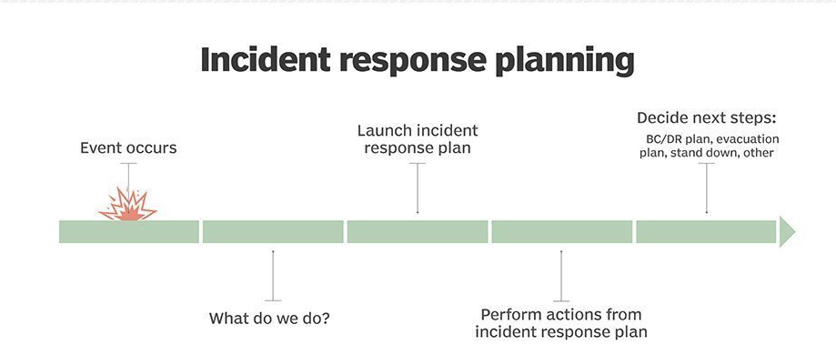
CloudOps Incident Response Plan
An incident response plan is a set of instructions to detect, respond to and limit the effects of an information security event.
Sometimes called an incident management plan or emergency management plan, an incident response plan provides clear guidelines for responding to several potential scenarios, including data breaches, DoS or DDoS attacks, firewall breaches, malware outbreaks and insider threats.

Slide 10
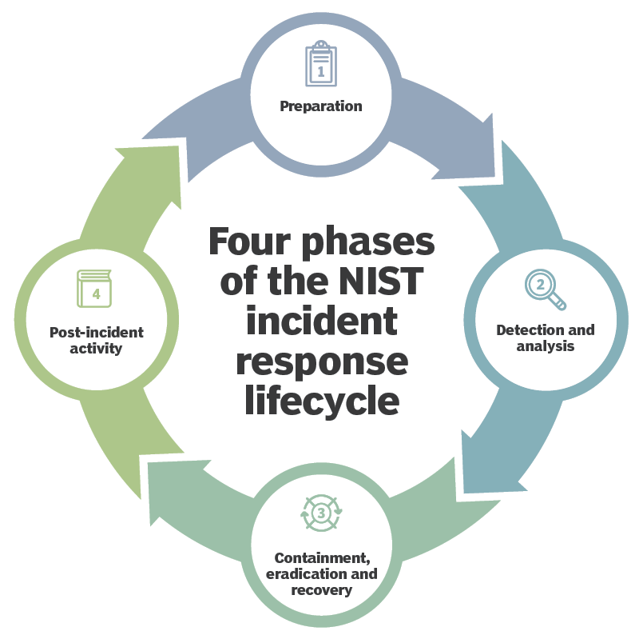
NIST Incident Response Lifecycle
Frameworks
The NIST "Computer Security Incident Handling Guide" is widely considered to be the authoritative source for incident response planning efforts.

Slide 11
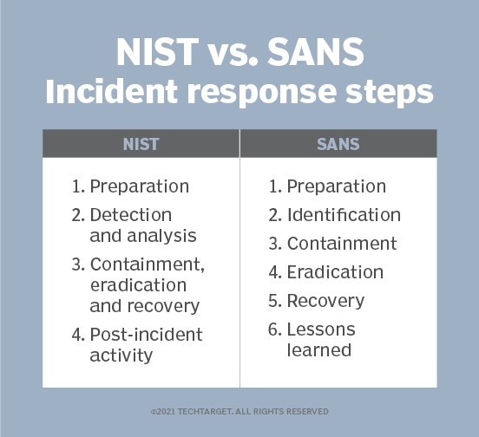
SANS Institute incident response framework
SysAdmin, Audit, Network, and Security
Preparation. Organizations should review and codify security policy, perform a risk assessment, identify sensitive assets, define the critical security incidents the team should focus on and build a computer security incident response team.
Identification. Organizations should monitor IT systems, detect deviations from normal operations and decide if they represent real security incidents. If an incident is discovered, the team should collect additional evidence, establish its type and severity and document everything.
Containment. Organizations need to perform short-term containment and then focus on long-term containment, which involves temporary fixes to enable systems to be used in production while rebuilding clean systems.
Eradication. Organizations need to remove malware from all affected systems, identify the root cause of the attack and take action to prevent similar attacks.
Recovery. Organizations should bring affected production systems back online cautiously to prevent more attacks. Test, verify and monitor affected systems to ensure they are back to normal activity.
Lessons learned. No later than two weeks from the end of the incident, the team should compile all relevant information about the incident and identify lessons that will help with future incident response activity.

Slide 12
Incident remediation: War room
A war room is a place (either in-person or virtual) where responders and stakeholders can gather to work through a major incident.
When a major incident occurs, many teams prefer to gather all subject matter experts (SMEs) to resolve the problem as quickly as possible.
Having everyone in the same space can decrease the chances of lapses in communication or delays in coordination.
War rooms in the technology industry originated as a key part of adopting Agile Methodology.
War rooms are meant to improve these human capabilities, allowing teams to communicate and adapt quickly during incidents.

Slide 13
Incident remediation: War room
Best practices for any war room
Involve the smallest number of people necessary.
Ensure that roles and responsibilities are determined at the beginning of the incident.
Most major incidents have assigned roles, such as incident commander, deputy, and scribe.
Set expectations for stakeholder updates.
Stakeholders may filter in and out of the war room depending on how much they’re impacted.
If stakeholders have to ask for updates ad hoc, it can distract responders from their tasks. Instead, make sure that stakeholders know when to expect updates.
Best practices for virtual war rooms
Create backup communication methods.
In the event that an incident causes your primary communication method to fall through, you need to be prepared with a backup.
This backup needs to be well known and documented so that all involved parties can participate without scrambling to find the right video conferencing link or sending multiple emails.
Familiarize everyone with the tools you use.
If you use a tool or platform to manage incident response, do all teams know how to use it?
Have well-established communication guidelines.
What you use to communicate is important, but understanding how you communicate is just as crucial.
Make sure you document how teams are expected to collaborate.

Slide 14
Incident Handling in Cloud Ops: Postmortem
A postmortem (or post-mortem) is a process intended to help you learn from past incidents.
Postmortems typically involve blame-free analysis and discussion soon after an incident or event has taken place.
An artifact is produced that includes a detailed description of exactly what went wrong in order to cause the incident, along with a list of steps to take in order to prevent a similar incident from occurring again in the future.
An analysis of how your incident response process itself worked during the incident should also be included in the discussion.
The value of postmortems comes from helping institutionalize a culture of continuous improvement.
This way, teams are better prepared when another incident inevitably occurs with mission- or business-critical systems.

Slide 15
Incident Handling in Cloud Ops: Postmortem
During incident response, the team is 100% focused on restoring service.
They should not be wasting time and mental energy thinking about how to do something optimally or performing a deep dive on what caused the incident.
Doing this could further delay remediation efforts and convolute the resolution process.
That’s why postmortems are essential—they provide a peacetime opportunity to reflect once the issue is no longer impacting users.
The postmortem process drives focus, instills a culture of learning, and identifies opportunities for improvement that otherwise would be lost.
Without a postmortem you fail to recognize what you’re doing right, where you could improve, and most importantly, how to avoid making the same mistakes in the future.
Writing an effective postmortem allows you to learn quickly from your mistakes and improve your systems and processes.
A well-designed, blameless postmortem allows teams to continuously learn, serving as a way to iteratively improve your infrastructure and incident response process.
Be sure to write detailed and accurate postmortems in order to get the most benefit out of them.
Organizations may refer to the postmortem process in slightly different ways:
Learning Review
After-Action Review
Incident Review
Incident Report
Post-Incident Review
Root Cause Analysis (or RCA)

Slide 16
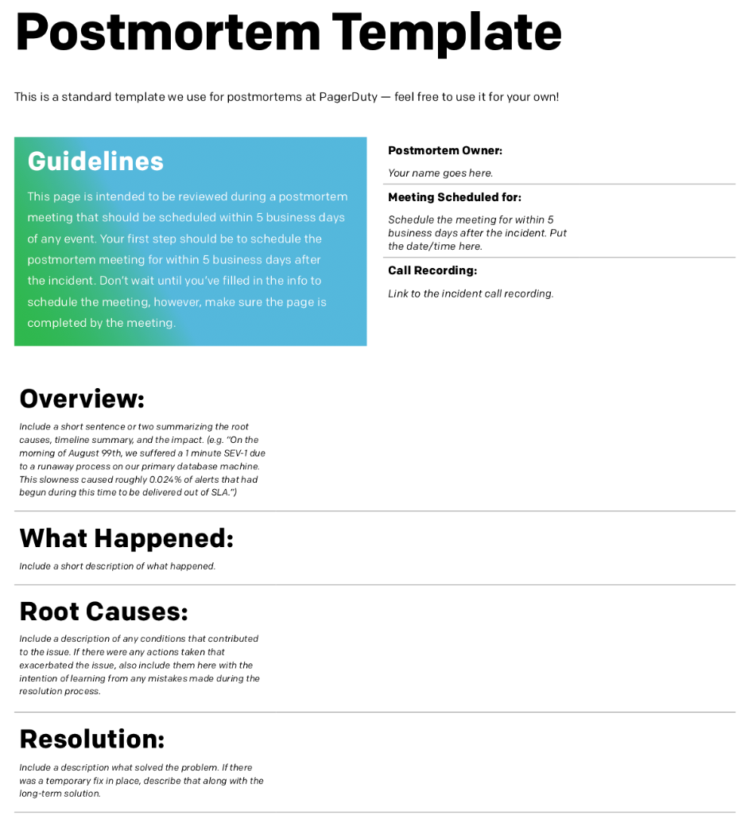
Incident Handling in Cloud Ops: Postmortem from Pagerduty

Slide 17
Cloud OPS Automation: Runbook
Runbook automation (RBA) enables automation of predefined procedures based on issues that typically reoccur
RBA allows you to create consistency and simplify the automation of complex operational and remediation procedures, and can be combined with non-automated processes for hybrid human-machine resolutions that ensure minimal error and fast response times.
runbook is a list of procedures or actions that need to be carried out for every alert or a combination of multiple alerts.
It is also often seen as a knowledge base that is constantly updated
Overall, runbook automation comes with the following three advantages:
It offers users the capability to be proactive, i.e., taking action before a problem occurs by predicting issues based on known signs or identifiers
It offers easy access to the operations capabilities needed to help you complete your tasks
It automates workflows that extend throughout your existing manual commands and automation
It should be emphasized, though, that runbook automation is not intended to take the place of your current scripts, tools, manual commands, or API calls.
Runbook automation is quickly becoming the key interface between humans and tools to improve operations procedures.

Slide 18
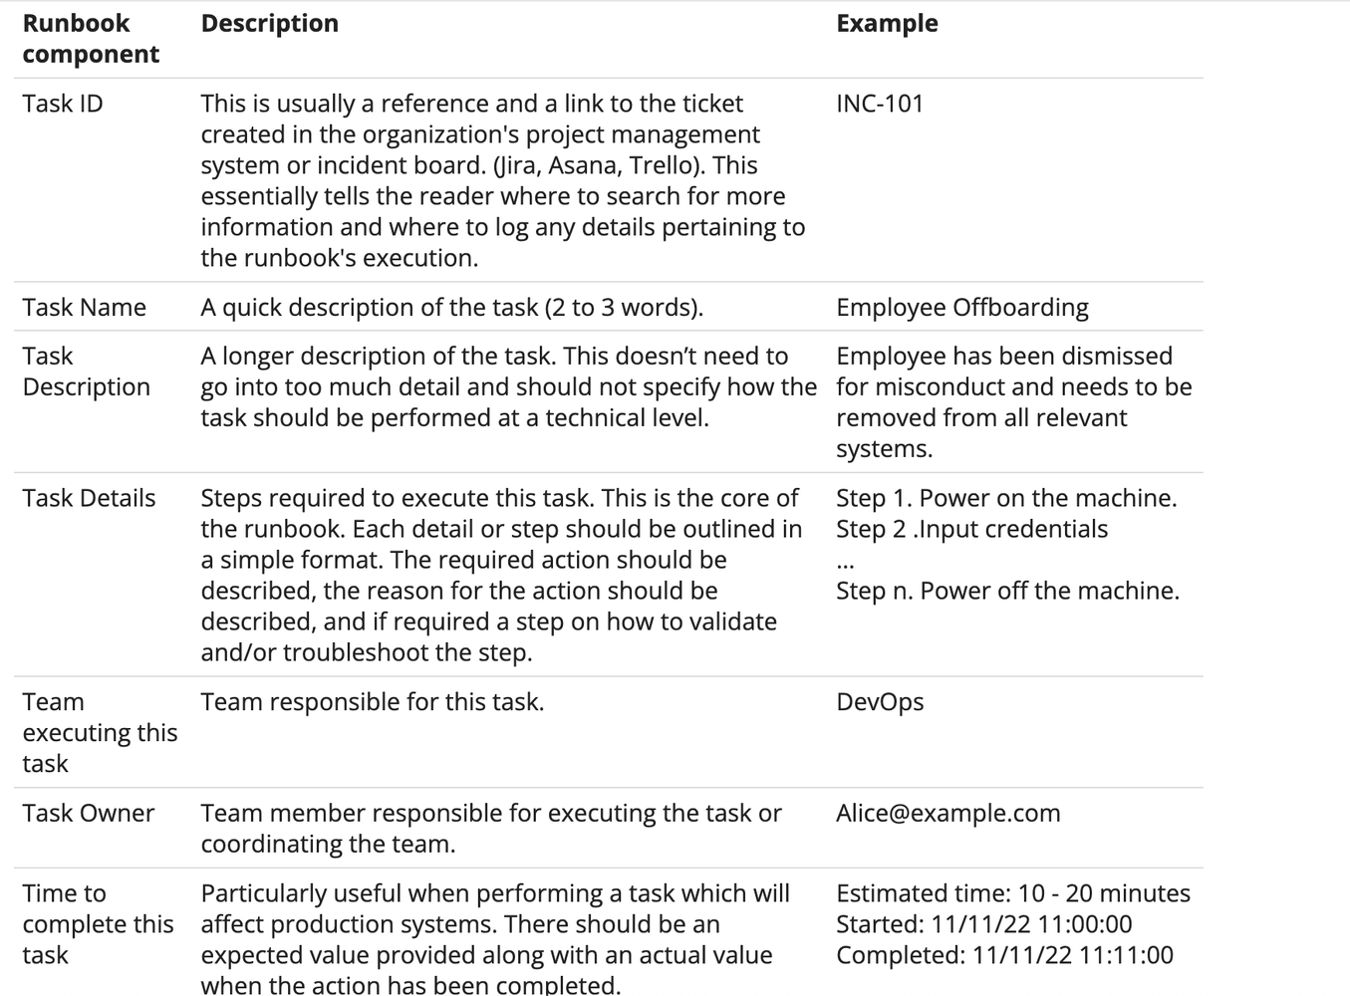
Cloud OPS Automation: Runbook Template

Slide 19
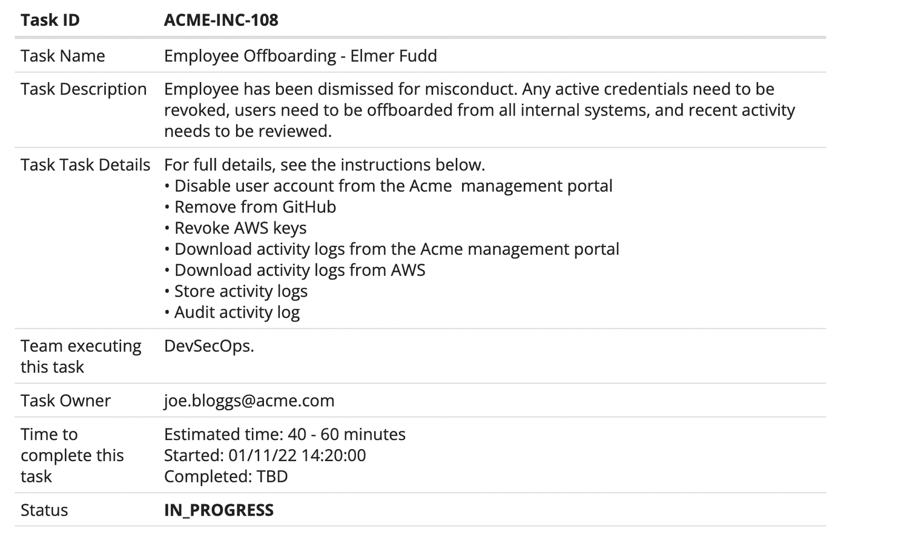
Cloud OPS Automation: Runbook Example

Slide 20
Cloud OPS Automation: Cloud Native Disaster Recovery Plan
Multi-Region Deployment: Deploy critical applications across multiple AWS regions to ensure high availability and disaster recovery.
Backup and Restore: Implement robust backup strategies using AWS Backup or third-party tools, ensuring data is recoverable in case of an incident.
Failover Strategies: Be prepared to switch on other environment to except downtime. (e.g. Route53, Global Accelerator)
Know your infra
Create an inventory of your cloud-based systems: This includes identifying all the resources, applications, and data that you have in the cloud.
Understand your dependencies: Understand the relationships between your systems and services, and how they depend on each other.
Document your architecture and design: Create detailed documentation of your systems, including their architecture and design, so that you have a clear understanding of how they work.
Draft a Disaster Recovery Plan Based on RPO and RTO
Conduct a Business Impact Analysis
Test your Disaster Recovery Plan
Simulate a disaster scenario: Test your disaster recovery plan by simulating a disaster scenario, such as a power outage or network failure.
Test the recovery process: Test the recovery process to ensure that it can restore your systems and data to a working state.
Test failover and failback: Test failover and failback to ensure that your systems and data can be moved between primary and backup environments.
Test communication and coordination: Test communication and coordination with your team and any third-party vendors to ensure that they can work together effectively in the event of a disaster.
Evaluate and improve: Evaluate the results of the test and make improvements as needed

Slide 21
AWS Services for Cloud Ops
Amazon CloudWatch: For monitoring resources and applications.
AWS CloudTrail: For governance, compliance, operational auditing, and risk auditing.
AWS Config: To assess, audit, and evaluate AWS resource configurations.
AWS Systems Manager: For visibility and control of infrastructure on AWS.
AWS Lambda and AWS Step Functions: For automating tasks and workflows.
AWS Security Hub: For comprehensive view of security alerts and security posture.
Amazon Inspector: Automated security assessment service to improve the security and compliance of applications deployed on AWS.
AWS Managed Grafana, Prometheus

Slide 22
Services for CloudOps
Cross-Platform Tools
Terraform: Infrastructure as code software tool for building, changing, and versioning infrastructure safely and efficiently across various cloud platforms.
Ansible: Automation tool for provisioning, configuration management, and application deployment.
Kubernetes: Open-source platform for automating containerized applications' deployment, scaling, and operations, across cloud and on-premises environments.

Slide 23
Cloud Ops Trends: Multi-Cloud and Hybrid Enviroments
Multi-Cloud: Using cloud services from more than one cloud provider, such as AWS, Azure, and Google Cloud Platform.
Hybrid Environment: Combining public cloud services with private cloud or on-premises resources.
Why it Matters:
Flexibility and Risk Mitigation: Avoids vendor lock-in and reduces dependency on a single cloud provider.
Optimized Performance and Cost: Different cloud providers may offer unique features or cost efficiencies for specific tasks.
Compliance and Geographical Reach: Helps in meeting regional data compliance requirements and performance expectations.

Slide 24
Cloud Ops Trends: Multi-Cloud and Hybrid Enviroments
Challenges in Multi-Cloud and Hybrid Environments
Complexity in Management: Managing multiple interfaces, varying service level agreements (SLAs), and different operational models.
Security and Compliance: Ensuring consistent security policies and compliance across different platforms and environments.
Cost Management and Optimization: Tracking and optimizing costs when using multiple cloud services.
Data Integration and Portability: Ensuring seamless data movement and integration across different cloud environments.
Network Complexity and Performance: Managing networking across multiple clouds and on-premises environments.

Slide 25
Decomposition of roles in infrastructure operations
Runbook for each type of alert
Exception Description with code and link on confluence
Included contact number/email into alert, which where raised (e.g. 3rd party provider)
Zero dependency on person
Each team member can answer on call or proccess alert ->
He has all docs, all contact numbers
He can raise alert -> do wake up call to specific person of particular team with required expertise
Separate Tower for each type of duty:
Database tower
Linux tower
Windows tower
Backup tower
Storage tower
On-call/Incedent managment team

