Slide 1
Kinesis
Easily collect, process, and analyze video and data streams in real time

Slide 2
What is Streaming in Software Engineering?
Continuous Data Flow:
Streaming involves the continuous flow of data from a source to a destination, often without waiting for the entire dataset to be available before processing.
Sequential Processing:
Data is typically processed in a sequential manner, as it arrives, rather than being loaded entirely into memory at once.
This allows for real-time or near-real-time processing.
Data Sources:
Streaming can involve various data sources, such as sensors, log files, social media feeds, databases, and more.
These sources continuously produce data that needs to be ingested and processed.
Data Formats:
Data in streaming can be in various formats, including text, JSON, XML, binary, audio, video, and more, depending on the application.
In summary, streaming in software engineering is a fundamental approach to handle continuous data flow, enabling real-time processing, scalability, low latency, and efficient resource usage.
It addresses various challenges associated with handling and processing data as it is produced, making it essential for a wide range of applications and industries, including IoT, big data analytics, content delivery, and more.

Slide 3
Why Streaming Exists?
Real-Time Processing:
Many applications require real-time or near-real-time data processing to make quick decisions or respond to events as they happen.
Streaming allows for the continuous analysis of data as it arrives.
Scalability:
Handling large volumes of data efficiently can be challenging.
Streaming enables scalable data processing by processing data in smaller, manageable chunks.
Low Latency:
In scenarios where low latency is critical, such as financial trading, gaming, or video streaming, streaming data directly to consumers reduces delays compared to batch processing.
Resource Efficiency:
Streaming often requires fewer resources (memory and CPU) compared to loading entire datasets into memory.
This efficiency is especially valuable when dealing with large datasets.
Fault Tolerance:
Streaming systems are designed to be fault-tolerant.
They can handle interruptions, recover from failures, and ensure data consistency in distributed environments.
Data Transformation:
Streaming can be used for real-time data transformation, enrichment, and aggregation, allowing for the generation of insights as data flows through the system.

Slide 4
Problems Solved by Streaming
Handling Large Data Volumes:
Streaming helps solve the problem of efficiently processing large volumes of data that cannot fit into memory all at once.
Real-Time Analytics:
Streaming enables real-time analytics, making it possible to gain insights, detect anomalies, and take actions as data is generated.
Event-Driven Architectures:
Streaming is central to event-driven architectures, where services react to events and messages in real-time, improving responsiveness and decoupling components.
Log Processing:
Log files, generated continuously by applications and servers, can be processed in real-time to monitor system health and troubleshoot issues.
Data Integration:
Streaming facilitates the integration of data from various sources, such as IoT devices, web applications, and external APIs, into a cohesive system.
Content Delivery:
In media streaming, content (e.g., audio, video) is delivered efficiently to end-users, adapting to network conditions and user preferences.

Slide 5
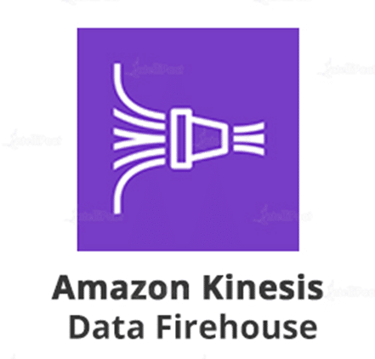
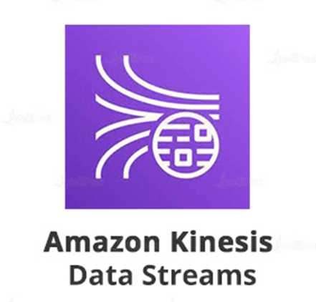
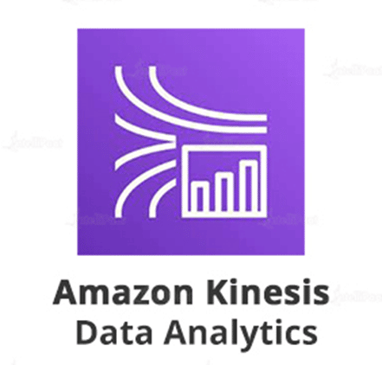
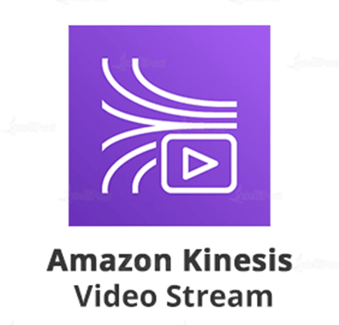
Kinesis overview
Amazon Kinesis is an Amazon Web Service designed to makes it easy to collect, process, and analyze video and data streams in real time.

Slide 6
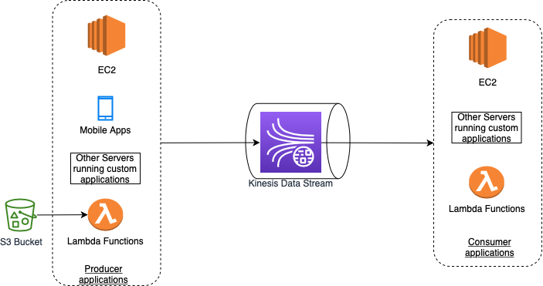
Kinesis Data Stream
You can use Amazon Kinesis Data Streams to collect and process large streams of data records in real time.
A typical Kinesis Data Streams application reads data from a data stream as data records.
These applications can use the Kinesis Client Library, and they can run on Amazon EC2 instances.
You can send the processed records to dashboards, use them to generate alerts, dynamically change pricing and advertising strategies, or send data to a variety of other AWS services.
The following are typical scenarios for using Kinesis Data Streams:
Accelerated log and data feed intake and processing
Real-time metrics and reporting
Real-time data analytics
Complex stream processing

Slide 7
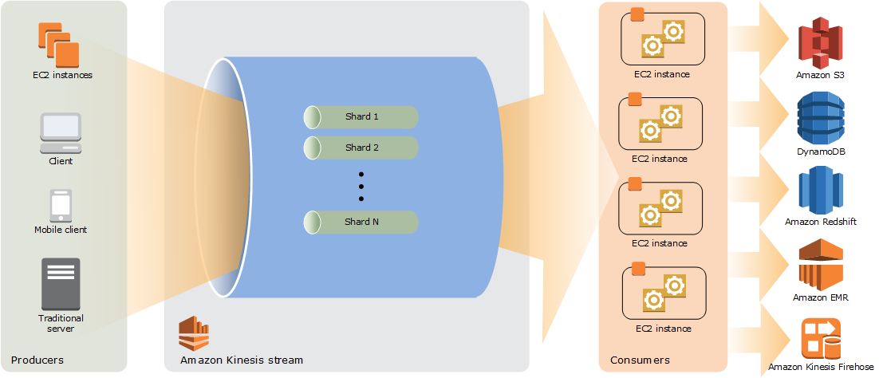
Kinesis Data Stream How shards work

Slide 8
Kinesis Data Stream Components
A Kinesis data stream is a set of shards.
Each shard has a sequence of data records .
A stream is composed of one or more shards, each of which provides a fixed unit of capacity.
Shard
Read:
Each shard can support up to 5 transactions per second for reads
up to a maximum total data read rate of 2 MB per second
Write:
up to 1,000 records per second for writes,
up to a maximum total data write rate of 1 MB per second (including partition keys).
Retention Period:
The retention period is the length of time that data records are accessible after they are added to the stream.
A stream’s retention period is set to a default of 24 hours after creation.
You can increase the retention period up to 8760 hours (365 days)
Partition Key
A partition key is used to group data by shard within a stream.
Kinesis Data Streams segregates the data records belonging to a stream into multiple shards.
It uses the partition key that is associated with each data record to determine which shard a given data record belongs to.
When an application puts data into a stream, it must specify a partition key.
Sequence Number
Each data record has a sequence number that is unique per partition-key within its shard.
Kinesis Data Streams assigns the sequence number after you write to the stream with client.putRecords or client.putRecord.
Sequence numbers for the same partition key generally increase over time.
The longer the time period between write requests, the larger the sequence numbers become.

Slide 9
Kinesis Data Stream Capacity Mode
A data stream capacity mode determines how capacity is managed and how you are charged for the usage of your data stream.
Currently, in Kinesis Data Streams, you can choose between an on-demand mode and a provisioned mode for your data streams.
On-demand
With the on-demand mode, Kinesis Data Streams automatically manages the shards in order to provide the necessary throughput.
You are charged only for the actual throughput that you use and Kinesis Data Streams automatically accommodates your workloads’ throughput needs as they ramp up or down.
Provisioned
With the provisioned mode, you must specify the number of shards for the data stream.
The total capacity of a data stream is the sum of the capacities of its shards.
You can increase or decrease the number of shards in a data stream as needed and you are charged for the number of shards at an hourly rate.
All Kinesis Data Streams capabilities, including retention mode, encryption, monitoring metrics, and others, are supported for both the on-demand and provisioned modes.

Slide 10
Kinesis Data Stream Capacity Mode Switching
You can switch the capacity mode of your data stream from on-demand to provisioned, or from provisioned to on-demand.
For each data stream in your AWS account, you can switch between the on-demand and provisioned capacity modes twice within 24 hours.
Switching between capacity modes of a data stream does not cause any disruptions to your applications that use this data stream.
When you switch from provisioned to on-demand capacity mode, your data stream initially retains whatever shard count it had before the transition, and from this point on, Kinesis Data Streams monitors your data traffic and scales the shard count of this on-demand data stream depending on your write throughput.
When you switch from on-demand to provisioned mode, your data stream also initially retains whatever shard count it had before the transition, but from this point on, you are responsible for monitoring and adjusting the shard count of this data stream to properly accomodate your write throughput.

Slide 11
Kinesis Data Stream Capacity Mode Comparison
Feature | On-Demand Capacity Mode | Provisioned Capacity Mode
Scaling | Automatically scales with the volume of data. | Requires manual scaling by managing the number of shards.
Throughput | Immediate access to the required throughput. | Throughput is based on the number of shards provisioned.
Shard Management | No shard management needed. | Manual management of shards is required.
Cost | Pay for the data ingested and retrieved, not for the shards. | Pay for the number of shards provisioned, regardless of actual usage.
Ease of Use | Low operational overhead and easier to manage. | Requires careful planning and monitoring for cost-efficiency.
Best for | Unpredictable workloads and new applications without prior usage patterns. | Predictable and steady workloads where usage patterns are well understood.

Slide 12
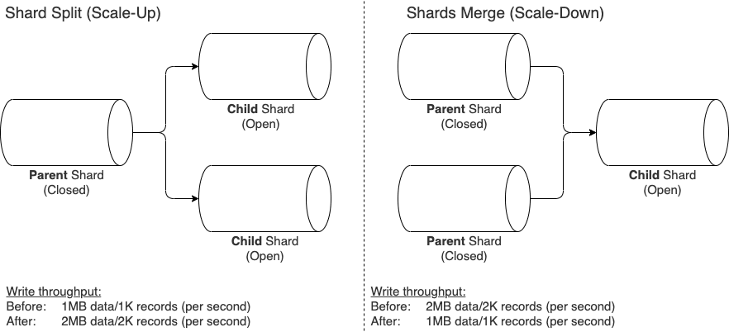
Kinesis Data Stream Resharding a Stream
Amazon Kinesis Data Streams supports resharding
which lets you adjust the number of shards in your stream to adapt to changes in the rate of data flow through the stream.
There are two types of resharding operations:
shard split and shard merge.

Slide 13
Kinesis Data Stream Resharding a Stream
Resharding is always pairwise in the sense that you cannot split into more than two shards in a single operation, and you cannot merge more than two shards in a single operation.
Splitting increases the number of shards in your stream and therefore increases the data capacity of the stream and the cost of your stream.
Similarly, merging reduces the number of shards in your stream and therefore decreases the data capacity—and cost—of the stream.
The maximum number of instances you can launch is n, to match the number of open shards in a ratio of 1:1.

Slide 14
Kinesis Data Stream Resharding a Stream
Use Cases for Shard Splitting
Increased Data Volume: If your application experiences a sudden surge in traffic (e.g., a retail website during a big sale), splitting shards in Kinesis can handle the increased data throughput.
IoT Device Data Ingestion: If the number of IoT devices sending data to your stream grows, splitting shards can ensure efficient data handling.
Use Cases for Shard Merging
Decreased Data Volume: Post-peak periods (like after a major event or sale) might require merging shards to optimize costs while maintaining adequate throughput.
Consolidating Data Sources: If you consolidate multiple data sources and the overall data volume decreases, merging shards can help manage costs.
Optimizing Costs in Predictable Workloads: For applications with predictable, lower data volumes, merging shards can keep the system cost-effective.

Slide 15
Kinesis Producer Library
An Amazon Kinesis Data Streams producer is an application that puts user data records into a Kinesis data stream (also called data ingestion).
The Kinesis Producer Library (KPL) simplifies producer application development, allowing developers to achieve high write throughput to a Kinesis data stream.
It acts as an intermediary between your producer application code and the Kinesis Data Streams API actions.
The KPL performs the following primary tasks:
Writes to one or more Kinesis data streams with an automatic and configurable retry mechanism
Collects records and uses PutRecords to write multiple records to multiple shards per request
Aggregates user records to increase payload size and improve throughput
Integrates seamlessly with the Kinesis Client Library (KCL) to de-aggregate batched records on the consumer
Submits Amazon CloudWatch metrics on your behalf to provide visibility into producer performance

Slide 16
Kinesis Client Library
The Kinesis Client Library is compiled into your application to enable fault-tolerant consumption of data from the stream.
The Kinesis Client Library ensures that for every shard there is a record processor running and processing that shard.
The library also simplifies reading data from the stream.
The Kinesis Client Library uses an Amazon DynamoDB table to store control data.
The Kinesis Client Library (KCL) uses an Amazon DynamoDB table for coordinating and managing the state of record processors that are reading data from each shard in a Kinesis stream.
Each application that processes data from a Kinesis stream creates its own DynamoDB table.
This table serves as a centralized store for control data, tracking which shard is assigned to which record processor, managing checkpoints (to keep track of the last record read by each processor), and handling resharding events.
This setup enables KCL to offer fault-tolerant stream processing, ensuring that data is processed reliably and efficiently even in distributed and scalable applications.
It creates one table per application that is processing data.
A consumer is an application that processes all data from a Kinesis data stream.
When a consumer uses enhanced fan-out, it gets its own 2 MB/sec allotment of read throughput, allowing multiple consumers to read data from the same stream in parallel, without contending for read throughput with other consumers.
By default, shards in a stream provide 2 MB/sec of read throughput per shard.
This throughput gets shared across all the consumers that are reading from a given shard.
In other words, the default 2 MB/sec of throughput per shard is fixed, even if there are multiple consumers that are reading from the shard.

Slide 17
Kinesis Client Library Types
Feature | Unregistered Consumers without Enhanced Fan-Out | Registered Consumers with Enhanced Fan-Out
Throughput | Shared throughput of up to 2 MB/sec per shard. | Dedicated throughput of up to 2 MB/sec per shard.
Fan-Out | Does not support fan-out (consumers share shard throughput). | Supports fan-out (each consumer gets a dedicated 2 MB/sec per shard).
Scalability | Limited scalability due to shared throughput. | Higher scalability with dedicated throughput for each consumer.
Latency | Potentially higher due to shared throughput. | Lower latency due to dedicated throughput and HTTP/2 support.
Consumer Management | Less complex as consumers are not registered. | Requires registration of consumers for enhanced fan-out.
Cost | Standard data retrieval costs apply. | Additional costs for enhanced fan-out feature.

Slide 18
Kinesis Client Library Use cases
Unregistered Consumers without Enhanced Fan-Out:
Suitable for applications where cost optimization is key and slightly higher latency is acceptable.
Ideal for scenarios with fewer consumers or when consumers can tolerate shared throughput limits.
Useful in smaller-scale or less time-sensitive data processing tasks.
Registered Consumers with Enhanced Fan-Out:
Optimal for real-time processing use cases requiring low latency, such as live data analytics or real-time monitoring systems.
Ideal for scenarios with many consumers needing dedicated throughput, ensuring no competition for shared resources.
Appropriate for large-scale applications where immediate data processing and delivery are critical.

Slide 19
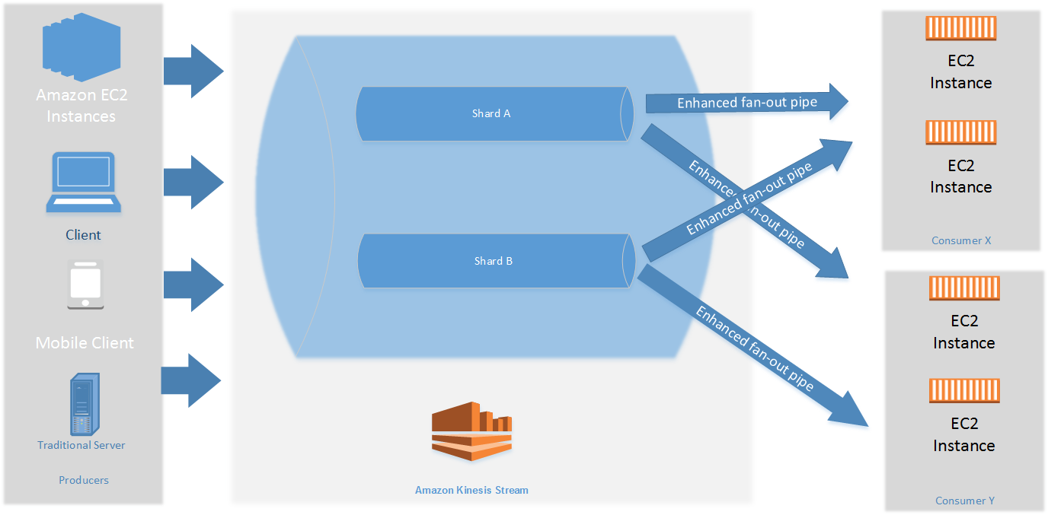
Consumers with Dedicated Throughput (Enhanced Fan-Out)
You can register up to twenty consumers per stream to use enhanced fan-out.
Two consumers that are using enhanced fan-out to receive data from the stream: Consumer X and Consumer Y.
Each of the two consumers is subscribed to all of the shards and all of the records of the stream.
With Enhanced Fan-Out, each consumer gets a dedicated connection to the shard that allows for lower latency and higher throughput compared to standard shared throughput consumers
This means that Consumer X and Consumer Y will receive all the information from the stream, but they do so independently of each other.
Each consumer has a dedicated stream of data (a "pipe") from each shard.
This setup ensures that Consumer X's data consumption doesn't impact Consumer Y's data consumption, allowing both to receive data simultaneously without contention, thus benefiting from the stream's full capacity.

Slide 20
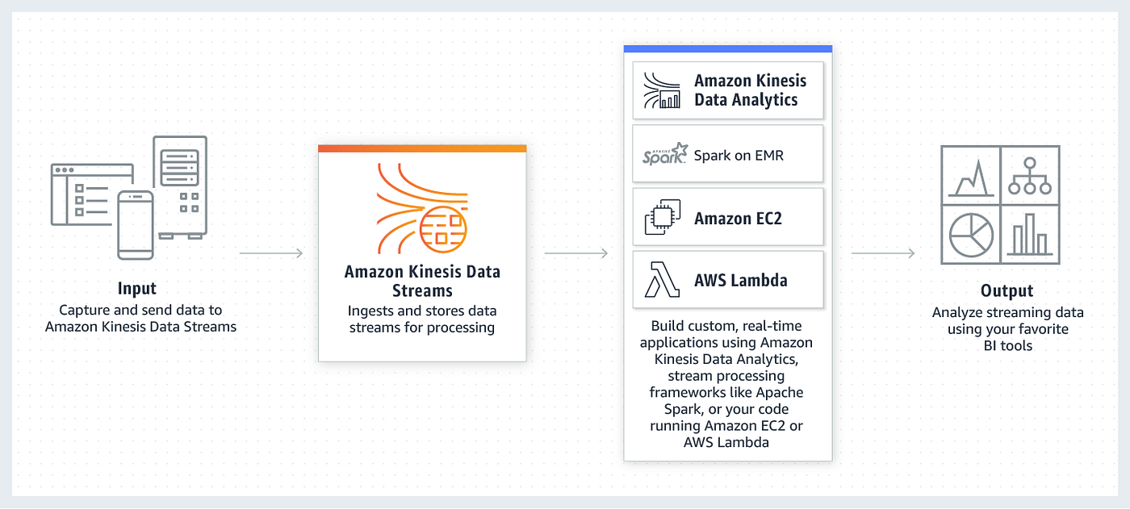
Kinesis Data Stream Destinations

Slide 21
Kinesis Data Steam Use Cases
Real-time Analytics for E-Commerce: E-commerce platforms can use Kinesis Data Streams to analyze customer data in real-time, allowing them to provide personalized recommendations, optimize website layouts, and identify buying patterns to enhance the customer shopping experience dynamically.
Fraud Detection in Financial Institutions: Banks and other financial institutions can deploy Kinesis Data Streams to monitor transactions in real-time, utilizing machine learning algorithms to detect unusual patterns and potentially fraudulent activities instantly, thereby enhancing the security of financial transactions.
Smart City Traffic Management: Municipalities can use Kinesis Data Streams to process data from various traffic sensors and CCTV cameras in real-time, enabling them to manage traffic flows more efficiently, reduce congestion, and respond quickly to incidents, thus fostering smarter and safer urban environments.
Healthcare Remote Patient Monitoring: Healthcare providers can utilize Kinesis Data Streams to enable remote patient monitoring, gathering data from wearable devices and medical sensors in real-time to provide timely interventions and personalized healthcare services, enhancing patient outcomes.
Supply Chain Optimization in Manufacturing: Manufacturing companies can leverage Kinesis Data Streams to monitor and analyze data from various points in the supply chain in real-time, helping them to optimize logistics, reduce operational costs, and respond swiftly to any disruptions in the supply chain.

Slide 22
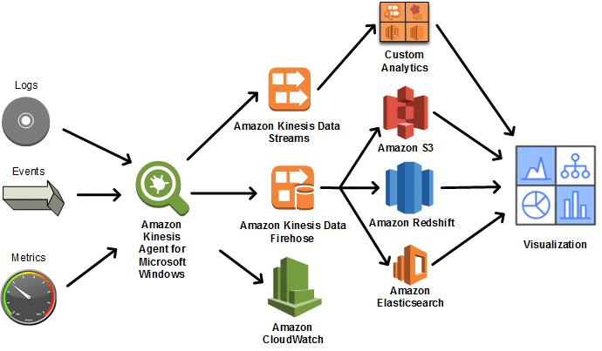
Kinesis Agent
Kinesis Agent is a stand-alone Java software application that offers an easy way to collect and send data to Kinesis Data Streams or Kinesis Data Firehose.
The use of Java allows it to be portable across various operating systems that can run the Java Virtual Machine (JVM).
However, it's worth noting that while the agent itself is a Java application, it can collect and send data from sources that are not Java-based
it can work with any log files that follow the supported formats.
The agent continuously monitors a set of files and sends new data to your stream.
The agent handles file rotation, checkpointing, and retry upon failures.
File Rotation: The process where log files are archived and a new log file is started, typically when the old one reaches a certain size.
Kinesis Agent automatically detects and starts reading the new file without losing data.
Checkpointing: Kinesis Agent keeps track of which data has been successfully sent.
If there's a failure or restart, it can resume sending data from where it left off, ensuring no data is missed or duplicated.
Retries: If data fails to be sent to Kinesis due to network issues or service disruptions, Kinesis Agent will automatically retry the transmission, handling temporary issues seamlessly.
It delivers all of your data in a reliable, timely, and simple manner.
It also emits Amazon CloudWatch metrics to help you better monitor and troubleshoot the streaming process.

Slide 23
Kinesis Agent Use Cases
Simplicity: It simplifies the process of sending data to Kinesis Data Streams and Firehose, handling file rotation, checkpointing, and retries automatically.
Efficiency: It batches records to optimize network usage and seamlessly handles the transmission of large volumes of data.
Real-Time Processing: It enables real-time data streaming for log data and metrics, which is crucial for monitoring, analytics, and other time-sensitive applications.
Scalability: The agent scales with your data volume, so as your data grows, you don't need to manually adjust your setup.
Centralized Log Processing: If you manage a fleet of servers, you can use Kinesis Agent to collect logs from all servers and stream them to Kinesis for real-time analysis or to feed a log analysis tool like Amazon Elasticsearch Service.
Application Monitoring: For applications that emit metrics or logs, the agent can be used to capture this data in real-time and send it to Kinesis. This allows for immediate monitoring and alerting based on application behavior.
Real-time Analytics: If your business requires real-time analytics, such as tracking user activity on a website, Kinesis Agent can stream this data to Kinesis Data Streams, which can then be processed by AWS analytics services.
IoT Data Ingestion: For IoT devices that generate continuous streams of data, the agent can collect and send this data to Kinesis, enabling real-time processing and analytics.

Slide 24
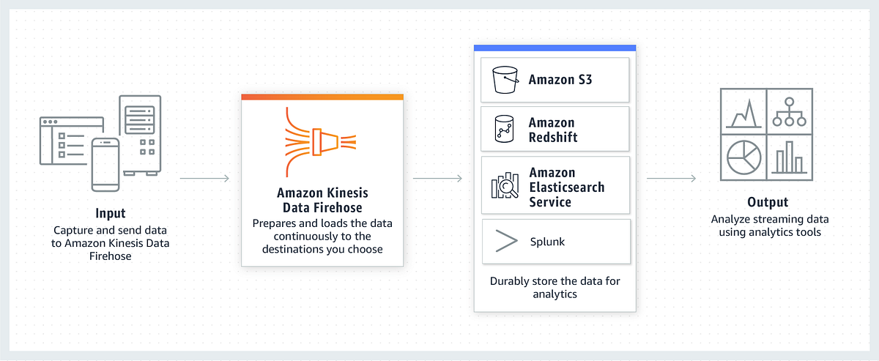
Kinesis Firehose
Amazon Kinesis Data Firehose is a fully managed service for delivering real-time streaming data to destinations such as
S3
Amazon Redshift
Amazon OpenSearch Service
Amazon OpenSearch Serverless
Splunk,
any custom HTTP endpoint
HTTP endpoints owned by supported third-party service providers.
With Kinesis Data Firehose, you don't need to write applications or manage resources.
You configure your data producers to send data to Kinesis Data Firehose, and it automatically delivers the data to the destination that you specified.
You can also configure Kinesis Data Firehose to transform your data before delivering it.

Slide 25
Kinesis Data Firehose Concepts
Kinesis Data Firehose delivery stream
The underlying entity of Kinesis Data Firehose.
You use Kinesis Data Firehose by creating a Kinesis Data Firehose delivery stream and then sending data to it.
Record The data of interest that your data producer sends to a Kinesis Data Firehose delivery stream. A record can be as large as 1,000 KB. (1 MB)
data producer
Producers send records to Kinesis Data Firehose delivery streams.
For example, a web server that sends log data to a delivery stream is a data producer.
You can also configure your Kinesis Data Firehose delivery stream to automatically read data from an existing Kinesis data stream, and load it into destinations.
buffer size and buffer interval
Kinesis Data Firehose buffers incoming streaming data to a certain size or for a certain period of time before delivering it to destinations.
Buffer Size is in MBs and Buffer Interval is in seconds.
Default Buffer Size is 5MBs
Default Buffer Interval is 300 seconds (5 mins)

Slide 26
Kinesis Firehose
Amazon Kinesis Data Firehose is a fully managed service that captures and automatically loads streaming data into AWS data stores for real-time analytics.
Data Collection: Firehose collects streaming data from various sources, including direct PUTs, Kinesis Data Streams, or with the Kinesis Agent which can be installed on servers to forward data like logs or event streams.
Data Transformation: Optionally, data can be transformed using AWS Lambda functions. You can convert data formats, enrich data, or perform other transformations as needed before loading.
Buffering: Firehose buffers incoming streaming data to a certain size or for a specified period, whichever condition is met first, to optimize the delivery.
Loading: The service then loads the buffered data into the chosen destination, such as Amazon S3, Amazon Redshift, Amazon Elasticsearch Service, or Splunk.
Error Handling: Firehose can retry data delivery if the initial attempts fail and can also send failed data to an Amazon S3 bucket for later analysis or reprocessing.
Monitoring and Management: The service integrates with Amazon CloudWatch for monitoring metrics and AWS IAM for access control.

Slide 27
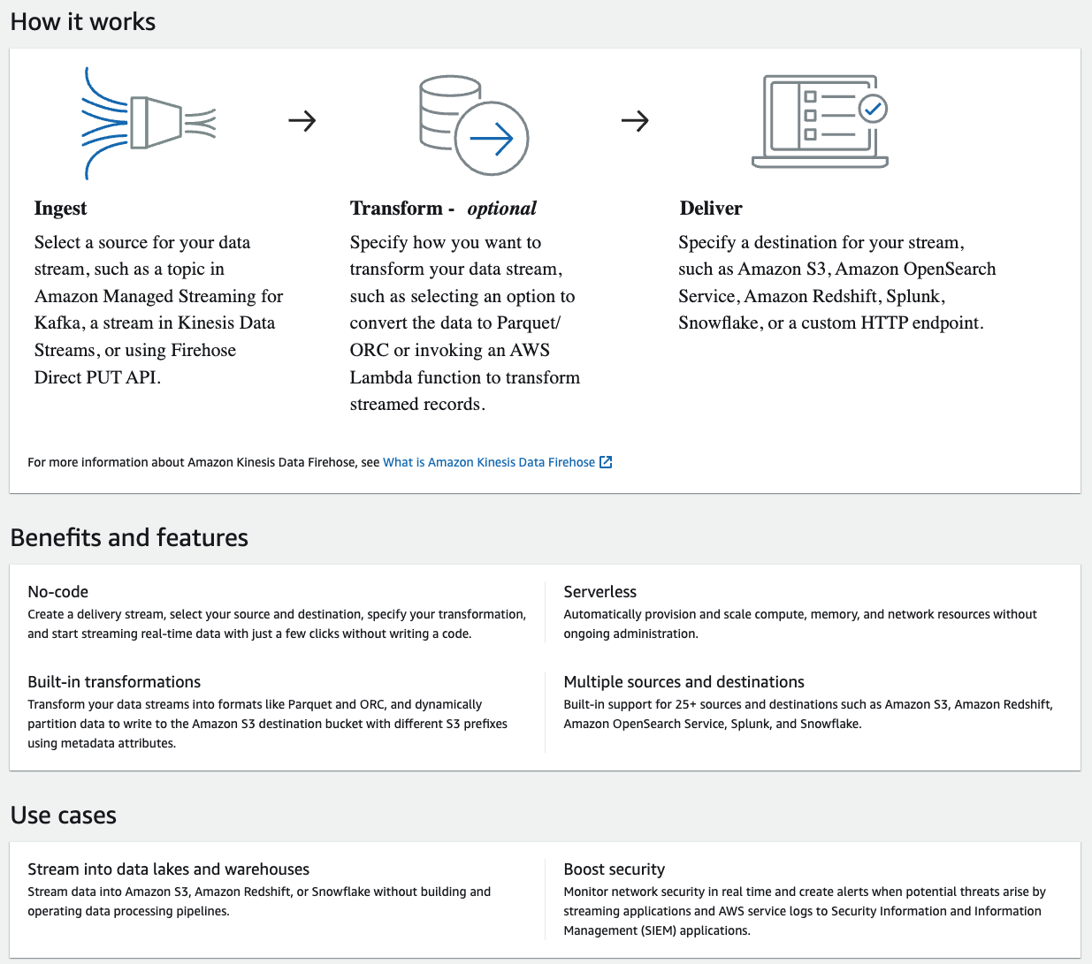
Kinesis Firehose

Slide 28
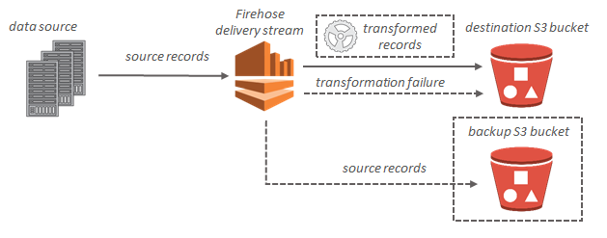
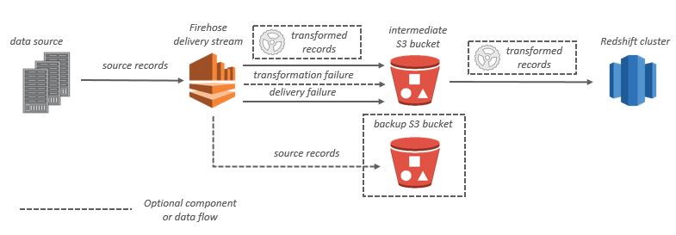
Kinesis Firehose Data flow

Slide 29
Kinesis Firehose Use Cases
Real-time Log and Event Data Analysis: Companies can leverage Kinesis Data Firehose to ingest large volumes of log and event data in real-time, enabling them to analyze operational data swiftly and maintain high system performance while identifying and responding to issues proactively.
Streaming Data Lakes: Organizations can use Kinesis Data Firehose to build data lakes with streaming data, facilitating near-real-time analytics and machine learning to gain insights from data as it is generated, thus creating a more responsive and agile business environment.
Social Media Sentiment Analysis: Businesses can use Kinesis Data Firehose to conduct real-time sentiment analysis on social media feeds, helping them to gauge public sentiment about their brand and products, and allowing for prompt responses to customer feedback and market trends.
IoT Device Data Aggregation: Companies can employ Kinesis Data Firehose to aggregate data from numerous IoT devices, facilitating the analysis of data streams to monitor device health, optimize performance, and glean actionable insights from the vast amount of data generated by these devices.
Mobile App Usage Analytics: App developers can utilize Kinesis Data Firehose to analyze mobile app usage data in real time, helping them to understand user behavior, identify popular features, and tailor app development strategies based on current usage patterns, thus improving app functionality and user satisfaction.

Slide 30
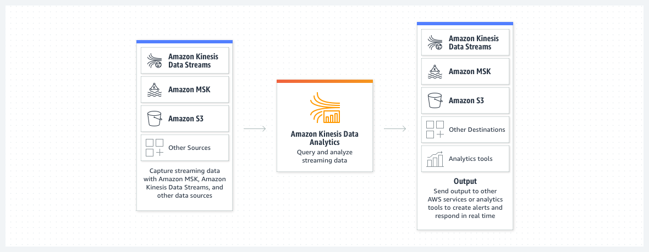
Kinesis Data Analytics
Amazon Kinesis Data Analytics is the easiest way to manipulate and analyze streaming data in real time with Apache Flink.
You can also use an interactive SQL editor to easily query streaming data and build streaming applications.

Slide 31
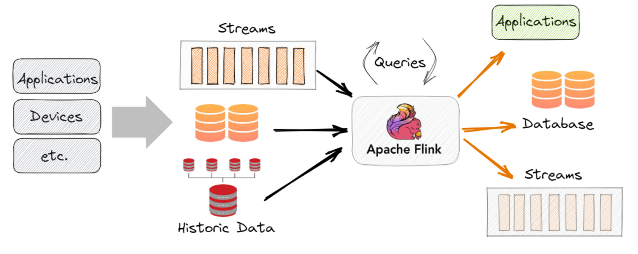
Apache Flink
Apache Flink is an open-source, unified stream-processing and batch-processing framework developed by the Apache Software Foundation

Slide 32
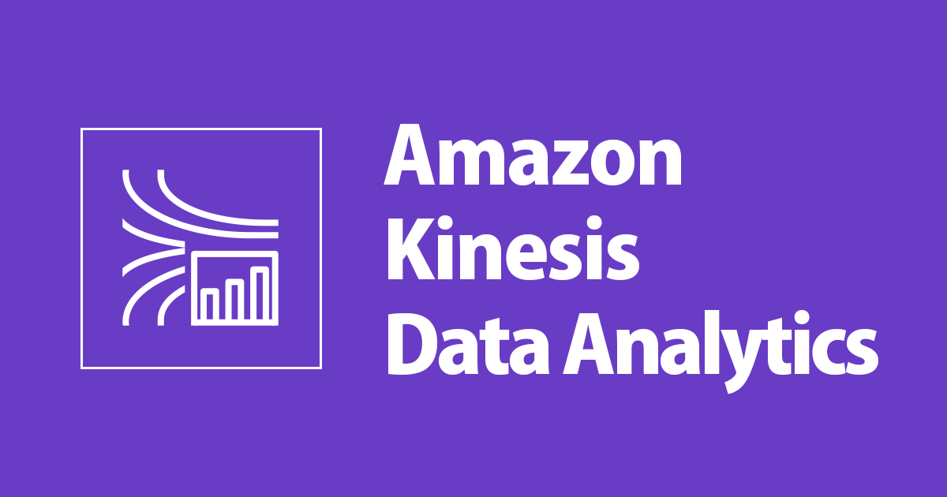
Kinesis Data Analytics
Amazon Kinesis Data Analytics is ideal for solving a wide range of streaming data use cases, including:
Streaming ETL for Internet-of-Things (IoT) with Apache Flink Applications
You can develop applications with Apache Flink libraries and use Amazon Kinesis Data Analytics to transform, aggregate, and filter streaming data from IoT devices such as consumer appliances, embedded sensors, and TV set-top boxes.
You can then use the data to send real-time alerts when a sensor exceeds certain operating thresholds.
Real-time log analytics with SQL
You can stream billions of small messages to Amazon Kinesis Data Analytics and calculate key metrics, which you can then use to refresh content performance dashboards in real time and improve content performance.

Slide 33
Kinesis Analytics Benefits
Powerful real-time processing
Amazon Kinesis Data Analytics provides built-in functions to filter, aggregate, and transform streaming data for advanced analytics.
It processes streaming data with sub-second latencies, enabling you to analyze and respond to incoming data and streaming events in real time.
No servers to manage
Amazon Kinesis Data Analytics is serverless;
there are no servers to manage.
It runs your streaming applications without requiring you to provision or manage any infrastructure.
Amazon Kinesis Data Analytics automatically scales the infrastructure up and down as required to run your applications with low latency.
Pay only for what you use
With Amazon Kinesis Data Analytics, you pay only for the processing resources that your streaming applications use.
There are no minimum fees or upfront commitments.

Slide 34
Kinesis Data Analytics Use Cases
Real-time Inventory Management:
Retail businesses can use Kinesis Data Analytics to monitor and analyze inventory levels in real-time, enabling immediate responses to low stock levels and helping to optimize inventory turnover, reducing carrying costs and avoiding stockouts.
Dynamic Pricing in Travel and Hospitality:
Airlines and hotels can leverage Kinesis Data Analytics to implement dynamic pricing strategies, analyzing real-time market data to adjust prices dynamically based on current demand and competitor pricing, maximizing revenue and improving competitiveness.
Live Sports Analytics:
Sports broadcasters can utilize Kinesis Data Analytics to offer real-time analytics and insights during live sports events, enhancing viewer engagement by providing dynamic statistics and interactive experiences based on live data streams.
Emergency Response Coordination:
Government agencies can deploy Kinesis Data Analytics during emergency situations to analyze data from various sources in real time, coordinating responses more effectively and disseminating critical information to the public promptly, thereby enhancing safety and responsiveness.
Predictive Maintenance in Manufacturing:
Manufacturing firms can use Kinesis Data Analytics to develop predictive maintenance models, analyzing sensor data in real time to predict when machinery is likely to fail, scheduling maintenance proactively to prevent costly downtimes and prolong equipment life.

Slide 35
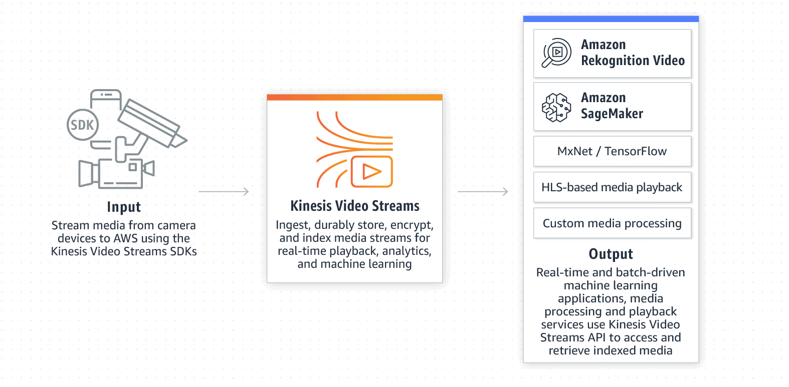
Kinesis video streams
You can use Amazon Kinesis Video Streams, a fully managed AWS service, to stream live video from devices to the AWS Cloud or build applications for real-time video processing or batch-oriented video analytics.
Kinesis Video Streams isn't only storage for video data.
You can use it to watch your video streams in real time as they are received in the cloud.
You can use Kinesis Video Streams to capture massive amounts of live video data from millions of sources.
You can also send non-video, time-serialized data such as audio data, thermal imagery, depth data, and RADAR data.
You can also configure your Kinesis video stream to durably store media data for the specified retention period.
Kinesis Video Streams automatically stores this data and encrypts it at rest.

Slide 36
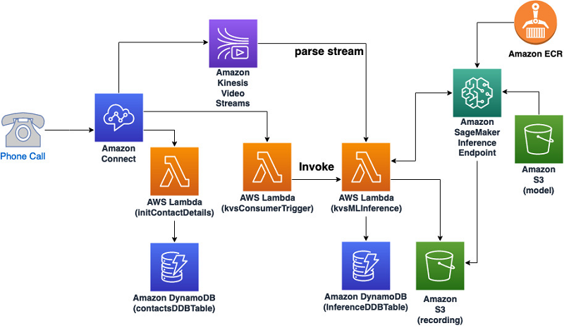
Kinesis video streams
Benefits of using Kinesis Video Streams include the following:
Connect and stream from millions of devices.
Durably store, encrypt, and index.
Focus on managing applications instead of infrastructure.
Build real-time and batch applications on data streams.
Stream data more securely.
Pay as you go.
Can be viewed:
HTTP Live Streaming (HLS) – You can use HLS for live playback.
GetMedia API – You use the GetMedia API to build your own applications to process Kinesis video streams.
GetMedia is a real-time API with low latency.

Slide 37
Exam takeaway
Data Stream –
A logical grouping of shards. There are no bounds on the number of shards within a data stream.
A data stream will retain data for 24 hours by default or 365 days at max, or up to 7 days when extended retention is enabled.
One shard can ingest up to 1000 data records per second, or 1MB/sec.
Add more shards to increase your ingestion capability.
When consumers use enhanced fan-out, one shard provides 1MB/sec data input and 2MB/sec data output for each data consumer registered to use enhanced fan-out.
Data Firehose
Record – The data of interest that your data producer sends to a Kinesis Data Firehose delivery stream.
A record can be as large as 1,000 KB.
Kinesis Data Firehose buffers incoming data up to 3 MB by default.

