Slide 1
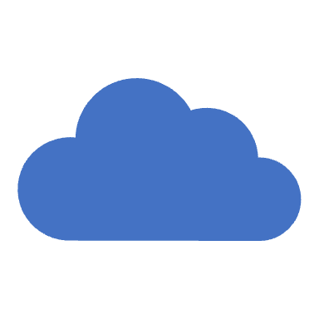
VMware Cloud on AWS
The Fastest, Safest Path for all your VMware Workloads

Slide 2
What is VMware?
VMware is a virtualization and cloud computing software provider.
Enterprise grade Virtualization
With VMware server virtualization, a hypervisor is installed on the physical server to allow for multiple virtual machines (VMs) to run on the same physical server.
Each VM can run its own operating system (OS), which means multiple OSes can run on one physical server.

Slide 3
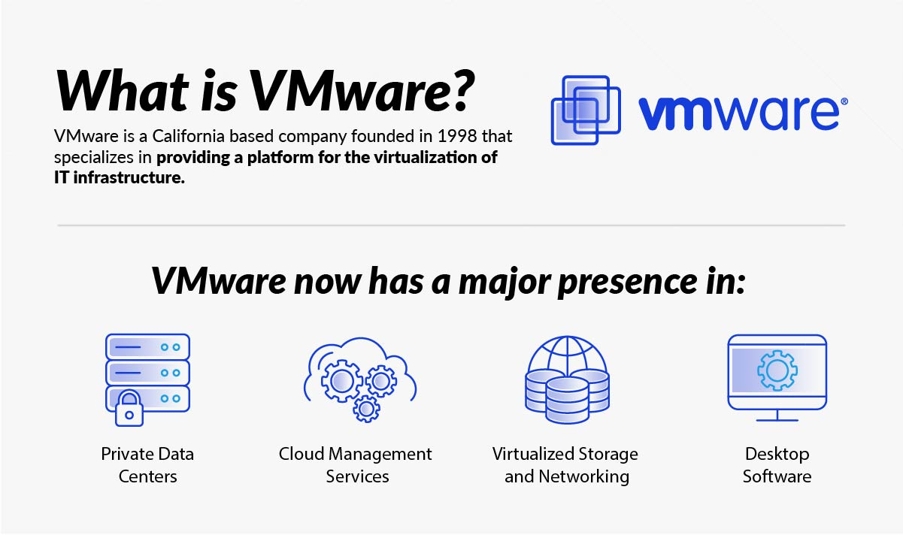
What is VMware?

Slide 4
Benefits of VMware
security based on a zero-trust model, along with better security than container systems like Kubernetes;
better provisioning of applications and resources;
simplified data center management
increased efficiency and agility of data center systems.

Slide 5
AWS Vmware in AWS
AWS VMware Cloud (VMC) on AWS is a service that allows you to seamlessly integrate your existing VMware on-premises infrastructure with the AWS Cloud.
It enables you to run, manage, and migrate VMware workloads in a hybrid cloud environment without the need for significant changes to your existing VMware infrastructure.
Physical Infrastructure: AWS VMware Cloud on AWS runs on dedicated bare-metal AWS infrastructure. AWS provides the physical hardware, including compute, storage, and networking resources, specifically designed for running VMware workloads.
vSphere-based Environment: AWS VMware Cloud is based on VMware's vSphere virtualization platform. You can use familiar VMware tools and interfaces to manage your VMware environment in the AWS Cloud.
Hybrid Cloud Connectivity: AWS VMware Cloud is connected to the AWS Global Network. This allows you to establish a high-speed, low-latency connection between your on-premises data center and the AWS Cloud. The connectivity options include AWS Direct Connect and VPN.
VMware Software: VMware provides the software components, including ESXi hypervisors, vCenter Server, and vSAN, as part of the service. You can deploy and manage virtual machines (VMs) using vCenter Server, just as you would in your on-premises environment.
Seamless Migration: You can use VMware HCX (Hybrid Cloud Extension) to facilitate the migration of VMs from your on-premises data center to AWS VMware Cloud. HCX enables live, bi-directional workload migrations with minimal downtime.
Scalability: AWS VMware Cloud is designed to be scalable. You can easily add or remove compute and storage capacity as needed to accommodate changes in workload demand.
Integration with AWS Services: While your VMware workloads run in the VMware Cloud environment, you can take advantage of AWS services for backup, disaster recovery, analytics, and more. This allows you to leverage AWS capabilities without re-architecting your applications.
Security and Compliance: AWS VMware Cloud adheres to AWS security best practices. You can apply AWS Identity and Access Management (IAM) policies and security groups to control access to your VMware workloads and resources.
Operational Consistency: AWS VMware Cloud provides operational consistency with your on-premises VMware environment. This consistency extends to patch management, monitoring, and backup processes.

Slide 6
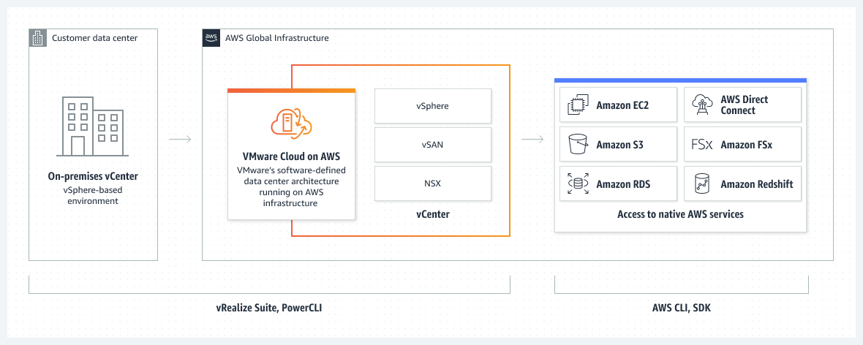
VMware Cloud on AWS

Slide 7
VMware Cloud on AWS: Use Cases
Application Migration and Modernization: Enterprises can use VMware on AWS to seamlessly migrate and modernize applications, taking advantage of AWS's scalable infrastructure while retaining the familiar VMware management framework, thus facilitating a smoother transition to the cloud with minimized downtime.
Hybrid Cloud Architecture: Organizations can build a resilient hybrid cloud architecture using VMware on AWS, creating an environment that allows for seamless workload mobility between on-premises VMware environments and the AWS cloud, therefore achieving a flexible and efficient infrastructure that meets evolving business needs.
Data Center Extension or Evacuation: Companies undergoing data center transformations can utilize VMware on AWS for data center extensions or evacuations, leveraging the solution to quickly add capacity to their existing data center or to evacuate data centers completely while maintaining operational continuity.
Disaster Recovery as a Service (DRaaS): Businesses can implement a robust disaster recovery solution using VMware Site Recovery on AWS, ensuring business continuity with a scalable, on-demand recovery solution that allows for consistent operations and swift recovery in the event of a disaster.
Next-Generation App Development: Developers can leverage VMware on AWS for next-generation application development, utilizing VMware Tanzu on AWS to build and deploy modern apps that can scale dynamically, thus encouraging innovation and speeding up the development process through a platform that supports both containerized and traditional workloads.

