Slide 1
AWS Config

Slide 2

AWS Config
AWS Config is a fully managed service that provides you with an AWS resource inventory, configuration history, and configuration change notifications to enable security and governance.
With AWS Config you can discover existing AWS resources, export a complete inventory of your AWS resources with all configuration details, and determine how a resource was configured at any point in time.
These capabilities enable compliance auditing, security analysis, resource change tracking, and troubleshooting.
Allow you to assess, audit and evaluate configurations of your AWS resources.

Slide 3
AWS Config Rules
A Config Rule represents desired configurations for a resource and is evaluated against configuration changes on the relevant resources, as recorded by AWS Config.
Can use AWS managed config rules (over 75)
Can make custom config rules (must be defined in AWS Lambda)
Ex: evaluate if each EBS disk is of type gp2
Ex: evaluate if each EC2 instance is t2.micro
Rules can be evaluated / triggered:
For each config change
And / or: at regular time intervals
AWS Config Rules does not prevent actions from happening (no deny)
Pricing: no free tier, $0.003 per configuration item recorded per region,$0.001 per config rule evaluation per region

Slide 4
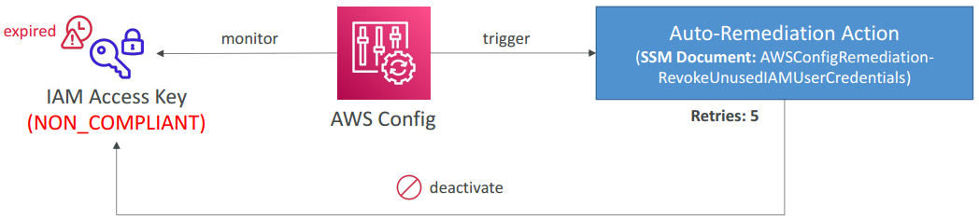
Config Rules – Remediations
Automate remediation of non-compliant resources using SSM Automation Documents
Use AWS-Managed Automation Documents or create custom Automation Documents
Tip: you can create custom Automation Documents that invokes Lambda function
You can set Remediation Retries if the resource is still non-compliant after auto- remediation

Slide 5
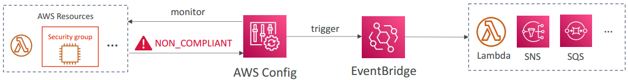
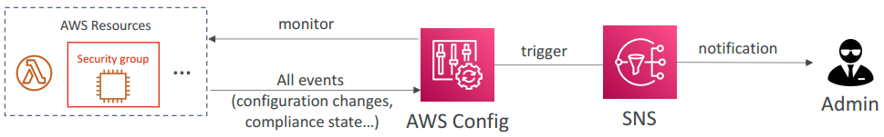
Config Rules – Notifications
Use EventBridge to trigger notifications when AWS resources are non-compliant
Ability to send configuration changes and compliance state notifications to SNS (all events – use SNS Filtering or filter at client-side)

Slide 6
Configuration Items
A Configuration Item (CI) is the configuration of a resource at a given point-in-time. A CI consists of 5 sections:
Basic information about the resource that is common across different resource types (e.g., Amazon Resource Names, tags).
Configuration data specific to the resource (e.g., Amazon EC2 instance type).
Map of relationships with other resources (e.g., EC2::Volume vol-3434df43 is “attached to instance” EC2 Instance i-3432ee3a).
AWS CloudTrail event IDs that are related to this state.
Metadata that helps you identify information about the CI, such as the version of this CI, and when this CI was captured.

Slide 7
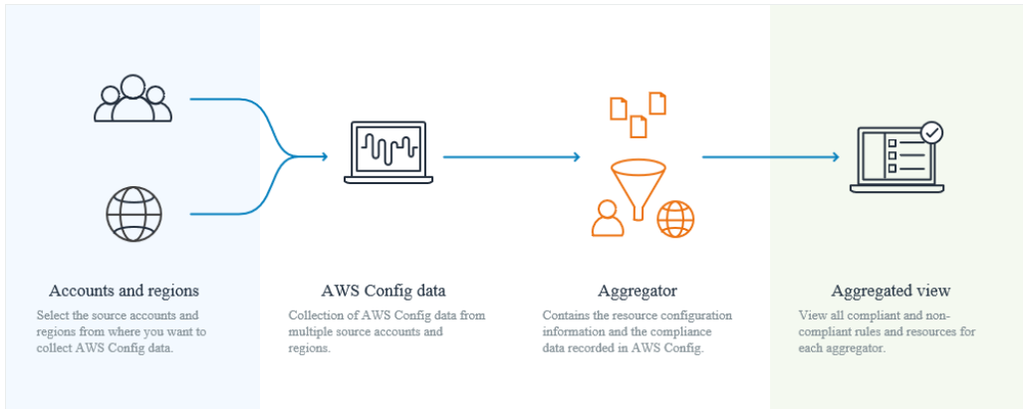
Multi-Account Multi-Region Data Aggregation
An aggregator is an AWS Config resource type that collects AWS Config configuration and compliance data from the following:
Multiple accounts and multiple regions.
Single account and multiple regions.
An organization in AWS Organizations and all the accounts in that organization which have AWS Config enabled.
Use an aggregator to view the resource configuration and compliance data recorded in AWS Config. The following image displays how an aggregator collects AWS Config data from multiple accounts and regions.

Slide 8
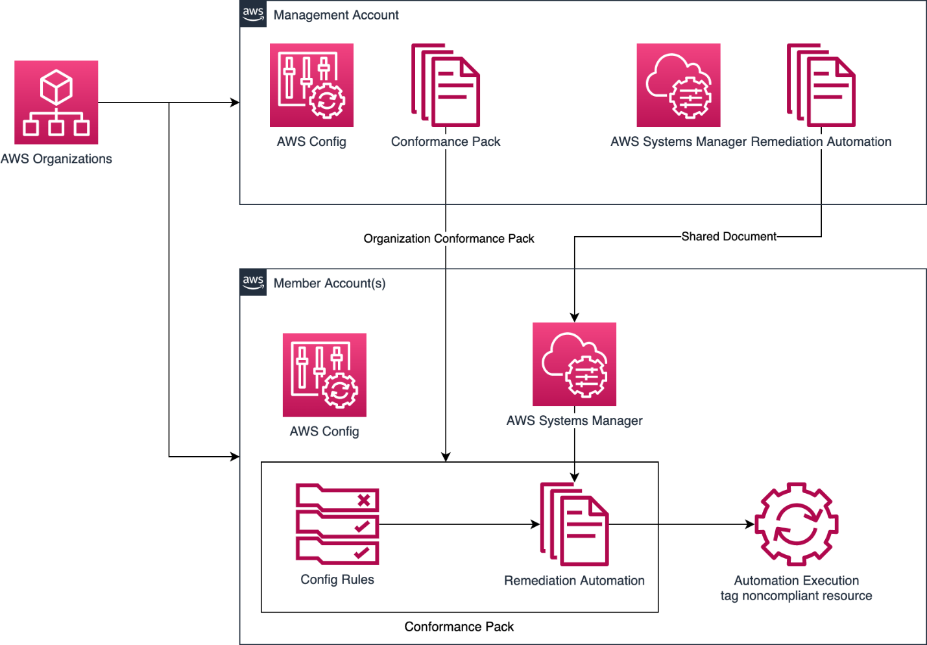
AWS Config Conformance Pack
A conformance pack is a collection of AWS Config rules and remediation actions that can be easily deployed as a single entity in an account and a Region or across an organization in AWS Organizations.
Conformance packs are created by authoring a YAML template that contains the list of AWS Config managed or custom rules and remediation actions.
You can also use AWS Systems Manager documents (SSM documents) to store your conformance pack templates on AWS and directly deploy conformance packs using SSM document names

Slide 9
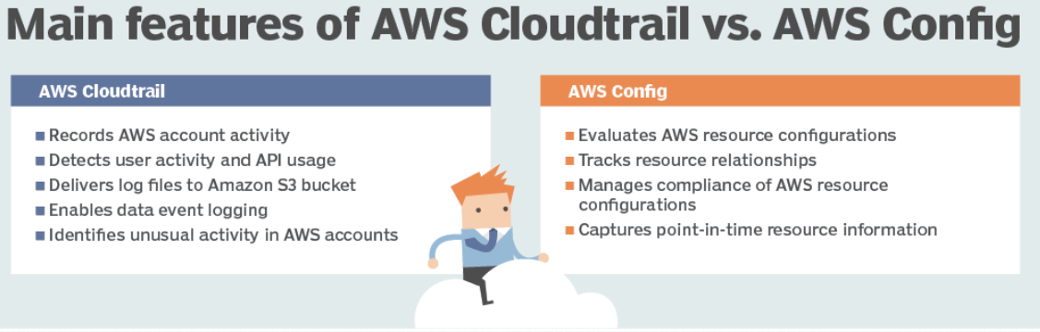
CloudTrail vs Config
CloudTrail
Record API calls made within your Account by everyone
Can define trails for specific resources
Global Service
Config
Record configuration changes
Evaluate resources against compliance rules
Get timeline of changes and compliance

Slide 10
AWS Config best practices
Enable AWS Config in all accounts and Regions.
Record configuration changes to ALL resource types.
Record global resources (such as IAM resources) only in one Region.
Ensure that you have a secure Amazon S3 bucket to collect the configuration history and snapshot files.
Specify an Amazon S3 bucket from another (central IT) account for centralized management of history files and snapshots.
Specify an Amazon Simple Notification Service (Amazon SNS) topic from another (central IT) account for centralized management of configuration and compliance notifications.
Use Amazon CloudWatch Events to filter AWS Config notifications and take action.
Use the AWS Config service linked role to allow Config to record resource configuration changes.
Set the appropriate permissions for the IAM role assigned to AWS Config.

